Slide 1

Reading Workshop
Oakfield Junior School

Slide 2
Aims of the session:
To outline some of the difficulties children face when learning to read
To explain how we teach reading at Oakfield
To show you ways in which you can support your child at home with reading

Slide 3
At Oakfield, we aim to encourage our pupils to have a lifelong love and enjoyment of
reading.

Slide 4

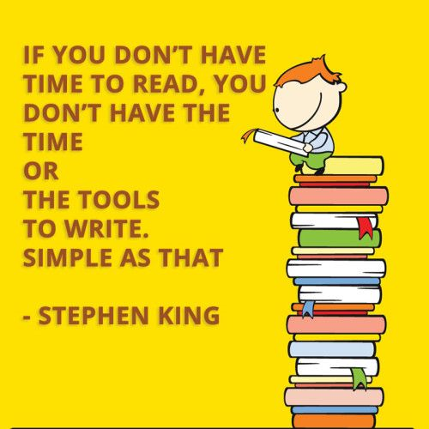

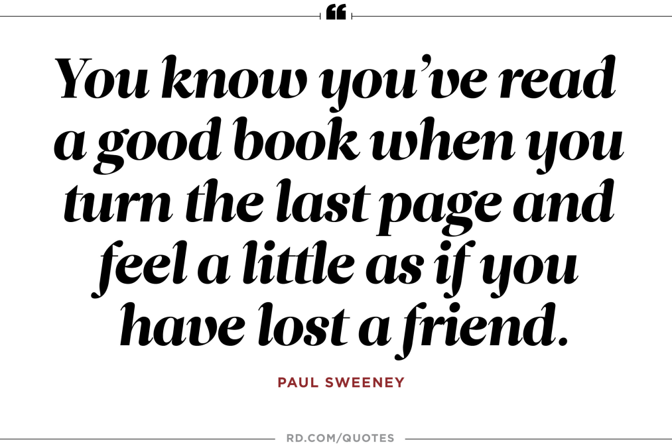

Slide 5
Word Recognition
Comprehension
Skilled word reading involves both the speedy working out of the pronunciation of unfamiliar printed words (decoding) and the speedy recognition of familiar printed words.
Good comprehension draws from linguistic knowledge (in particular of vocabulary and grammar) and on knowledge of the world. Comprehension skills develop through pupils experience of high quality discussion as well as from reading and discussing a range of stories, poems and non-fiction.

Slide 6
+
Good language comprehension
Poor word recognition
Good word recognition
Good language comprehension
-
+
Good word recognition
Poor language comprehension
Poor word recognition
Poor language comprehension
What kind of reader
is your child?
-

Slide 7
Effective adult readers use a range of flexible reading comprehension strategies so quickly and automatically… we hardly notice they are taking place!!
The price we pay for our expertise is that the strategies we use have become hidden from us.

Slide 8
Word Recognition
Pupils who find decoding the words n the page challenging often have a poor phonemic awareness and limited phonic knowledge.
They can’t hear the different sounds in words.
They do not recognise the sounds that different letter strings make.
They need to use a range of strategies to enable them to read the words on the page

Slide 9
Phonemic awareness
The ability to identify, think about and manipulate the sounds in speech.
To promote phonemic awareness, children need to be able to:
1.Listen
2. Notice rhyme - know that sounds have meaning and follow certain patterns
3. Notice syllables – know that words can be split into smaller parts

Slide 10
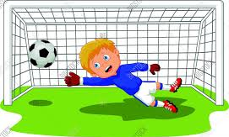
Phonics
The ability to segment and manipulate the sounds of oral language.
The goal of Phonics is to enable readers to decode new written words by sounding them out – it is the first strategy that should be taught in helping them to learn to read.

Slide 11
Skills involved in the teaching of Phonics
GPC’s: Grapheme/Phoneme correspondence. Children are taught all the phonemes (sounds) and the ways of writing them down. These are taught in a particular order.

Slide 12
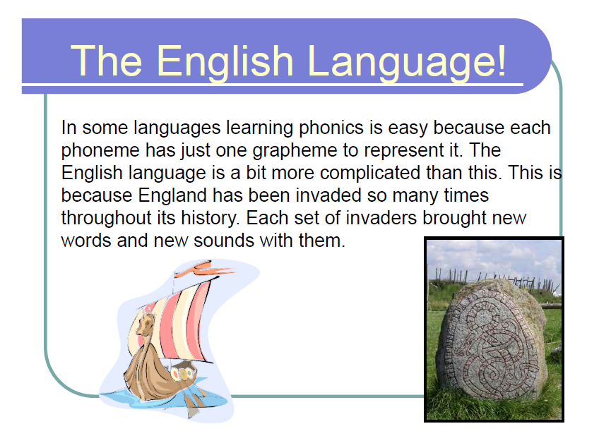

Slide 13
Phonemes and Graphemes
See sheet at tables
One example – er sound has 6 different graphemes ur, ir, er, ear, or, ar
Burn, first, fern, heard, work, dollar

Slide 14
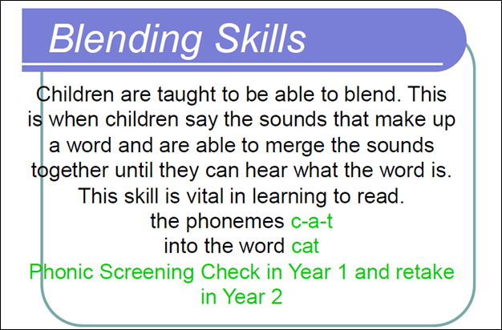

Slide 15
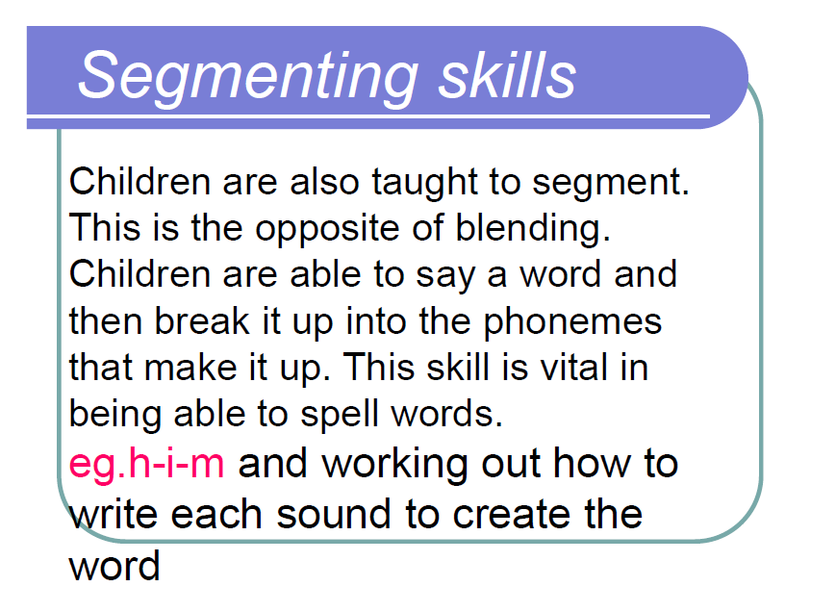

Slide 16
What can you do at home to support your child with Phonics?
Talk about words and signs when you’re out and about
Play rhyming games
https://www.phonicsplay.co.uk/Phase5Menu.htm
Play word games – crosswords, word searches, Boggle

Slide 17

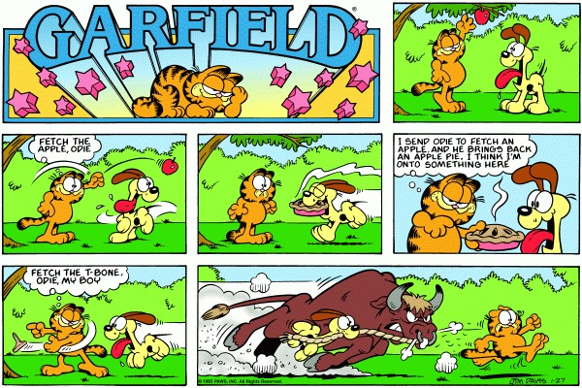
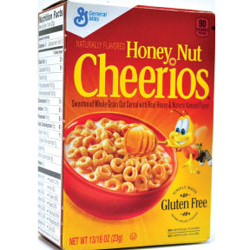
Get your child reading
Comics
Recipes
Cereal boxes
Road signs
Number plates

Slide 18
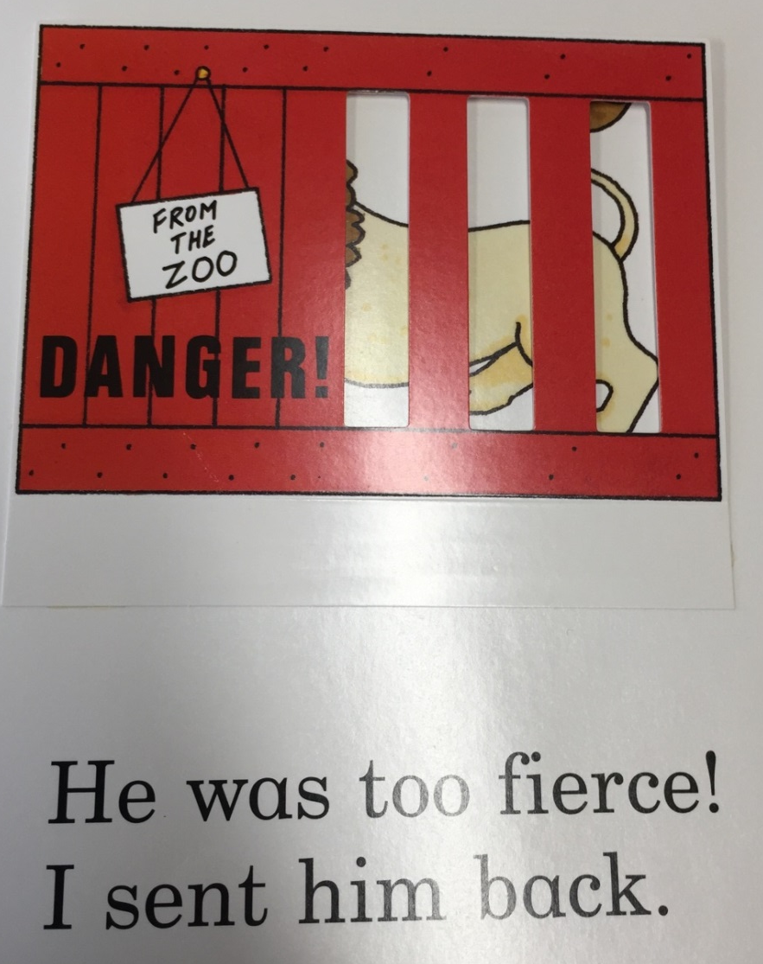
Other strategies to help with reading the text
Using the pictures to help work out the missing word
Reading on to the end of a sentence to predict the missing word
Using knowledge of word types
to work out what type of word is missing

Slide 19

Factors that influence poor comprehension

Slide 20
Weak background knowledge
When reading an extract of text about building towers and a wave knocking it over– a child could picture towers made from bricks as he had never been to the beach before – hadn’t spotted the VIP word – wave.
Billy was howling because his whole day had been spoilt. All his work had been broken by the wave. His mum came over to help but she accidentally stepped on the one tower that was left. “Never mind,” she said. “Let’s go back for tea. You can build some more towers tomorrow.”

Slide 21
Limited Vocabulary
A reader must know at least 90% of the words in a text to comprehend it
I libbled spig in the croopit on a Morflip hicklepulg. It was filp after we yambled into Huphlup Greep. The webble was yisking. Blord had ippen we’d be yambling just in shrud for the exime. Troosey ugo was there. Just me. The greks were inside the volda with Yabba Hoost, mirriming about the diggle.

Slide 22
Working memory
Tasks that involve storing large pieces of information can be difficult for those children with a poor working memory

Slide 23
Asking questions and making predictions
Good readers are active readers who ask questions and make predictions
What star?
The photograph of the newly discovered star was on the front page.

Slide 24
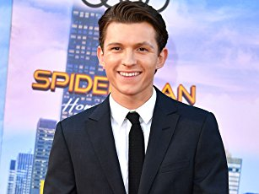
Ok… That sort of star

Slide 25
Comprehension monitoring
Good readers listen to self, check reading makes sense, detect errors and repair .
They make/build pictures in mind
Make links between the text and their background knowledge
Notice VIP words
Predict and ask questions

Slide 26
Spot the mistake
Moles
It is very dark underground but for some animals it’s home. For example, moles are small dark creatures that can tunnel at high speed. They have sensitive noses and they can see very well. A mole can dig a tunnel as long as a football pitch in one night. Moles are very shy and only wake up at night but then they get moving. They are fantastic diggers but they don’t see very well. Have you ever seen lots of small mounds on a field? Watch out there’s a mole about!

Slide 27
Inference
Inference is the bedrock of comprehension.
Good comprehension involves going beyond the literal meaning of text.
We make links between sentences, use knowledge of books and background knowledge to generate inferences.
The answers are not all in the text. Readers have to bring plenty of things to it to get the full meaning.
Accessing background knowledge is crucial to making inferences.

Slide 28
Using inference to establish meaning of unknown words
Jay lay down on his stomach, and gripped the edges of the luge as it rushed down the snowy mountain.
Abe was in love with comedy and like other farceurs before him, wrote prolifically.
The potter maleated the clay by kneading, rubbing and adding water.

Slide 29
Strategies to help us understand and enjoy reading
Use our background knowledge and connect to text
Predict, ask questions, I wonder….
Visualise
Think like a detective, use inference
Notice breakdown and repair
Watch out for VIP words
Put together to build the gist

Slide 30
How do we teach your child to read?
Book Fairs
Book weeks
Guided Reading
Library
Independent reading
Comprehension lessons
Shared reading
Spelling lessons
Reading & Spelling intervention

Slide 31
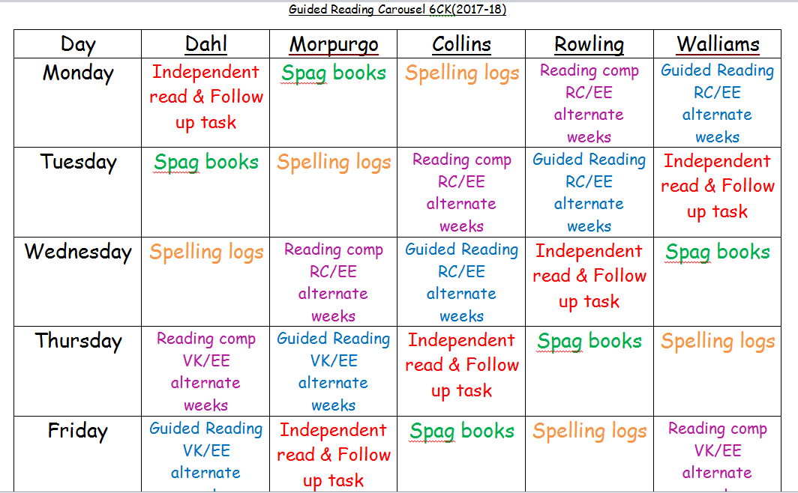
Insert example carousel
Notes:
Instead of always having your teaching opportunity during guided reading where children are reading a real book – you can rotate yourself between this group and the reading comprehension group.
For a long time we know that children need to practise reading comprehension test style questions – we often put this into our carousel so that the children are practising it each week but the children don’t get any better at it –because we don’t work with this group therefore we are not teaching the children how to improve.
By rotating yourself between the two groups on a two weekly basis – there are teaching opportunities at both activities. You can also use your TA to rotate with you like we have done above with Elaine. I am going to go on to show you what this would look like in a minute.
By combining the independent read and the follow up task –it makes it a more purposeful reading exercise. I find during free/independent reading children quite often flit between different books and half the time you don’t know what they’ve read or if they’ve even read anything. By making sure they read their guided reading book that they’ve read with you and their group the day before, you can set them a certain point to read up to and set a follow up task that will ensure they have understood what they’ve read. I will share some examples shortly.
We know that the SPAG books have proved successful and that our spag results have improved significantly – if you are struggling with resources for this, please come and see me. It’s important I think during this time to set a particular activity or page you would like all the children to do- so that you xan then go through the answers with the class together at some point during the week once they have all completed it. For your more able set them an extension task for once they have completed the task- find 5 examples in their reading book – write their own sentences with an example.
The spelling logs have proved to be really successful in helping the children apply different strategies to learn words they are unsure of spelling. I have left the different strategy list at the table if you haven’t seen it before. We need to ensure that they are checking their work that has been marked in their English, Topic, Science books and recording spelling errors in their logs and applying appropriate strategies in order to learn the spelling of these words.
It’s important that they are also learning the Yr 3 and 4 list and Yr 5 and 6 list during this time also.
It’s also important for them to be set a follow up or extension task so that they are using this time wisely – ask them to put the word into a sentence or find out 5 synonyms for the word.

Slide 32
7 different Assessment focuses for Reading
AF 1 – Reading the words on the page
AF 2 – Using literal retrieval
AF 3 – Using Inference to understand the text
AF 4 – Understanding structure and organisation of a text
AF 5 –Understanding the language used in a text
AF 6 – Understanding the purpose of the text
AF 7 – Relating the text to social, cultural and historical traditions

Slide 33
Example
Focus for session: AF 5
Understand language, technique and style.
What simile has been used to show how the boy is feeling?
Why does the author compare his feelings to pigeons flying?
Why does the author describe the boy’s block in detail?
Find a simile that shows the boy is comfortable on his block.
Find a copy two words to show the boy is nervous on his first journey to Beecher Prep.
Follow up Task for tomorrow’s session:
Find the meaning of these three words:
Hesitated, cursing, slaughter.
Read up to page 49.
Write down what you know already about Ms Petosa using evidence from the text.
Okay, so I admit that the first day of school I was so nervous that the butterflies in my stomach were more like pigeons flying around my inside. Mom and dad were probably a little nervous too, but they acted all excited for me, taking pictures of me and Via before we left the house since it was Via’s first day of school too.
Even though Beecher Prep is just a few blocks from our house, I’ve only been on that block a couple of times before. In general, I try to avoid blocks where there are lots of kids roaming around. On our block, everybody knows me and I know everybody. I know every brick and every tree trunk and every crack in the sidewalk. I know Mrs Grimaldi, the lady who’s always sitting by her window, and the old guy who walks up and down the street whistling like a bird. I know the deli on the corner where mum gets our bagels, and the waitresses at the coffee shop who all call me ‘honey’ whenever they see me. I love my neighbourhood of North River Heights, which is why it was so strange to be walking down these blocks feeling like it was all new to me suddenly.
Notes:
Extract from Wonder – fabulous book – film comes out in Autumn.

Slide 34
End of KS2 assessments
The test consists of a reading booklet with 3 texts (approx 2,300 words) and a separate answer booklet.
The expectation for vocabulary understanding and stamina is high.
They have a total of 1 hour to read the texts and answer the questions and it is marked out of 50.

Slide 35
Look at the paragraph beginning: Glancing nervously….
Find and copy one word meaning relatives from a long time ago.

Slide 37
What can you do to support your child at home?
Make reading fun!
Encourage your child to enjoy books everyday!
Share books with your child
Hear your child read daily
Talk around the text
Ask questions
Offer your own ideas
Encourage wide reading –
range of genres
Using libraries
Be enthusiastic about the ‘Reading
Challenge’ (Reading raffle)
Read a range of things!
(From newspapers to packaging!)
Your child is never too old for you to read to them or for them to read to you.

Slide 38
Recommended questions
See sheet at your tables
The questions are broken down into the 7 assessment focuses

Slide 39

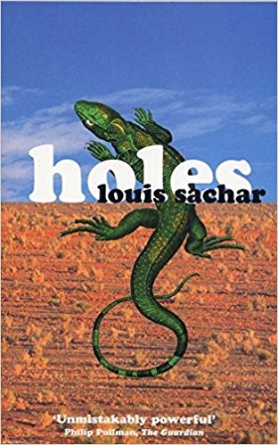

Recommended texts
Help yourself to recommended reading lists. There is one for each year group broken down into genres.

Slide 40
Finally …
Supporting your child to read is the most important thing you can do to help your child succeed
Your child’s ability to read directly impacts their ability to write
The impact lasts a lifetime; successful readers tend to be more imaginative and confident
Children learn by example so if they see you reading they are likely to want to join in
Talk, talk talk! More able readers are better speakers. The wider and richer their vocabulary and knowledge and their experience of the world, the better their comprehension will be

Slide 41
Any questions?

