Slide 1

‘From Small Acorns to Mighty Oaks’

Slide 2
Our Vision
For all learners to have courage to embrace new experiences with confidence; work co-operatively, whilst respecting and caring for others; be curious about the whole world and enjoy learning for life.

Slide 3
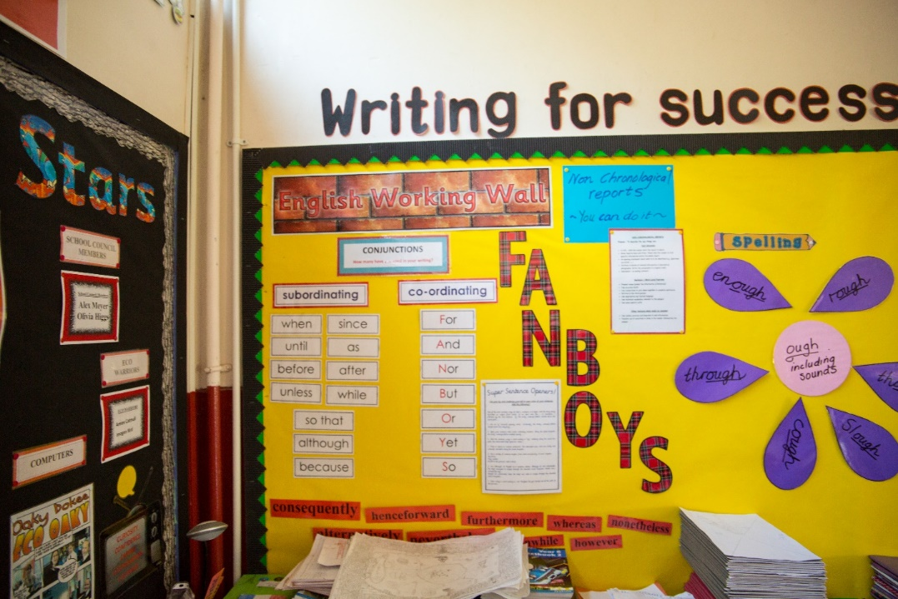
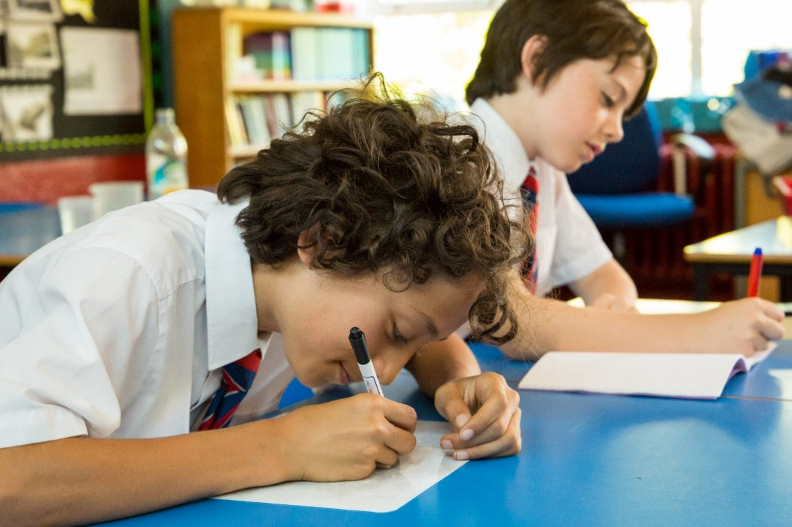
Learner Intents

Slide 4
Learner Intents
During our pupils learning journey at Oakfield our aim is for them to learn how …
Curiosity
•To be creative individuals who make the most of all opportunities and experiences inside and outside the classroom and ask questions to deepen their knowledge, understanding and skills resulting in positive progress
Confidence
•To be resilient, healthy and confident individuals in body and mind
Co-operation
•To be proud of their achievements and those of others and learn and play collaboratively
Caring
•To be responsible and respectful individuals who contribute positively to our inclusive community and know how to keep themselves and others safe
Courage
•To have a growth mindset and love the challenge of learning

Slide 5
Home School Agreement
Aims and Objectives
To heighten home school partnership
To provide clear guidance and expectations for children, parents and staff
To remind us of all our commitments
The school will:
Provide a safe, well ordered and caring environment
Welcome and encourage parents interest and involvement in school life
Ensure that your child is valued for who he or she is and is helped to make good progress in their spiritual, moral, social, emotional, physical and intellectual development
Provide a broad and balanced curriculum that matches your child’s academic and social needs…
The parents /carers will:
Foster respect for all adults who work within the Oakfield community
Ensure high standards of attendance and punctuality…
The pupil will:
Follow the Oakfield Golden Rules, work to the best of my ability and make the most of all learning experiences.

Slide 6
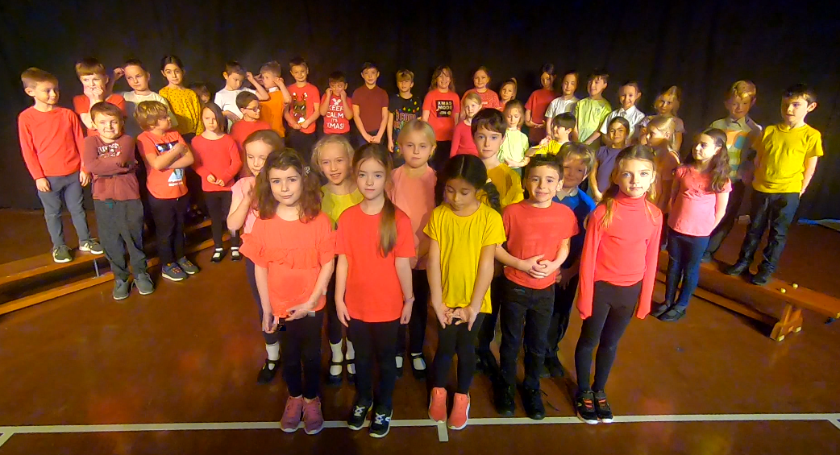
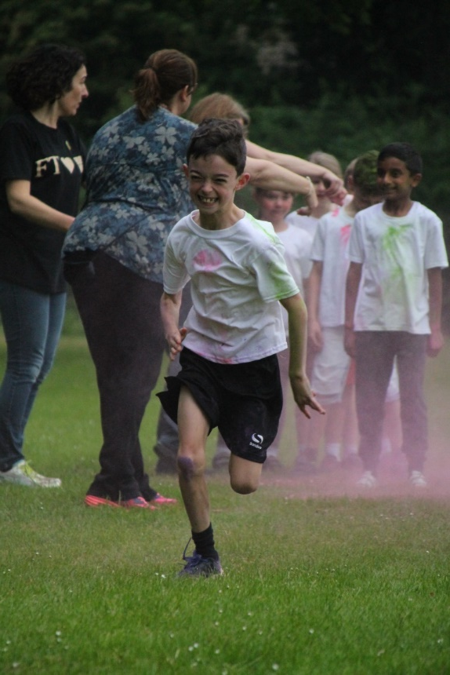
Extra-Curricular Experiences

Slide 7
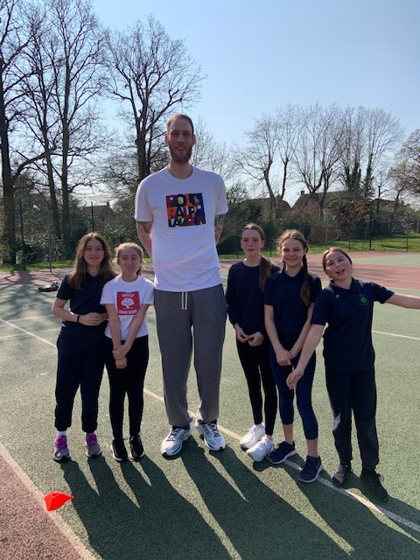
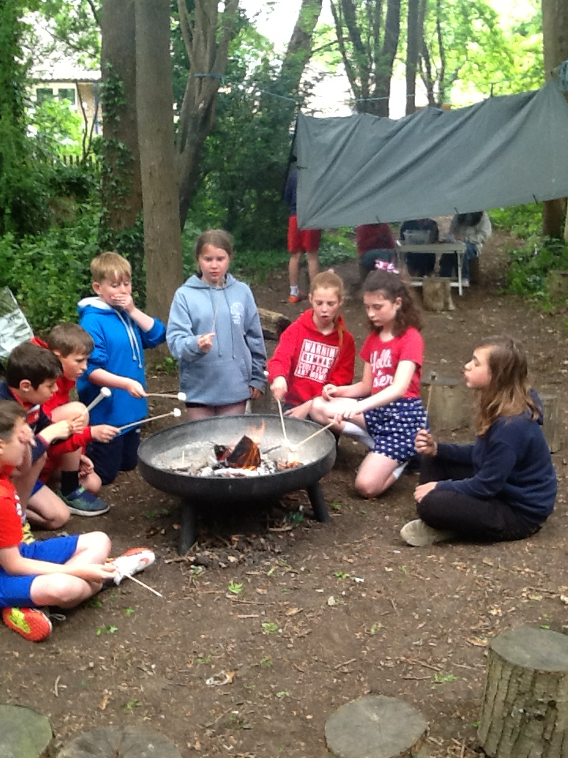
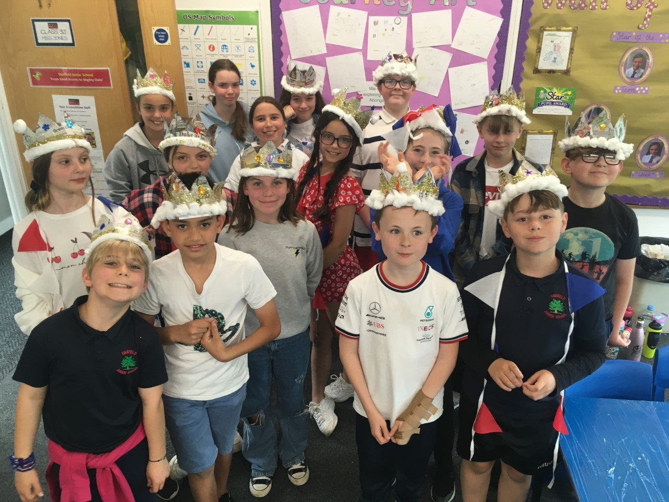
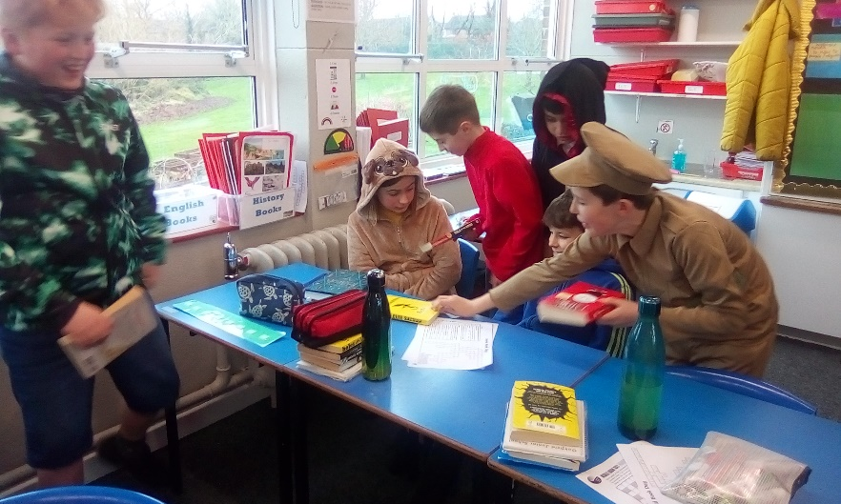
Extra-Curricular Experiences

Slide 8



Additional Support
Mrs Buckler- SENCo
(mainstream)
Mrs Venables & Mrs Goby
(Centre Managers & Teachers)

Slide 9
Transition
Meetings between infant schools and junior school staff (Class teachers, Head teachers, Safeguarding leads, SENcos)
Transition Day 1st July 2025 (drop off 9:10am main entrance, meet new teachers and other pupils, fruit snack and water, packed lunch, small pencil case, collect 3pm top playground)
Visits to infant schools to meet pupils
Buddies Wake & Shake
Additional transition sessions Pupils joining from other infant schools (3rd July pm) & Centre Pupils
Meetings (optional additional) with headteacher Thursday 26th am & Friday 27th pm. SENCO Monday 23rd am, Tuesday 24th pm
Friends Welcome Picnic Wednesday 3rd September 2025

Slide 10
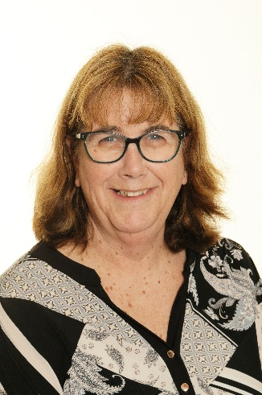
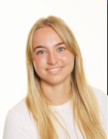
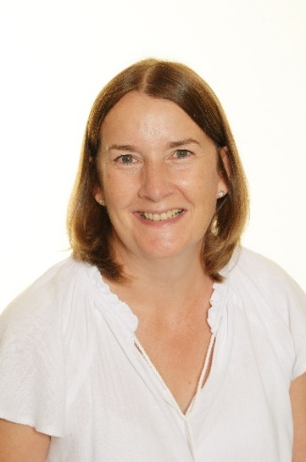
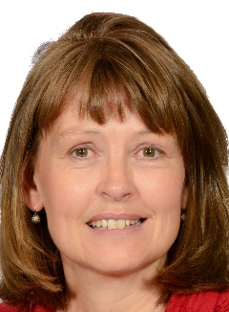
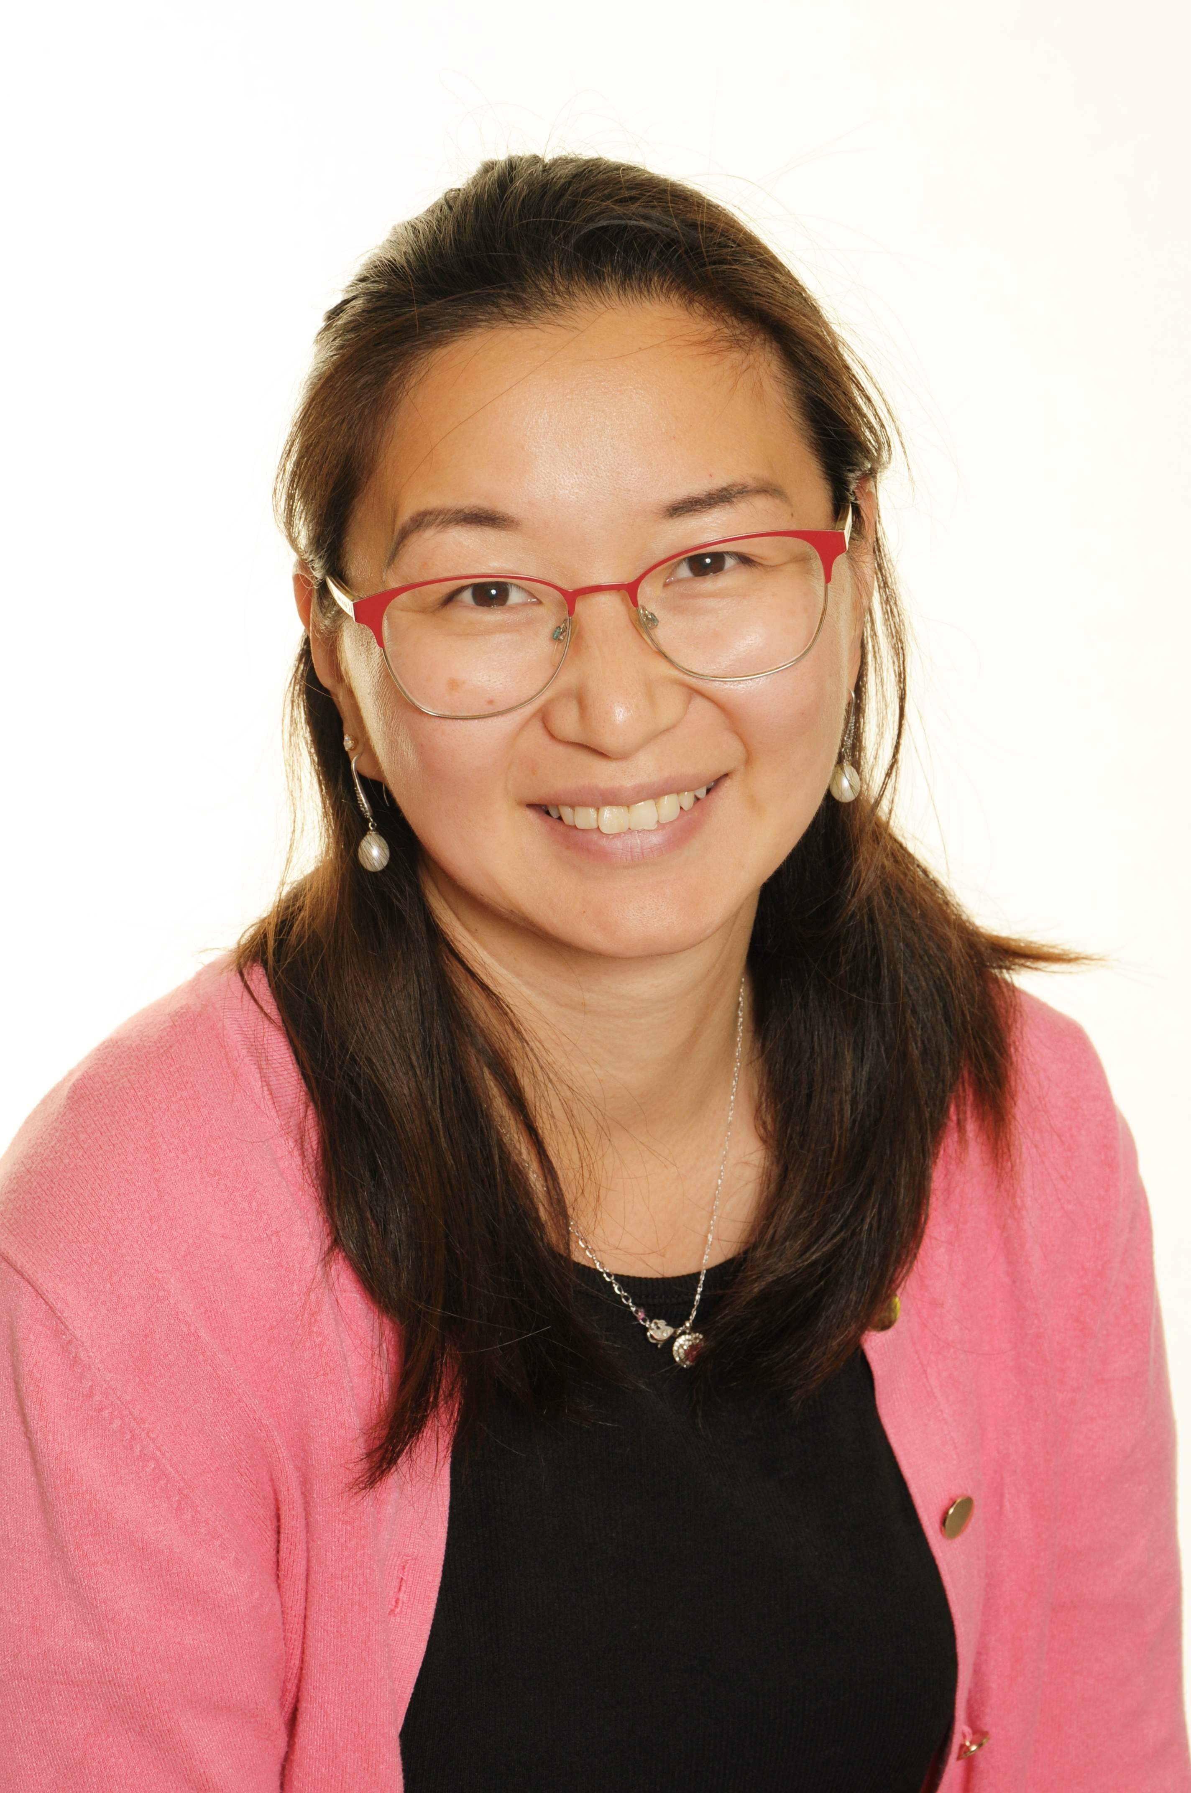
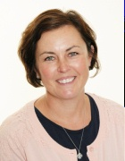
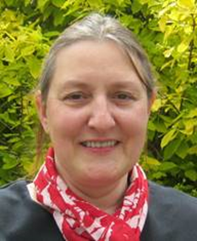
Meet the Year 3 Team
Year 3 Hazel Class-Mrs Gumbrell (Wednesday-Friday) and Mrs Martin (Monday &Tuesday)
Year 3 Holly Miss Baines & Mrs Gregory
Support Staff: Mrs Edger, Mrs Wang, Mrs Mason

Slide 11
Year 3 Priorities
Resilience & Independence
Reading
Spelling/Phonics
Handwriting
Learning multiplication tables
Behaviour for learning
Enjoyment

Slide 12
Maths
Autumn term objectives will focus on Number (place value) and Calculations (4 operations). Homework will be set on Doodle Maths, according to the units that your child is learning in class.
Reminder: All children are subscribed to Doodle Learning, and TT Rockstars. Usernames and passwords will be found at the back of their planner in the first few weeks of Year 3. Knowing times table facts up to 12x12 is essential by the end of year 4.

Slide 13
English
Our genres for the Autumn term are: stories in the style of familiar books, character descriptions, adventure stories and letter writing.
Full class guided reading sessions are held daily. SPaG (Spelling Grammar and Punctuation) lessons are incorporated into the daily English teaching. The Year 3/4 statutory spelling list can be found in the back of the pupil planner.
If you are able to give up any spare time to hear the children read, then please let us know as offers will be gratefully received.

Slide 14
Science
Our topics for the Autumn term are: Nutrition and Movement, Rocks and Soils.
Outdoor learning opportunities.
There are useful resources on the BBC website or google ‘nutrition and movement Year 3’ and ‘rocks and soils Year 3.’
Other topics will be: forces and magnets, plants and light.

Slide 15
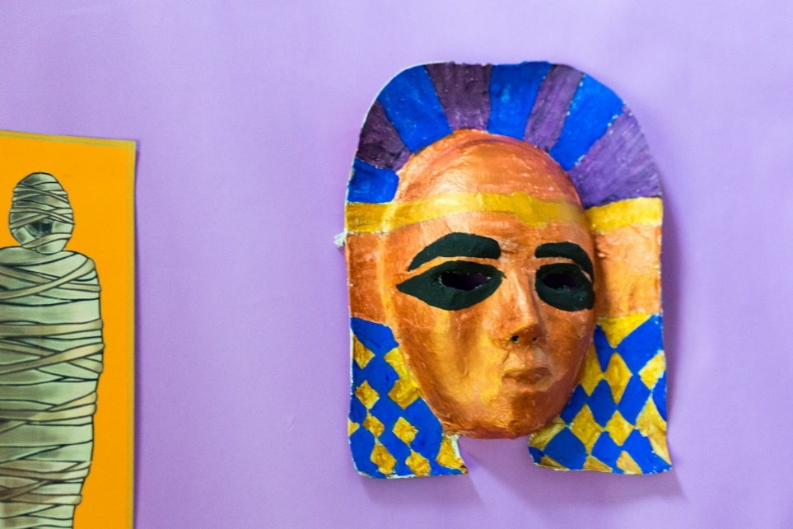
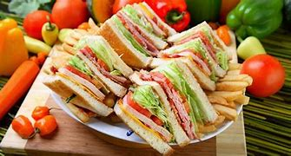



Year 3 Highlights
Curriculum

Slide 16

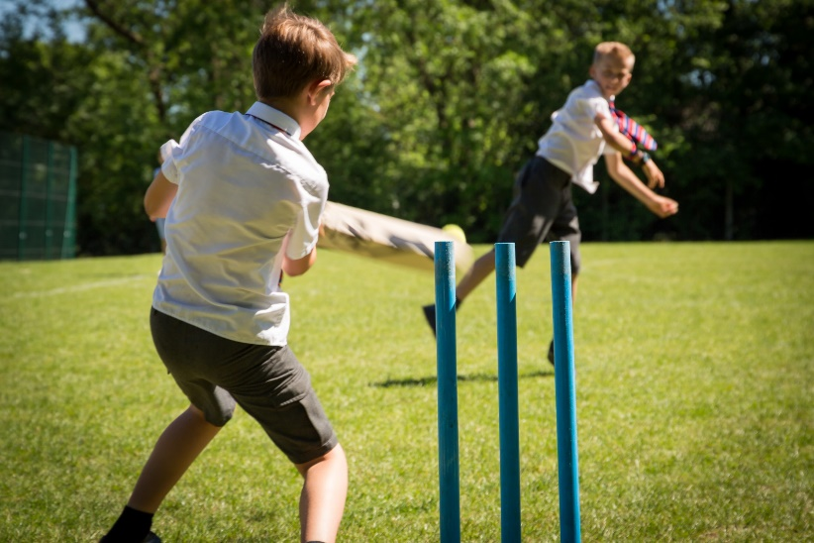

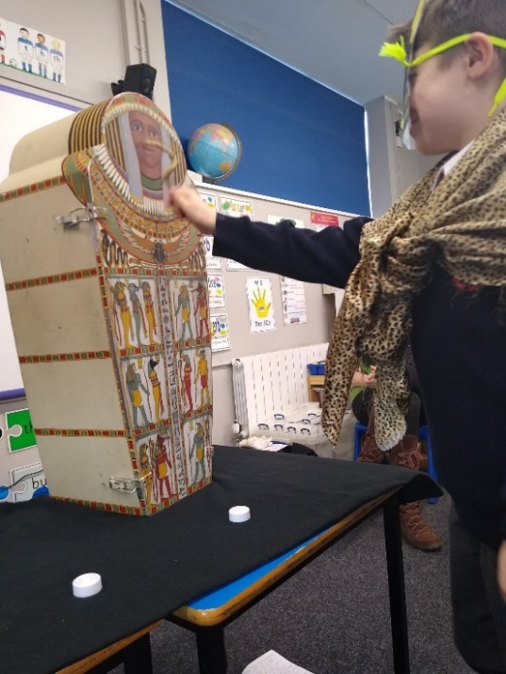
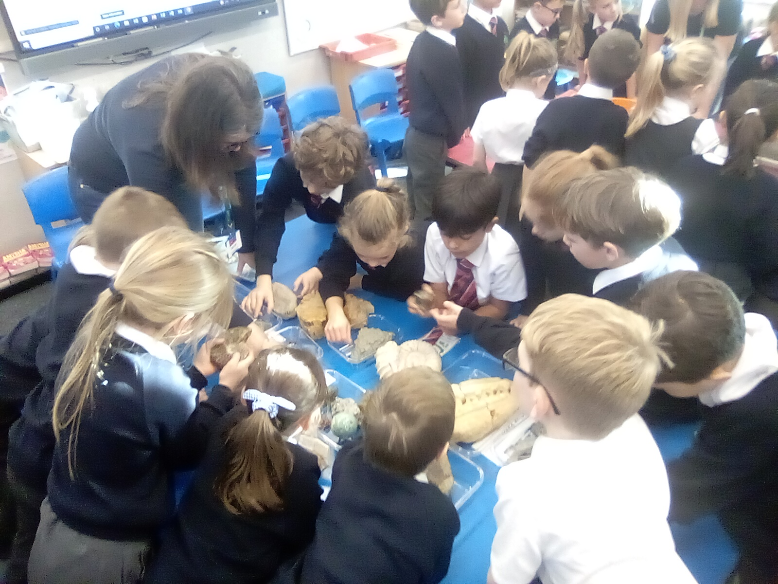
Year 3 Highlights
Enrichment

Slide 17



RE
How we can live together in one world?
ISLAM
Where do Muslims pray? What is most important to them and why?
CHRISTIANITY
How different symbols can tell us what Christians believe. Christian art. Stories told in the Bible and the different books with in it.
SIKHISM
Their 5 key beliefs, 5K’s, The Langar,
Place of worship-The Gurdwara

Slide 18
PSHE
PSHE: We will be using a scheme called Jigsaw which brings together emotional literacy, social skills and spiritual development in a comprehensive scheme of learning.
Autumn 1: Being me in my world
Autumn 2: Celebrating difference
Spring 1: Dreams and goals
Spring 2: Healthy me
Summer 1: Relationships
Summer 2: Changing me (Including SRE Sex & Relationship Education)

Slide 19
ART & DT
ART & DT: Colour mixing, pencil skills ,water colour, tracing skills, self-portrait, colour wheel
Journey Art-Aboriginal symbols, Paul Klee
City Scapes- silhouttes, reflections
Pop Art- Andy Warhol
Sandwich making- part of our healthy eating
Egyptian Masks

Slide 20
PE
PE: PE Kit should be worn on PE days. Plimsolls for indoor PE sessions and trainers for outdoors are expected. Navy tracksuits are allowed in colder months. Watches and earrings must be removed by the children for PE lessons. Thursday
Dance- robotic movement
Gymnastics
Hockey
Tennis
Swimming- 10 weekly lessons Summer Term
Athletics – sprinting and long distance

Slide 21


Geography and History
We use an enquiry based scheme led by innovative key questions. The children are taught important subject knowledge, whilst allowing sufficient time for mastering key subject skills, and challenging outcomes through investigating at greater depth.

Slide 22
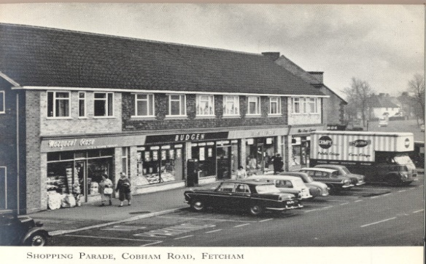
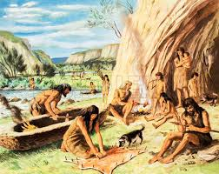

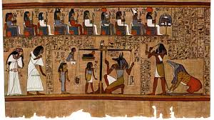


Geography & History
Local History
Megacities
Jungles and Deserts
Stone Age
Ancient Egyptians

Slide 23
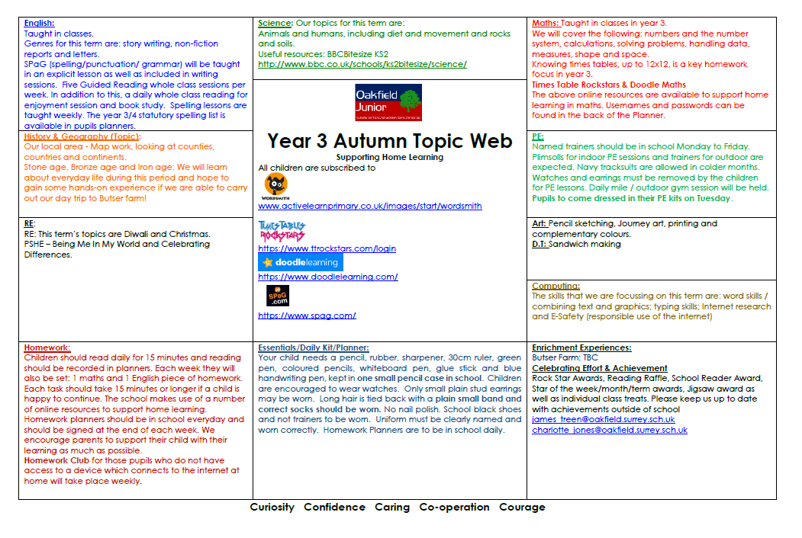
Topic Web

Slide 24
Homework
Children should read daily for 15 minutes and reading should be recorded in planners & signed by parents.
Each week they will also receive: 1 maths (Doodle maths/TT Rock stars) and 1 English piece of homework. Spelling will be set fortnightly initially. The statutory word list will be in your child’s planner. Each piece of homework should take about 15 minutes to complete, but children may carry on working if they are happy to. Homework planners should be in school everyday and should be signed at the end of each week. We encourage parents to support their child with their learning as much as possible.
Homework Club ensures all pupils have access to a laptop. Thursday after school

Slide 25
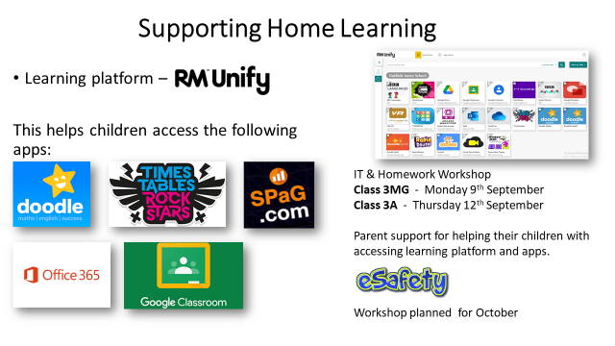
Supporting Home Learning
Helping your children logging and accessing online learning apps. Trouble shooting tips and advice.
Home learning IT Sessions:
9th & 11th September 2025
2:30-3:15 or 3:15-4:00

Slide 26



Learning Experiences
Outdoors: our wooded area & pond/ gardening/use of our extensive grounds
Music: recorders, concerts, productions, choir
Performances: to parents including class assemblies, festivals, concerts & productions
Clubs: (before school/lunchtime/after school) 14 on offer for year 3 pupils

Slide 27
Equipment
Essentials/Daily Kit/Planner: Your child needs a blue handwriting pen, lead pencils, a rubber, green biro/pen, sharpener, 30cm clear ruler, green highlighter, black whiteboard pens, coloured pencils ( felt tips and gel pens are not necessary) and a glue stick in one small pencil case ( to fit into a tray under the desk). They need a named shirt for art and DT classes. Children may wear watches and only small gold or silver, stud earrings. Hair must be tied back away from the face with a plain blue/black band. No nail varnish may be worn.
REMINDER - inhalers should be kept in pupils bags in lockers. All medicines should be handed into the school office.

Slide 28
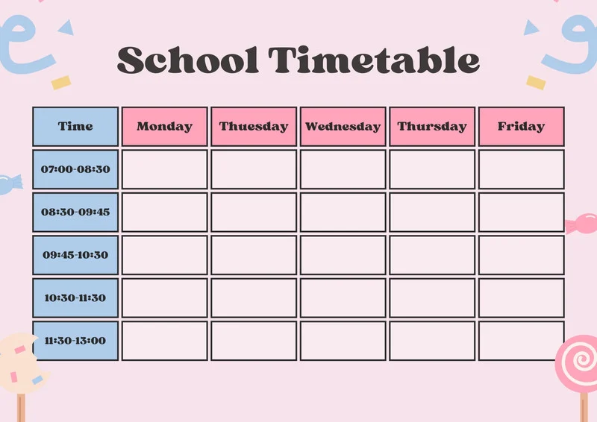
School Day
Supervised (on top playground) 8.30
Whistle 8.35
Registration 8.35-8.45
Late (report to office) 8.45 onwards
Handwriting & Reading 8.45-9.15
English writing 9:15-10:15
Assembly 10.15-10.35
Playtime 10.35-10.50
Maths 10:50-12:10
Lunchtime 12:10-1:10
Reading 1:10-1:20
Variety of Subjects 1:20-3:15
End (dismissed onto top playground) 3:15

Slide 29
Communication
Contact your class teacher
Planner
Top playground before school & at the end of the day
Email
julie_gumbrell@oakfield.surrey.sch.uk
cheryl_martin@oakfield.surrey.sch.uk
kerrie_gregory@oakfield.surry.sch.uk
hollie_baines@oakfield.surrey.sch.uk
head@oakfield.surrey.sch.uk
School Office parent@oakfield.surrey.sch.uk
Phone the school office if a message is important and needs to be read that day. Emails to teachers are not read during the school day as they are busy teaching.

Slide 30

Oakfield Community
Helpers: Many hands make light work. All help is greatly appreciated so please contact the office or your child’s class teacher if you are able to offer support (readers, trips, clubs etc.)
Skills: We would love to hear from you if you have any specialist skills, qualifications or contacts etc. that if shared could benefit the school (plumber, grounds, repairer, handyperson etc.)

Slide 31

Oakfield Community
Governors: Governing Boards are the strategic decision makers and vision setters in every school. They ensure that the best possible education is given for every child at Oakfield.
Arts and Wellbeing Hub
We are planning an ambitious and much needed project to enhance school and local facilities, to support family wellbeing and promote the Arts.
Governor positions available: Parent; Finance; Health & Safety; Teaching & Learning

Slide 32

Oakfield Community
Aim is to organise a number of enjoyable school community events and to raise as much money as possible to assist the school with financing great projects. Friends positions available friends@oakfield.surrey.sch.uk

Slide 33

Arts and Wellbeing Hub
Exciting News! We are planning an ambitious and much needed project to enhance school and local facilities, to support family wellbeing and promote the Arts.

Slide 34


