Slide 1

‘From Small Acorns to Mighty Oaks’

Slide 2
Our Vision
For all learners to have courage to embrace new experiences with confidence; work co-operatively, whilst respecting and caring for others; be curious about the whole world and enjoy learning for life.

Slide 3
Supporting the School
Governors: Governing Boards are the strategic decision makers and vision setters in every school. They ensure that the best possible education is given for every child at Oakfield. We currently have two co-opted governor vacancies. Please contact Mrs Willemse or Tess Trewinnard (Governor) tess_trewinnard@oakfield.surrey.sch.uk should you be interested in learning more about this position.
Friends: Aim is to organise a number of enjoyable school community events and to raise as much money as possible to assist the school with financing great projects. We are currently looking for more parents to join the Friends. Co-Chair position available.
Helpers: Many hands make light work. All help is greatly appreciated please contact the office or your child’s class teacher if you are able to offer support (reading/trips etc.). DBS checks.
Skills: We would love to hear from you if you have any specialist skills or qualifications, contacts etc. that if shared could benefit the school.

Slide 4
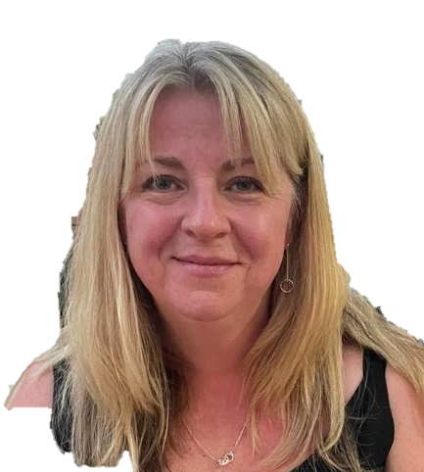
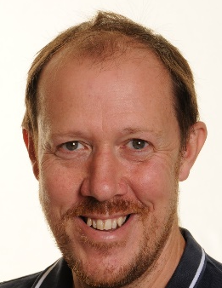
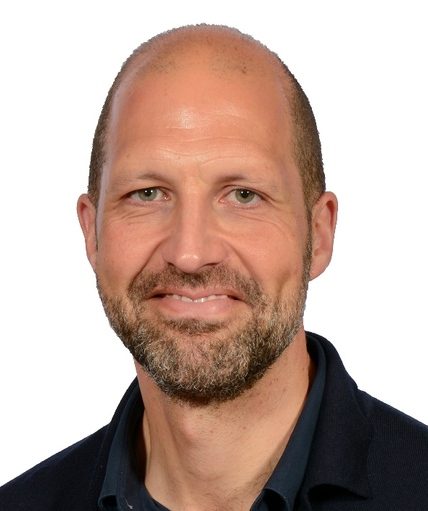
Year 5 Team
Year Group Leader:
Mrs Katie Holden
Class teachers:
Mrs Holden –Alder: Monday-Thursday
Mr Treen-Hawthorn
In class support-Mrs Smith HLTA
English and Maths SEND group support & Thrive-Mr Barrett

Slide 5
Our Priorities
Writing – stamina & enjoyment for writing
Reading- inference and enjoyment
Maths- fluency of times tables and number facts
Learning multiplication tables
Emotional well-being and resilience

Slide 6

Maths
Numeracy: Is taught in 2 groups across year 5. Both groups will cover the following: Counting and Understanding Number, Calculating, Using & Applying Mathematics. Knowing and Using Number Facts, Measuring, Shape, Handling Data.
Learning of times tables to x12 for instant recall
Homework : All children are subscribed to Doodle and TT Rockstars. Passwords and usernames will be redistributed. Homework will include a mixture of calculation, problem solving, times tables and arithmetic. Most of these will be online.

Slide 7

English
SPAG: No Nonsense spelling scheme, grammar & punctuation. Spelling lessons are taught weekly.
Dramatic Conventions: Saving Pompeii
Older Literature: Shakespeare unit
Poetry: The children will analyse themes portrayed in the famous poem ‘The Highwayman’.
Persuasion: Charlotte’s Web. Children analyse the key features in persuasion texts and write their own persuasive letter for a given audience and purpose.
Report Writing: Explorers
Novels and Stories by a significant children’s author: Michael Morgurgo
Five Guided Reading sessions per week. In addition to this, a daily whole class reading for enjoyment session and book study.
Pupils will have access to Doodle English and Spag.com

Slide 8

Science
Science: Our topics for this term are:
1st half -Forces in Action ( different types of forces and their impact on everyday life)
2nd half – Earth, Moon and Sun – The concept that the sun is the centre of the universe and planets orbit around it. How we get night and day.
( Future topics include: Properties and changes in materials, Animals including humans, growth and development, Living things and their habitats and Life Cycles).
There are useful resources on the BBC website: http://www.bbc.co.uk/schools/ks2bitesize/science/

Slide 9

PHSE- Jigsaw
We use the Jigsaw scheme which brings together emotional literacy, social skills and spiritual development in a comprehensive scheme of learning.
There are six puzzles for your child to complete each academic year.
Autumn 1 Being me in my world with an emphasis on emotional well-being
and resilience
Autumn 2 Celebrating differences ( inc anti-bullying)
Spring 1 Dreams and goals
Spring 2 Healthy me
Summer 1 Relationships
Summer 2 Changing me ( including Relationship & Sex Education)
Additional emotional and social support includes Thrive, Elsa and Calm Club (at lunchtimes).

Slide 10

We use SACRE RE scheme and cover Christianity, Buddhism and Hinduism in year 5.
Christianity- Creation – What do Christians believe about Creation. Looking at the Big Bang theory and scientists thoughts (humanism). How did the Church begin and where is it now? What do we mean by the word salvation and why do we like stories about rescue?
Hinduism- What helps Hindus (sanatanis) to worship? Brahman – the one ultimate reality or life force. Samsara. Karma, Moksha, Dharma. Celebrations.
Buddhism - Who was the Buddha? Why is he so important to many Buddhists and how do they show it?
Trip - Walk through Easter at St Mary’s Church

Slide 11


Geography and History
We use the Primary Connected Geography and History in addition to personalised local units.
This is an enquiry based scheme led by key questions. The children are taught important subject knowledge and key subject skills, through investigating at greater depth.

Slide 12


Geography
How do volcanoes affect the lives of people on Hiemaey?
How is climate change affecting the world?
Local study of Fetcham and Leatherhead
History
How have the medical breakthroughs of the last two hundred and fifty years affected the lives of the people of Britain?
The story of the Trojan Horse: historical fact, legend or classical myth?
Local study of Fetcham and Leatherhead

Slide 13
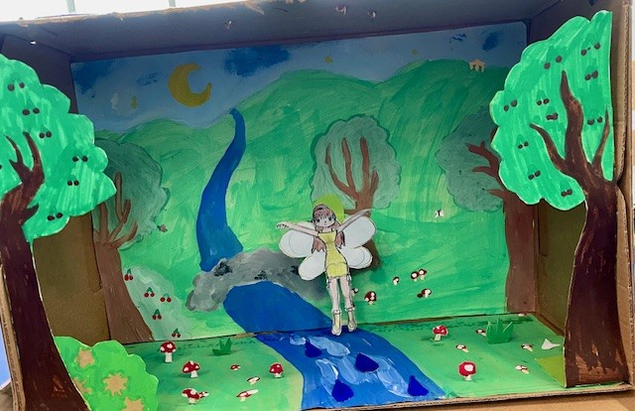
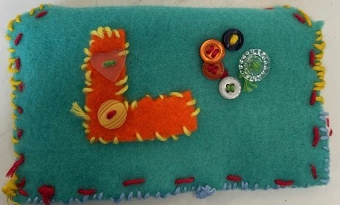
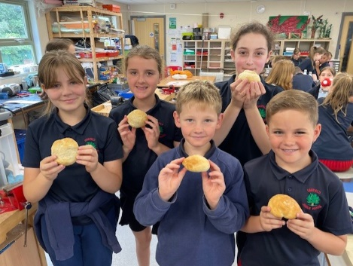
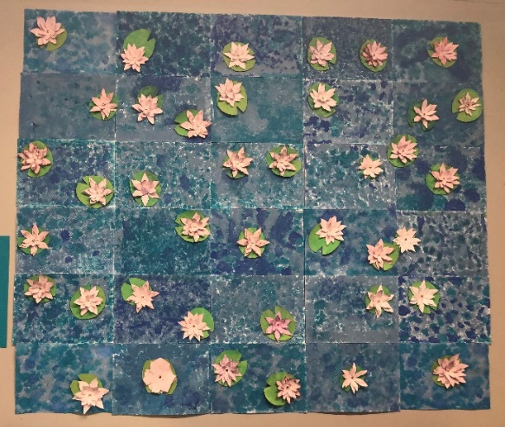
ART & DT: The impressionists including Monet, Manet and Degas –we explore impressionism; look at Monet’s works – haystacks, cities, garden in Giverny. Final piece – large scale art based on Monet’s Water lilies.
We design and sew money containers in the spring term and design and make shoebox theatres in the spring and summer term. Our final unit is making bread rolls! (A firm favourite). Art overall/old shirt in school all the time.

Slide 14

PE : Invasion games (netball and hockey), athletics, gymnastics, dance, indoor athletics, rounders and tennis.
Wednesday is PE day for year 5. Children to come to school dressed in correct PE kit. Watches & earrings must be removed at home before coming to school on PE days. Navy tracksuits are allowed in colder months.

Slide 15
Enrichment experiences
Science Learning Dome
St Mary’s church – Walk Through Easter
Fire Safety talk
Workshops and activities in school including Midsummer Night’s Dream workshop
Residential in and around Canterbury TBC
Celebrating Effort and Achievement
Reading raffle, School Reader Award weekly, Doodle certificates, House points, Rockstar Certificates and Star awards are given as well as individual class rewards. Please keep us up to date with any achievements outside of school.

Slide 16

HOMEWORK
Reading: 25 minutes per night 5 x per week. They can read their school reading book or home books at the appropriate level. Children must record reading in their planners.
Homework for English, spellings and maths will be available on Google Classroom on Fridays to be handed-in the following Thursday. Spelling lists are set weekly. Each homework task should take no longer than 25-30 minutes; longer if a child is happy to continue. On occasion, Science, Topic or Art homework may be given. We encourage parents to support their child with their learning as much as possible and you should sign your child’s homework planner at the end of each week.
Homework club will be available for those children who do not have access to digital devices or connection to the internet at home or require support on a particular activity.
There will be a teacher present to support.
Homework club is on Thursday lunchtime in Alder class.

Slide 17
Essentials/Daily Kit/Planner:
Your child needs: a pencil, rubber, sharpener, 30cm ruler, coloured pencils, whiteboard pen, green pen, scissors, glue stick and blue handwriting pen, kept in one small pencil case, which can be taken home every day or be kept in their locker. All clearly named.
An art shirt/ apron/ overall is required, and kept in their locker.
Children are encouraged to wear watches.
Only plain, small stud earrings can be worn – no other jewellery.
Long hair is tied back with plain blue or black hair bands (boys and girls).
No nail polish.
School black shoes and not trainers to be worn.
Uniform must be clearly named and worn correctly.
Homework Planners are to be in school daily.
Inhalers must be in school daily and any other medicine given to office.

Slide 18

Class teacher is the first point of contact.
katie_holden@oakfield.surrey.sch.uk
james_treen@oakfield.surrey.sch.uk
School Office: parent@oakfield.surrey.sch.uk
Mrs Willemse: head@oakfield.surrey.sch.uk
We have an open door policy and we value close communication between home and school.
Planners need to be in school daily and children are asked if there are any notes. Emails are checked when able, so if a matter is urgent please telephone the office before lunchtime and leave a message.
Autumn term Parent consultations: Tuesday 21st October 3.30 – 6.30pm in classrooms and Thursday 23rd 3.30 – 6.30pm in classrooms.

Slide 19
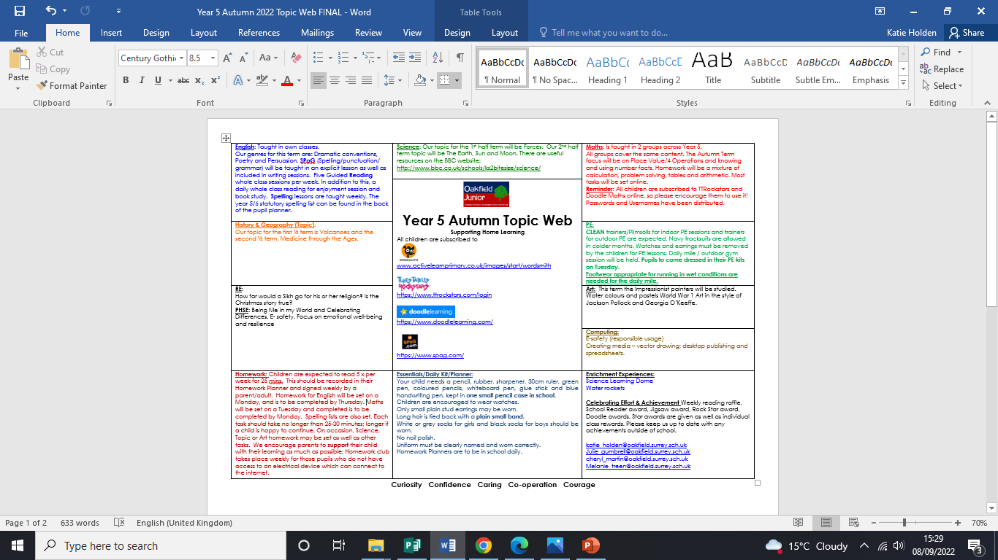
Year 5 Autumn Topic Web
Sent home in your child’s book bag.
An electronic copy will be sent via email and will be available on the school website.

Slide 20

We’d like to say a big thank you for all the support that you give your child, as it really makes a difference.

