Slide 1

‘From Small Acorns to Mighty Oaks’

Slide 2
Our Vision
For all learners to have courage to embrace new experiences with confidence; work co-operatively, whilst respecting and caring for others; be curious about the whole world and enjoy learning for life.

Slide 3
Supporting the School
Governors: Governing Boards are the strategic decision makers and vision setters in every school. They ensure that the best possible education is given for every child at Oakfield. We currently have 2 governor positions available. Please contact Mrs Willemse or Tess Trewinnard should you be interested in learning more about this position.
Friends: Aim is to organise a number of enjoyable school community events and to raise as much money as possible to assist the school with financing great projects. We are currently looking for more parents to join the Friends. All are invited to attend the Friends meetings.
Helpers: Many hands make light work. All help is greatly appreciated please contact the office or your child’s class teacher if you are able to offer support (reading/trips etc.). We will need to do a DBS check if you don't already have one.
Skills: We would love to hear from you if you have any specialist skills or qualifications, contacts etc. that if shared could benefit the school.

Slide 4
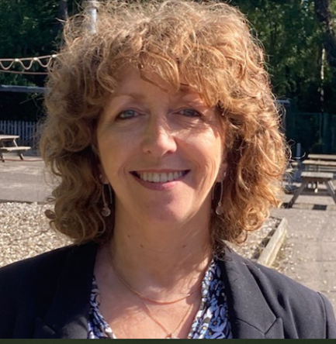
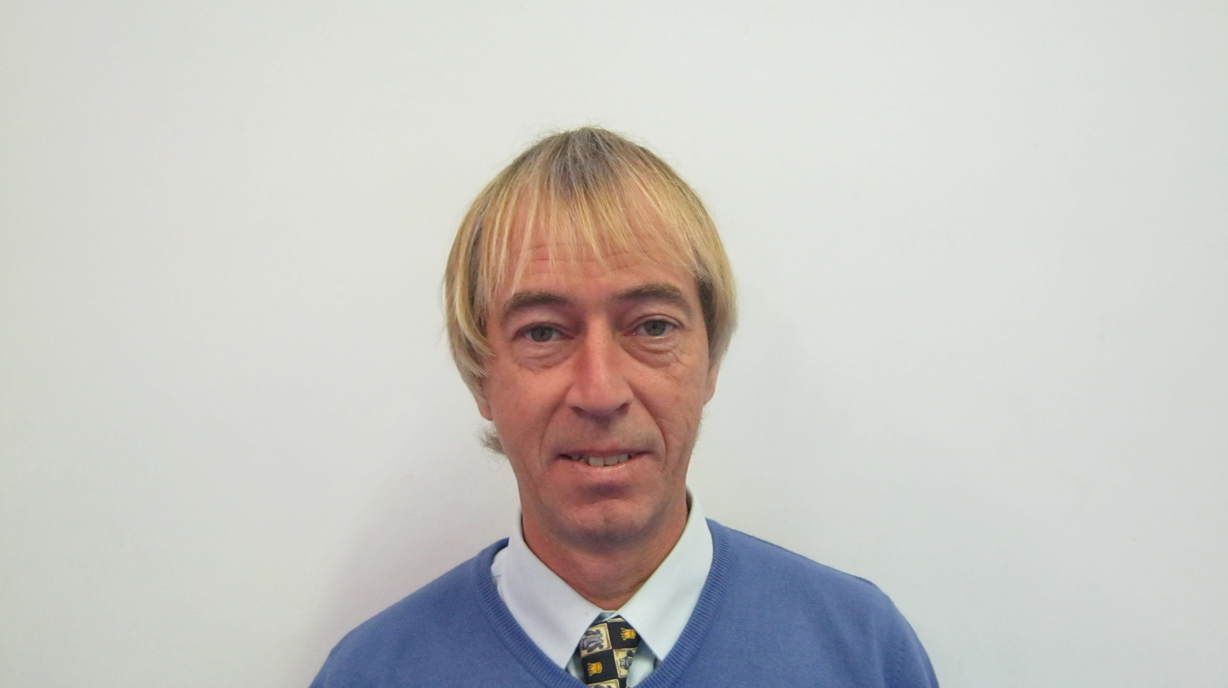
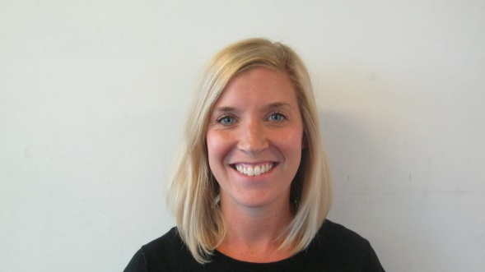
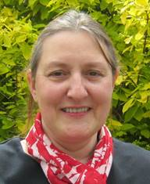
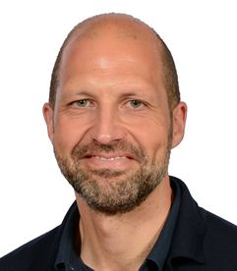
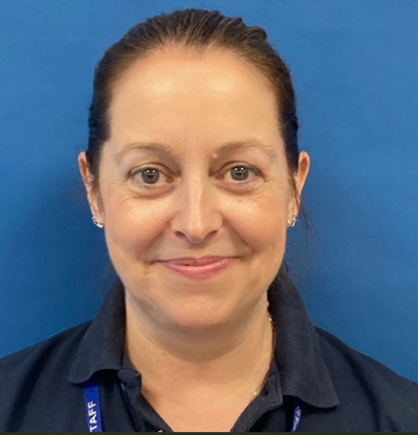
The Year 6 Team
Mrs Cole
Mrs Treen
Mr Myers
Mrs Wigley
Mrs Mason
Mrs Ginn
Mr Barrett

Slide 5
English
English: Taught in own classes.
Our genres for this term are: newspaper reports, narrative & poetry.
SPaG (Spelling/punctuation/ grammar) will be taught within our five writing sessions. Five Whole Class Reading sessions per week. (A class novel will be shared daily by the class teacher after lunch; two reading sessions per week will be based on the class novel). Children all have a colour band book. Silver Upper allows children to be a free reader.
Spelling lessons are taught weekly. The year 5/6 statutory spelling list can be found in the back of the pupil planner and all Yr 3-6 rules will be emailed to you all. These are also available on Google classroom. Certain children will have individual spellings to learn each week.
Pupils will have access to Doodle English and Spag.com
Yr 6 recommended reading list will be emailed to parents.

Slide 6

Maths
Maths: Is taught in 2 groups across Year 6.
Both groups cover the same content: the Autumn Term focus will be on Place Value, 4 Operations and Fractions. Arithmetic will be included in the extended daily session and homework will be a mixture of calculation, problem solving, times tables and arithmetic. Most will be online activities.
Reminder: All children are subscribed to Doodle Maths and TT Rockstar so please encourage them to use these. Passwords and Usernames have been re-distributed.

Slide 7
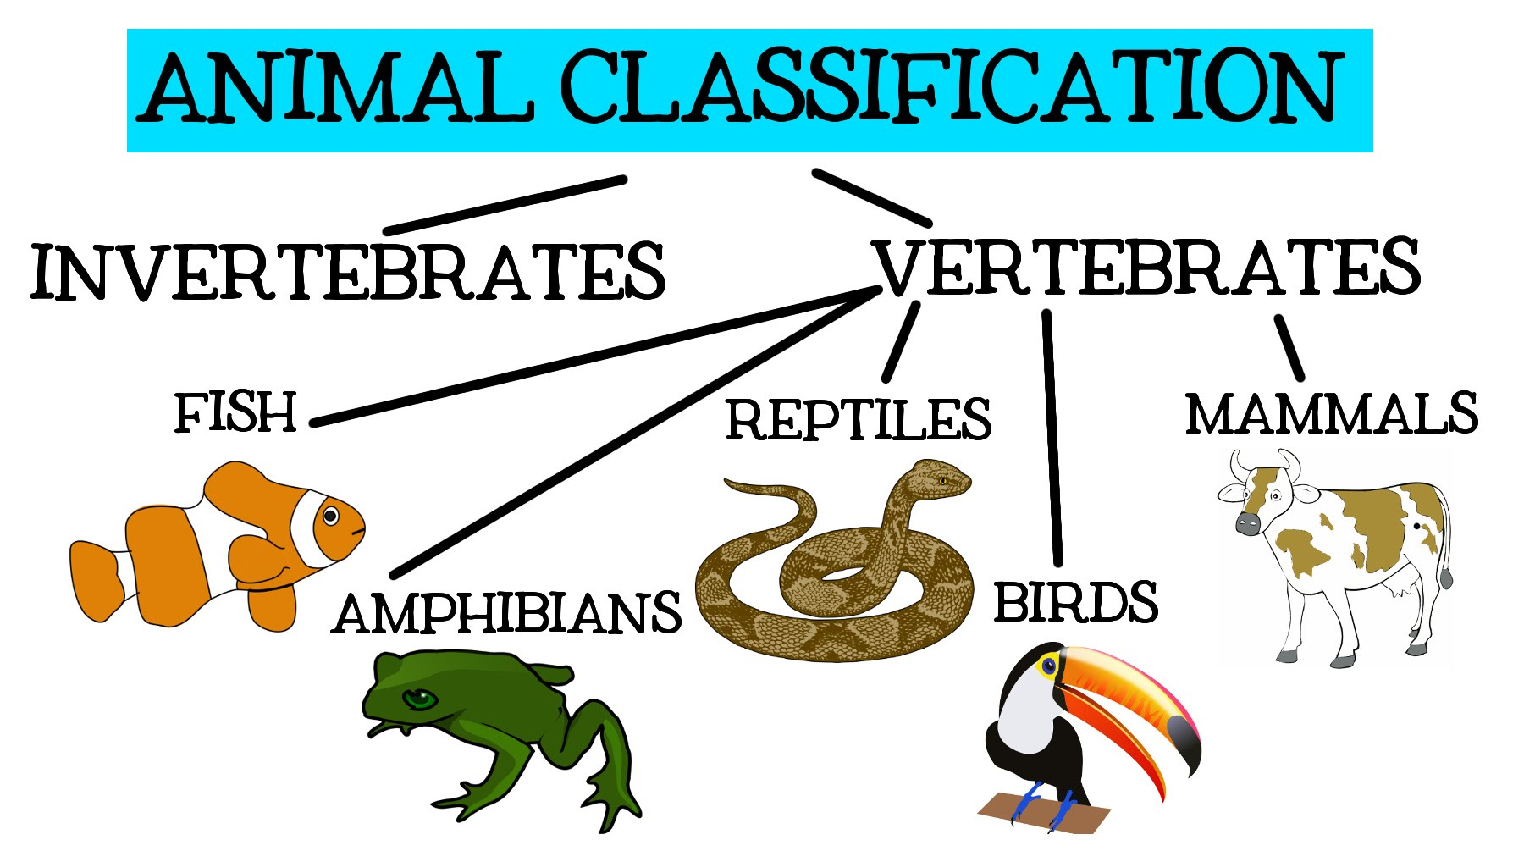

Science
Science: Evolution and Inheritance and Light.
There are useful resources on the BBC website: http://www.bbc.co.uk/schools/ks2bitesize/science/
Outdoor Learning opportunities
Mrs King and Mrs Treen will be teaching Science

Slide 8
PSHE & RE
PSHE: We use the Jigsaw scheme which brings together emotional literacy, social skills and spiritual development in a comprehensive scheme of learning. This term’s themes are: ‘Being me in my world’ and ‘Celebrating Difference’.
RSE – Relationships and Sex Education will be taught during the summer term by the class teachers.
Emphasis on well-being and resilience
RE: Islam – What helps Muslims to lead a good life?
Christianity – What do Christians believe about the Messiah?
Religious cultural trip out/ visitor in
Additional social and emotional support: Calm Club, Thrive and ELSA

Slide 9
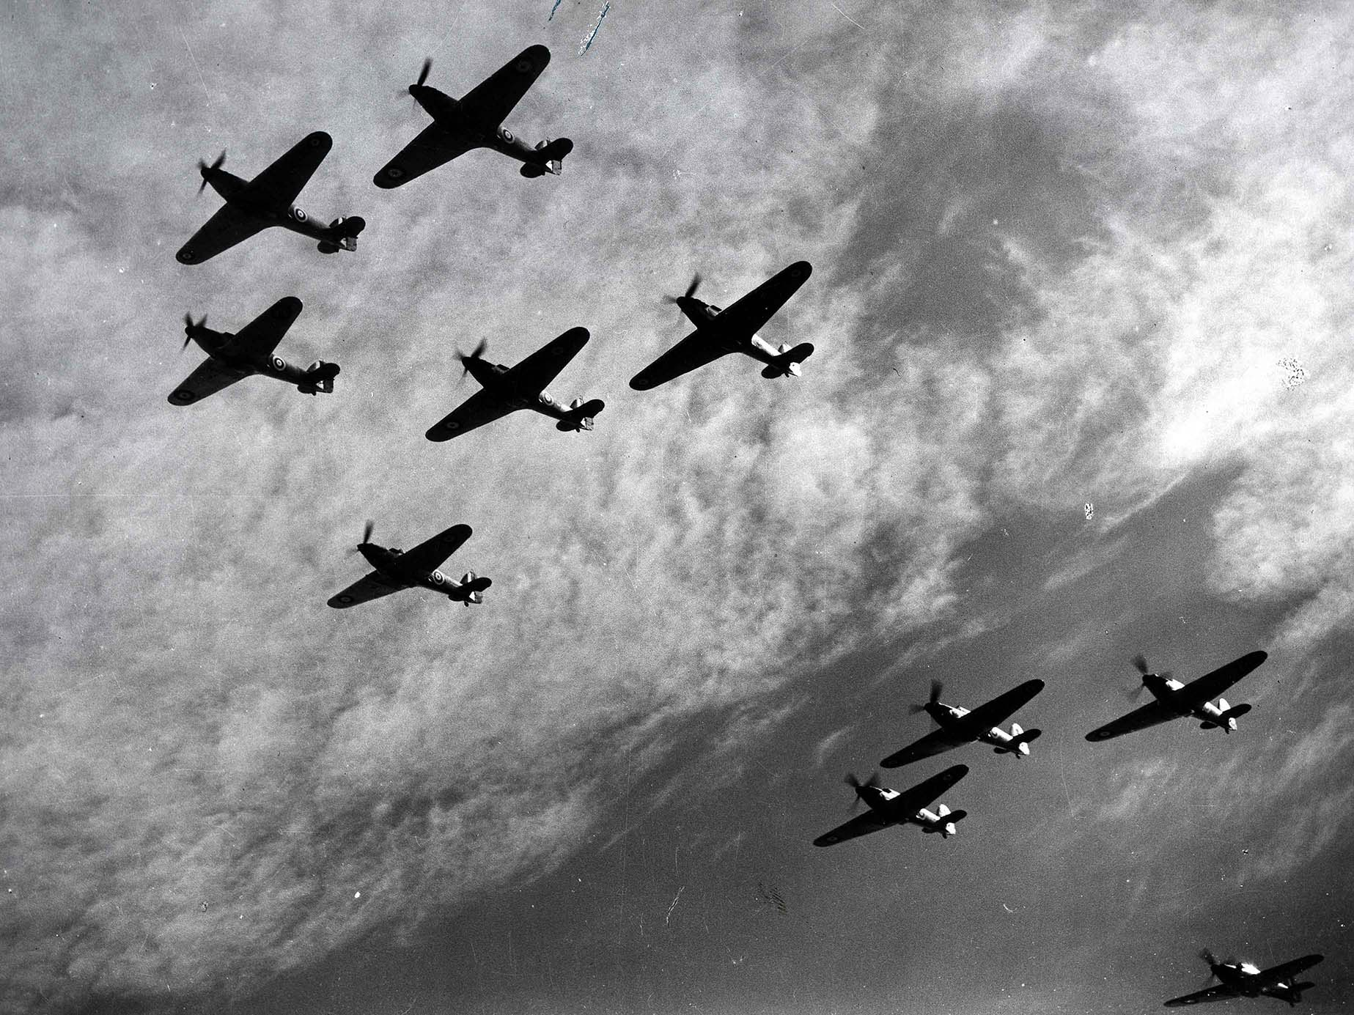
Foundation Subjects
History and Geography: The Battle of Britain and Rivers Topic
Art & DT: Art focuses on a range of drawing and painting techniques linked in with our WW2 topic- People in Action and Art Illusions.
Computing: Creating Media – Power Apps where the pupils will create an App for a tablet or phone on the Amazon
Creating Models – The pupils will
create their own digital 3D models
E-Safety – The pupils are taught
continually how to use technology,
safely, respectfully and responsibly.

Slide 10

PE
PE: Dance & Indoor Athletics
Daily Mile
Monday is PE day for Year 6 – children to come to school dressed in PE kit.
Navy tracksuits are allowed in colder months. Watches and earrings must be removed at home before coming to school on PE days.

Slide 11
Preparation for SATs
The Y6 formal SATs assessments take place week starting 11th May.
We hold a detailed information meeting for parents regarding this in March.
We will be preparing the children for these tests throughout the year, carrying out several rounds of practice papers.
CAN WE PLEASE ASK THAT YOU DO NOT USE SATS PAPERS DATED 2022, 2023,2024 AND 2025 AT HOME AS WE WILL BE USING THESE IN SCHOOL AS PART OF OUR ASSESSMENT PROCEDURES.
Planner: Record of your child’s progress and practice SATS scores

Slide 12
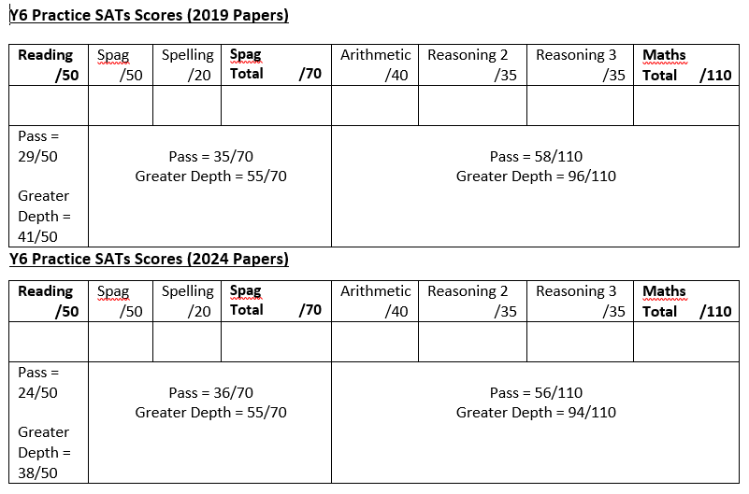

Slide 13
Enrichment Experiences
Enrichment Experiences:
Workshops to run in school.
Residential trip – Swanage 6th- 9th July 2026 – Est cost TBC (Meeting during Summer 1)
Bikeability Level 2 – date in November TBC
Milestones Museum - date in January TBC
Booster sessions before school.
Teachers run weekly booster groups.
Celebrating Effort & Achievement
Reading Raffle, School Reader Award, Doodle Certificates, Housepoints, Rockstar Certificates and Star of the Week/Month/Term Awards are given as well as individual class rewards. Please keep us up to date with any achievements outside of school.

Slide 14
Homework
Children are expected to read 5x per week for 25-30 mins. This should be recorded in their Homework Planner and signed weekly by a parent/adult.
Planners are checked each week– parents to please sign the week before.
Homework for Maths and English will be set online (Doodle, SPAG.com) on a Friday.
Writing journal tasks will be set twice a half term.
Spelling lists are set weekly and tested on a Friday.
Homework should take no longer than 35 minutes or longer if a child is happy to continue.
On occasion, science, topic or art homework may be given or additional handwriting activities for those who need it. We encourage parents to support their child with their learning as much as possible. Homework club takes place weekly on a Thursday lunchtime for children that require more support or those children that don’t have access to digital devices or connection to the internet at home.
ALL HOMEWORK IS RECORDED IN PLANNERS AND IS ON GOOGLE CLASSROOM.

Slide 15
Essentials/Daily Kit/Planner:
Your child needs a pencil, rubber, sharpener, 30cm ruler, coloured pencils, whiteboard pen, glue stick and blue handwriting pen, kept in one small pencil case, which should be taken home each day or kept in lockers. An art shirt is required. Children are encouraged to wear watches. Only plain, small stud earrings can be worn. Long hair is tied back with plain blue or black hair bands. No nail polish. School black shoes and not trainers to be worn. Uniform must be clearly named and worn correctly. Homework planners are to be in school daily.
Inhalers must be in school daily and any medicine given to office.

Slide 16

Class teacher is the first point of contact.
At Oakfield, we have an open door policy and we value close communication between home and school. To enable this to work successfully, we check planners daily and we ask you to do the same. Emails are checked regularly, however if a matter is urgent please call the school office and leave a message before lunchtime.
rachael_cole@oakfield.surrey.sch.uk
gary_myers@oakfield.surrey.sch.uk
melanie_treen@oakfield.surrey.sch.uk
head@oakfield.surrey.sch.uk
School Office: parent@oakfield.surrey.sch.uk

Slide 17

We’d like to say a big thank you for all the support that you give your child as it really makes a difference.
Parent Consultations:
Tuesday 21st October and Thursday 23rd October 3.30-6.30

