Slide 1
YEAR 3 HOME LEARNING

Slide 2

2 WEEK BLOCK: ENGLISH

Slide 3

ACTIVITY 1
COMPREHENSION
Please start each English session with a mini comprehension from the folder provided online.
Each comprehension comes with an answer sheet.
Read aloud to someone at home if you need to, to help you with this task.
An Ancient Egypt Activity pack
https://ojs-my.sharepoint.com/:f:/g/personal/ed_james_oakfield_surrey_sch_uk/EjdfnE821IBBpNZWyf0Ejb0B_5sNElTjGPeBUAkjUOl2eQ?e=8srXpu
Rainforests activity pack
https://ojs-my.sharepoint.com/:f:/g/personal/ed_james_oakfield_surrey_sch_uk/EuAeD4fuk69Lr8_nZgcLDwMBMGyNlb2BvAIIVpou4fOMUA?e=1i97XW
Stone Age Activity pack
https://ojs-my.sharepoint.com/:f:/g/personal/ed_james_oakfield_surrey_sch_uk/Ei8B11_kyXtLj-jMr0UsndwBptU0Z_pOvIXIH9aTAPGsXg?e=nipsde
10 MINUTES

Slide 4

ACTIVITY 2
GRAMMAR
Choose a game each day from one of the websites below.
https://www.topmarks.co.uk/english-games/7-11-years/spelling-and-grammar
http://www.sheppardsoftware.com/grammargames/pandapopPartsofSpeech.htm
http://www.crickweb.co.uk/ks2literacy.html
https://www.bbc.co.uk/bitesize/topics/zhrrd2p
http://www.primaryhomeworkhelp.co.uk/literacy/
http://www.funenglishgames.com/grammargames.html
10 MINUTES

Slide 5

ACTIVITY 3
WRITING COMPOSITION
Please follow this link to Authorfy website where authors have posted daily writing challenges. You can choose your own author challenge from the growing selection available. A new challenge is posted daily.
https://authorfy.com/10minutechallenges/
Alternatively or as well as you could choose a writing task from the next slide!
30 MINUTES

Slide 6
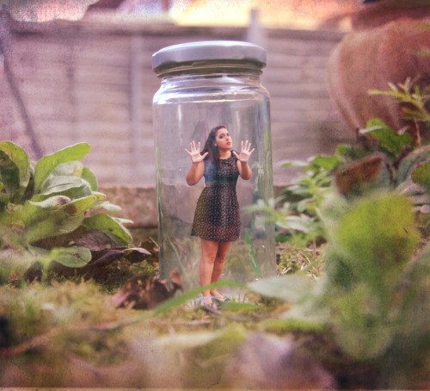


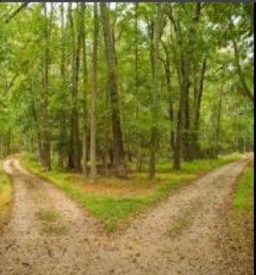
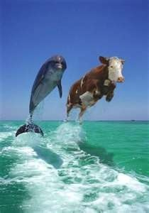
WRITING COMPOSITION
Choose a task each day or alternatively spend longer on one task over a few days
Write a story about this picture and give your story a name.
If you had one superpower, what would it be? Explain why you have chosen that superpower, what you would do with it, and how it would change your life.
Write an explanation as to why you would choose your option.
Recreate a new ending for the last book you read.
What questions come to your mind when you see this picture?

Slide 7
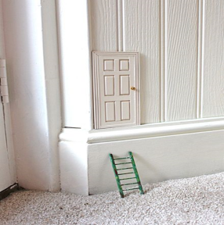


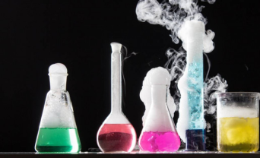
WRITING COMPOSITION
Choose a task each day or alternatively spend longer on one task over a few days
One day you find this door in the corner of your room. What is it for? Where does it take you?
Write a blurb for a story you have read.
Create a travel brochure for a chosen destination.
Write a set of instructions for an activity you have completed, or an experiment you have carried.

Slide 8

ACTIVITY 4
SPELLING
Please continue to work through the Year 3 lists – aim to learn 10 new spellings each week and revisit 10 from previous weeks.
Get someone to test you on them at the end of the week.
10 MINUTES

Slide 9

ACTIVITY 5
READING
Please ensure you continue to read a good quality reading book from the year 3 list
Talk to someone at home about the book that you are reading.
Read a few pages aloud to somebody; this is a different skill to silent reading. Can you make it exciting? Use different voices.
30 MINUTES

