Slide 1

LO: To understand the role of a
farmer in Ancient Egypt.

Slide 2
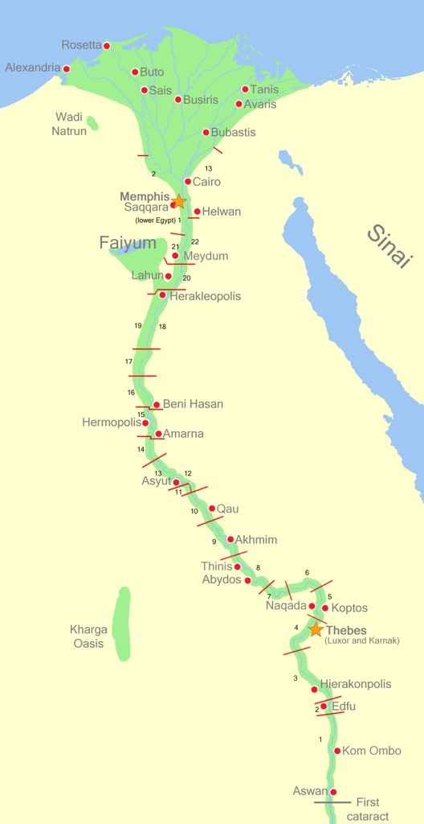
The River Nile
Why was The River Nile so important to the Ancient Egyptians?

Slide 3
The River Nile
The River Nile runs through Egypt. Most people live along and around the River Nile.
This is because it is green and crops can be grown in the areas around the Nile whilst the rest of Egypt is desert.
The people of ancient Egypt depended on the Nile to survive.

Slide 4
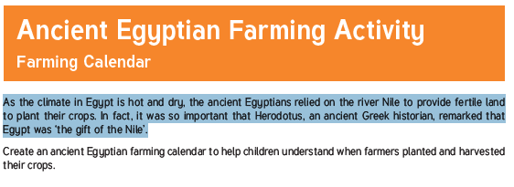

Slide 5
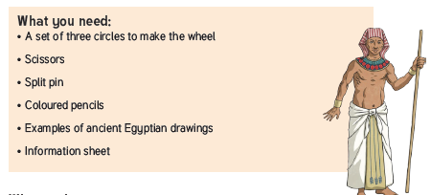

Slide 6
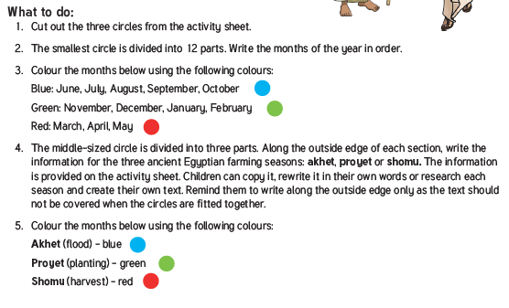

Slide 7
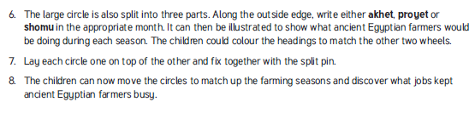

Slide 8
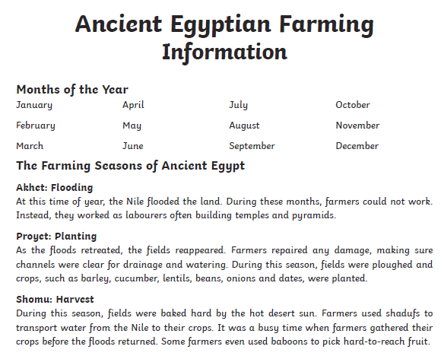

Slide 9
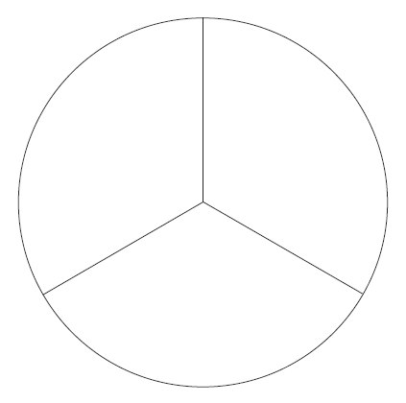

Slide 10
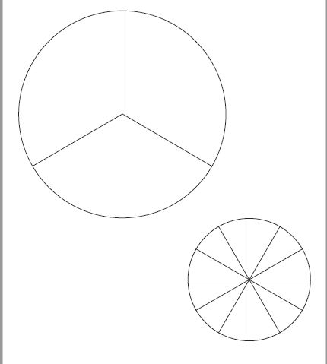

Slide 11
Write a summary to explain what a typical year might look like for an Ancient Egyptian farmer.

