Slide 1
Year 3
Egyptian Art

Slide 2
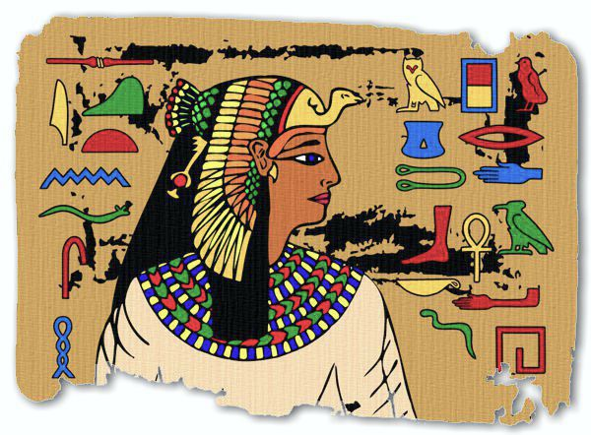
LO: I can draw an Ancient Egyptian figure head and use a
medium of my choice to add detail.

Slide 3
This Ancient Egyptian head is based upon a painting of Queen Nefertari from her tomb in the Valley of the Queens. Queen Nefertari is usually shown wearing the Royal Vulture Crown of the goddess Nekhbet, the protector of Upper Egypt. Nefertari was the favourite wife of the greatest of all the pharaohs, Rameses II, and she bore him at least six children. She probably died after his 30th year on the throne, about 12 centuries before the birth of Christ.

Slide 4
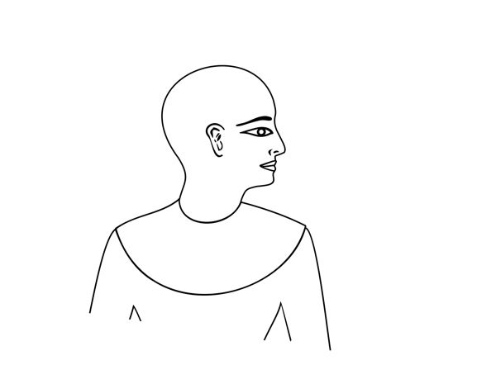
Step 1 - Drawing an Ancient Egyptian Figure
A traditional Egyptian image shows the head and lower body viewed from the side, with the eye and upper body viewed from the front.

Slide 5
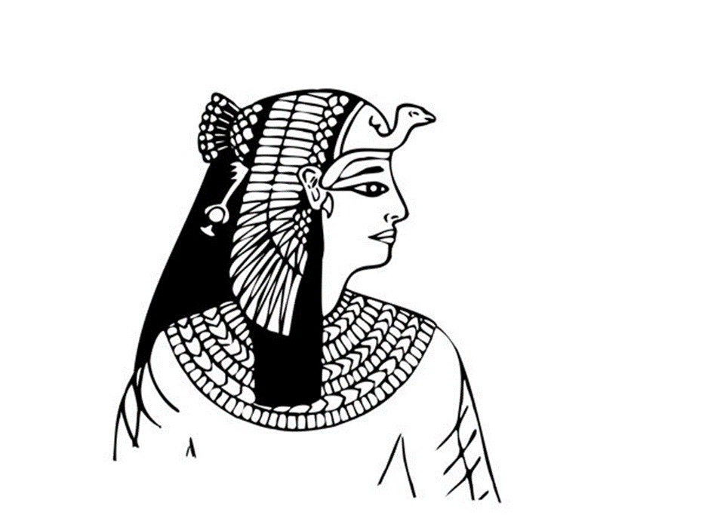
Step 2 - Drawing the Crown and Pectoral Decoration
In the second stage of this drawing we have added a headdress, a pectoral decoration and a tunic.

Slide 6
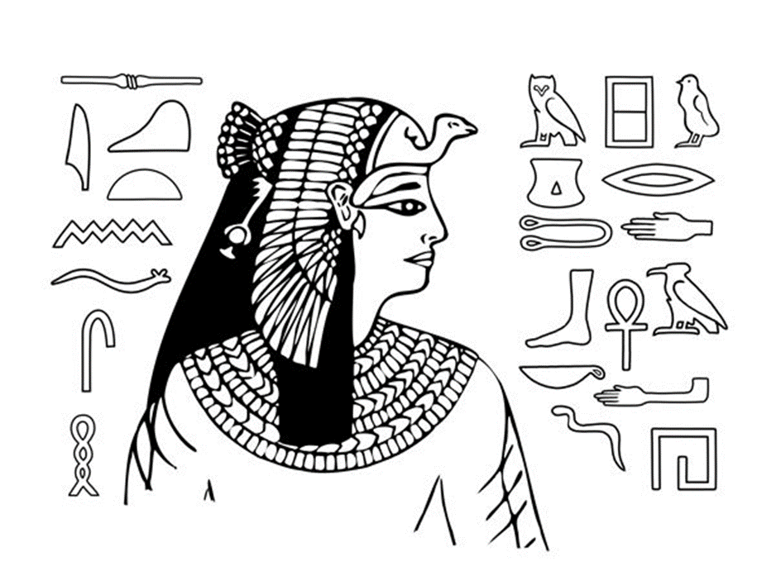
Step 3 - Drawing a Hieroglyphic Background
At this stage you can decorate the background with an arrangement of hieroglyphics.
Try to arrange your hieroglyphs to create an interesting composition.
Find the hieroglyphs alphabet on:
https://www.ducksters.com/history/ancient_egypt/hieroglyphics_examples_alphabet.php

Slide 7
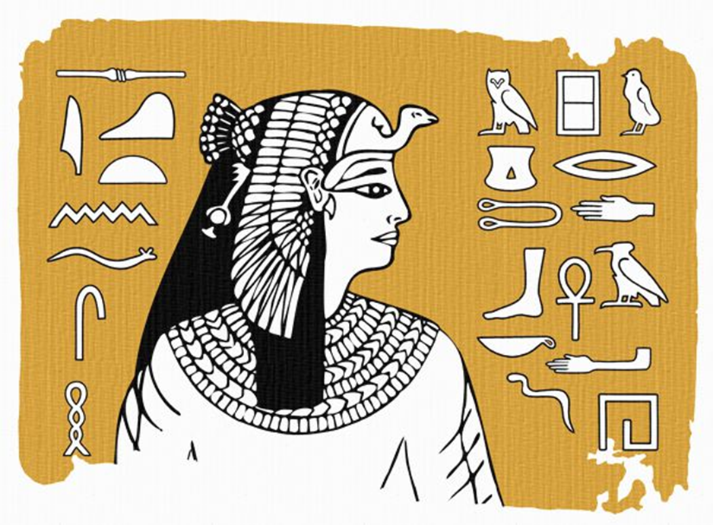
Step 4 – Painting/colouring the background
You are now ready to start the colouring or painting of the portrait.
We have used yellow ochre for the background as this sandy colour is often associated with Ancient Egyptian images.
The borders are deliberately painted more loosely to show the piece is aging!

Slide 8
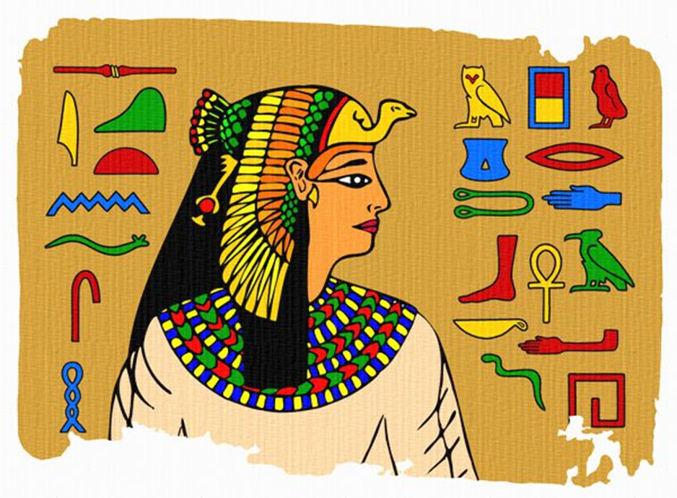
Step 5 – Painting or colouring the Figure and Hieroglyphics
To complete the painting, carefully fill in the details of the figure and hieroglyphs using a range of appropriate colours.
Strong primary colours (red, yellow and blue) and secondary colours (green, orange and purple), in combination with black and white, were often used in Ancient Egyptian painting.
We can’t wait to see your finished design!

