Slide 1

Welcome to Year 4

Slide 2
‘From Small Acorns to Mighty Oaks’

Slide 3
Our Vision
For all learners to have courage to embrace new experiences with confidence; work co-operatively, whilst respecting and caring for others; be curious about the whole world and enjoy learning for life.

Slide 4
Supporting the School
Governors: Governing Boards are the strategic decision makers and vision setters in every school. They ensure that the best possible education is given for every child at Oakfield. Please contact Mrs Willemse should you be interested in learning more about this position.
Friends: Aim is to organise a number of enjoyable school community events and to raise as much money as possible to assist the school with financing great projects. We are currently looking for more parents to join the Friends. All are invited to attend the Friends AGM.
Helpers: Many hands make light work. All help is greatly appreciated please contact the office or your child’s class teacher if you are able to offer support (reading/trips etc.).
Skills: We would love to hear from you if you have any specialist skills or qualifications, contacts etc. that if shared could benefit the school.

Slide 5
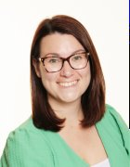
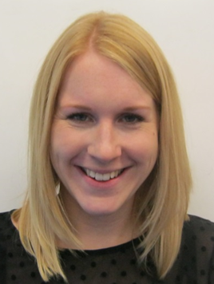
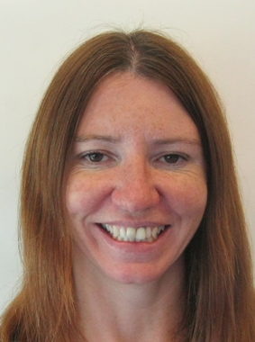
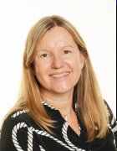
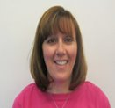
Meet the Team
Mrs Emily Buckler (Year Group Leader)
Mrs Sue King
Miss Allen
Mrs Holman
Mrs Etty

Slide 6

Autumn Term focus will be on Place Value; 4 Operations and Fractions. Homework will be a mixture of calculation, problem solving, tables and arithmetic. Most will be online activities.
Knowing times table facts up to 12x12 is essential. Year 4 National Times Table Check –End of May/ start of June 2026.
Reminder: All children are subscribed to Times Tables Rockstars and Doodle maths.

Slide 7

Our genres for this term are: stories with mythical settings and explanation texts.
SPaG (Spelling/punctuation/ grammar) will be taught within our five writing sessions. Five Whole Class Reading sessions per week. (A class novel will be shared daily by the class teacher after lunch; two reading sessions per week will be based on the class novel). Spelling lessons are taught weekly. The year 3/4 statutory spelling list can be found in the back of the pupil planners
Pupils will have access to Doodle English & Spell and Spag.com

Slide 8

Electricity and Properties of materials
There are useful resources on the BBC website. http://www.bbc.co.uk/schools/ks2bitesize/science/
Outdoor learning opportunities will be encouraged.

Slide 9

PSHE: We use a scheme called Jigsaw which brings together emotional literacy, social skills and spiritual development in a comprehensive scheme of learning. Emphasis on well-being and resilience
Autumn 1: Being me in my world
Autumn 2: Celebrating difference
Spring 1: Dreams and goals
Spring 2: Healthy me
Summer 1: Relationships
Summer 2: Changing me (Including SRE)
Additional social and emotional support (Calm Club, ELSA & Thrive)

Slide 10

We use the Surrey Agreed syllabus for RE
Beliefs and Practices (Judaism and Christianity) including Christmas.
Religious enrichment during the year
Picture News weekly

Slide 11


The school uses the Collins Geography and History scheme. This is an enquiry based scheme led by innovative key questions. The children are taught important subject knowledge, whilst allowing sufficient time for mastering key subject skills, and challenging outcomes through investigating at greater depth.
HISTORY : Romans
GEOGRAPHY: Fairtrade

Slide 12


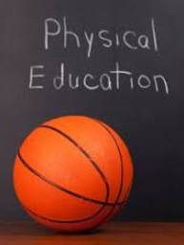
ART: Pointillism
DT: Catapaults using our Plan Be scheme
PE: Taught on Fridays
Pupils should come to school dressed in their PE Kit on their PE day. Children will also take part in the daily mile and use the outdoor gym equipment. Navy tracksuits are allowed in colder months. Watches and earrings must be removed by the children for PE lessons.
Thursday 11th September for 6 weeks we will be having cricket coaching run by Surrey Cricket- PE kit must be worn

Slide 13

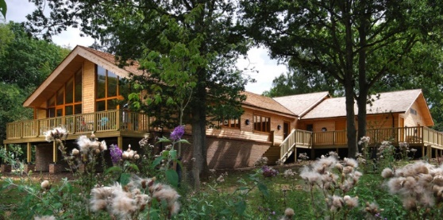
Bignor Roman Villa: 22nd October 2025
High Ashurst residential: 5th-7th November 2025 (Parent meeting 14th October)
The Children's Concert 28th January 2026
Pond dipping: July

Slide 14

Children are expected to read 5x per week for 20 mins. This should be recorded in their Homework Planner and signed weekly by a parent/adult.
Homework for Maths and English will be set every Monday and uploaded onto Google Classroom the weekend before. Spelling lists are set weekly. Homework should take no longer than 20 minutes unless a child is happy to continue. On occasion, science, topic or art homework may be set instead of online tasks.
We encourage parents to support their child with their learning as much as possible.
Homework club takes place during Tuesday Lunchtime for children that require more support or those children that don’t have access to digital devices or a connection to the internet at home.
Topic Webs will be sent home

Slide 15
Essentials/Daily Kit/Planner:
Your child needs a pencil, rubber, sharpener, 30cm ruler, coloured pencils, whiteboard pen, glue stick and blue handwriting pen, green biro, green highlighter, kept in one small pencil case. An art shirt is required. Children are encouraged to wear watches. Only plain, small stud earrings can be worn. Long hair is tied back with plain blue or black hair bands. No nail polish. School black shoes and not trainers to be worn. Uniform must be clearly named and worn correctly. Homework Planners are to be in school daily.
Inhalers must be in school daily and any medicine given to office.

Slide 16
Going Home Arrangements
A reminder to all parents to ensure that you have filled in page 85 of your child’s planner outlining what the going home arrangements are for the Term. This will need to be updated termly or more frequently if arrangements change.
Please do this together with your child to ensure that they are clear about expectations.
All pupils and staff need to have a clear understanding of who will be meeting them on each day of the week, where and when.
e.g. Monday (Mrs Martin-mother) top playground 3:15pm
e.g. Tuesday (Mrs Mason-child minder) gazebo 4:00pm after football club
e.g. Wednesday (Simon-brother year 6) bottom playground 3:15pm
Please ensure that teachers & office staff are made aware of any changes to pick up arrangements and that these changes are added to pg 85 if they are permanent.
Parents must give written consent in the planner on page 85 if they have given permission for their child to walk home on their own. This responsibility should only be given to pupils in upper key stage two (year six ideally) in preparation for secondary school and where parents feel confident their children know how to keep themselves safe.

Slide 17
Going Home Arrangements
All pupils in year 3 only are handed over to a responsible adult on the top playground at the end of the school day by a member of staff.
Pupils in year 4 Cherry Class & year 6 will be dismissed via the side doors where they can meet with their responsible adult.
Pupils in year 4 Appl Class & year 5 will be dismissed onto the top playground via the top doors.
All pupils are routinely reminded that if the adult they are expecting to fetch them is not where they are expecting them to be, they need to make their way back to the school office for support.
Please remind your child to NEVER leave school site without a responsible adult’s permission.

Slide 18

Class teacher is the first point of contact.
At Oakfield, we have an open door policy and we value close communication between home and school. To enable this to work successfully, we check planners daily and we ask you to do the same. Emails are checked regularly however if a matter is urgent please call the school office and leave a message before lunchtime.
Contacting your teacher
Planner
Email
emily_buckler@oakfield.surrey.sch.uk
suzanne_king@oakfield.surrey.sch.uk
sarah_allen@oakfield.surrey.sch.uk
vicky_holman@oakfield.surrey.sch.uk
School Office parent@oakfield.surrey.sch.uk

Slide 19

We’d like to say a big thank you for all the support that you give your child as it really makes a difference.
Parent consultations will take place on 21st and 23rd of October.

