Slide 1
Baroque Music
Year 3

Slide 2
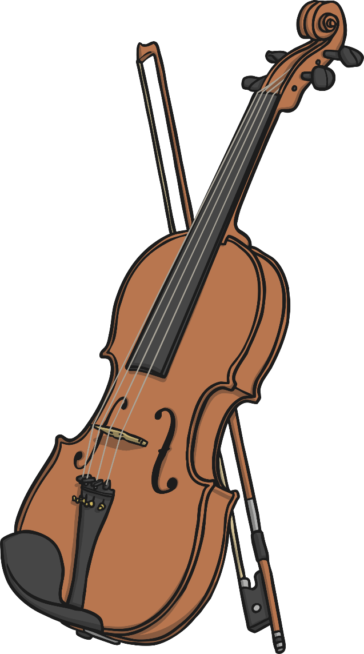
LO: To learn about the Baroque period in musical history.
Success Criteria
To be able to give examples of features of the Baroque period, including instruments and composers.

Slide 3
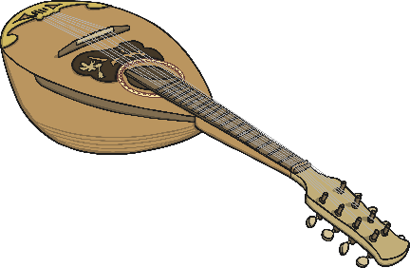
Music in History
Baroque Period 1600 to 1750
The
Gunpowder
Plot
1605
The Great Fire of London
1666
Vivaldi is
born
1678
Bach and Handel
born
1685
The piano is invented
1700

Slide 4
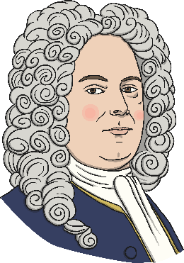
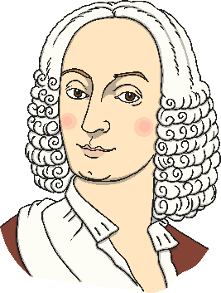
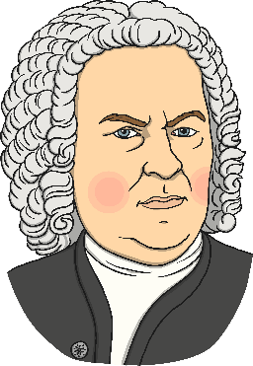
Baroque (1600 - 1750)
The orchestra was born within the Baroque period. Operas were written for the first time and were based upon Roman or Greek mythology.
Famous composers from this period include:
Johann Sebastian Bach
Born: 1685 Died: 1750
George Frederick Handel
Born: 1685 Died: 1759
Antonio Vivaldi
Born: 1678 Died: 1741

Slide 5
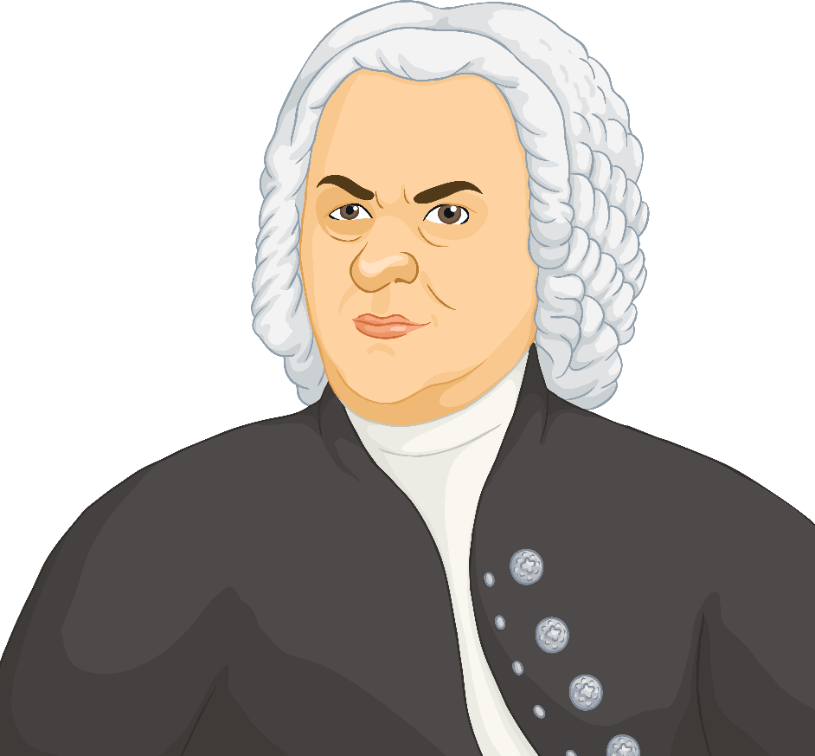
Johan Sebastian Bach
1685 - 1750
A German Baroque Composer
Johann Sebastian Bach was born in Eisenach, Germany in 1685.
As a child, Bach's father taught him to play violin and harpsichord.
He had 20 children!
Some of his most famous works include the Brandenburg Concertos, the Well-Tempered Clavier, and the Toccata and Fugue in D Minor.

Slide 6
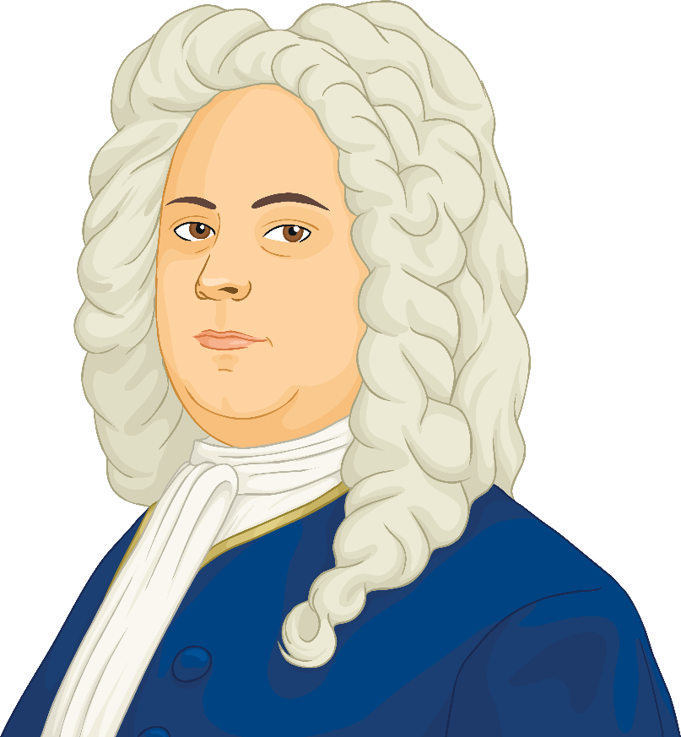
George Frideric Handel
1685 - 1759
A German Baroque Composer
George Frederic Handel was born on 23rd February 1685 – the same year as Baroque composer Johann Sebastian Bach.
His aunt gave him a harpsichord for his seventh birthday, which Handel played whenever he had the chance.
His father wanted him to be a lawyer.
He wrote Water Music and The Messiah.

Slide 7
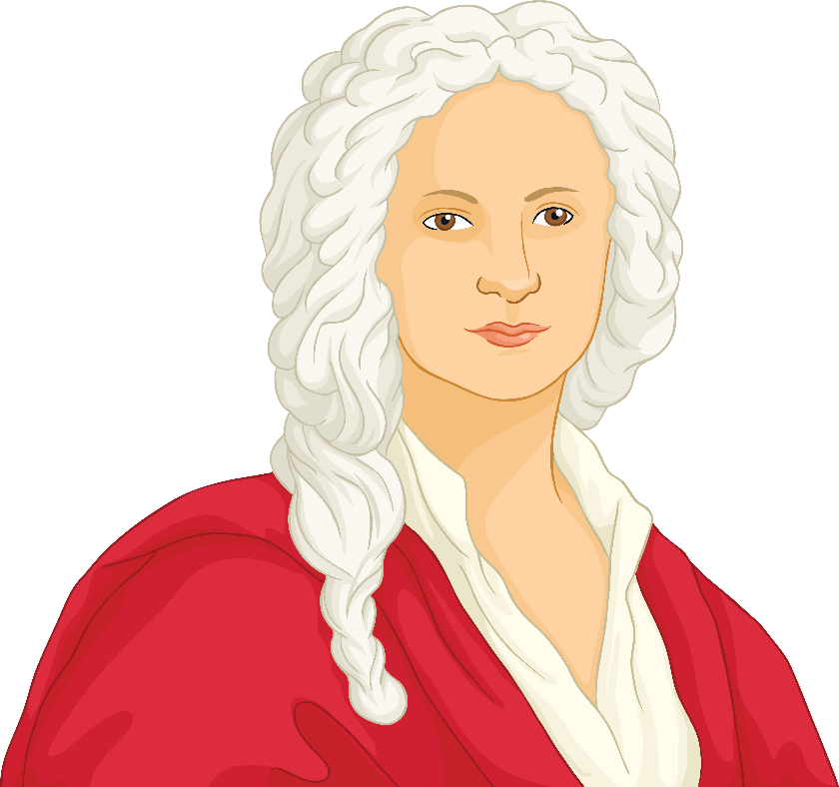
Antonio Vivaldi
1678 - 1741
An Italian Baroque Composer
Antonio Vivaldi was born on 4th March 1678 in Venice.
Antonio's father, Giovanni Battista, was a barber before becoming a violinist, and taught Antonio to play the violin and then toured Venice playing the violin with him.
He wrote The Four Seasons.

Slide 8
Features Of The Baroque Period
Music composed in this era can be
described as elaborate.
You may hear decorative trills.
A trill is quickly alternating between two notes.
New styles such as concertos and sonatas were also introduced.
A concerto is a solo piece accompanied by an orchestra. A concerto can be written for any instrument.
A sonata is usually a piece written to be performed by a soloist and is made up of several movements. A movement could be described as a chapter within the piece.

Slide 9
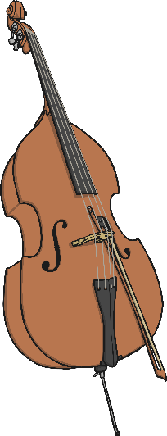
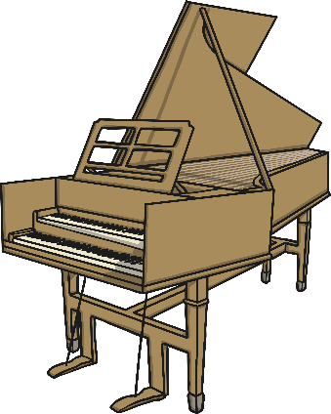

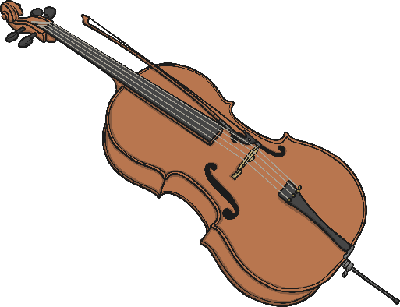

Instruments Of The Baroque Era
The harpsichord was commonly used. The piano was only invented part way through the Baroque period. The harpsichord was a popular keyboard instrument before then.
Other Baroque orchestral instruments include cellos and double basses, violins, violas, recorders and sometimes trumpets.
Listen to this double Trumpet Concerto by Antonio Vivaldi.
Can you hear the 2 trumpet soloists?
Can you hear the string instruments accompanying them?
Keep listening – can you hear the harpsichord too?
Listen right to the end. This is typical Baroque music.
double bass
mandolin
cello
Click on the picture to hear what it sounds like.

