Slide 2
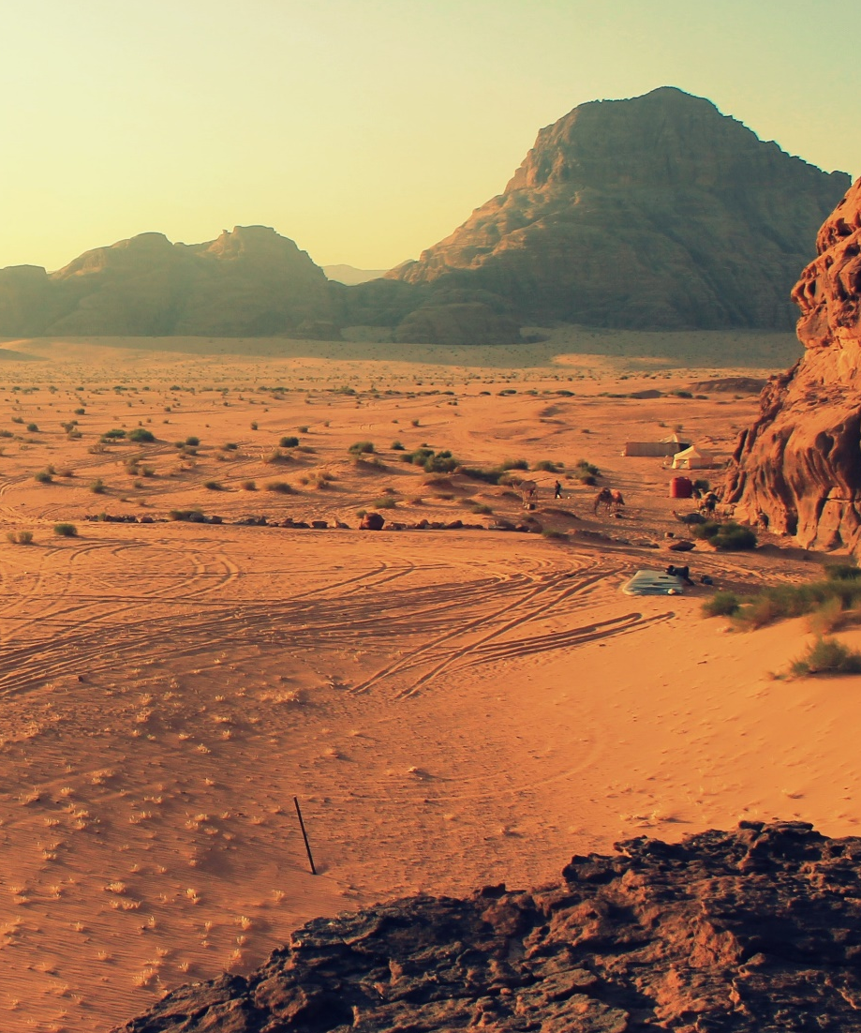
What Is a Desert?
A desert is any place that gets less than 25cm of rainfall a year.
There are deserts on all continents.
Deserts are part of a land type called drylands. These areas often lose more moisture through evaporation than they get in rainfall.
Deserts cover over 1/5 of the world’s land surface.

Slide 3

Where Are Deserts?
Here are some of the world’s largest deserts.
Sahara
Gobi
Patagonia
Syrian
Great Victoria
Kalahari
Arabian

Slide 4
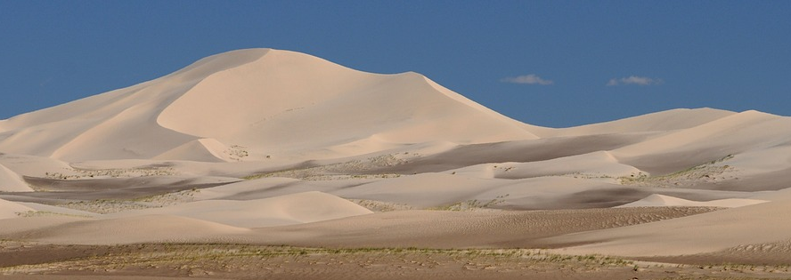
What Are Deserts Like?
We tend to think that all deserts are hot. The Sahara regularly has temperatures of 50°C during the day. The highest recorded temperature
in Death Valley in the USA was 56.7°C.
Some deserts however are actually cold. Winter temperatures in the Gobi desert can reach -40°C. The world’s largest deserts are in the Arctic and Antarctic.
The Gobi Desert
Did You Know?
Only 20% of the earth’s deserts are covered in sand.

Slide 5
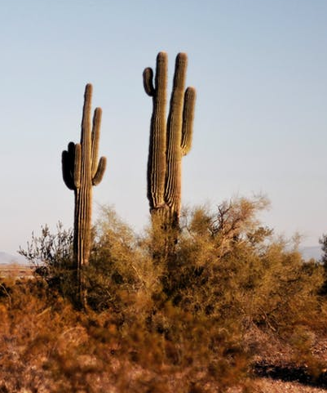
What Plants Live in the Desert?
Despite the harsh conditions, many plants live in the deserts.
Bougainvillea and California poppies are examples of flowering plants which bloom in the desert after there has been rain.
Palm trees grow in some deserts. These palm trees don’t usually grow fruit. They are good at storing water.
Cacti (the plural of cactus) are suited to desert life. When there is moisture in the air, a cactus swells to store the water. A cactus has spikes instead of leaves in order to conserve the water. The spikes also ward off animals that might try to eat the cactus.

Slide 6
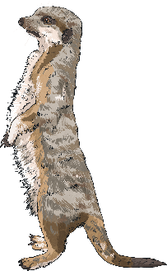
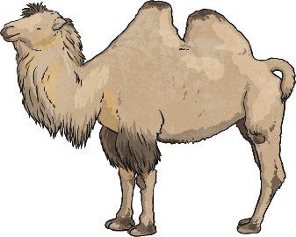
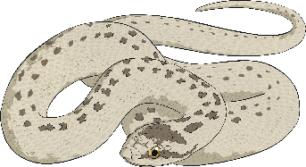
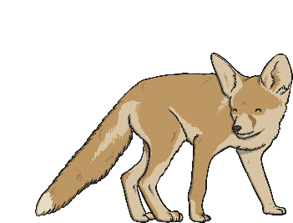
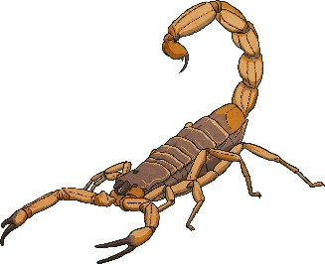
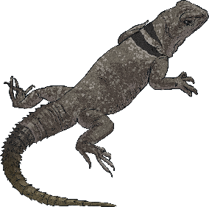
What Animals Live in the Desert?
Animals that are adapted to living in the desert are known as xerocoles.
Click on a picture to find out more about some of these animals.
camel
meerkat
sidewinder
fennec fox
scorpion
lizard

Slide 7
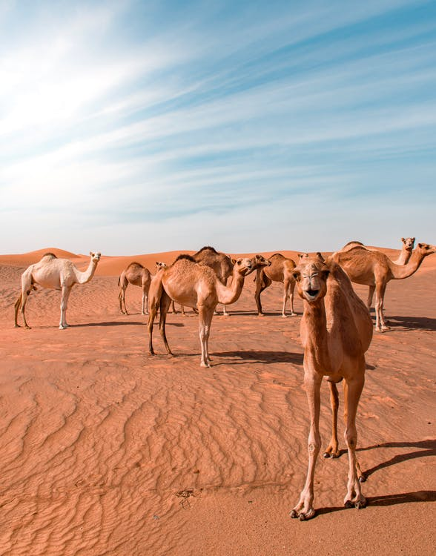
Camel
A camel’s hump stores fat that can be converted into energy when food is scarce.
To protect themselves from sandstorms, they have long eye lashes and their nostrils can close to keep sand out.
Camel’s feet are wide to avoid slipping through sand. The soles of their feet are thick pads to avoid burns from the hot sand.
back

Slide 8
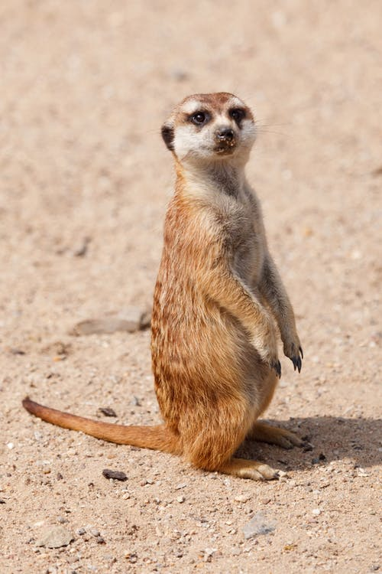
Meerkat
The dark rings around a meerkat's eyes reduces the glare of the hot desert sun. Their eyes also have a transparent layer which protects their eyes while they are digging into the sand to make burrows.
The layer of fur on a meerkat’s stomach is thin. This means when they lie on their backs in the sun, their bodies warm up quickly.
Meerkats prey on many animals in the desert, including rodents, birds and scorpions.
back

Slide 9
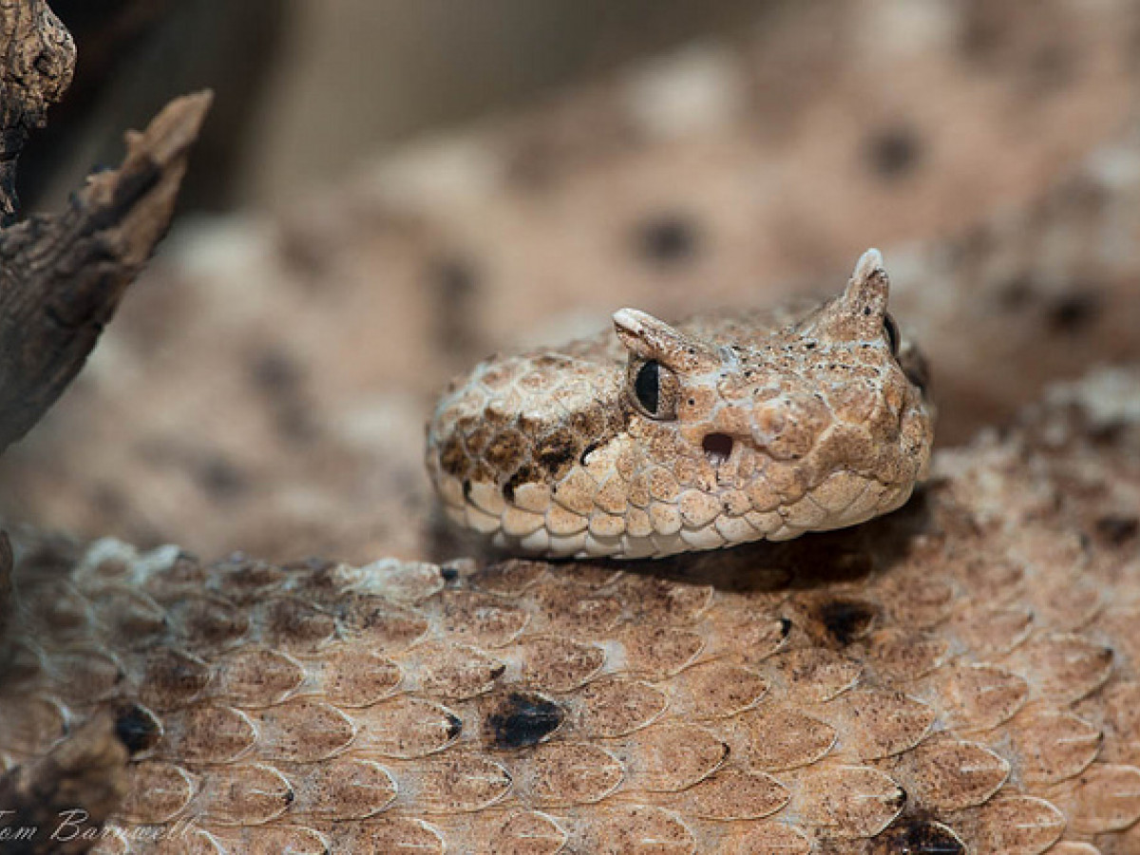
Sidewinder
Sidewinders are rattlesnakes that live in some of the hottest deserts on earth. They are known for the strange patterns their movements leave in the sand.
A sidewinder’s colouring means it is camouflaged against the sand. This makes it easier for it to catch its prey. Unlike most species of snake, female sidewinders are larger than males.
They can move at speeds of up to 29 km per hour.
back

Slide 10
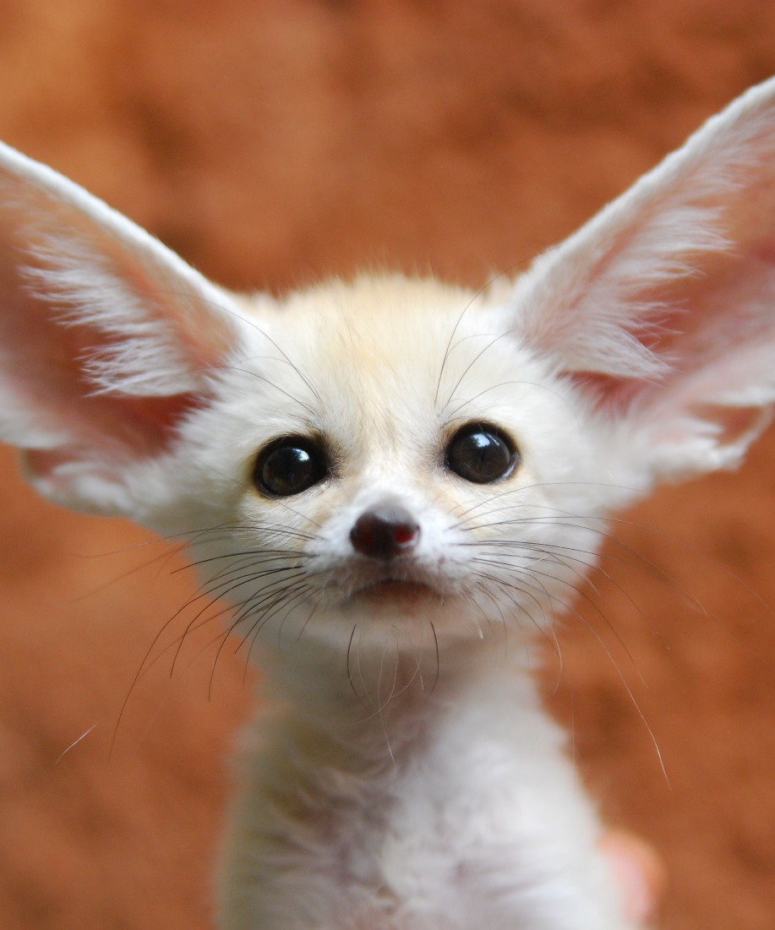
Fennec Fox
Fennec foxes, also called desert foxes, are known for their very large ears. The ears help them listen for their prey. The ears also help heat to leave the fox’s body.
The long thick fur protects the fox’s skin from the sun during the day and keeps the fox warm in the cool desert nights.
The hair on the fox’s feet protects it from hot sand. The feet are specially shaped to make it easy for the fox to dig their underground dens.
back

Slide 11
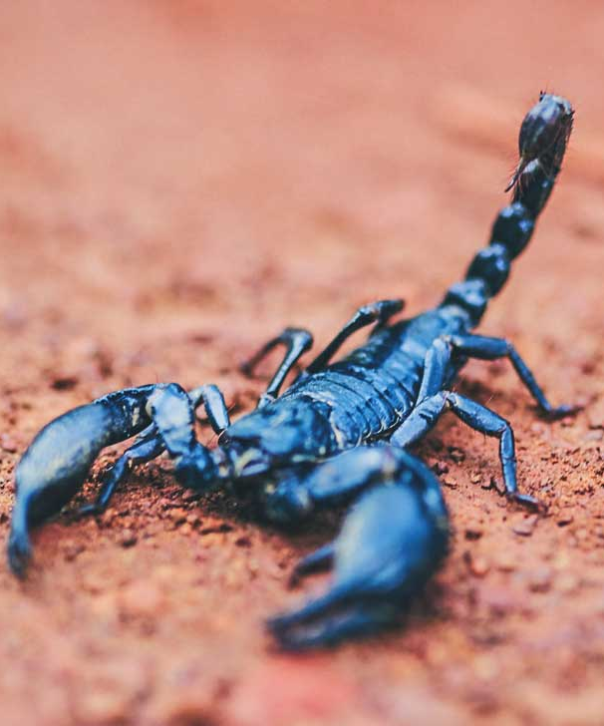
Scorpion
Scorpions are arachnids, which means they are in the same family as spiders. Scorpions can slow down the amount of energy they get from food so they can survive on a very small amount of food in the desert.
They avoid the heat of the desert by burrowing underneath the sand.
30 – 40 species of scorpion have a sting strong enough to kill a human!
back

Slide 12
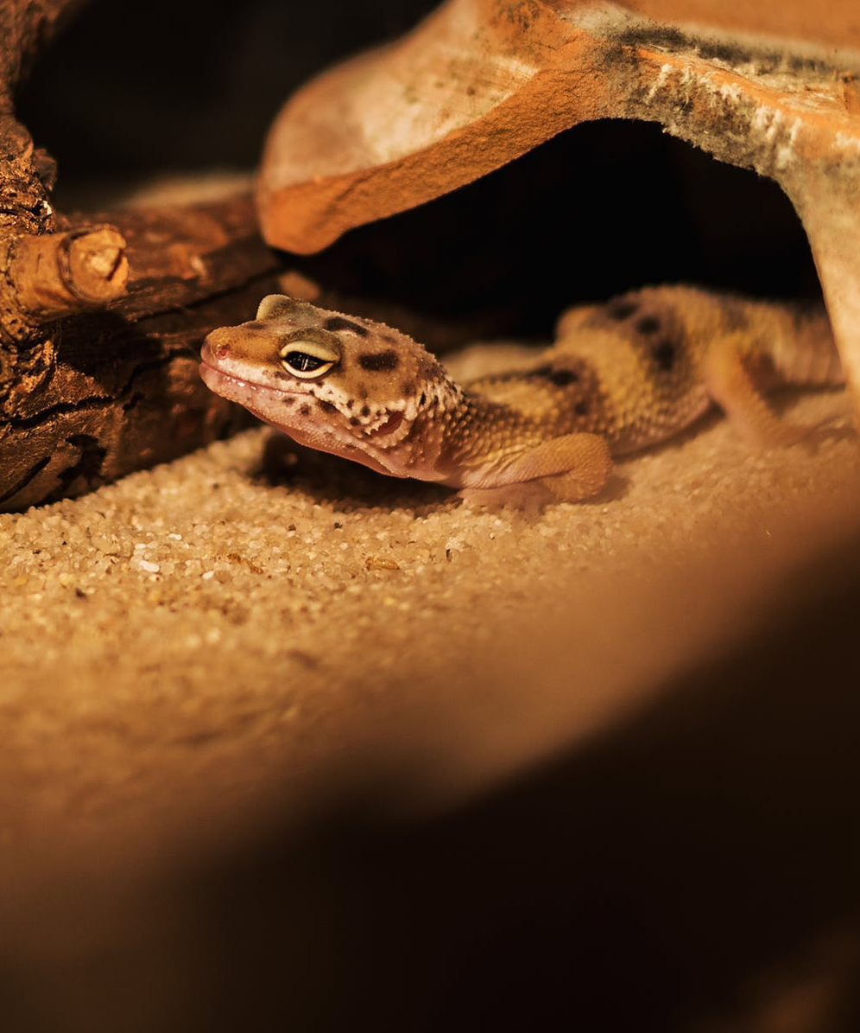
Lizard
Lizards are cold-blooded animals, so they rely on their environment to help warm them up. They use the hot desert sun to get warm.
Some lizards have spiny scales on their toes to help them run across the sand instead of sinking into it.
A lizard’s claws help it burrow underneath the sand to help it escape the hot sun and also flee from predators. Some lizards have clear membranes over their eyes to protect them while they burrow.
back

Slide 13
Activities
1: Label the 10 largest deserts on the world map.
2: Create a fact file for one of the 10 largest deserts;
this can be written; presented on video; or using creative materials.

