Slide 1
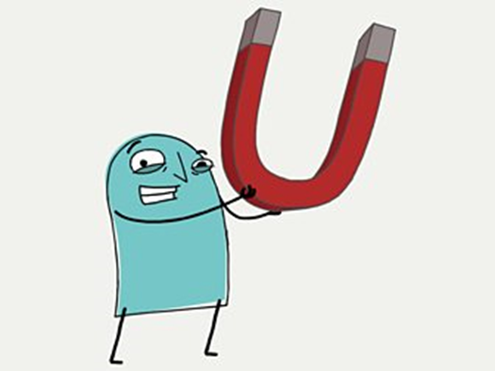
Year 3 Science
Magnets and Forces

Slide 2
LO: I know there are forces between magnets.
When two magnets are close, they create pushing or pulling forces on one another.
These forces are strongest at the ends of the magnets. The two ends of a magnet are known as the north pole and the south pole.
Same poles repel
If you try to put two magnets together with the same poles pointing towards one another, the magnets will push away from each other. We say they repel each other.
Different poles attract
If you put two magnets together with different poles pointing towards one another, the magnets will pull towards each other. We say they attract each other.

Slide 3
Which materials are magnetic?
Magnetic metals
Magnetic materials are always made of metal, but not all metals are magnetic.
Iron is magnetic, so any metal with iron in it will be attracted to a magnet. Steel contains iron, so a steel paperclip will be attracted to a magnet too.
Most other metals, for example aluminium, copper and gold, are NOT magnetic.
Watch the video to find out more and sort the metals into ‘magnetic’ and ‘non-magnetic’.
https://www.bbc.co.uk/bitesize/topics/zyttyrd/articles/zw889qt

Slide 4
Tasks
Task 1: Create a table of magnetic and non- magnetic metals.
Task 2: Create a list of magnets which we use in everyday life! If you are stuck for ideas, try researching :
https://www.coolkidfacts.com/magnetism-facts-for-kids/
Ext: Create a poster which displays fun facts about magnets from :
https://www.coolkidfacts.com/magnetism-facts-for-kids/

