Slide 1
Time Travel.
Design A Time Machine.

Slide 2
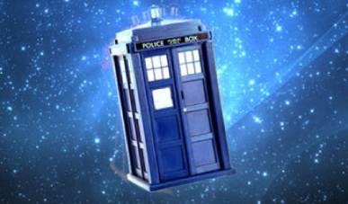
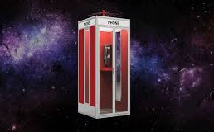
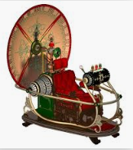
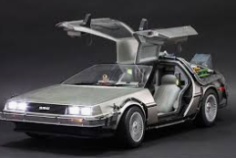
For yesterday’s lesson, you researched a number of different time machines from different television programmes, films and books.

Slide 3
Today’s Challenge.
1. Using what you learnt yesterday and the ideas that you thought of, we would like you to design your own time machine, today. It could be something similar to yesterday’s machines, a mixture of them or something completely different. Let your imagination run wild!
2. Draw your machine, annotating all of the most important features on your diagram.
3. Colour in your design.
Additional Challenge:
4. Make your time machine. It could be made from junk, clay, Lego or something else. It can be a mini version or it could be large enough for a toy or even you, to sit in.
5. We would love you to send us photographs of your designs and machines.

