Slide 1
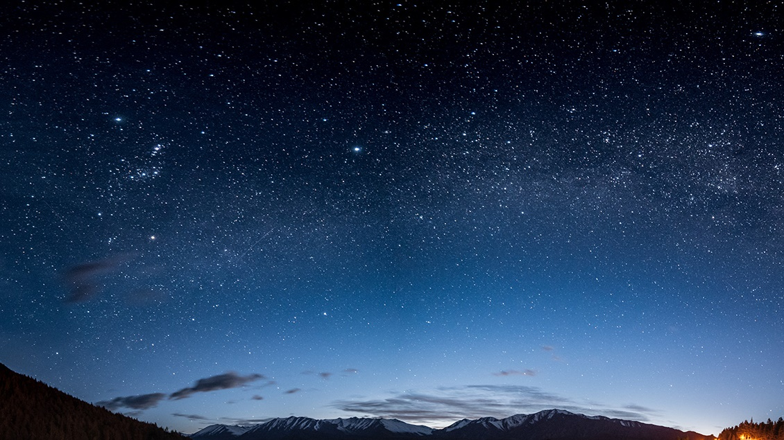
Time Travel.
Create a Mood Board.

Slide 2
Mood Boards.
What is a mood board?
A mood board is an arrangement of images, materials, pieces of text, etc. intended to project a particular style or idea.
It can include just about anything — photography, designs or illustrations, colour palettes, textures, descriptive words — anything that helps you define the direction of your project. It is a very efficient visual communication tool and helps to convey your visual ideas to others. They are commonly used in the fields of marketing, design, retail and industry.
On the next slide, you will see a variety of different mood boards. These are related to different eras: the 1950s, 1960s, 1970s, 1980s, as well as a couple of more futuristic boards.

Slide 3
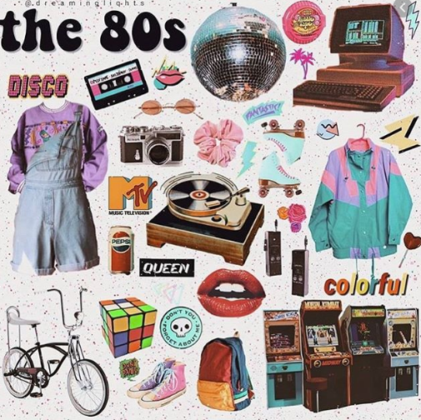
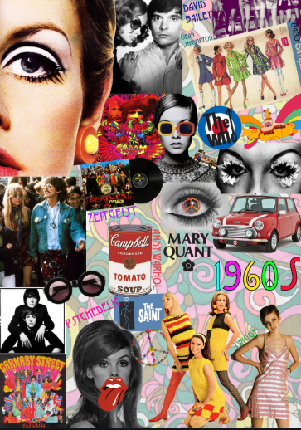
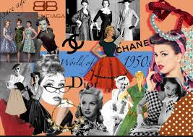
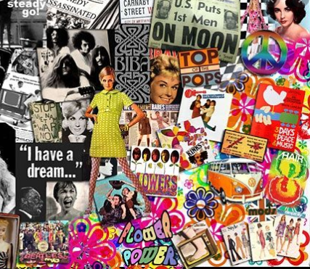
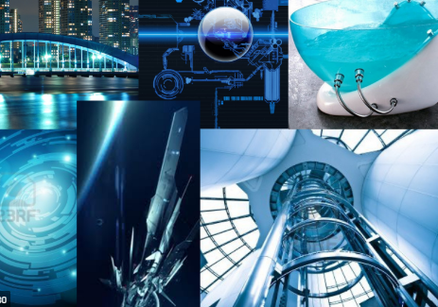
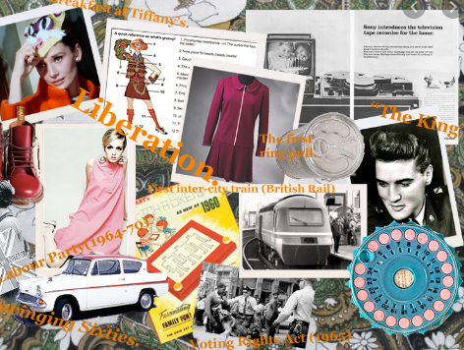
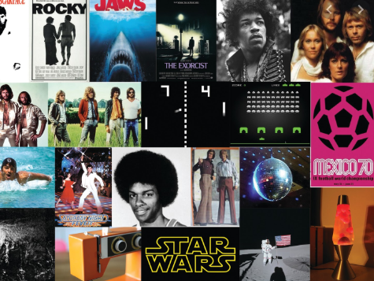
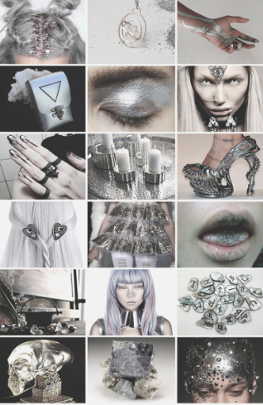

Slide 4
T0day’s Challenge.
We would like you to think about where you would travel in the time machine that you designed, yesterday. Would you go back in time to the 1960s, perhaps, or not quite so far back and visit the 1980s? Would you like to travel forward in time and see what the future looks like?
We want you to create a mood board for the era of your choice. However, we don’t suggest going any further back than the 1920s as you may find it more difficult to find enough information for your board.
On the next slide, we will give you some ideas as to what you could include on your mood board.

Slide 5
Things That You May Like To Include On Your Mood
Board.
Fashions from the time
Music that was popular
Films that were released
Vehicles-what did the cars look like, for example?
Name(s) of the prime minister(s)
Popular games
Football teams at the top of the league
Home appliances
Architecture
Technology
Words of the time
If you are basing your mood board on the future, you will need to use your imagination.
Will people be even more conscious about caring for the environment? Will clothes be ethically sourced and made from recyclable material? Will there be less plastic used?

Slide 6
We really look forward to seeing pictures of your mood boards. Be as creative and as informative as possible. Remember, you can draw, print off and cut out pictures from the internet, make labels, use materials, include photographs, change fonts, etc. It should be clear and obvious which era your mood board represents.
Finally, we would like you to write a short paragraph on why you chose this particular era.
Have fun!

