Slide 1
YEAR 4 HOME LEARNING

Slide 2

2 WEEK BLOCK: ENGLISH

Slide 3
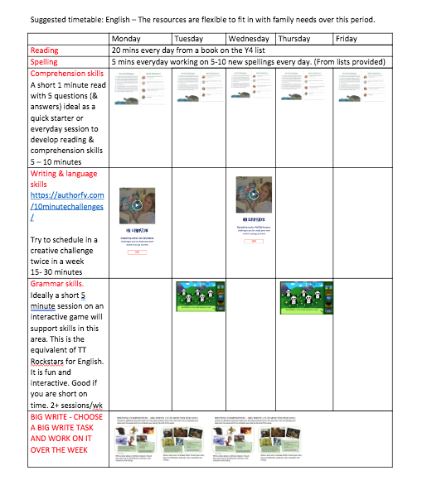
GUIDANCE
THE ACTIVITIES SET OUT IN THIS PACK ARE DESIGNED TO BE FLEXIBLE TO ALLOW FOR DAYS WHEN YOU MAY HAVE MORE TIME THAN OTHERS.
WE HAVE SET OUT A SUGGESTED PROGRAMME TO ILLUSTRATE HOW THE ACTIVITES MIGHT FIT IN TO A DAILY / WEEKLY SCEHDULE.

Slide 4

ACTIVITY 1
DAILY COMPREHENSION
Please start each English session with a mini comprehension from the folder provided online.
Each comprehension comes with an answer sheet.
Read aloud to someone at home if you need to, to help you with this task.
10 MINUTES
This is an ideal activity to complete if you are short on time.
LINKS TO THE SHARED FILES:
Vikings
https://1drv.ms/u/s!ApFLkuLcYtnjljstYa5G-a7PCKsP?e=XKdnSh
Animals
https://1drv.ms/u/s!ApFLkuLcYtnjlj6jnoC9eSkSE3bO?e=spy6HX
Magic & Wizards
https://1drv.ms/u/s!ApFLkuLcYtnjlj8wqcmP-hltYtP8?e=B2Xbx2
Rainforests
https://1drv.ms/u/s!ApFLkuLcYtnjlkLHwXYKpWUN3Mob?e=fw1F6B

Slide 5

ACTIVITY 2
GRAMMAR
Choose a game each day from one of the websites below. https://www.topmarks.co.uk/english-games/7-11-years/spelling-and-grammar
http://www.sheppardsoftware.com/grammargames/pandapopPartsofSpeech.htm
http://www.crickweb.co.uk/ks2literacy.html
https://www.bbc.co.uk/bitesize/topics/zhrrd2p
http://www.primaryhomeworkhelp.co.uk/literacy/
http://www.funenglishgames.com/grammargames.html
10 MINUTES

Slide 6

ACTIVITY 3
WRITING COMPOSITION (2 PER WEEK)
Please follow this link to Authorfy website where authors have posted daily writing challenges. You can choose your own author challenge from the growing selection available. A new challenge is posted daily.
https://authorfy.com/10minutechallenges/
20 MINUTES

Slide 7
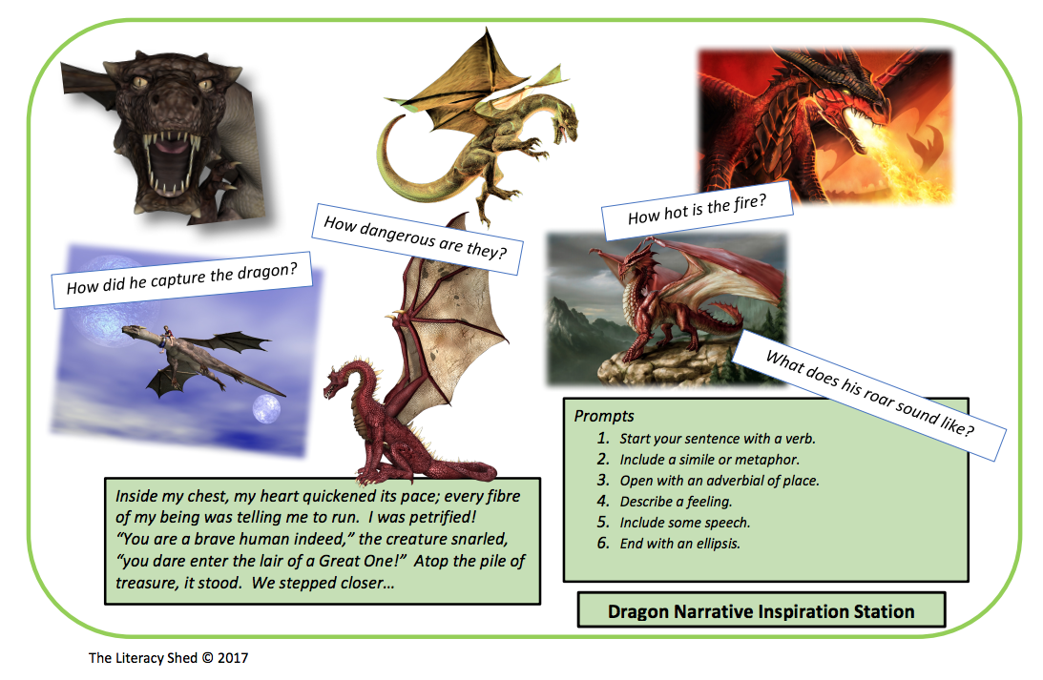
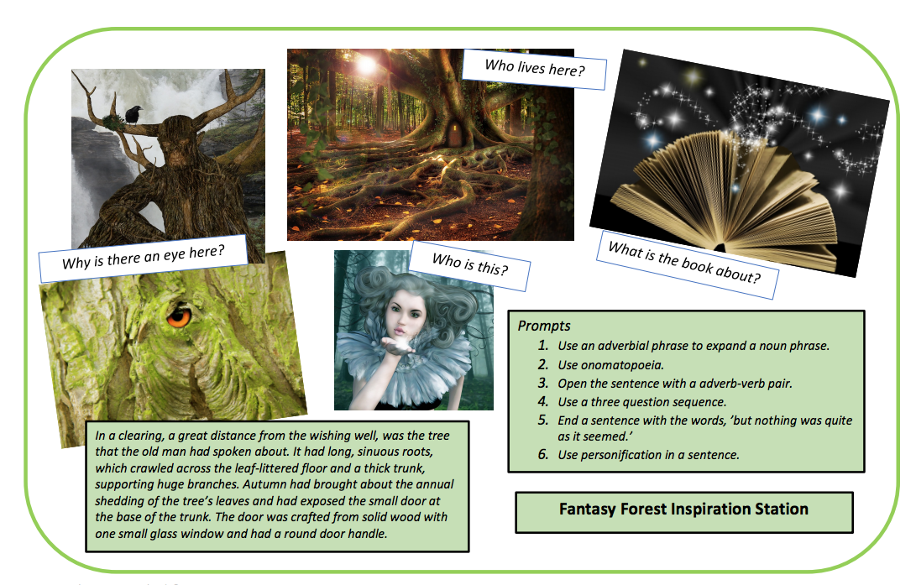
WRITING COMPOSITION – BIG WRITE (15-20 MINUTES PER DAY)
Choose an additional task each week from the options below and on the next chart. You can develop your ideas over the week and try to complete your task by the end of the week.
Write a story about a mythical creature. Ensure your story has an introduction, build up, crisis, resolution and ending.
Write a story set in a fantasy forest. Ensure your story has an introduction, build up, crisis, resolution and ending.​

Slide 8
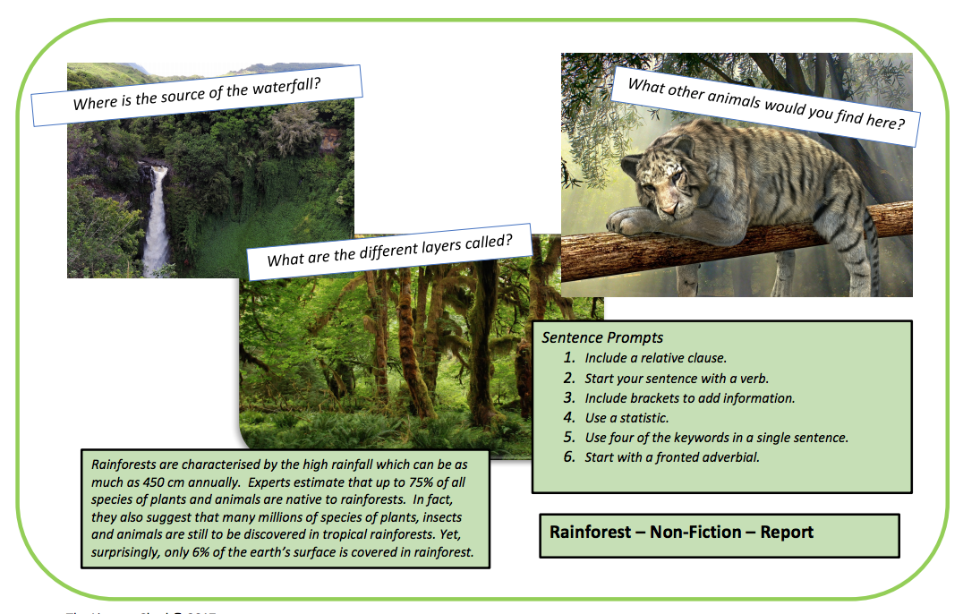
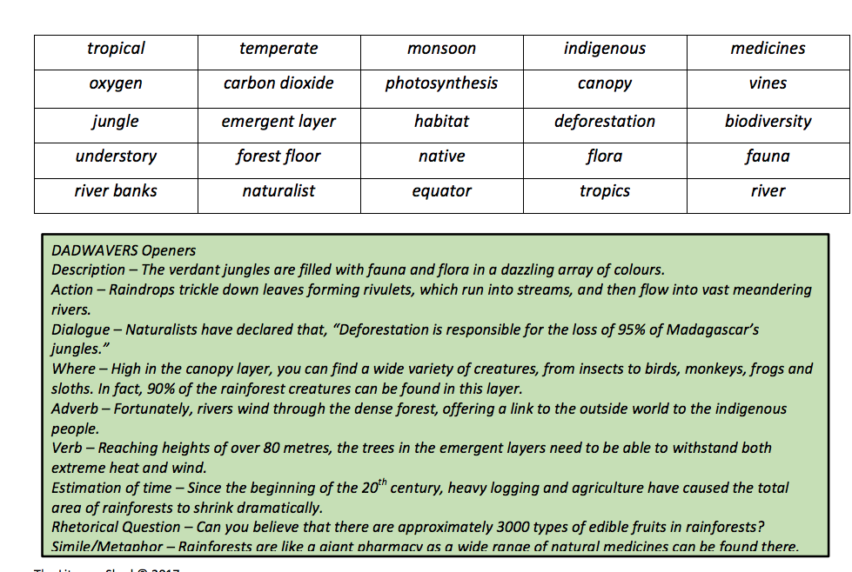
WRITING COMPOSITION – BIG WRITE
Research The Rainforests and write a report. Ensure your report has the key features of a non-fiction information report including: Key facts, pictures, technical vocabulary (key words), headings, sub-headings and bullet points. You could use your information to design an information leaflet.

Slide 9
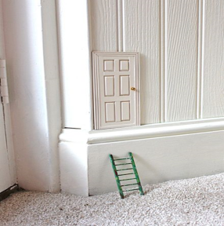



WRITING COMPOSITION – DAILY CHALLENGE (10 MINUTES)
One day you find this door in the corner of your room. What is it for? Where does it take you?
Write a blurb for a story you have read.
Create a travel brochure for a chosen destination.
Write a set of instructions for an activity you have completed, or an experiment you have carried.

Slide 10

ACTIVITY 4
SPELLING
Please continue to work through the Year 4-5 lists – aim to learn 10 new spellings each week and revisit 10 from previous weeks.
Get someone to test you on them at the end of the week.
10 MINUTES

Slide 11

ACTIVITY 5
READING
Please ensure you continue to read a good quality reading book from the year 4 list
Talk to someone at home about the book that you are reading.
Read a few pages aloud to somebody; this is a different skill to silent reading. Can you make it exciting? Use different voices.
20 MINUTES

