Slide 1
YEAR 4 HOME LEARNING
English block 2

Slide 2

2 WEEK BLOCK: ENGLISH – Weeks beginning: 4th May and 11th May 2020

Slide 3
Highlights and paragraph for your Reports
We have begun to write your reports and we need your help.
Complete the highlights of year 4 and short paragraph and email back to your teacher.
Thank you very much for your help!

Slide 4

Main Activity – Option 1
Click on the link below to access your English lessons for the next two weeks using the National Oak Academy website
https://www.thenational.academy/online-classroom/schedule
Select – Year 4
Then Select the English lesson for each day this week

Slide 5

Alternatively…..
Main activity – Option 2
BBC Bitesize – Daily English lessons
Click on the link below to access the daily English lessons for Year 4 from BBC Bitesize
https://www.bbc.co.uk/bitesize/dailylessons
Select – Year 4
Then select the daily English lesson each day this week

Slide 6


Extra Activities/Tasks
Doodle English / Doodle Spell
Spend 10 minutes playing on the Doodle App for English or spelling each day.
10 MINUTES
You can download the computer apps here:
English: https://www.doodleenglish.com/download-doodleenglish-windows-macs/
Or you can use the Google Chrome web browser on your PC, laptop or Mac:
students.doodleenglish.com
students.doodleenglish.com/spell

Slide 7

ACTIVITY 2
DAILY COMPREHENSION
Please start each English session with a mini comprehension from the folder provided online.
Each comprehension comes with an answer sheet.
Read aloud to someone at home if you need to, to help you with this task.
10 MINUTES
This is an ideal activity to complete if you are short on time.
LINKS TO THE SHARED FILES:
Extreme Weather
https://1drv.ms/u/s!ApFLkuLcYtnjlkBNnOijUxKH9jRO?e=bzixHe
Sports
https://1drv.ms/u/s!ApFLkuLcYtnjlkM4kpYxcjQGH-JS?e=qwsJRh
Vikings
https://1drv.ms/u/s!ApFLkuLcYtnjljstYa5G-a7PCKsP?e=XKdnSh
Animals
https://1drv.ms/u/s!ApFLkuLcYtnjlj6jnoC9eSkSE3bO?e=spy6HX
Magic & Wizards
https://1drv.ms/u/s!ApFLkuLcYtnjlj8wqcmP-hltYtP8?e=B2Xbx2
Rainforests
https://1drv.ms/u/s!ApFLkuLcYtnjlkLHwXYKpWUN3Mob?e=fw1F6B

Slide 8

Activity 3
Guided Reading Activity (1 per week)
Choose one extract of a book from the options offered on the next two slides and complete the Guided Reading Task. Read the extract first, highlighting any important facts. (PDFs for each extract are available by following the link to the shared folder)
You can complete the task over several days. Ensure that you read the text thouroughly before you start the writing task.

Slide 9


Choose an extract from the two given here. Read the extract carefully and then write a short story about what happens next.
Remember to include:
An introduction (Setting and build up)
A crisis or problem
A resolution and ending. Aim to write at least 3 paragraphs.
Ensure you use your writing skills. Your skills checklist is:
An opening line that starts with 2 or 3 adjectives. (Example: Lost,alone and afraid, )
Use at least one expanded noun phrase including a preposition. (The frightened boy shivered with fear, under the table)
One simile or metaphor.
Sensory language (see, hear, feel, smell, touch)
https://ojs-my.sharepoint.com/:b:/g/personal/paula_moss_oakfield_surrey_sch_uk/EWR5oT7p-UVBn6Mt-VAbOCoBoaeko0SBnytsluNUYRqtkg?e=wqCIb7
https://ojs-my.sharepoint.com/:b:/g/personal/paula_moss_oakfield_surrey_sch_uk/Ee4FGFor32BDgqjR0BRJNGsB9FSkP9cKMxp0tN3Vm7Xhwg?e=uKo4u1

Slide 10


Choose an extract from the two given here. Read the extract carefully and then imagine you are one of the characters and write a diary entry .
Use this diary checklist to ensure your diary entry is complete.
Write in the past tense, using the first person. (Example: Today seemed like any normal day at first. I ate my breakfast then went to school)
Use sequencing langauage to open paragraphs. (Example: At first, later, next, Finally)
Share personal feelings as though talking to a friend.
Include the date, and begin by adressing your diary (Dear Diary,)
Finish with a promise of what you are going to do next.
Ensure you continue to use your writing skills. Your skills checklist is:
An opening line that starts with 2 or 3 adjectives. (Example: Lost,alone and afraid, )
Use at least one expanded noun phrase including a preposition. (I shivered with fear, under the table)
Exciting verbs
Sensory language (see, hear, feel, smell, touch)
https://ojs-my.sharepoint.com/:b:/g/personal/paula_moss_oakfield_surrey_sch_uk/EWlWyTpSCLlMo2HzxCfumugBDy_ZdJ3FzccObcEEhGDRmw?e=Ah3Pai
https://ojs-my.sharepoint.com/:b:/g/personal/paula_moss_oakfield_surrey_sch_uk/EamNuqZHVA5PoV3jjAd6U3oByikwEyT74h78IC-l8gA9vw?e=RC8ht2

Slide 11

Daily Activity
READING
Please ensure you continue to read a good quality reading book from the year 4 list
Talk to someone at home about the book that you are reading.
Read a few pages aloud to somebody; this is a different skill to silent reading. Can you make it exciting? Use different voices.
20 MINUTES

Slide 12

Daily Activity
SPELLING
Please continue to work through the Year 4-5 lists – aim to learn 10 new spellings each week and revisit 10 from previous weeks.
Get someone to test you on them at the end of the week.
10 MINUTES

Slide 13
OPTIONAL Extension Activities
WRITING COMPOSITION

Slide 14
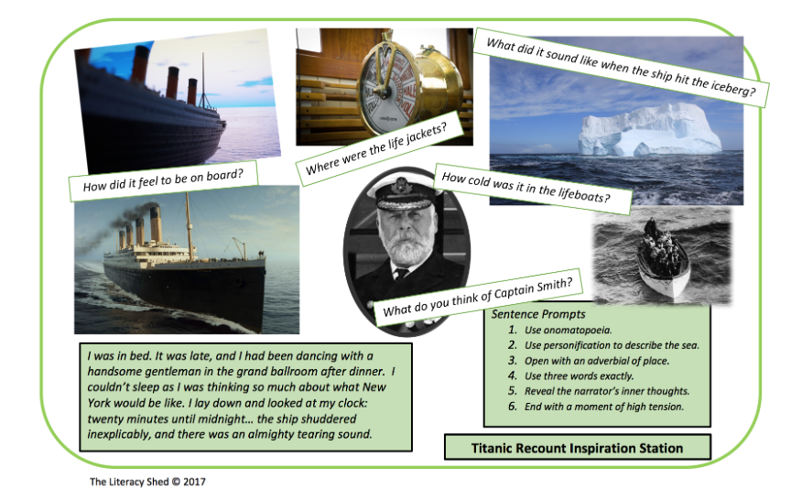
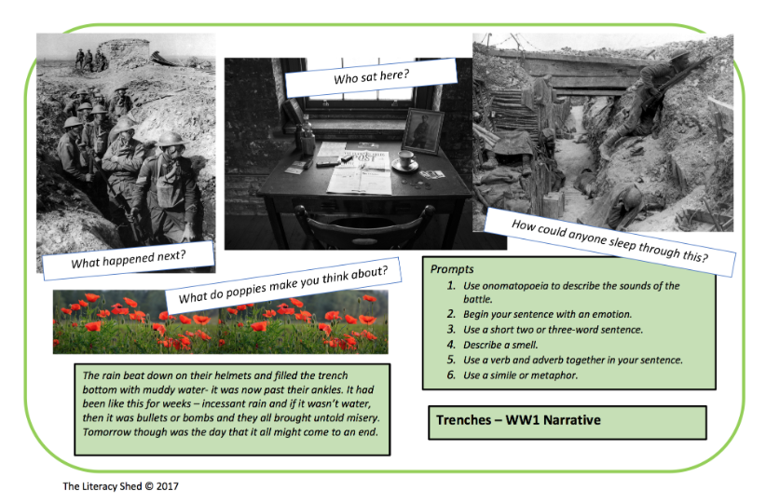
WRITING COMPOSITION – BIG WRITE (15-20 MINUTES PER DAY)
Choose an additional task each week from the options below and on the next chart. You can develop your ideas over the week and try to complete your task by the end of the week.
Write a recount of what it must have been like to be aboard the Titanic on the day it hit an iceberg. Research what happened to inspire your story. Choose to be either the Captain or a passenger. Remember to structure your recount using paragraphs:
Introduction (what it was like and how you were feeling before the iceberg)
Build up and crisis. (what were you doing when the iceberg struck the boat)
Your feelings.
What happened.
How did it end for you?
Write a recount of what it must have been like to be involved in a battle during the Great War. Choose to be either a soldier or a General. Remember to structure your recount using paragraphs:
Introduction (what it was like and how you were feeling before the iceberg)
Build up and crisis. (what were you doing when the iceberg struck the boat)
Your feelings.
What happened.
How did it end for you?

Slide 15
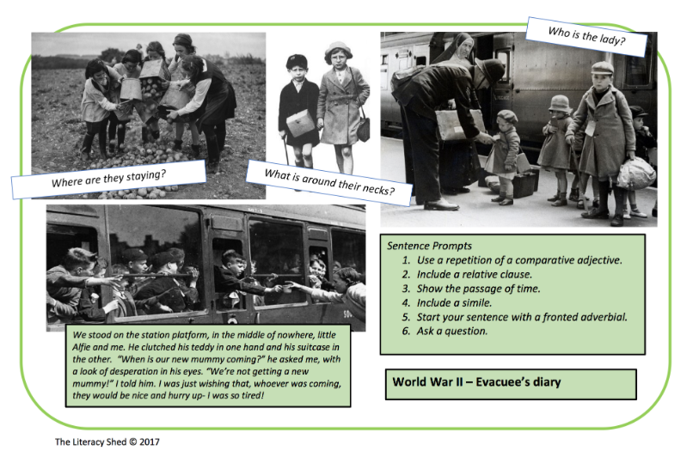
WRITING COMPOSITION – BIG WRITE
Research The second world war experience of a child evacuee to create a fact file using powerpoint to present your findings. Then write a diary entry from the point of view of one of the children leaving their parents in the city to live in the safety of the countryside.
Use the Diary checklist from p.9 to help you plan your entry.

Slide 16

WRITING COMPOSITION CHALLENGE (1 PER WEEK)
Please follow this link to Authorfy website where authors have posted daily writing challenges. You can choose your own author challenge from the growing selection available. A new challenge is posted daily.
https://authorfy.com/10minutechallenges/
20 MINUTES

Slide 17
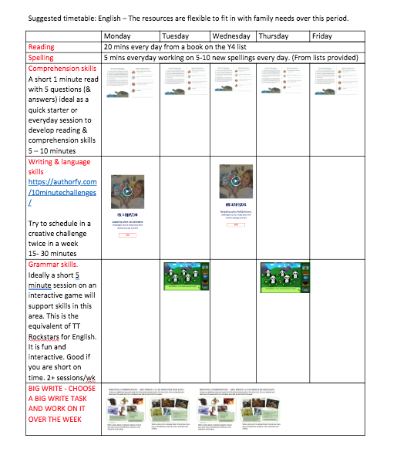
GUIDANCE
THE ACTIVITIES SET OUT IN THIS PACK ARE DESIGNED TO BE FLEXIBLE TO ALLOW FOR DAYS WHEN YOU MAY HAVE MORE TIME THAN OTHERS.
WE HAVE SET OUT A SUGGESTED PROGRAMME TO ILLUSTRATE HOW THE ACTIVITES MIGHT FIT IN TO A DAILY / WEEKLY SCEHDULE.

