Slide 1
YEAR 4 HOME LEARNING
English block 3
w/c 18th May 2020

Slide 2

1 WEEK BLOCK: ENGLISH – Week beginning: 18th May

Slide 3

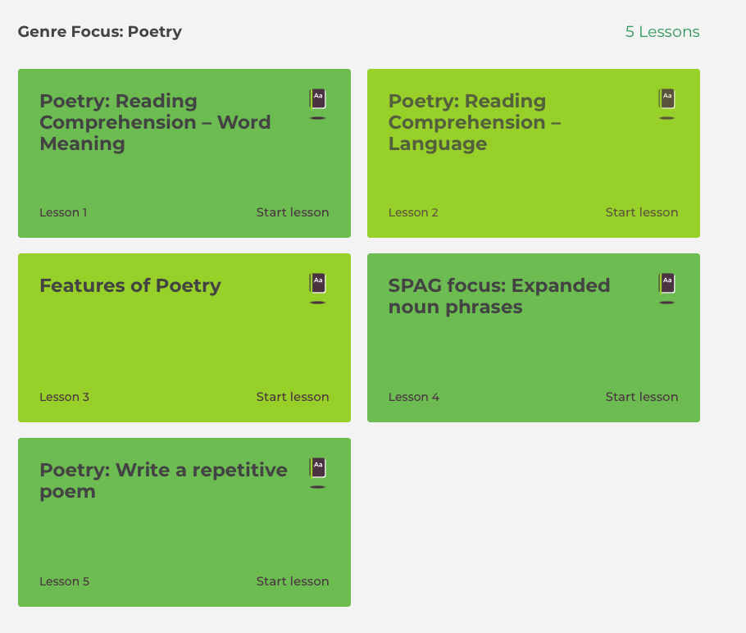
Main Activity – Option 1
Click on the link below to access your English lessons for the next week using the National Oak Academy website
https://www.thenational.academy/online-classroom/year-4/english#subjects
Select – Year 4 and choose the Poetry lessons (1-5)Please ensure you start at lesson 1 and follow the sequence for the week.

Slide 4
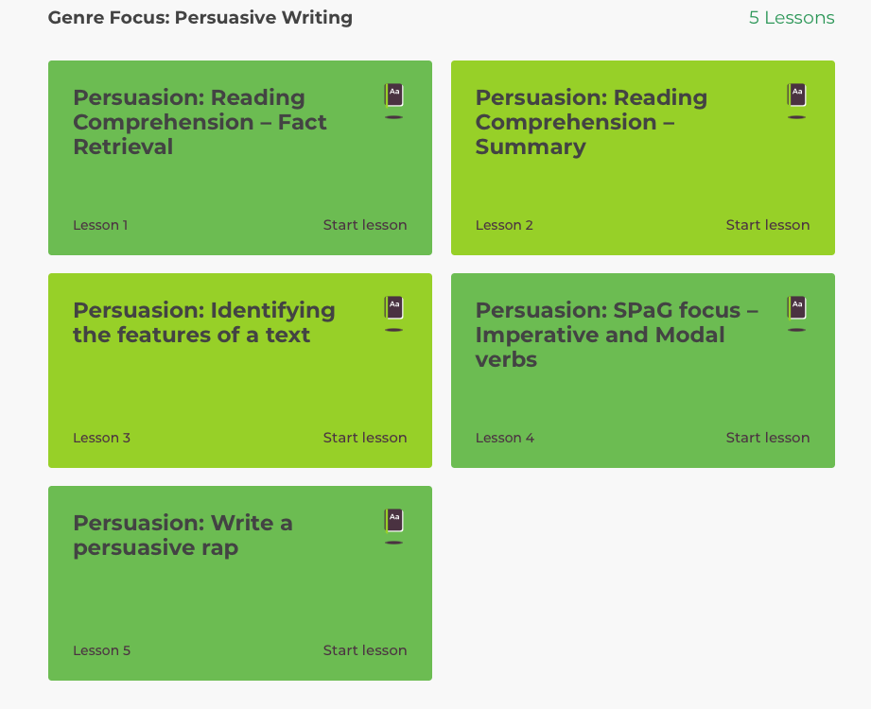
Main Activity – Option 2
Click on the link below to access your English lessons for the next week using the National Oak Academy website:
https://www.thenational.academy/online-classroom/year-4/english#subjects
Select – Year 4 and choose the Persuasive writing lessons (1-5)Please ensure you start at lesson 1 and follow the sequence for the week.

Slide 5

Alternatively if you are unable to access Oak Academy, BBC Bitesize offers a good option:
Main activity – Option 3
BBC Bitesize – Daily English lessons
Click on the link below to access the daily English lessons for Year 4 from BBC Bitesize
https://www.bbc.co.uk/bitesize/dailylessons
Select – Year 4
Then select the daily English lesson each day this week.

Slide 6

Spelling
Doodle English / Doodle Spell
Spend 10 minutes playing on the Doodle App for English or spelling each day.
10 MINUTES
You can download the computer apps here:
English: https://www.doodleenglish.com/download-doodleenglish-windows-macs/
Or you can use the Google Chrome web browser on your PC, laptop or Mac:
students.doodleenglish.com
students.doodleenglish.com/spell

Slide 7
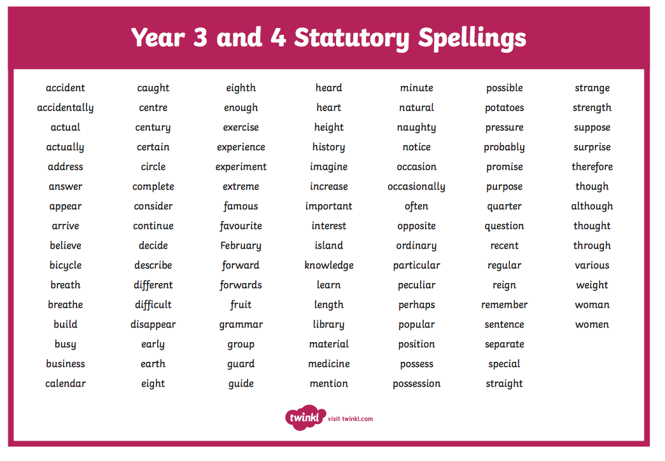
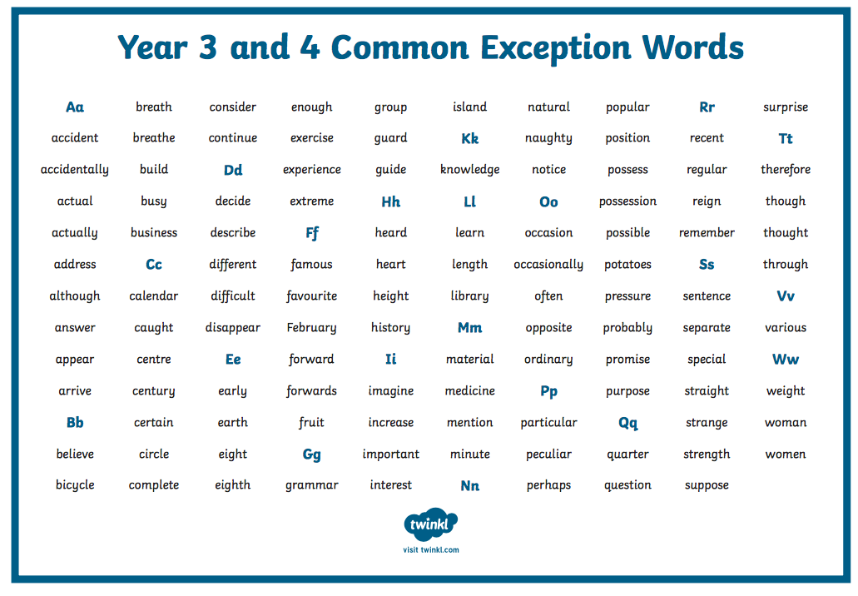
Statutory Spelling lists: Year 4: Practise spelling from the list every day.

Slide 8

Reading Comprehension
DAILY COMPREHENSION
Please choose a mini comprehension from the folder provided online.
Each comprehension comes with an answer sheet.
Read aloud to someone at home if you can. Practise your expression and fluency. (New files added in purple)
10 MINUTES
LINKS TO THE SHARED FILES:
World Religions
https://1drv.ms/u/s!ApFLkuLcYtnjlkQDcNg2CS0BlQBs?e=51JIbt
Ancient Egyptians
https://1drv.ms/u/s!ApFLkuLcYtnjljwtfJVs1NYiuShZ?e=BnvTAf
Extreme Weather
https://1drv.ms/u/s!ApFLkuLcYtnjlkBNnOijUxKH9jRO?e=bzixHe
Sports
https://1drv.ms/u/s!ApFLkuLcYtnjlkM4kpYxcjQGH-JS?e=qwsJRh
Vikings
https://1drv.ms/u/s!ApFLkuLcYtnjljstYa5G-a7PCKsP?e=XKdnSh
Animals
https://1drv.ms/u/s!ApFLkuLcYtnjlj6jnoC9eSkSE3bO?e=spy6HX
Magic & Wizards
https://1drv.ms/u/s!ApFLkuLcYtnjlj8wqcmP-hltYtP8?e=B2Xbx2
Rainforests
https://1drv.ms/u/s!ApFLkuLcYtnjlkLHwXYKpWUN3Mob?e=fw1F6B

Slide 9

Reading - Daily Activity
Please ensure you continue to read a good quality reading book from the year 4 / 5 list (See following pages.)
Talk to someone at home about the book that you are reading.
Read a few pages aloud to somebody; this is a different skill to silent reading. Can you make it exciting? Use different voices.
20 MINUTES

Slide 10

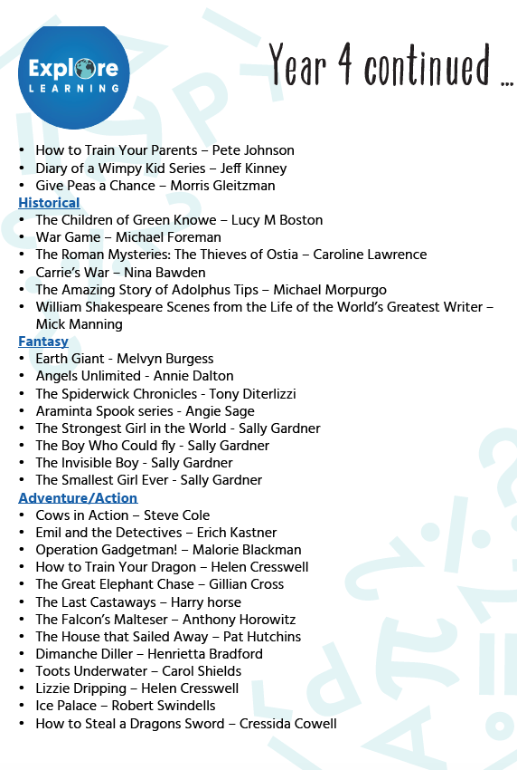


Slide 11

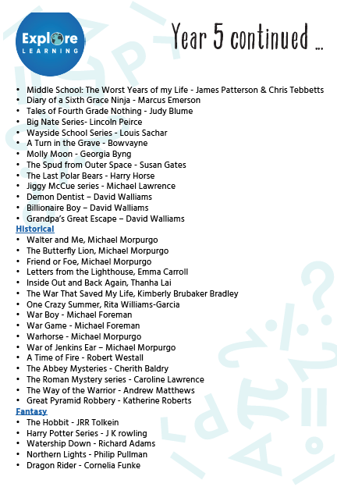
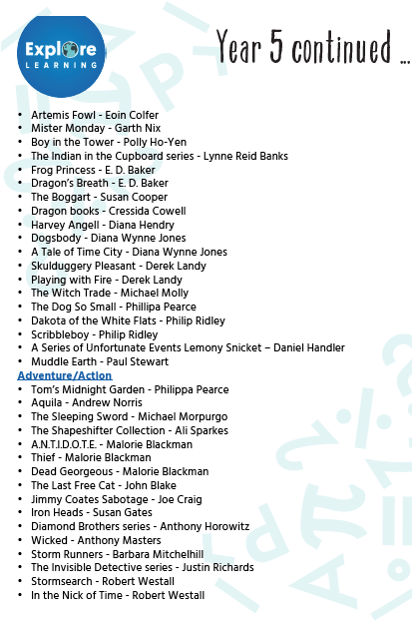


Slide 12
Extension Activities
Guided reading & Writing Composition

Slide 13

Extension Activity : Guided Reading
Choose one extract of a book from the options offered on the next two slides and complete the Guided Reading Task. Read the extract first, highlighting any important facts. (PDFs for each extract are available by following the link to the shared folder)
You can complete the task over several days. Ensure that you read the text thouroughly before you start the writing task.

Slide 14


Choose an extract from the two given here. Read the extract carefully and then imagine you are one of the characters and write a diary entry .
Use this diary checklist to ensure your diary entry is complete.
Write in the past tense, using the first person. (Example: I was fast asleep in my tent when..)
Use sequencing langauage to open paragraphs. (Example: At first, later, next, Finally)
Share personal feelings as though talking to a friend. (I wonder if I will ever have such a special friend again…)
Include the date, and begin by addressing your diary (Dear Diary,)
Finish with a promise of what you are going to do next or a hope for the future.
Ensure you continue to use your writing skills. Your skills checklist is:
An opening line that starts with 2 or 3 adjectives. (Example: Lost, alone and afraid, )
Use at least one expanded noun phrase including a preposition. (I shivered with fear, under the table)
Exciting verbs
Sensory language (see, hear, feel, smell, touch)
https://ojs-my.sharepoint.com/:b:/g/personal/paula_moss_oakfield_surrey_sch_uk/EdW3F8YzyOVNsZmg7crd7kwBQ3lHqdhjT5PTBeqogmRQoQ?e=MT9Pg6
https://ojs-my.sharepoint.com/:b:/g/personal/paula_moss_oakfield_surrey_sch_uk/EeMKToTzEipLl_hkjQYcSM0B9R5sbhyqw4Uo8K_c6LmZ-w?e=iVtlRV

Slide 15

Choose an extract from the two given here. Read the extract carefully and then write a short story about what happens next.
Remember to include:
An introduction (Setting and build up)
A crisis or problem
A resolution and ending. Aim to write at least 3 paragraphs.
Ensure you use your writing skills. Your skills checklist is:
An opening line that starts with 2 or 3 adjectives. (Example: Lost,alone and afraid, )
Use at least one expanded noun phrase including a preposition. (The frightened boy shivered with fear, under the table)
One simile or metaphor.
Sensory language (see, hear, feel, smell, touch)
https://ojs-my.sharepoint.com/:b:/g/personal/paula_moss_oakfield_surrey_sch_uk/EQ74c4NPt9hDhNkOAN3SOJoBOJsrQCbOc0fRgR_MGPFvww?e=XGOdpd
https://ojs-my.sharepoint.com/:b:/g/personal/paula_moss_oakfield_surrey_sch_uk/Ee4FGFor32BDgqjR0BRJNGsB9FSkP9cKMxp0tN3Vm7Xhwg?e=uKo4u1

Slide 16
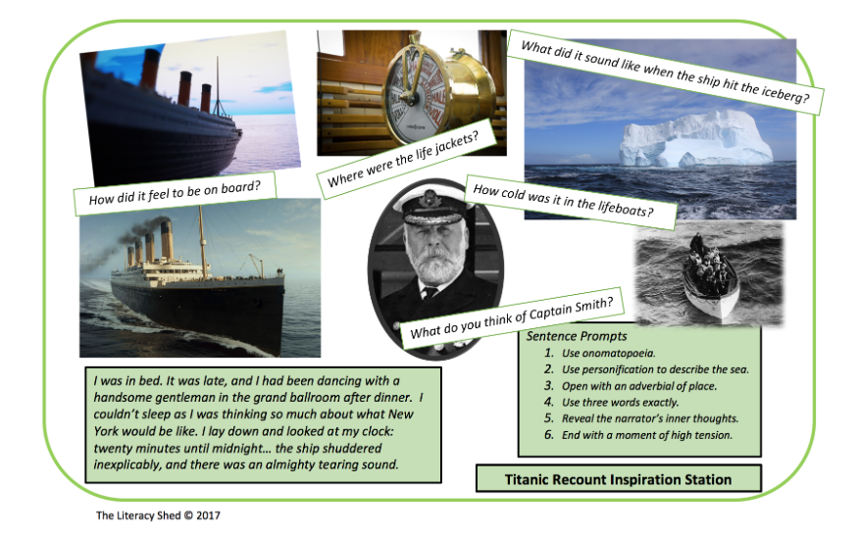
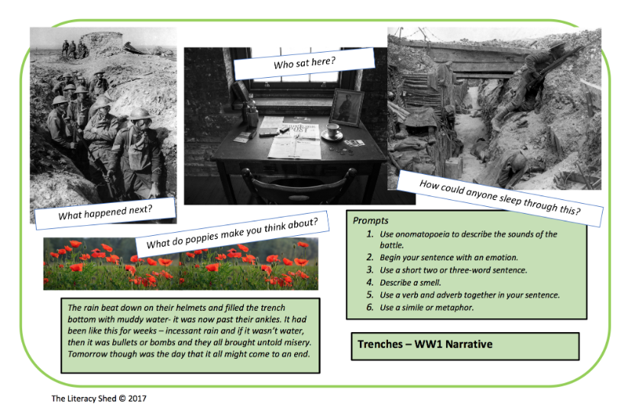
WRITING COMPOSITION – BIG WRITE (15-20 MINUTES PER DAY)
Choose an additional task from the options below and on the next chart. You can develop your ideas over the week and try to complete your task by the end of the week.
Write a recount of what it must have been like to be aboard the Titanic on the day it hit an iceberg. Research what happened to inspire your story. Choose to be either the Captain or a passenger. Remember to structure your recount using paragraphs:
Introduction (what it was like and how you were feeling before the iceberg)
Build up and crisis. (what were you doing when the iceberg struck the boat)
Your feelings.
What happened.
How did it end for you?
Write a recount of what it must have been like to be involved in a battle during the Great War. Choose to be either a soldier or a General. Remember to structure your recount using paragraphs:
Introduction (what it was like and how you were feeling before the iceberg)
Build up and crisis. (what were you doing when the iceberg struck the boat)
Your feelings.
What happened.
How did it end for you?

Slide 17
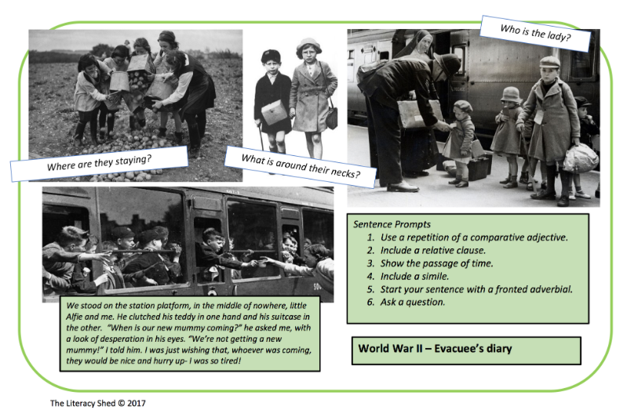
WRITING COMPOSITION – BIG WRITE
Research The second world war experience of a child evacuee to create a fact file using powerpoint to present your findings. Then write a diary entry from the point of view of one of the children leaving their parents in the city to live in the safety of the countryside.
Use the Diary checklist from p.9 to help you plan your entry.

Slide 18

WRITING COMPOSITION CHALLENGE (1 PER WEEK)
Please follow this link to Authorfy website where authors have posted daily writing challenges. You can choose your own author challenge from the growing selection available. A new challenge is posted daily.
https://authorfy.com/10minutechallenges/
20 MINUTES

Slide 19
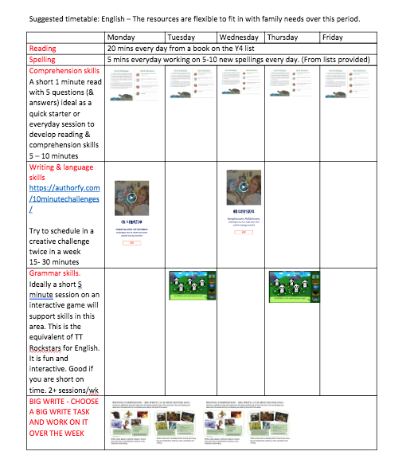
GUIDANCE
THE ACTIVITIES SET OUT IN THIS PACK ARE DESIGNED TO BE FLEXIBLE TO ALLOW FOR DAYS WHEN YOU MAY HAVE MORE TIME THAN OTHERS.
WE HAVE SET OUT A SUGGESTED PROGRAMME TO ILLUSTRATE HOW THE ACTIVITES MIGHT FIT IN TO A DAILY / WEEKLY SCEHDULE.

