Slide 1
YEAR 4 HOME LEARNING
English block 5
w/c 15th June 2020

Slide 2

ENGLISH – Week beginning: 22nd & 29th June

Slide 3

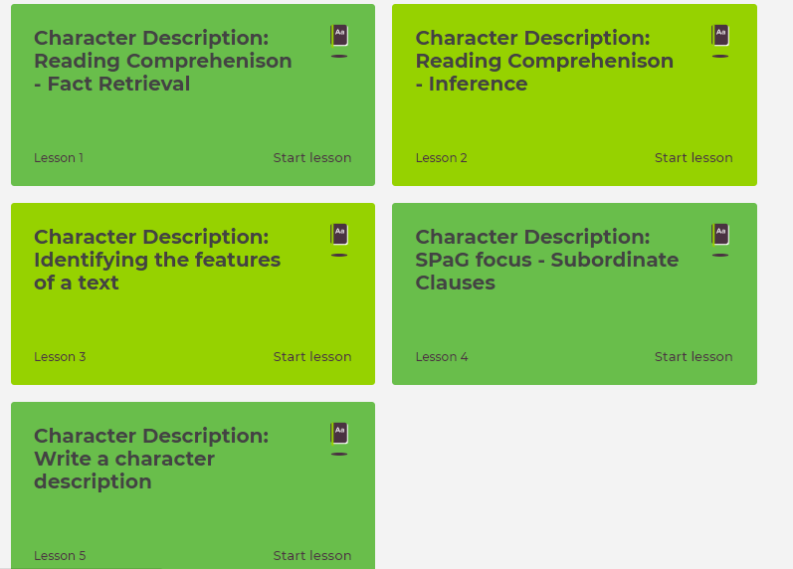
Week 1 Main Activity
Click on the link below to access your English lessons for the next week using the National Oak Academy website:
https://classroom.thenational.academy/subjects-by-year/year-4/subjects/english
Select – Year 4 and choose the Genre focus: Character Description (1-5)Please ensure you start at lesson 1 and follow the sequence for the week.

Slide 4
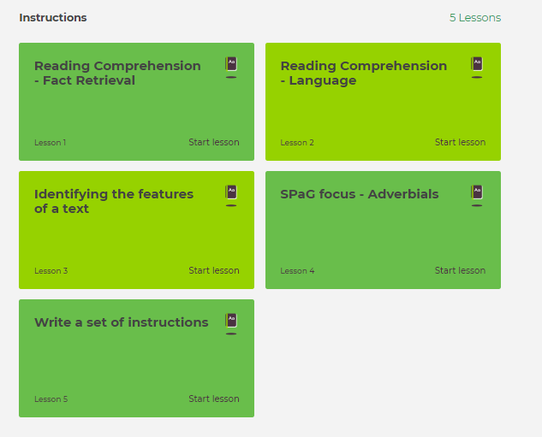
Week 2 : Main Activity
Click on the link below to access your English lessons for the next week using the National Oak Academy website:
https://classroom.thenational.academy/subjects-by-year/year-4/subjects/english
Select – Year 4 and choose the Genre Focus: Instructions sequence of lessons (1-5)Please ensure you start at lesson 1 and follow the sequence for the week.

Slide 5

Alternatively if you are unable to access Oak Academy, BBC Bitesize offers a good option:
Alternative Main activity
BBC Bitesize – Daily English lessons
Click on the link below to access the daily English lessons for Year 4 from BBC Bitesize
https://www.bbc.co.uk/bitesize/dailylessons
Select – Year 4
Then select the daily English lesson each day this week.

Slide 6

Spelling
Doodle English / Doodle Spell
Spend 10 minutes playing on the Doodle App for English or spelling each day.
10 MINUTES
You can download the computer apps here:
English: https://www.doodleenglish.com/download-doodleenglish-windows-macs/
Or you can use the Google Chrome web browser on your PC, laptop or Mac:
students.doodleenglish.com
students.doodleenglish.com/spell

Slide 7
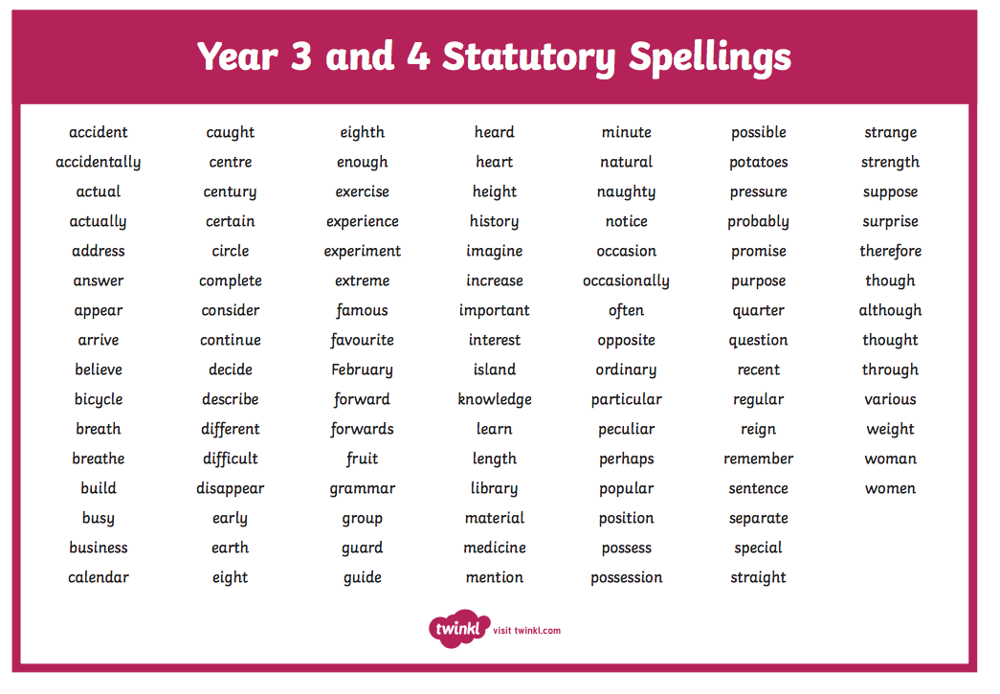
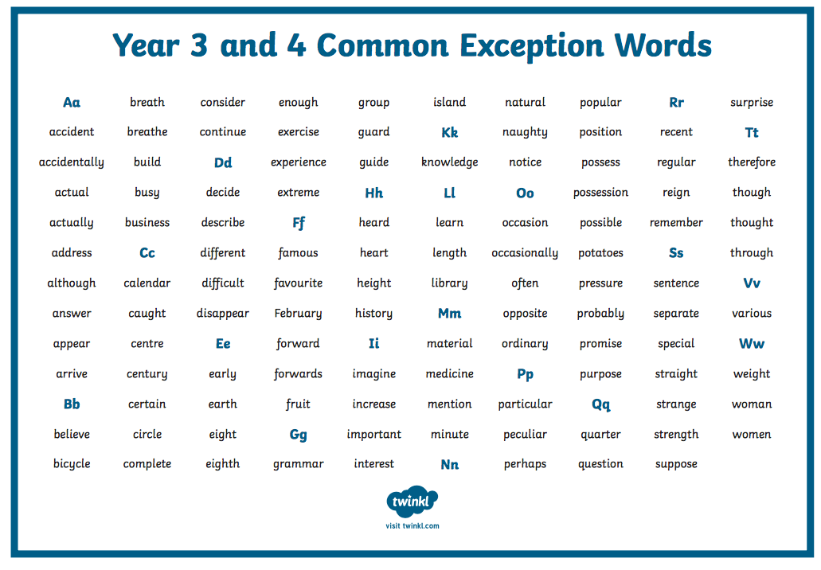
Statutory Spelling lists: Year 4: Practise spelling from the list every day.

Slide 8

Reading Comprehension
DAILY COMPREHENSION
Please choose a mini comprehension from the folders provided online.
Each comprehension comes with an answer sheet.
Read aloud to someone at home if you can. Practise your expression and fluency. (New files added in box below)
10 MINUTES
LINKS TO THE PREVIOUSLY SHARED FILES:
World Religions
https://1drv.ms/u/s!ApFLkuLcYtnjlkQDcNg2CS0BlQBs?e=51JIbt
Ancient Egyptians
https://1drv.ms/u/s!ApFLkuLcYtnjljwtfJVs1NYiuShZ?e=BnvTAf
Extreme Weather
https://1drv.ms/u/s!ApFLkuLcYtnjlkBNnOijUxKH9jRO?e=bzixHe
Sports
https://1drv.ms/u/s!ApFLkuLcYtnjlkM4kpYxcjQGH-JS?e=qwsJRh
Vikings
https://1drv.ms/u/s!ApFLkuLcYtnjljstYa5G-a7PCKsP?e=XKdnSh
Animals
https://1drv.ms/u/s!ApFLkuLcYtnjlj6jnoC9eSkSE3bO?e=spy6HX
Magic & Wizards
https://1drv.ms/u/s!ApFLkuLcYtnjlj8wqcmP-hltYtP8?e=B2Xbx2
Rainforests
https://1drv.ms/u/s!ApFLkuLcYtnjlkLHwXYKpWUN3Mob?e=fw1F6B
New Resources Summer 2020
Aliens – 3 comprehensions
Pirate adventures - 3 comprehensions
Myths from other cultures - 3 comprehensions
SCi Fi Stories - 4 comprehensions

Slide 9

Reading - Daily Activity
Please ensure you continue to read a good quality reading book from the year 4 / 5 list (See following pages.)
Talk to someone at home about the book that you are reading.
Read a few pages aloud to somebody; this is a different skill to silent reading. Can you make it exciting? Use different voices.
20 MINUTES

Slide 10
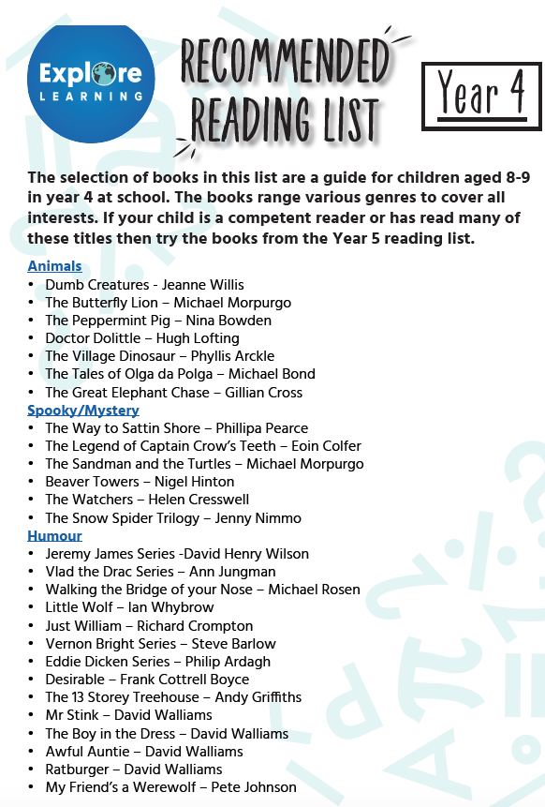
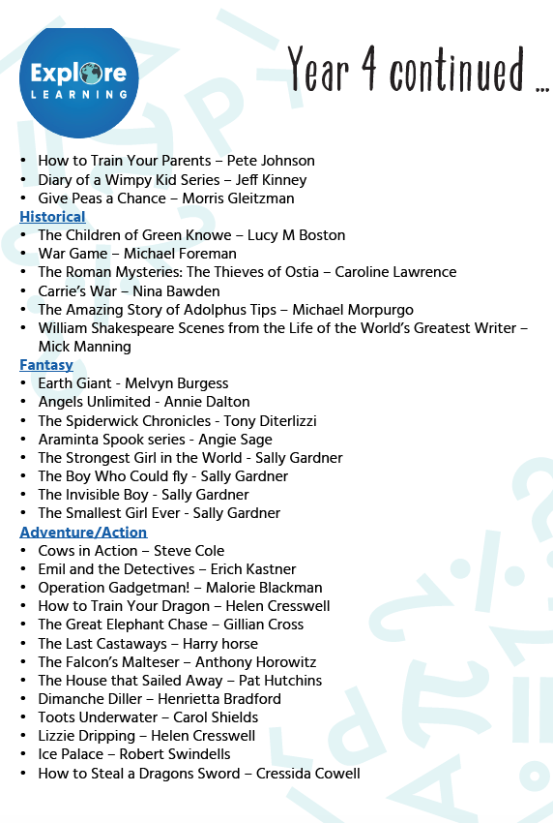


Slide 11
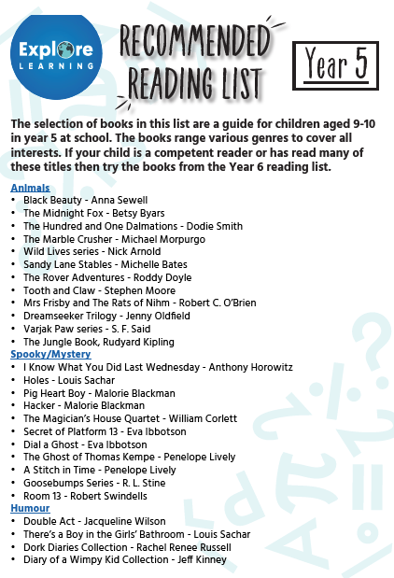
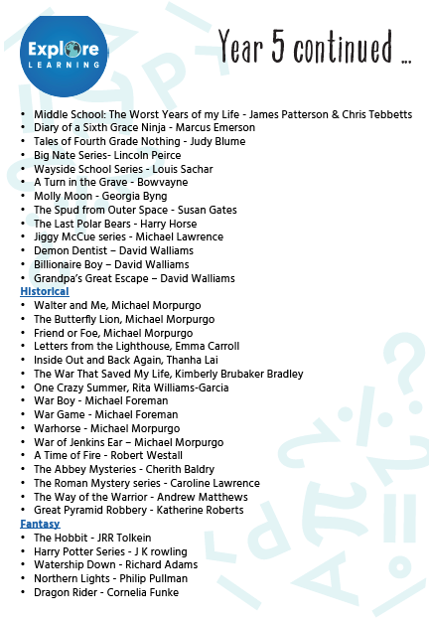
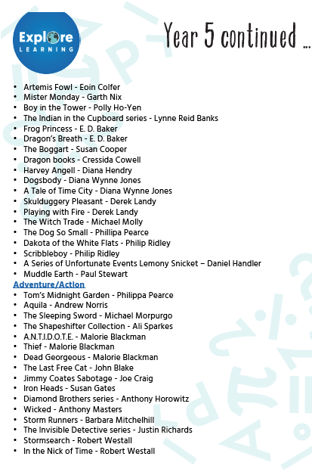


Slide 12

Extension Activities
Guided Reading & Writing Composition

Slide 13

Extension Activities : Guided Reading and Writing
For those of you who want to challenge yourselves and practise your writing skills, you can choose an extension task from the following pages. Choose an extract of one of the books from the options offered on the next few slides and complete the Guided Reading Task. Read the extract first, highlighting any important facts or ideas. (PDFs for each extract are available by following the link to the shared folder)
You can complete the task over several days. Ensure that you read the text thoroughly before you start the writing task.

Slide 14

Read the extract carefully and then design your own mythical world. Use the map of Arcosi on p.6 as inspiration. Then, write your own version of a story, based on Shadow Dragons, in the setting you have created. You don’t have to write about dragons. You can create your own mythical creature.
Remember to include:
An introduction (Setting, characters and build up)
A crisis or problem for your characters.
A resolution and ending. What do they do? How does it work out? Aim to write at least 3 paragraphs.
Ensure you use your writing skills. Your skills checklist is:
An opening line for a paragraph that starts with 2 or 3 adjectives. (Example: Lost, alone and afraid, )
Use at least one expanded noun phrase including a preposition. (The frightened boy shivered with fear, under the table)
One simile or metaphor.
Sensory language (see, hear, feel, smell, touch)
Shadow Dragons

Slide 15

Read the extract carefully and then imagine you are Freddie and write a letter to your grandma.
What would you say?
Write in the past tense, using the first person. (Example: I went into your room today..)
Use sequencing language to open paragraphs. (Example: At first, later, next, Finally)
Share personal feelings as though talking to a friend. (I wonder if I will ever have such a special friend again…)
Include the date, and begin by addressing your Grandma (Dear Grandma,)
Finish with a promise of what you are going to do next or a hope for the future.
Ensure you continue to use your writing skills. Your skills checklist is:
An opening line that starts with 2 or 3 adjectives. (Example: Lost, alone and afraid, )
Use at least one prepositional phrase (I shivered with fear, under the bed)
Exciting / emotional verbs
Sensory language (see, hear, feel, smell, touch)
Try to include a simile.
Click on the link below :
Freddie Yates

Slide 16


Choose an extract from the two given here. Read the extract carefully and then imagine you are one of the characters and write a diary entry .
Use this diary checklist to ensure your diary entry is complete.
Write in the past tense, using the first person. (Example: I was fast asleep in my tent when..)
Use sequencing language to open paragraphs. (Example: At first, later, next, Finally)
Share personal feelings as though talking to a friend. (I wonder if I will ever have such a special friend again…)
Include the date, and begin by addressing your diary (Dear Diary,)
Finish with a promise of what you are going to do next or a hope for the future.
Ensure you continue to use your writing skills. Your skills checklist is:
An opening line that starts with 2 or 3 adjectives. (Example: Lost, alone and afraid, )
Use at least one expanded noun phrase including a preposition. (I shivered with fear, under the table)
Exciting verbs
Sensory language (see, hear, feel, smell, touch)
https://ojs-my.sharepoint.com/:b:/g/personal/paula_moss_oakfield_surrey_sch_uk/EdW3F8YzyOVNsZmg7crd7kwBQ3lHqdhjT5PTBeqogmRQoQ?e=MT9Pg6
https://ojs-my.sharepoint.com/:b:/g/personal/paula_moss_oakfield_surrey_sch_uk/EeMKToTzEipLl_hkjQYcSM0B9R5sbhyqw4Uo8K_c6LmZ-w?e=iVtlRV

Slide 17

Choose an extract from the two given here. Read the extract carefully and then write a short story about what happens next.
Remember to include:
An introduction (Setting and build up)
A crisis or problem
A resolution and ending. Aim to write at least 3 paragraphs.
Ensure you use your writing skills. Your skills checklist is:
An opening line that starts with 2 or 3 adjectives. (Example: Lost, alone and afraid, )
Use at least one expanded noun phrase including a preposition. (The frightened boy shivered with fear, under the table)
One simile or metaphor.
Sensory language (see, hear, feel, smell, touch)
https://ojs-my.sharepoint.com/:b:/g/personal/paula_moss_oakfield_surrey_sch_uk/EQ74c4NPt9hDhNkOAN3SOJoBOJsrQCbOc0fRgR_MGPFvww?e=XGOdpd
https://ojs-my.sharepoint.com/:b:/g/personal/paula_moss_oakfield_surrey_sch_uk/Ee4FGFor32BDgqjR0BRJNGsB9FSkP9cKMxp0tN3Vm7Xhwg?e=uKo4u1

Slide 18
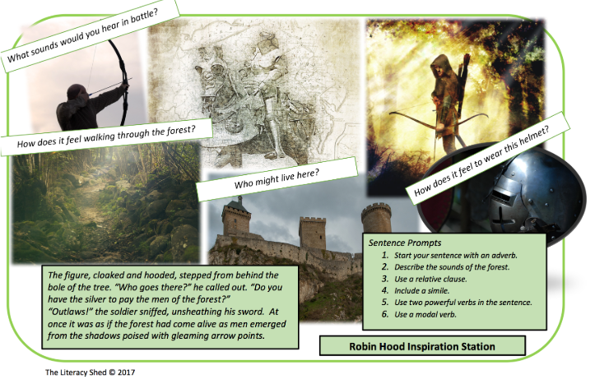
WRITING COMPOSITION – DIARY ENTRY
Research The legend of Robin Hood, then use the picture prompts to write a diary entry from the perspective of EITHER Robin hood, The Sheriff of Nottingham or Maid Marion.
Use the Diary checklist to help you plan your entry.
Date and salutation
Personal Chatty style
Exaggeration
Past tense
Personal disclosure
Sequencing words (in tr beginning, Later, after a while, finally etc)
Write in paragraphs
End by looking forward to the future.

Slide 19
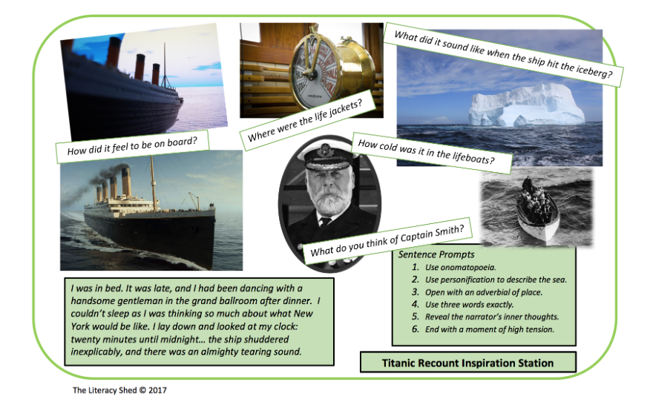
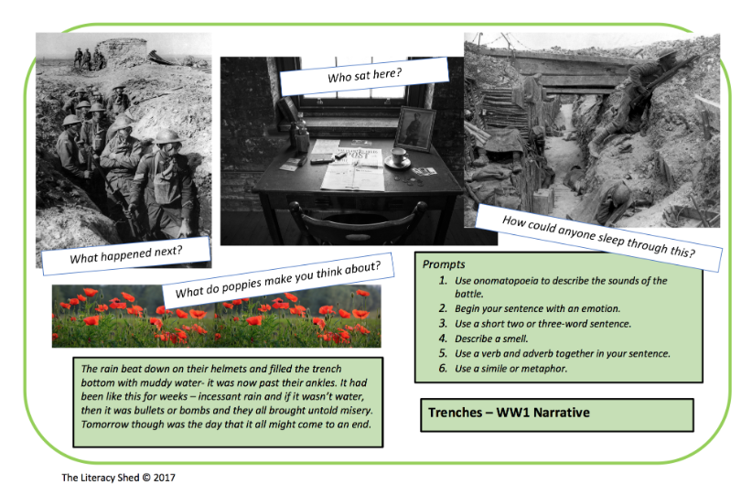
WRITING COMPOSITION – RECOUNT(15-20 MINUTES PER DAY)
Choose an additional task from the options below and on the next chart. You can develop your ideas over the week and try to complete your task by the end of the week.
Write a recount of what it must have been like to be aboard the Titanic on the day it hit an iceberg. Research what happened to inspire your story. Choose to be either the Captain or a passenger. Remember to structure your recount using paragraphs:
Introduction (what it was like and how you were feeling before the iceberg)
Build up and crisis. (what were you doing when the iceberg struck the boat)
Your feelings.
What happened.
How did it end for you?
Write a recount of what it must have been like to be involved in a battle during the Great War. Choose to be either a soldier or a General. Remember to structure your recount using paragraphs:
Introduction (what it was like and how you were feeling before the iceberg)
Build up and crisis. (what were you doing when the iceberg struck the boat)
Your feelings.
What happened.
How did it end for you?

Slide 20
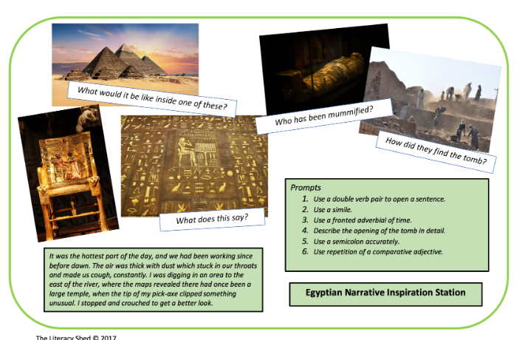
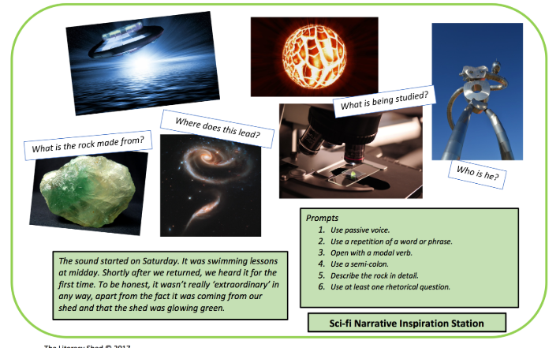
WRITING COMPOSITION – NEWS REPORT / RECOUNT
Choose an additional task from the options below and on the next chart. You can develop your ideas over the week and try to complete your task by the end of the week.
Write a News Report detailing the events of an Alien invasion. Use the picture prompts to guide you. When was the alien craft first spotted? What happened? How would you describe the Aliens?. Remember to structure your recount using paragraphs:
Introduction (what was happening before the craft was spotted)
Build up and crisis. (Where did the craft appear?)
What happened next?
How did people react?
Why did the Aliens come?
Remember to include some quotes from eye whitnesses.
Write a News Report or personal recount about the discovery of an Egyptian Mummy / Treasure. Remember to structure your recount using paragraphs:
Introduction (what it was like and how you were feeling before the discovery)
Build up and crisis. (what were you doing when the discovery was made)
Who or what was discovered?
Your feelings about the discovery.
What happened next
Why was the discovery important?

Slide 21

WRITING COMPOSITION CHALLENGE (1 PER WEEK)
Please follow this link to Authorfy website where authors have posted daily writing challenges. You can choose your own author challenge from the growing selection available. A new challenge is posted daily.
https://authorfy.com/10minutechallenges/
20 MINUTES

Slide 22
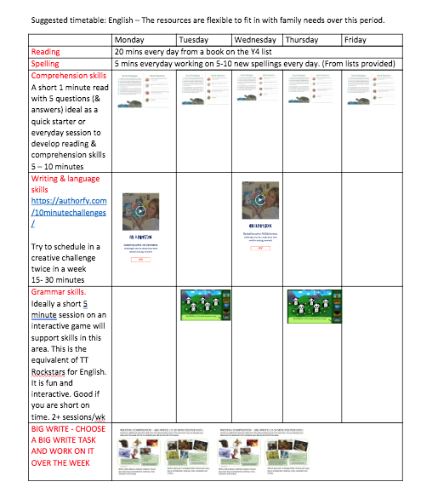
GUIDANCE
THE ACTIVITIES SET OUT IN THIS PACK ARE DESIGNED TO BE FLEXIBLE TO ALLOW FOR DAYS WHEN YOU MAY HAVE MORE TIME THAN OTHERS.
WE HAVE SET OUT A SUGGESTED PROGRAMME TO ILLUSTRATE HOW THE ACTIVITES MIGHT FIT IN TO A DAILY / WEEKLY SCEHDULE.

