Slide 1
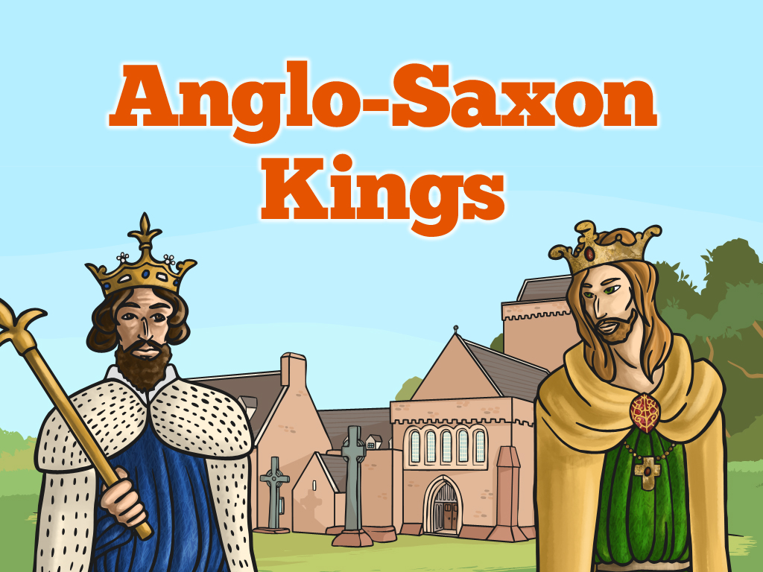


Slide 2
Aim
I can compare the significance of Anglo-Saxon kings during the Viking period.
Success Criteria
I can identify key facts about the Anglo-Saxon kings.
I can demonstrate my understanding of the significance of the Anglo-Saxon kings.
I can compare the similarities and differences between the Anglo-Saxon kings.

Slide 3
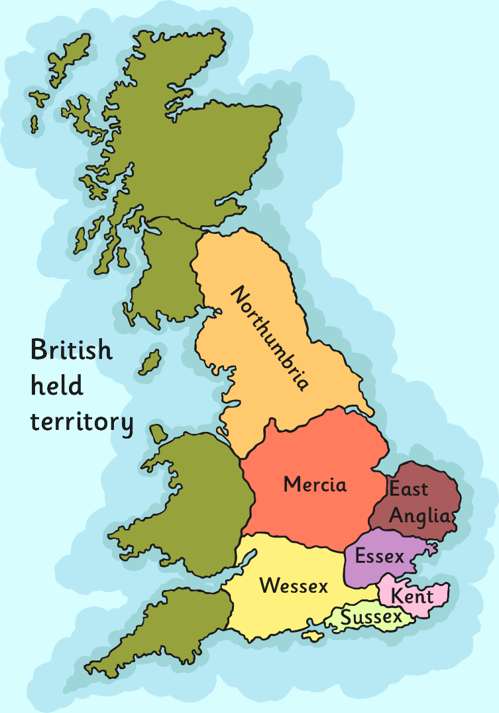
Kingdoms
The kings of Anglo-Saxon Britain each ruled their own kingdom and the people in it. They also controlled their own army. Kings constantly fought to control other kingdoms and defend their land. They were known as warrior-kings.
When the Anglo-Saxons first settled in Britain there were seven kingdoms. However, by AD 878 there was only one kingdom left; Wessex, ruled by King Alfred the Great. The other kingdoms had been overrun by the Vikings who established their own kingdoms.

Slide 4
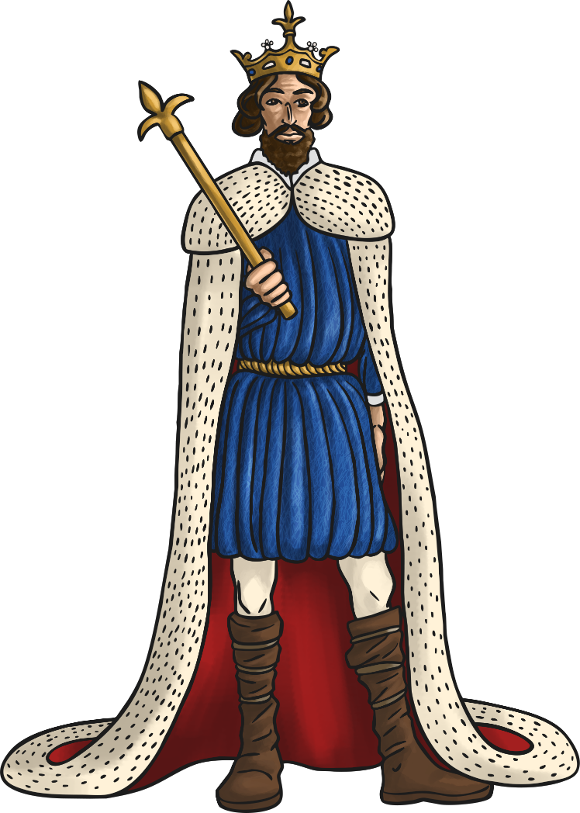


Kings Vs. Vikings
Some of the Anglo-Saxon Kings are well known for the resistance they put up against the Vikings. They fought hard to keep control of their land and tried to push the Vikings out.
One of the best known Anglo-Saxon kings is King Alfred the Great. He is the only British monarch to have the title ‘great’ in his name.

Slide 5

King Alfred the Great
So, what made King Alfred so great?
King Alfred is credited with being the first Anglo-Saxon king to defeat the Vikings in battle and buy the people of Britain some peace from them.
Alfred became king in AD 871. He reigned until his death in AD 899.
In AD 878 the Vikings invaded Wessex and forced King Alfred into hiding. However, Alfred was not prepared to give up.
Later in AD 878, King Alfred and his small band of followers defeated the Vikings at the Battle of Edington. The Battle of Edington was reported as a fierce and bloody event and King Alfred was reported to charge into battle like a wild boar. King Alfred and his men drove back the attacking Vikings who surrendered. It is said that the Viking leader of this battle, King Guthrum, immediately converted to Christianity and was baptised by King Alfred himself.

Slide 6
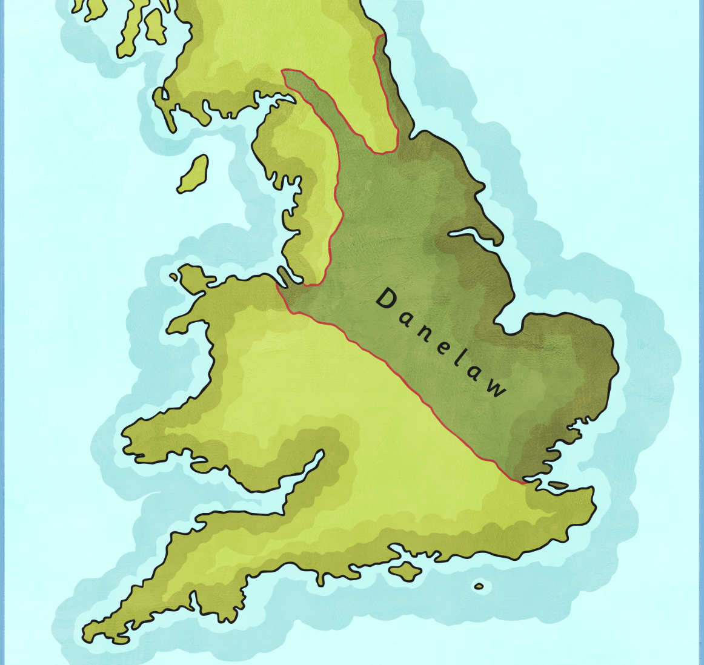
Danelaw
King Alfred knew that although he had been able to stop the Vikings from taking over in Wessex, he would never be able to control them in the rest of England.
In AD 886, he made a deal with King Guthrum and established a treaty which gave the Vikings control over Northern and Eastern England, an area which later became known as Danelaw.
King Alfred got to keep control over Wessex and he also got to rule over West Mercia and Kent.
This arrangement helped to establish more peaceful relationships between the English and the Vikings.

Slide 7
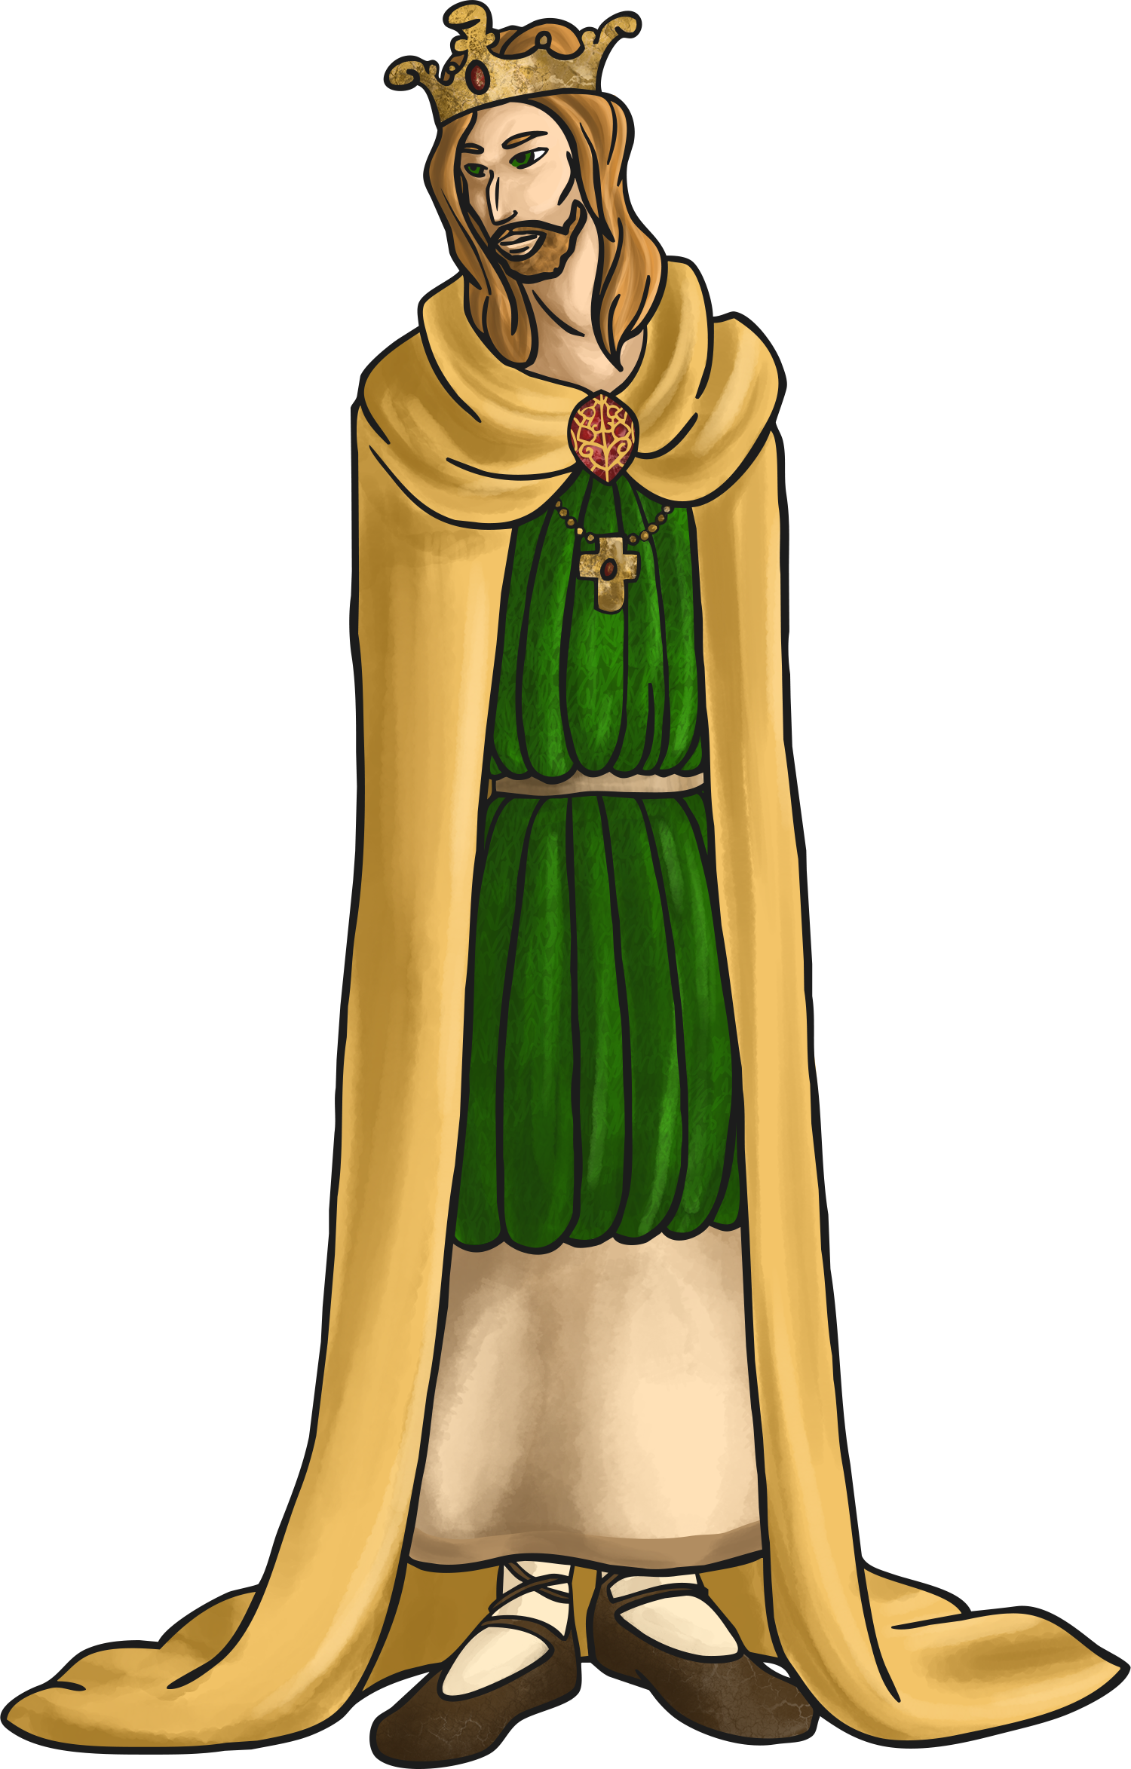
King Athelstan
After the death of King Alfred the Great, his son Edward the Elder took the throne. When Edward died, his son Athelstan (King Alfred’s grandson) became king. Athelstan is regarded as the first king of all Britain and he is remembered as a great leader.
Athelstan was king from AD 924-939.
During his reign he drove the Vikings back more and more and was able to claim control over a greater area of land.
In AD 927 Athelstan won back the kingdom of York from the Vikings. He also established control over King Constantine from Scotland and the other Northern kings. The 5 Kings of Wales also agreed to pay tribute (money) each year to King Athelstan.

Slide 8
King Athelstan
At the Battle of Brunanburh in AD 937 Athelstan fought with his Viking and Welsh allies to stop an invasion by the Scottish king.
Athelstan is know for forming good relationships with leaders from other countries. He married his four sisters to important rulers abroad which helped strengthen Britain’s position overseas. He also had strong links with religious leaders and he founded many churches.
Do you think Athelstan was as ‘great’ as King Alfred?
Think about the actions and achievements of King Alfred and King Athelstan.
What important or influential things did the two kings do?
Why are they such important historical figures?

Slide 9
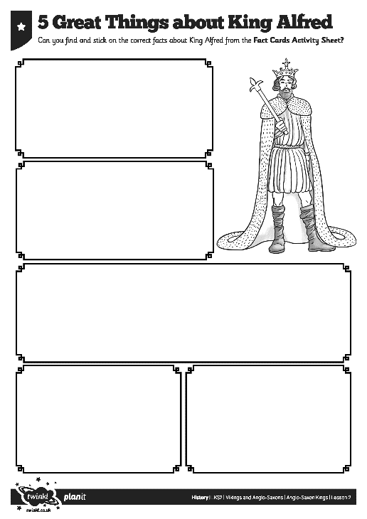
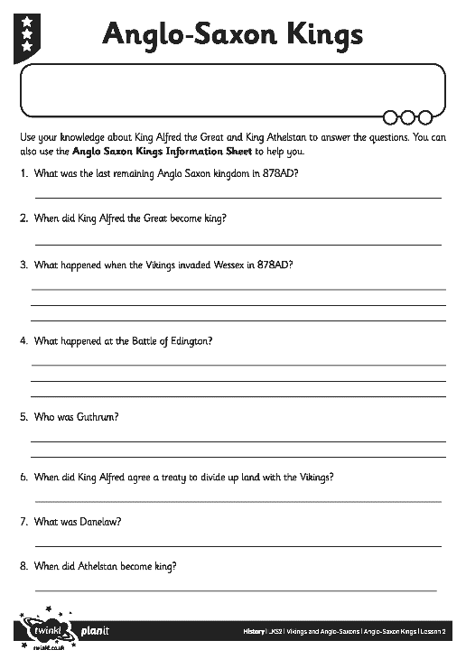
King Activities
Use the information you have learnt in the lesson to complete the activity about King Alfred and King Athelstan and their fight against the Vikings.
Download these worksheets on the school website in our Year 4 Home Learning History area.

