Slide 1


And Danelaw

Slide 2
Aim
Was Danegeld successful and getting rid of the Vikings?
Success Criteria
I can recall key details about King Ethelred and the introduction of Danegeld.
I can explain the problems King Ethelred faced before introducing Danegeld.

Slide 3
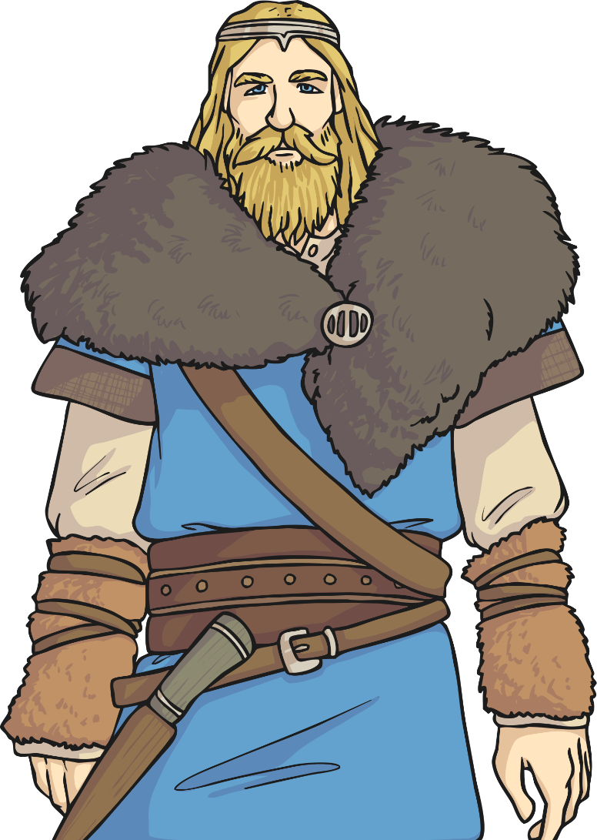
The Second Viking Age
After the early Viking raids, Britain enjoyed a period of relative peace, and Viking attacks stopped for some time.
King Edgar, who ruled from AD 959 - 975, was able to concentrate on organising the Christian church and building many new churches and other religious buildings.
At this time, Denmark was becoming a major power led by King Harold Bluetooth. Viking armies were very strong and well organised and the raids were more about getting money which meant that the Danes could become even more powerful.
The Viking warriors were a greatly feared bunch!

Slide 4
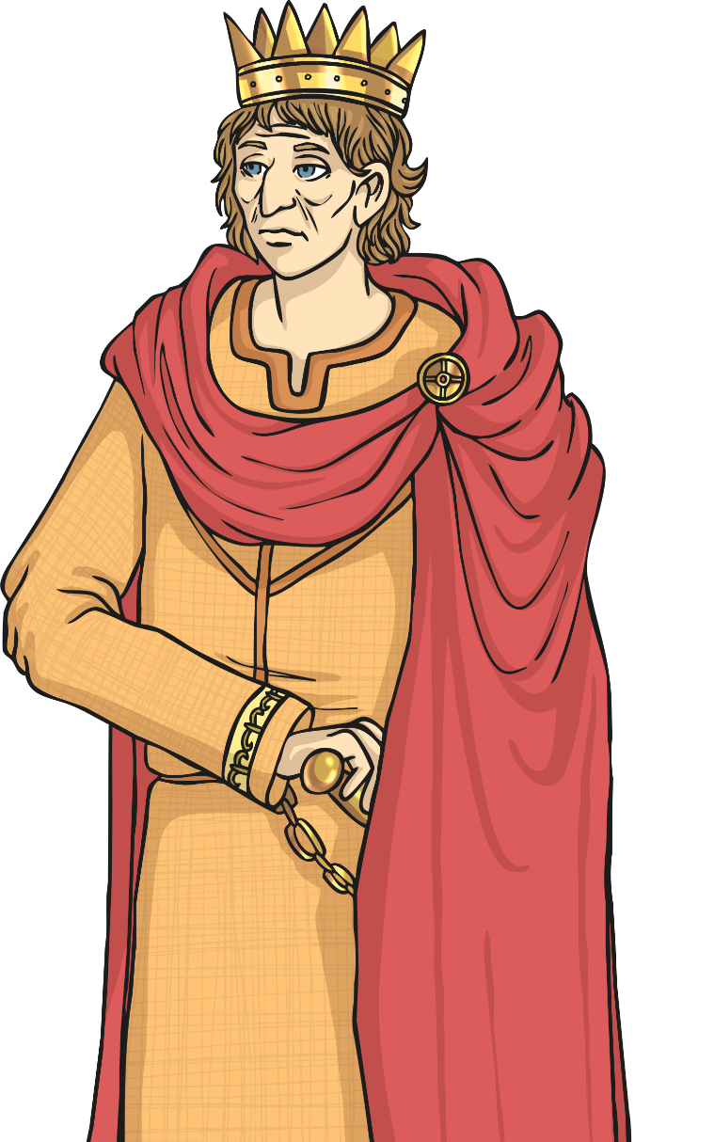
King Ethelred II The Unready
Read the information about Ethelred II The Unready.
In AD 978, a young boy called Ethelred became king. His supporters had killed his older brother, Edward II, so that he could rule, even though he was only 7 years old at the time. Ethelred came to be known as ‘The Unready’ because he was believed to be ‘unwise’ or ‘badly advised’.
Ethelred had a lot to deal with during his reign. His brother’s supporters were a constant threat and Viking attacks were brutal. Ethelred was not a good soldier and Britain was struggling from all the Viking raids so he had to think of other ways to deal with the situation.
Do you think it is fair that King Ethelred is known as ‘The Unready’? Why/why not?

Slide 5
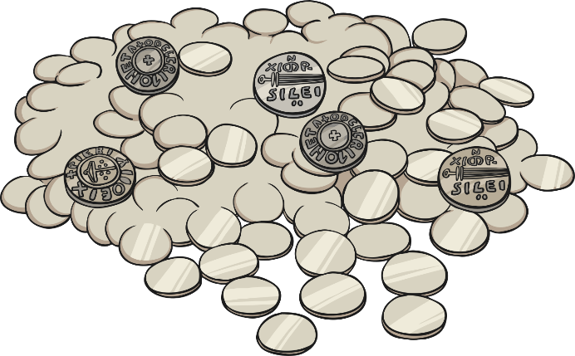
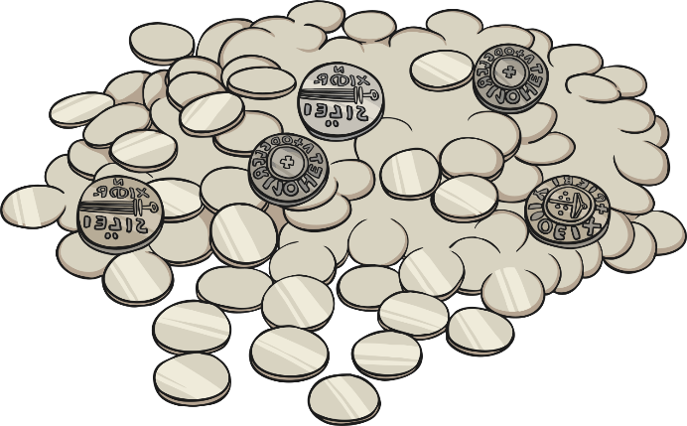
Danegeld
One thing King Ethelred did was form good relationships with Normandy to give him extra support, and he even married the Duke of Normandy’s daughter later on.
Another strategy he used was paying the Vikings to go away. This had been done before (King Alfred the Great was the first to do it many years earlier) but under Ethelred’s rule it became an official agreement. The Anglo-Saxons first called it Gafol, but it was later called Danegeld by the Normans and it means ‘paying the Dane’.
In AD 991 the Vikings were given 4500kg of silver to go home, but they soon returned. Each time there was a fresh attack they were paid again. The Vikings learnt that if they kept raiding Britain they would keep getting paid. By 1012, 22 000kg of silver was given to the Vikings in Danegeld.
King Ethelred II was heavily criticised for his ineffective strategy.

Slide 6

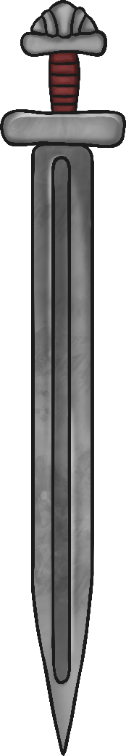
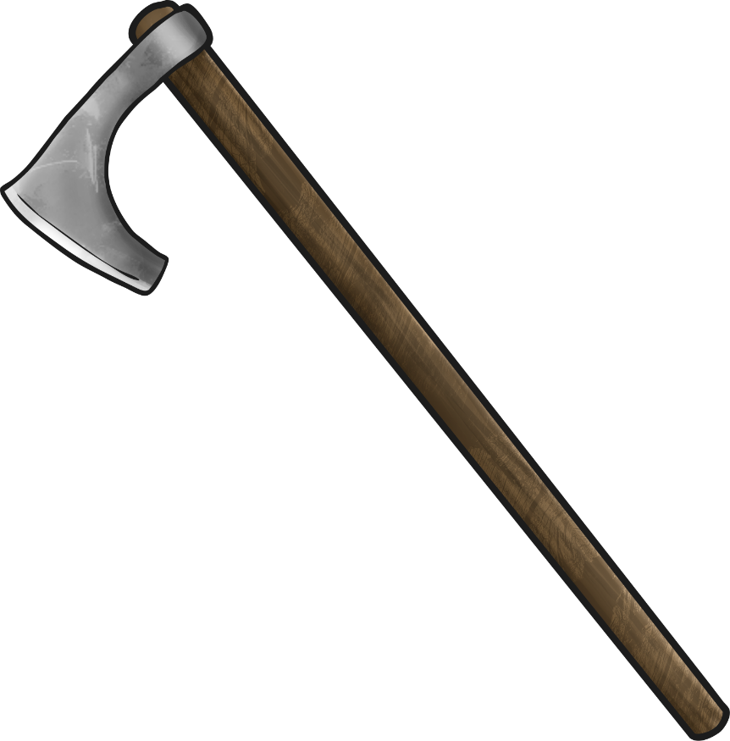
Paying the Dane
So why did King Ethelred choose to pay the Vikings rather than fight them?
The Vikings are probably best known for their fierce warriors. They were expert fighters, extremely organised and very brave in battle.
Viking warriors wore helmets made of leather or metal and they carried a large shield made of wood and covered in leather. They used axes, swords and spears.
Vikings are often shown in pictures wearing helmets with horns but they did not actually wear horned helmets in battle. Instead, the Vikings’ helmets would have been smooth and close-fitting to the head which is much more practical! It is thought that horned helmets were worn only in religious ceremonies.
To what extent do you think the skill and efficiency of the Viking warriors affected King Ethelred’s decision to pay them rather than fight them?

Slide 7
Challenge
Look at the BBC Bitesize page:
https://www.bbc.co.uk/bitesize/topics/ztyr9j6/articles/zjcxwty
This will explain about how the country was split into two parts.
Then complete the map showing how England was divided into to two areas. Maps can be downloaded from the home learning area.

