Slide 1

Year 4 Summer 1: Do we have to go to church to demonstrate our beliefs?
Lesson 1 Beliefs

Slide 2
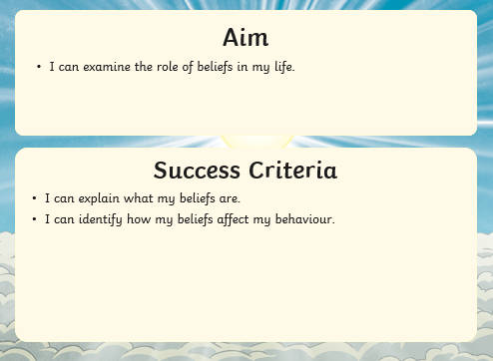

Slide 3

What are beliefs?
This Photo by Unknown Author is licensed under CC BY-SA

Slide 4
Christians believe in the teachings of Jesus.
Jesus to taught us many things, but most of all to love God and to love one another.
In this story of Jesus, he gives us a famous set of beliefs – The Beatitudes. He tells us what we will receive if we live our life, showing our beliefs to others.
https://www.youtube.com/watch?v=Ze7w3-BL3OM

Slide 5
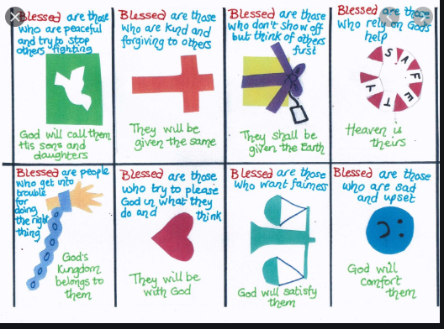

Slide 6
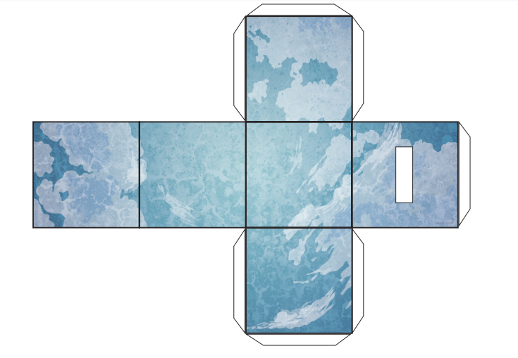
Your Task
Using the template in the file attached, make a keepsake to remind you of the beliefs you are most inspired by. What beliefs will make you the best person that you can be?
On each square, draw a picture to remind you of each belief.
When you have finished designing your box, cut it out and form it into your memory box.
Each time you do something that demonstrates your beliefs, make a little note and add it into the box. How well do your beliefs shape and inspire your life?

Slide 7
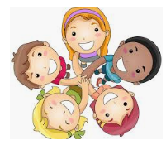




Example
Using the template in the file attached, make a keepsake to remind you of the beliefs you are most inspired by. What beliefs will make you the best person that you can be?
On each square, draw a picture to remind you of each belief.
When you have finished designing your box, cut it out and form it into your memory box.
Each time you do something that demonstrates your beliefs, make a little note and add it into the box. How well do your beliefs shape and inspire your life?

