Slide 1

Year 4 Summer 1: Do we have to go to church to demonstrate our beliefs?
Lesson 2 : Inspiration
Where do I find my inspiration – how does it help me?

Slide 2
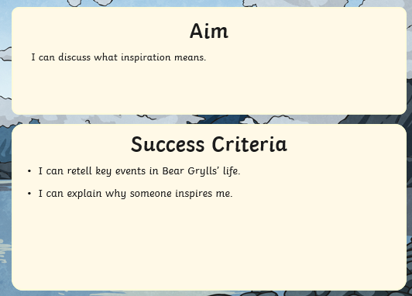

Slide 3

What is Inspiration?

Slide 4
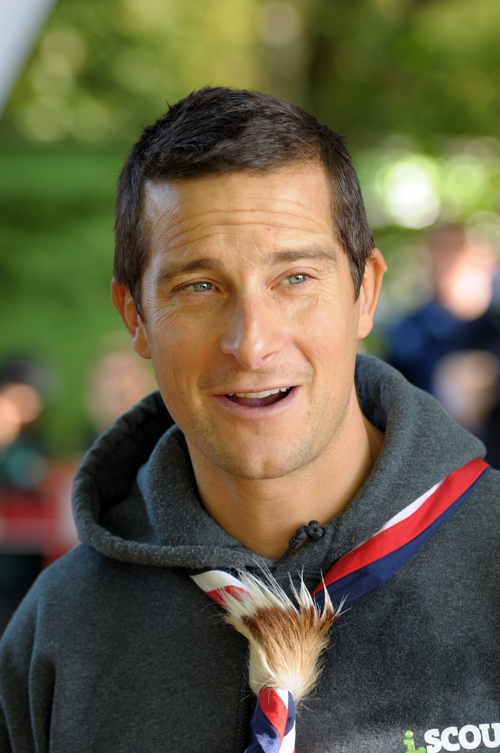
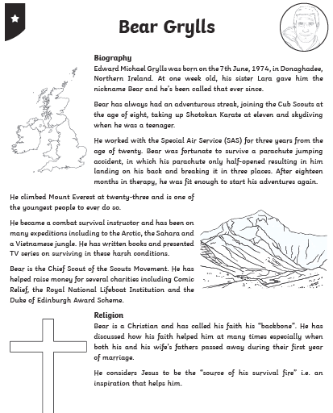
Read your information text about Bear Grylls.
When Bear was injured and in his hospital bed his father stuck a picture of Mount Everest on the wall. Bear Grylls used this as inspiration to recover from his injuries and one day climbed the mountain.
Today he is an inspiration to millions.

Slide 5
Now highlight key information in the text about:
challenges Bear Grylls faced
how faith has helped and inspired him.

Slide 6

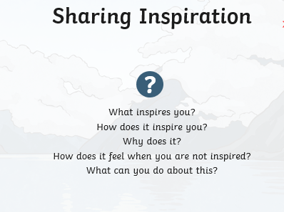
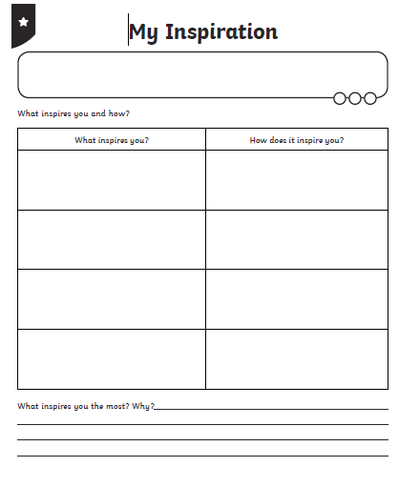
Use the activity sheet to collect your thoughts

Slide 7
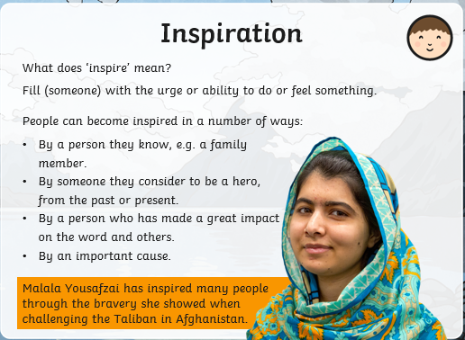
You might want to consider…

Slide 8

Your Task –make a mini-book of inspiration
Using a sheet of A4 paper, make a mini book recording the people and things that most inspire you.
On half the pages, draw a picture to remind you of each idea
Over the next week, each time you come across something that inspires you, make a note in your mini book. What was it? Why did it inspire you? What will you do because of it?
If you are unsure how to make the mini book, watch the video in the clip and follow the instructions.
https://www.youtube.com/watch?v=21qi9ZcQVto

