Slide 1

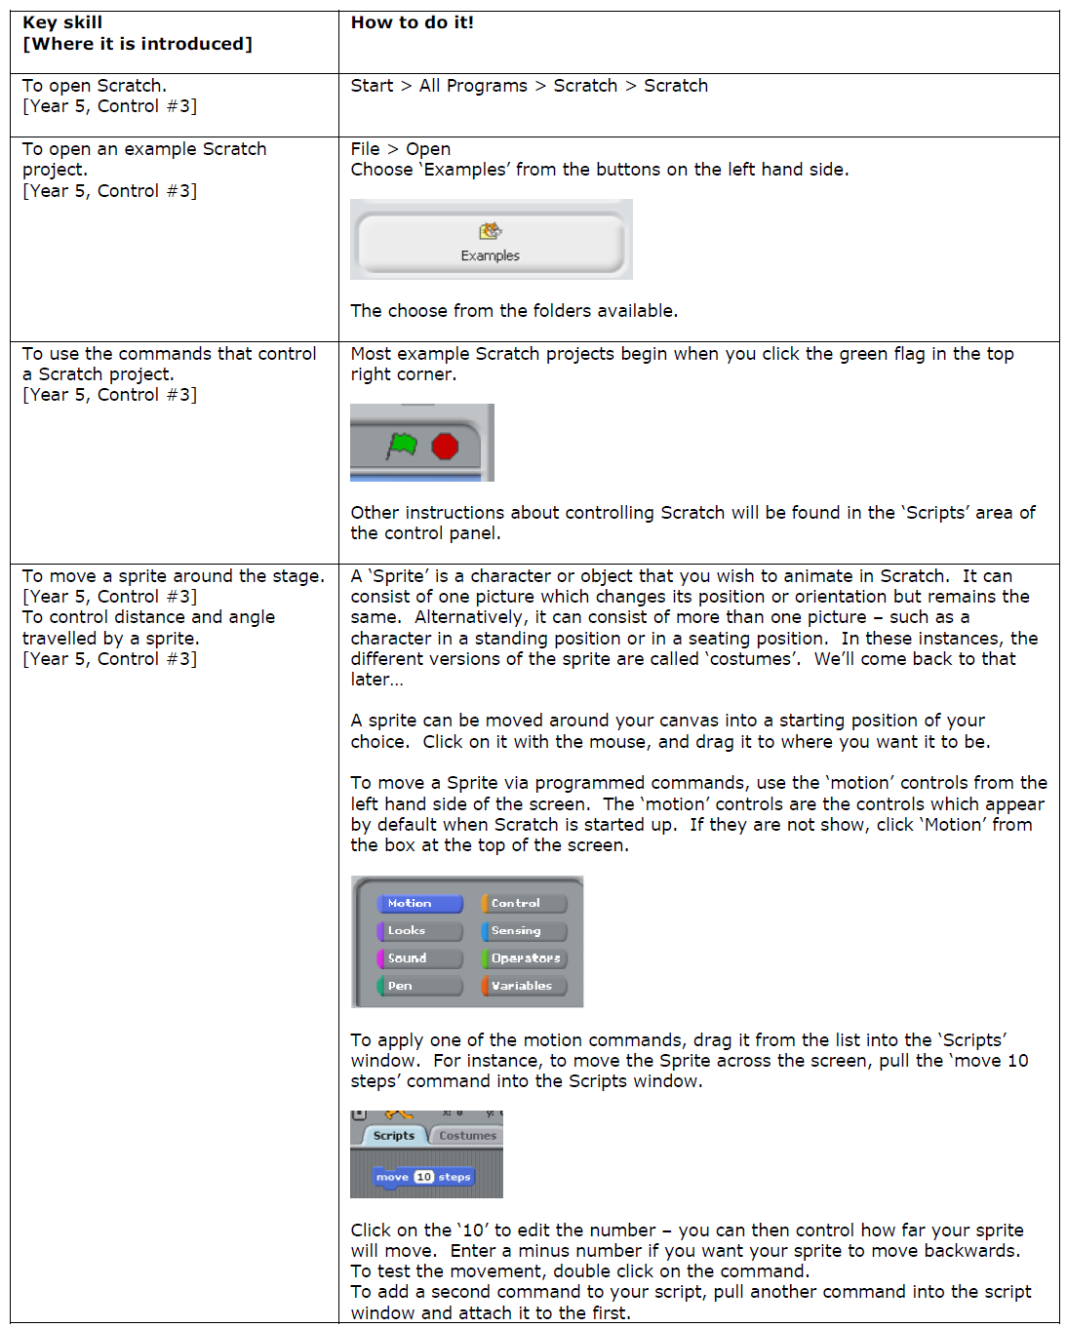
ICT
@
Using Scratch

Slide 2
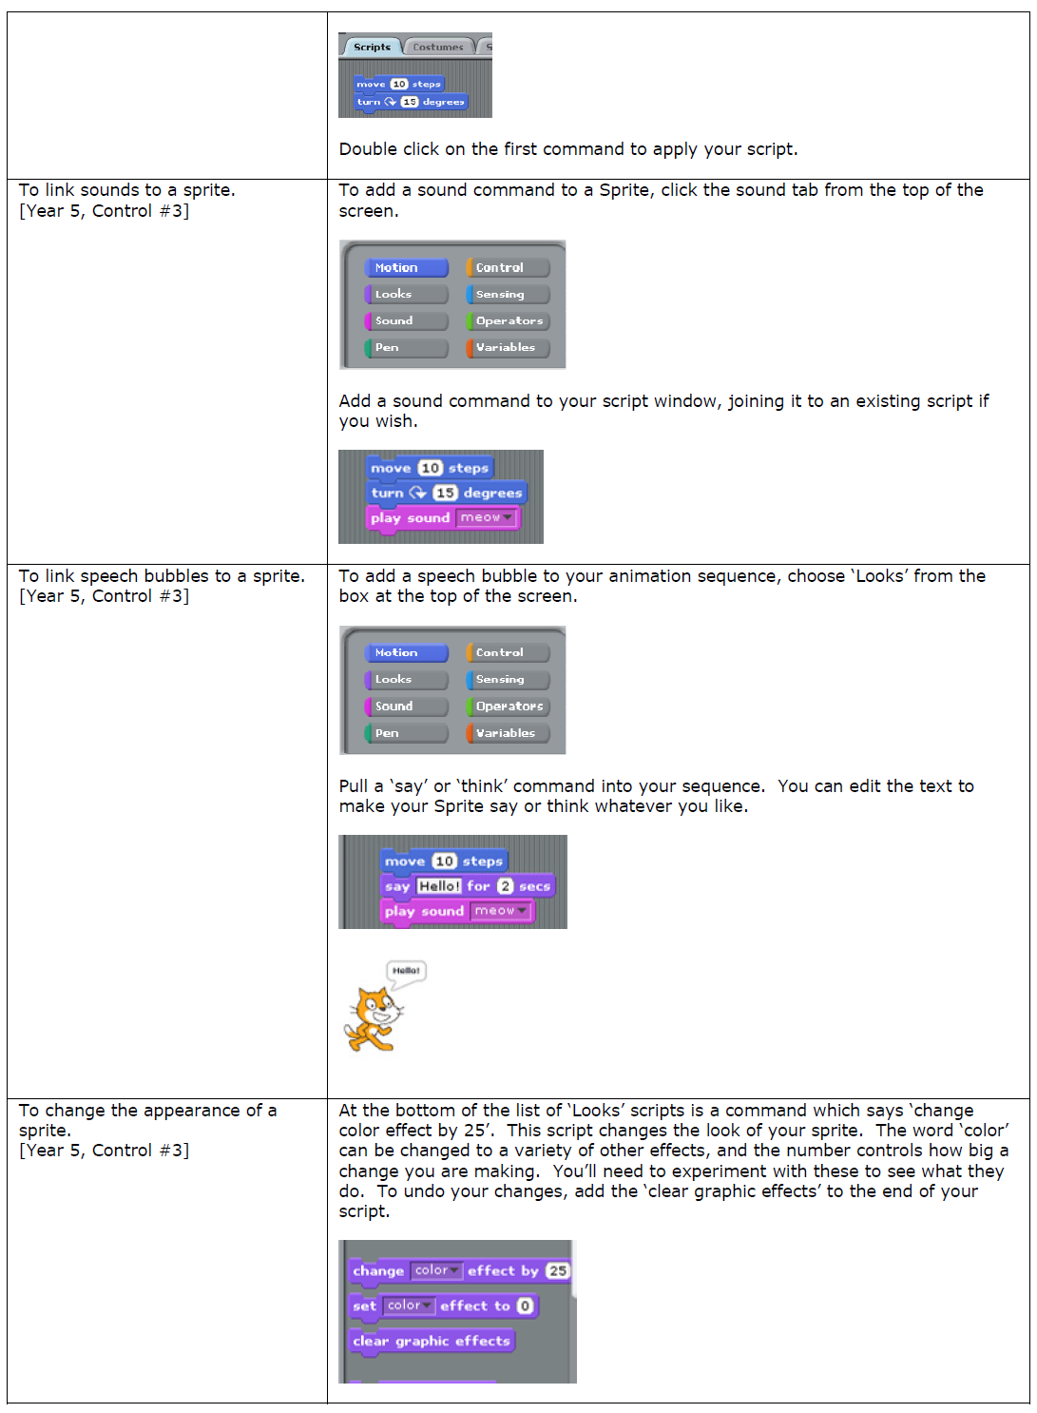
ICT
@
Using Scratch

Slide 3
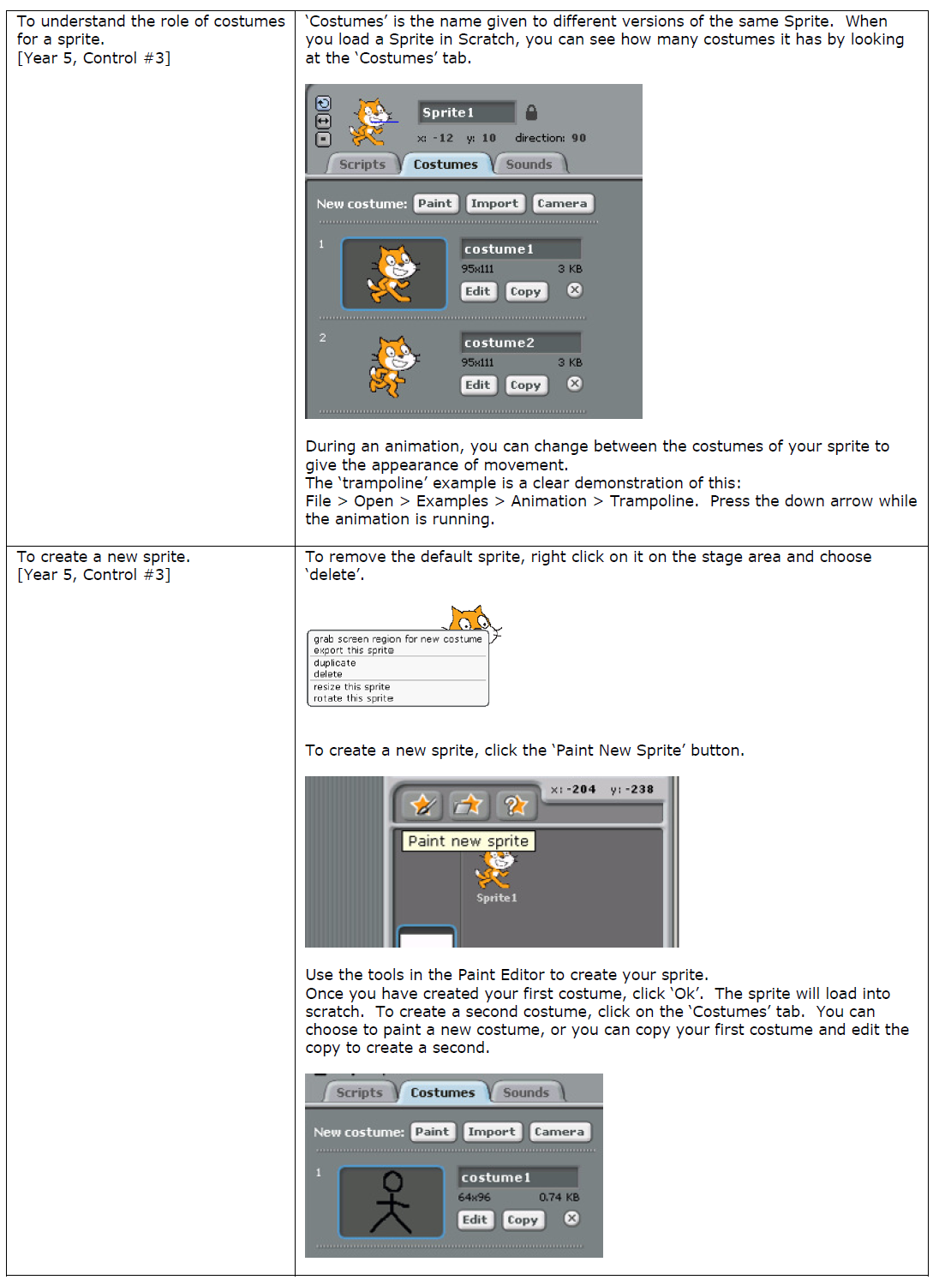
ICT
@
Using Scratch

Slide 4
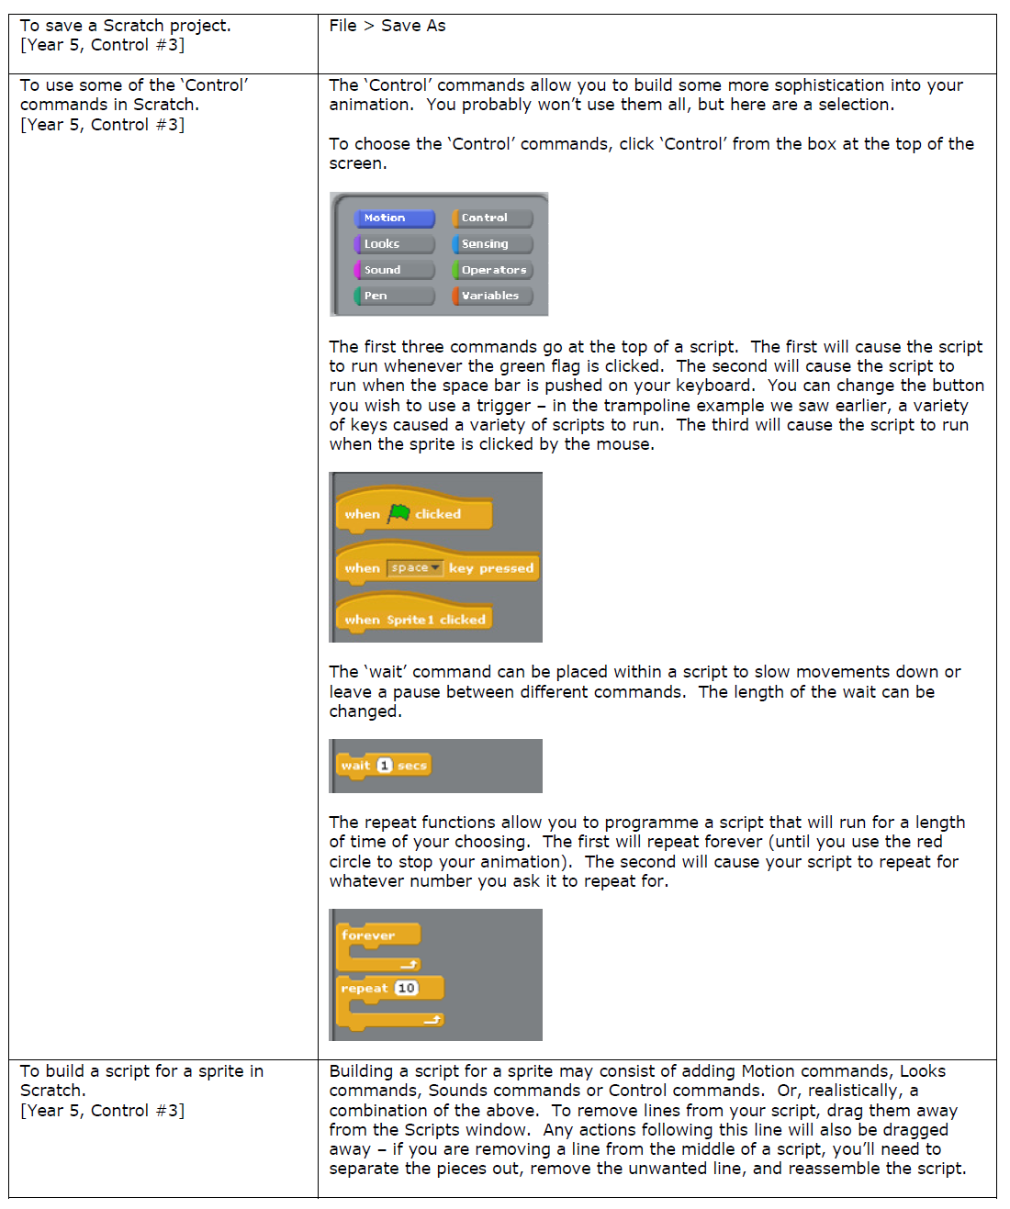
ICT
@
Using Scratch

Slide 5
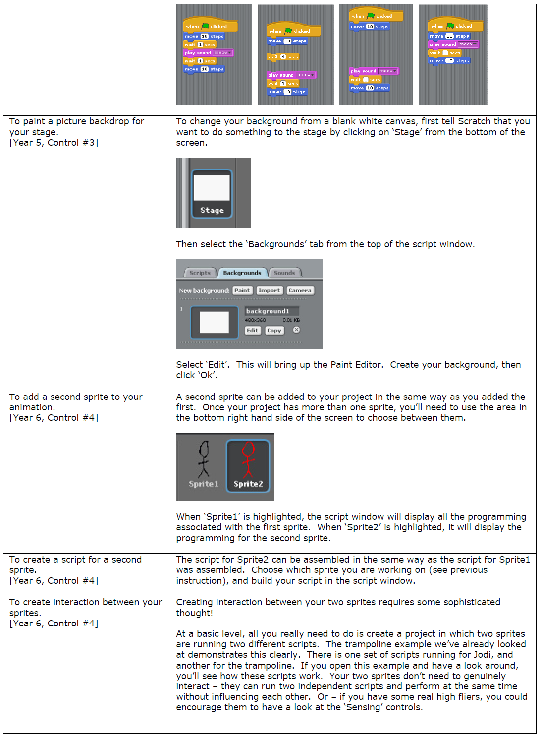
ICT
@
Using Scratch

Slide 6
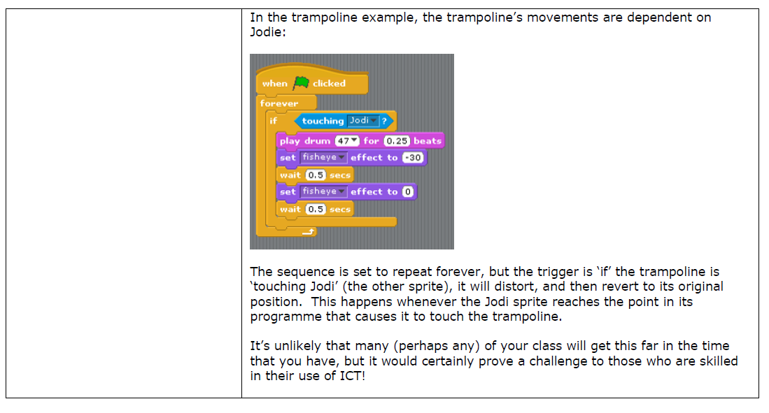
ICT
@
Using Scratch

