Slide 1

Lesson Objective & focus
Recognise that vibrations from sound travel through a medium to reach the air.

Slide 2
Input for new learning
Watch this first.
https://www.bbc.co.uk/bitesize/topics/zgffr82/articles/zx9hcj6
Complete the online quiz below the video

Slide 3
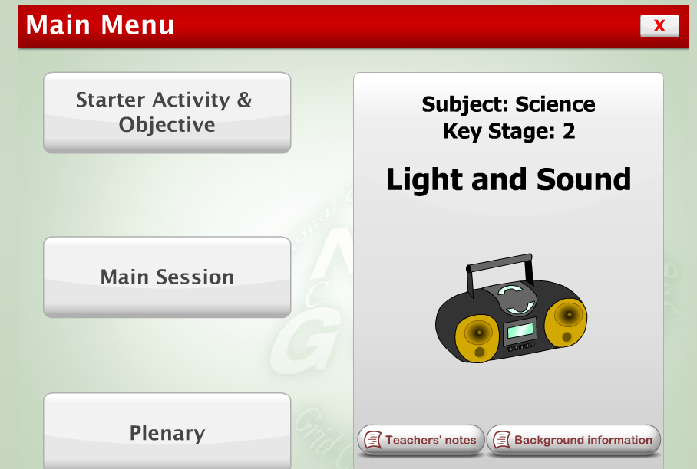
Task
Follow the interactive lesson by clicking on the picture below

