Slide 1

Lesson Objective & focus
Find patterns between the pitch of a sound and features of an object that produced it

Slide 2
Input for new learning
Watch this first.
https://www.bbc.co.uk/bitesize/topics/zgffr82/articles/z3j3jty
And complete the online quiz

Slide 3
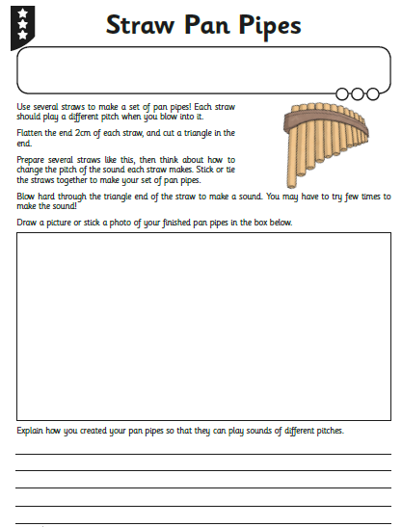
Task

Slide 5

Complete the investigation from dr. Cox video – can you make three different sounds from ordinary everyday objects? (The shaker; elastic band guitar; tuning fork – use a dinner fork)
Describe the sound that each makes – how are they different?
Task

