Slide 1

Lesson Objective & focus
Sound Investigation
Demonstrate your understanding of how sound moves through medium by making a telephone from strings and plastic cups.

Slide 2
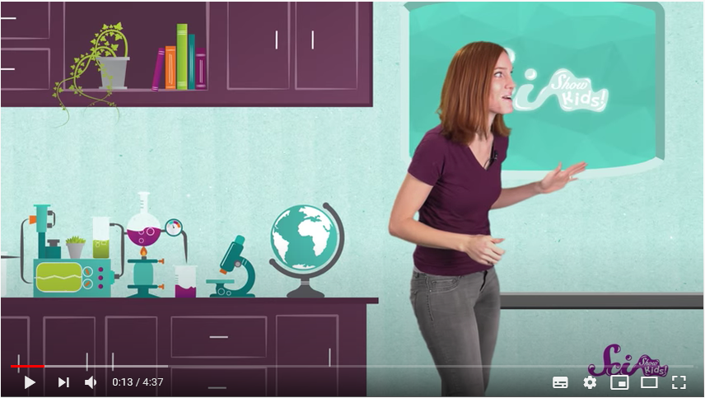
Input for new learning
Watch this first.
https://www.youtube.com/watch?v=3yqB2KFwJCo

Slide 3
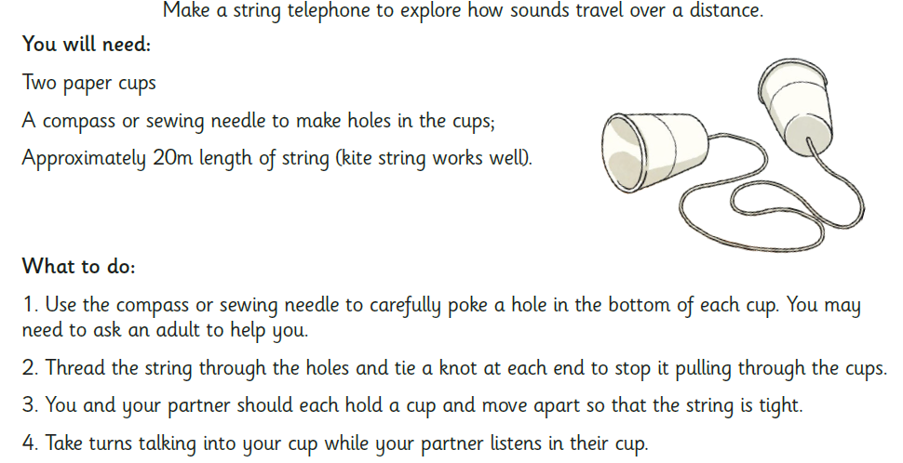
Task

Slide 4
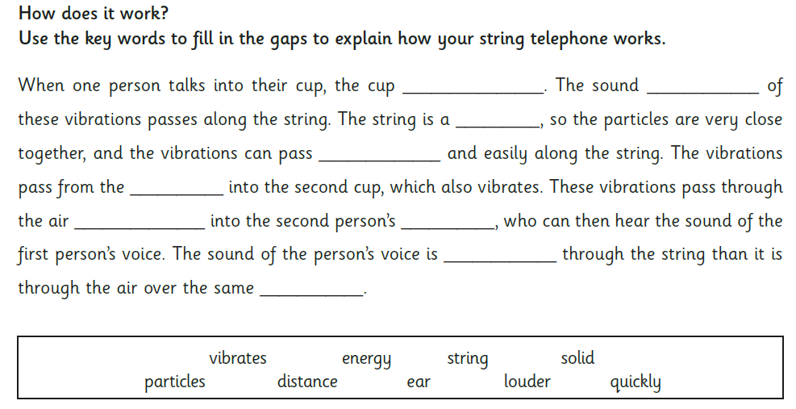
Task

