Slide 1

Lesson Objective & focus:
Identify how sounds are made and understand that vibrations create sound waves.

Slide 2
Input for new learning
Watch this first as a good all round introduction to the topic
https://www.youtube.com/watch?v=3-xKZKxXuu0
Then watch and complete this:
https://www.bbc.co.uk/bitesize/topics/zgffr82/articles/zstr2nb
Complete the online quiz below the video.

Slide 3
Task
Spooky sounds. Sit quietly for 60 seconds, make a list of everything you can hear. Try this in different places , indoors, outdoors or in in the bath.
What do you think it would sound like in space?
The next slides have some space sounds….

Slide 4
Spooky
Space
Sounds
Pete Edwards
Durham University
Notes:
Notice the Witch Head Nebula as the backdrop to the title slide
http://antwrp.gsfc.nasa.gov/apod/ap061211.html

Slide 5
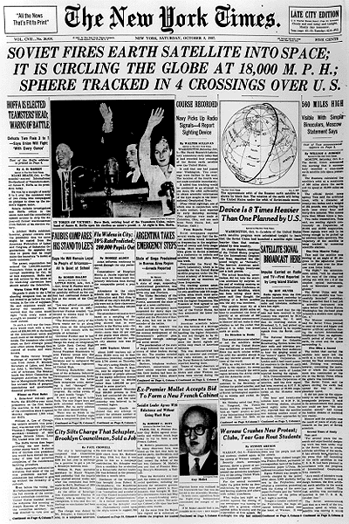
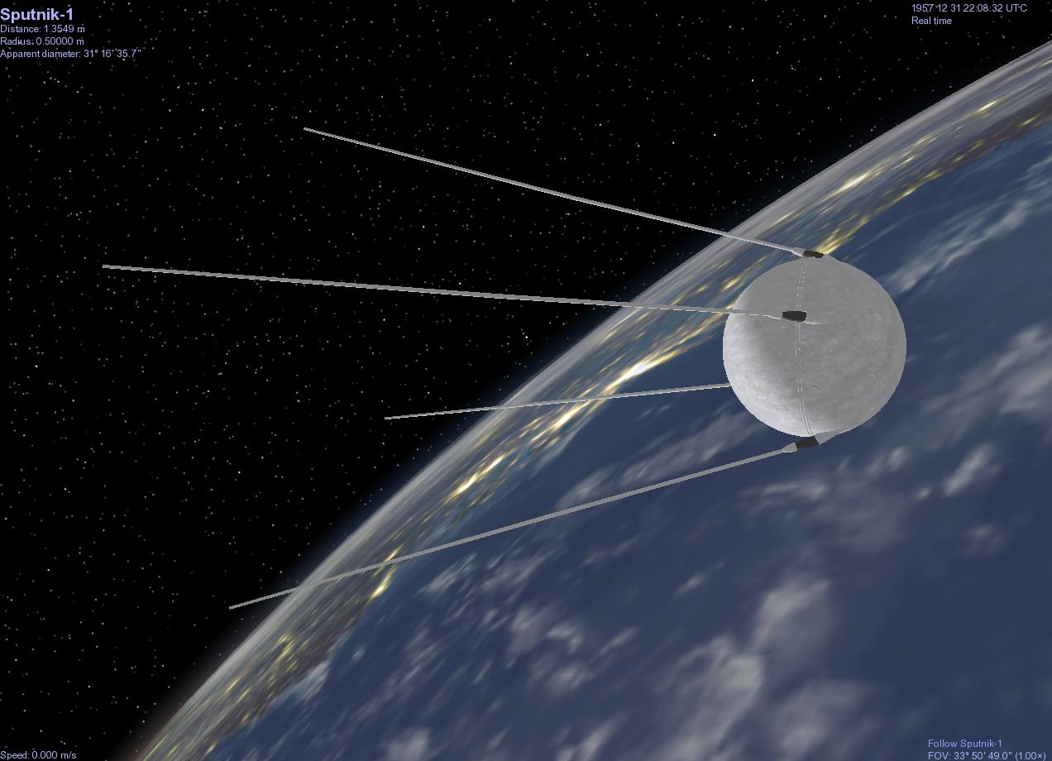
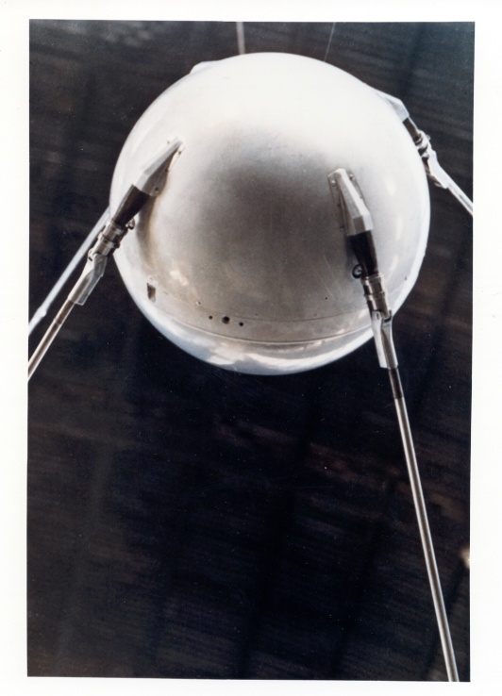

Notes:
Sputnik first artificial satellite in space launched by Soviets in 1957
Had on board a radio transmitter which broadcast radio signals which were picked up by receivers on Earth
http://history.nasa.gov/sputnik/

Slide 6
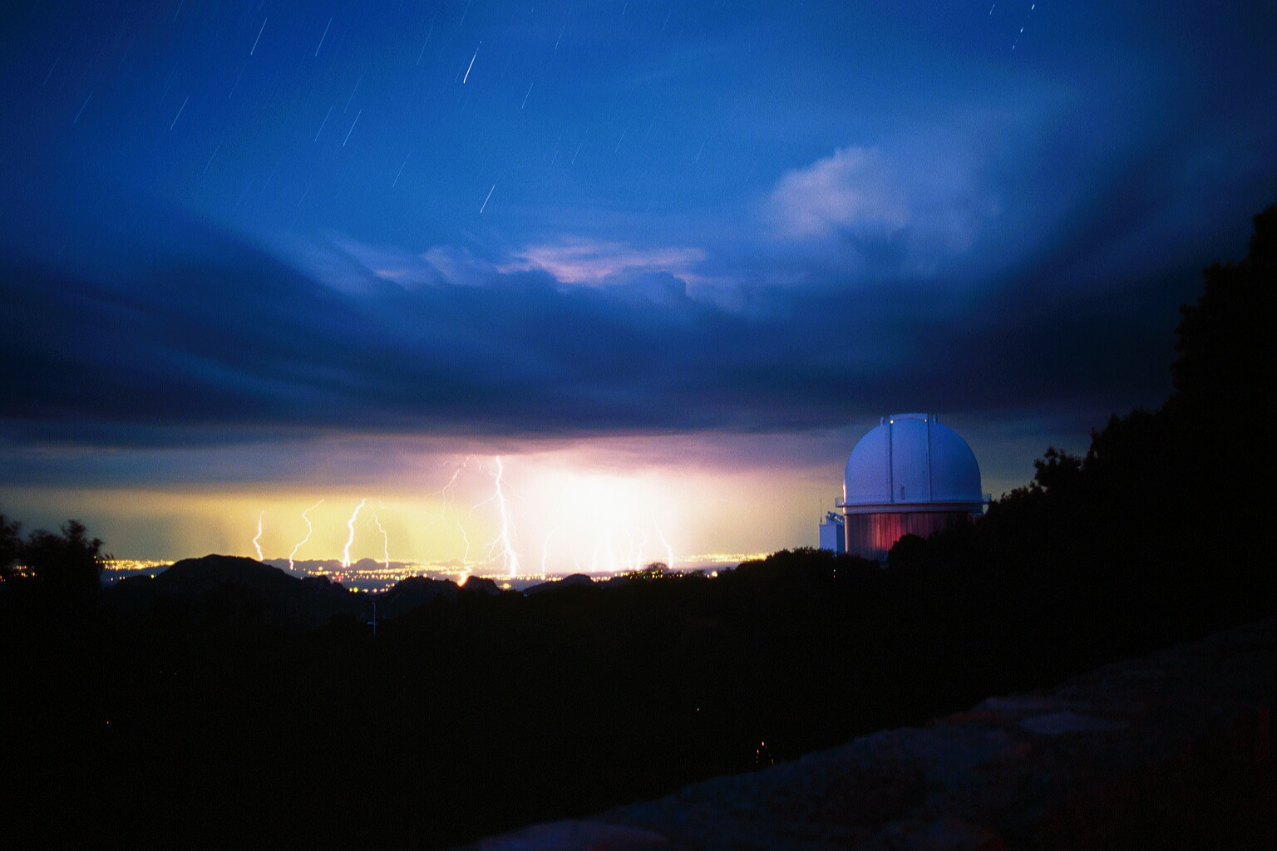
Notes:
Lightening strikes can produce ‘whistlers’ in the atmosphere

Slide 7
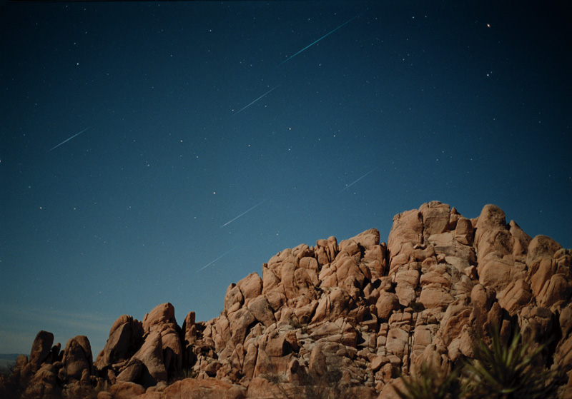
Notes:
Shooting stars can also produce radio transmissions – here is a recording of the radio emission and a picture and of the Leonids Meteor shower
http://antwrp.gsfc.nasa.gov/apod/ap031118.html

Slide 8
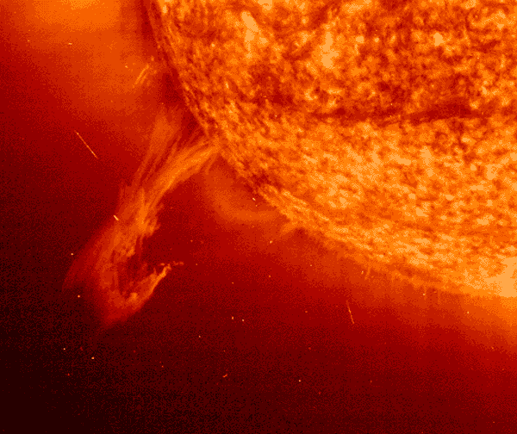

Notes:
Sunspots are associated with Solar Flares. These release a cloud of charged particles, the Solar Wind, which can blow towards the Earth producing radio emission
http://hesperia.gsfc.nasa.gov/sftheory/

Slide 9
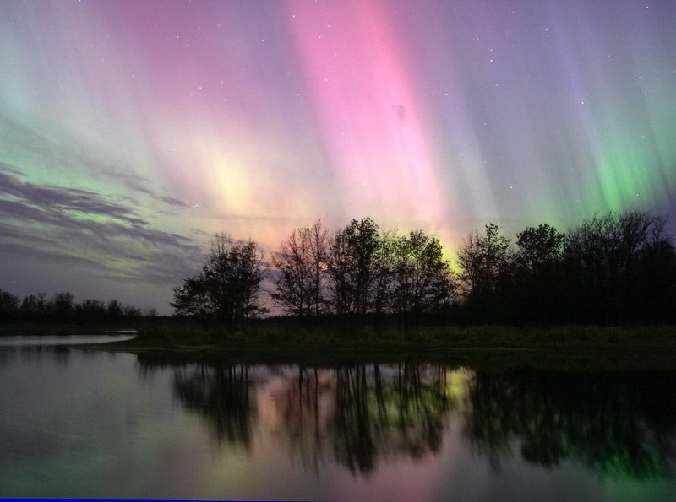
Notes:
This is what causes the Northern (and Southern) lights – the Aurora Borealis (North) and Aurora Australis (South)
http://antwrp.gsfc.nasa.gov/apod/ap041117.html
These also produce radio emission that we can record

Slide 10
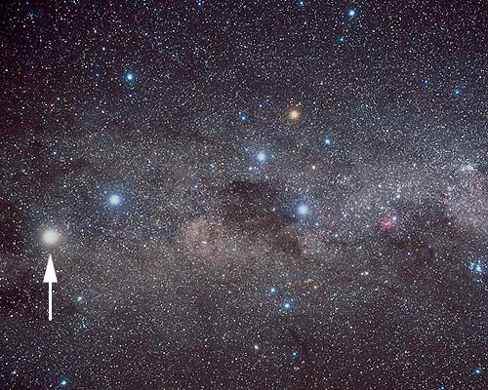
α Centauri
Notes:
Alpha Centauri with a radius 1.3 times that of the sun

Slide 11
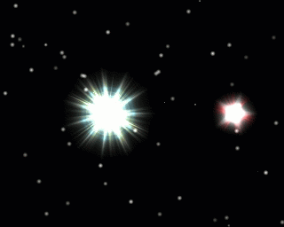
HR 3881
Notes:
HR 3831 with a radius about 1.9 bigger than that of the sun
A binary star - http://imagine.gsfc.nasa.gov/docs/science/know_l1/binary_stars.html

Slide 12
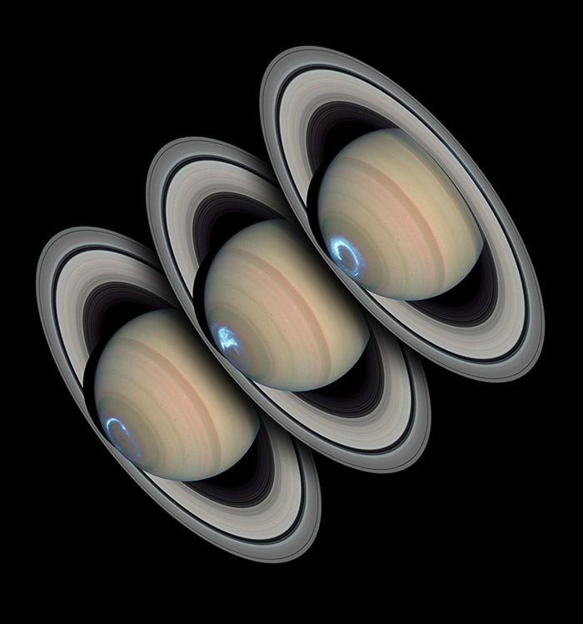
Notes:
Finally the radio emission from an aurora on Saturn as recorded by Cassini
http://saturn.jpl.nasa.gov/multimedia/images/image-details.cfm?imageID=1613
http://antwrp.gsfc.nasa.gov/apod/ap050222.html

Slide 13
Investigation
To try the musical coat hanger experiment

