Slide 1
YEAR 5 HOME LEARNING

Slide 2

2 WEEK BLOCK: ENGLISH

Slide 3

ACTIVITY 1
COMPREHENSION
There are several comprehensions for year 5 on the school website. Choose two, that interest you, to complete.
You may complete them all if you have time but only if you have completed the ‘Explorers’ writing tasks.
Read aloud to someone at home if you need to, to help you with this task.
20 MINUTES

Slide 4

ACTIVITY 2
GRAMMAR
Choose a game each day from one of the websites below.
https://www.topmarks.co.uk/english-games/7-11-years/spelling-and-grammar
http://www.sheppardsoftware.com/grammargames/pandapopPartsofSpeech.htm
http://www.crickweb.co.uk/ks2literacy.html
https://www.bbc.co.uk/bitesize/topics/zhrrd2p
http://www.primaryhomeworkhelp.co.uk/literacy/
http://www.funenglishgames.com/grammargames.html
10 MINUTES

Slide 5

ACTIVITY 3
WRITING COMPOSITION ( 2 X per week)
Please follow this link to Authorfy website where authors have posted daily writing challenges. You can choose your own author challenge from the growing selection available. A new challenge is posted daily.
https://authorfy.com/10minutechallenges/
30 MINUTES

Slide 6
Writing Composition- Big write Week 1 (30 minutes 3 X each week)
What makes someone a great explorer?
Log on to Active Learn and then Wordsmith.
2. Look in My Stuff and read Ultimate Explorers eBook- screen 1 and 2
(don’t forget the pop ups/footprints).
3. Write a large paragraph explaining the skills and qualities needed
to be an explorer.
In My Stuff, complete ‘Improve It’.
5. Watch ‘Amazon Adventure’ in My Stuff. Read ‘Advertisement features’ in My Stuff.
Use ‘Join us’ in My Stuff to make notes on.
Write an advert for ‘The Explorer Times’ to encourage a junior explorer to join a new
expedition to the Amazon rainforest. Aim to write ½ page and remember the language
you used to persuade Mr Zuckerman to not kill Wilbur in Charlotte’s Web.

Slide 7
Writing Composition- Big write Week 2 (30 minutes 3 X each week)
What makes someone a great explorer?
Log on to Active Learn then Wordsmith.
Read the eBook Ultimate Explorers up to screen 7. Don’t forget to watch the video on screen 6.
Who is the bravest-Ellen or Helen? What dangers did they both face? How did they feel? Write a short explanation as to why you think this, giving at least three reasons. Use Ellen or Helen? sheet in My Stuff.
Choose your own explorer to write about. You could choose an explorer already mentioned in the eBook and do some extra research or you could choose your own explorer who you’d like to find out about. Here are some ideas: Sir Tim Peake, Sir David Attenborough, Amelia Earhart, Steve Backshall, Bear Grylls, Sir Ernest Shackleton, Sir Edmund Hillary, Neil Armstrong, Christopher Columbus. This writing will probably take two days.

Slide 8
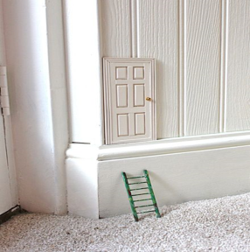

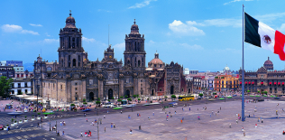

WRITING COMPOSITION- Daily Challenge if you have time after your Explorers work. ( 10 minutes)
Choose a task each day or alternatively spend longer on one task over a few days
One day you find this door in the corner of your room. What is it for? Where does it take you?
Write a blurb for a story you have read.
Create a travel brochure for a chosen destination.
Write a set of instructions for an activity you have completed, or an experiment you have carried.

Slide 9

ACTIVITY 4
SPELLING
Please continue to work through the Year 5/6 lists at the back of your planner– aim to learn 10 new spellings each week and revisit 10 from previous weeks.
Get someone to test you on them at the end of the week.
10 MINUTES

Slide 10

ACTIVITY 5
READING
Please ensure you continue to read a good quality reading book.
Talk to someone at home about the book that you are reading.
Read a few pages aloud to somebody; this is a different skill to silent reading. Can you make it exciting? Use different voices.
25 MINUTES

