Slide 1
YEAR 5 HOME LEARNING
Here are some more exciting and interesting activities for you to have a go at whilst learning at home.
Thank you for all your super work that you’ve sent us. You have obviously been working hard-keep sending it in!
Take care and see you all soon.
Mrs Martin, Mrs Gumbrell and Mrs Holden

Slide 2

2 WEEK BLOCK: ENGLISH – Weeks beginning: 18th May and 1st June 2020

Slide 3

Main Activity – Option 1
3 x per week
Click on the link below to access your English lessons for the next two weeks using the National Oak Academy website
https://www.thenational.academy/online-classroom/schedule
Select – Year 5
Then Select the English lesson for each day this week

Slide 4

Alternatively…..
Main activity – Option 2
3 x per week
BBC Bitesize – Daily English lessons
Click on the link below to access the daily English lessons for Year 5 from BBC Bitesize
https://www.bbc.co.uk/bitesize/dailylessons
Select – Year 5
Then select the daily English lesson each day this week

Slide 5
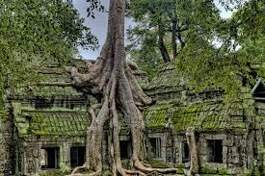
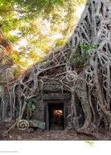

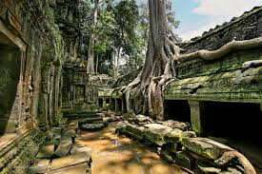
Big Write Imaginary Story 2 x per week
We know you enjoy writing stories and that some of you have already been writing your own.
The photographs on this slide and the next are of amazing places and trees.
Think about where these places could be and the magic and mystery that surrounds them.
How did these trees end up as they are? What created their shape?
Does anyone live in them? Who are they and what do they look like? Do they have special powers?
Brainstorm noun phrases/expanded noun phrases to describe your place and any characters.
Think about your story mountain: opening, build up, climax, resolution and ending. Plan your story.
Try to include: fronted adverbials as sentence starters; precise, descriptive language; conjunctions; relative clause beginning with who, which, that; ideas grouped in paragraphs and a variety of punctuation such as , (), - - :; ? !

Slide 6

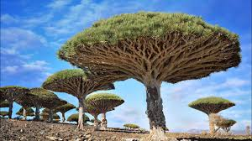
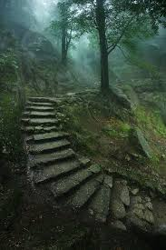
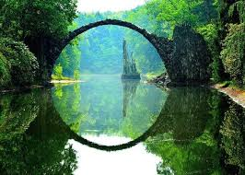
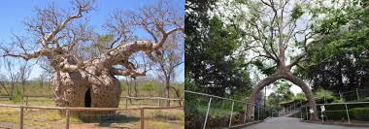
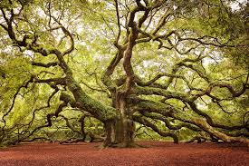
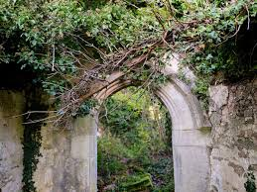
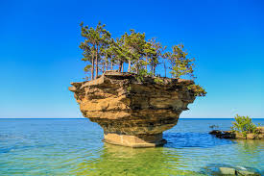


Slide 7


Extra Activities/Tasks
Doodle English / Doodle Spell
Spend 10 minutes playing on the Doodle App for English or spelling each day.
10 MINUTES
You can download the computer apps here:
English: https://www.doodleenglish.com/download-doodleenglish-windows-macs/
Or you can use the Google Chrome web browser on your PC, laptop or Mac:
students.doodleenglish.com
students.doodleenglish.com/spell

Slide 8

SPELLING
Please continue to work through the Year 5 lists – aim to learn 10 new spellings each week and revisit 10 from previous weeks. If you have learnt them all, keep practicing and putting them into interesting sentences.
Get someone to test you on them at the end of the week.
10 MINUTES

Slide 9

READING
Please ensure the children continue to read a good quality reading book.
Talk to someone at home about the book that you are reading.
Read a few pages aloud to somebody; this is a different skill to silent reading. Can you make it exciting? Use different voices.
30 MINUTES

Slide 10


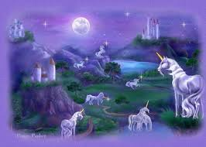

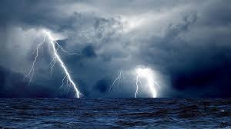
Choose a task each day or alternatively spend longer on one task over a few days
Write a poem about this imaginary world.
Lots of you are cooking. Write a set of instructions.
Write a Biography for a person of your choice that inspires you. They may not be famous-just someone you know
Describe the picture above using expanded noun phrases and precise, interesting language.

Slide 11

OPTIONAL EXTRA HOME LEARNING EXTENSION ACTIVITIES
WRITING COMPOSITION
Please follow this link to Authorfy website where authors have posted daily writing challenges. Children can choose their own author challenge from the growing selection available. A new challenge is posted daily.
https://authorfy.com/10minutechallenges/
Alternatively or as well as they could choose a writing task from the next slide!
30 MINUTES

