Slide 1
YEAR 5 HOME LEARNING
It was great to see most of you either via zoom or in school.
Here are some more interesting activities for you including a new ebook-Animals on the Move.
Take care and see you all soon.
Mrs Martin, Mrs Gumbrell and Mrs Holden

Slide 2

2 WEEK BLOCK: ENGLISH – Weeks beginning: 8th June and 15th June 2020

Slide 3

Main Activity – Option 1
3 x per week
Click on the link below to access your English lessons for the next two weeks using the National Oak Academy website
https://www.thenational.academy/online-classroom/schedule
Select – Year 5
Then Select the English lesson for each day this week

Slide 4

Alternatively…..
Main activity – Option 2
3 x per week
BBC Bitesize – Daily English lessons
Click on the link below to access the daily English lessons for Year 5 from BBC Bitesize
https://www.bbc.co.uk/bitesize/dailylessons
Select – Year 5
Then select the daily English lesson each day this week

Slide 5
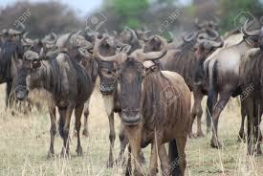
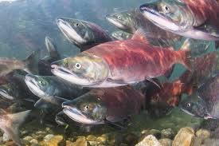
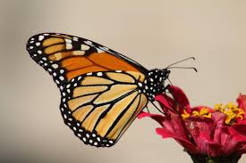
Big Write Animals on the Move (non-fiction) 2 x per week
Which animal makes the toughest migration?
Log on to Active Learn and Wordsmith.
Look in ‘My Stuff’ and read the ebook Animals on the Move.
What does migration mean? If you are still unsure, look it up in a dictionary.
You are going to be learning about facts and opinions. Use in ‘My Stuff’ Fact or opinion to work out which sentence starters are facts and which are opinions.
In ‘My Stuff’ complete the next Fact or opinion? To sort the facts and opinions, explaining your choices. Stick the statements onto separate pieces of paper under the headings Facts or Opinions.
Look carefully at the Contents and Index screens of the ebook.
Complete the quiz questions set in ‘My Stuff’.
Complete your own quiz questions set in ‘My Stuff’. Test a family member or friend if possible.

Slide 6


Extra Activities/Tasks
Doodle English / Doodle Spell
Spend 10 minutes playing on the Doodle App for English or spelling each day.
10 MINUTES
You can download the computer apps here:
English: https://www.doodleenglish.com/download-doodleenglish-windows-macs/
Or you can use the Google Chrome web browser on your PC, laptop or Mac:
students.doodleenglish.com
students.doodleenglish.com/spell

Slide 7

SPELLING
Please continue to work through the Year 5 lists – aim to learn 10 new spellings each week and revisit 10 from previous weeks. If you have learnt them all, keep practicing and putting them into interesting sentences.
Get someone to test you on them at the end of the week.
10 MINUTES

Slide 8

READING
Please ensure the children continue to read a good quality reading book.
Talk to someone at home about the book that you are reading.
Read a few pages aloud to somebody; this is a different skill to silent reading. Can you make it exciting? Use different voices.
30 MINUTES

Slide 9




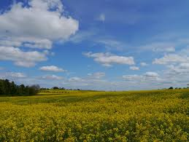
Choose a task each day or alternatively spend longer on one task over a few days
Choose a sport. Write a set of instructions for your chosen sport including what equipment will be needed, rules and how to play. Make your instructions very clear-pretend they are for someone who has never played before.
Design a meal including starters, main and pudding. List the ingredients and instructions. Cook your meal with help.
Write an acrostic poem. Begin each line with a letter from Wonderful Weather.
Create your own comic strip story.

Slide 10

OPTIONAL EXTRA HOME LEARNING EXTENSION ACTIVITIES
WRITING COMPOSITION
Please follow this link to Authorfy website where authors have posted daily writing challenges. Children can choose their own author challenge from the growing selection available. A new challenge is posted daily.
https://authorfy.com/10minutechallenges/
Alternatively or as well as they could choose a writing task from the next slide!
30 MINUTES

