Slide 1
YEAR 5 HOME LEARNING
It was great to see most of you again either via zoom or in school.
We are going to continue with our ebook-Animals on the Move.
Take care and hopefully see you all soon.
Mrs Martin, Mrs Gumbrell and Mrs Holden

Slide 2

2 WEEK BLOCK: ENGLISH – Weeks beginning: 6th July and 13th July 2020

Slide 3

Main Activity – Option 1
3 x per week
Click on the link below to access your English lessons for the next two weeks using the National Oak Academy website
https://www.thenational.academy/online-classroom/schedule
Select – Year 5
Then Select the English lesson for each day this week

Slide 4

Alternatively…..
Main activity – Option 2
3 x per week
BBC Bitesize – Daily English lessons
Click on the link below to access the daily English lessons for Year 5 from BBC Bitesize
https://www.bbc.co.uk/bitesize/dailylessons
Select – Year 5
Then select the daily English lesson each day this week

Slide 5
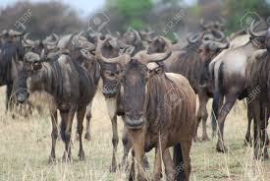
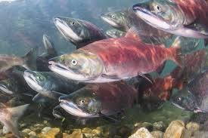
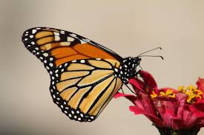
Big Write Animals on the Move (non-fiction) 2 x per week
Which animal makes the toughest migration?
Log on via Active Learn to your Wordsmith account.
Read the ebook Animals on the Move including all the pop ups.
Read the animal fact files in the pop ups on screen 8 of the book.
Choose one animal and think about how the information about this animal has been presented in the fact file.
Identify the language choices made and the way the text is structured and presented.
Use Museum fact file in My Stuff – choose another animal/s from the ebook and create your own fact file entries for a museum exhibition about animal migration.
Read report features in My Stuff.
Read screen 4 of the ebook on salmon migration. Identify the key features of a report text.
Think about how these features help the author to present information about the salmon’s migration.
Use Animal report in My Stuff. Create your own report text describing another animal’s migration. Use secondary sources such as non-fiction books and web sites (remember esafety) and use features including introductory paragraph, fact box, bullet points, maps and photographs showing migratory groups.

Slide 6


Extra Activities/Tasks
Doodle English / Doodle Spell
Spend 10 minutes playing on the Doodle App for English or spelling each day.
10 MINUTES
You can download the computer apps here:
English: https://www.doodleenglish.com/download-doodleenglish-windows-macs/
Or you can use the Google Chrome web browser on your PC, laptop or Mac:
students.doodleenglish.com
students.doodleenglish.com/spell

Slide 7

SPELLING
Please continue to work through the Year 5 lists – aim to learn 10 new spellings each week and revisit 10 from previous weeks. If you have learnt them all, keep practicing and putting them into interesting sentences.
Get someone to test you on them at the end of the week.
10 MINUTES

Slide 8

READING
Please ensure the children continue to read a good quality reading book.
Talk to someone at home about the book that you are reading.
Read a few pages aloud to somebody; this is a different skill to silent reading. Can you make it exciting? Use different voices.
30 MINUTES

Slide 9



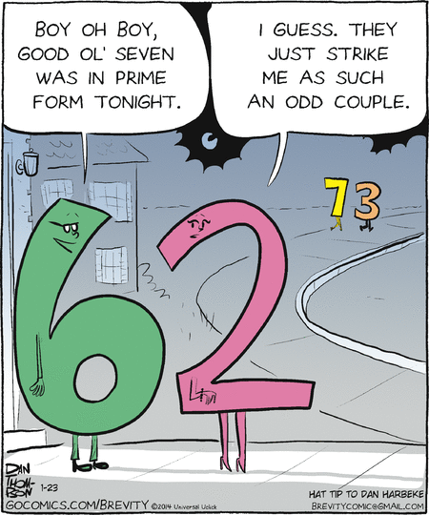

Choose a task each day or alternatively spend longer on one task over a few days
Choose a sport. Write a set of instructions for your chosen sport including what equipment will be needed, rules and how to play. Make your instructions very clear-pretend they are for someone who has never played before.
Design a meal including starters, main and pudding. List the ingredients and instructions. Cook your meal with help.
Draw and write a comic strip for an imaginary story.
Be as creative as you can!
Describe the picture above using expanded noun phrases and precise, interesting language. Ask someone to draw a picture using your description.
Were they able to do it? Was your description precise enough?

Slide 10

OPTIONAL EXTRA HOME LEARNING EXTENSION ACTIVITIES
WRITING COMPOSITION
Please follow this link to Authorfy website where authors have posted daily writing challenges. Children can choose their own author challenge from the growing selection available. A new challenge is posted daily.
https://authorfy.com/10minutechallenges/
Alternatively or as well as they could choose a writing task from the next slide!
30 MINUTES

