Slide 1
My Local History topic
At the moment, you cannot go out and about in Leatherhead taking photographs, sketching and finding evidence about all the exciting things that you are going to learn about. That doesn’t matter, you can do that at a later time. I have added lots of great photographs to help you with your learning.
I have put in RED and bold anything that I want you to do.
Let’s get learning!

Slide 2
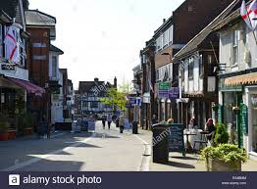
Why is Letherhead called Leatherhead?

Slide 3
Draw a time line
(See the next slide for my version)
Sellotape two pieces of A4 paper together
Draw a line across the middle horizontally
Mark along the line 1.5cm to represent 50 years-700 AD to 2000 AD.
You will be adding dates, people and events to your time line as you learn about Leatherhead.
( There is not enough room to put on all the dates like the Roman times).

Slide 4
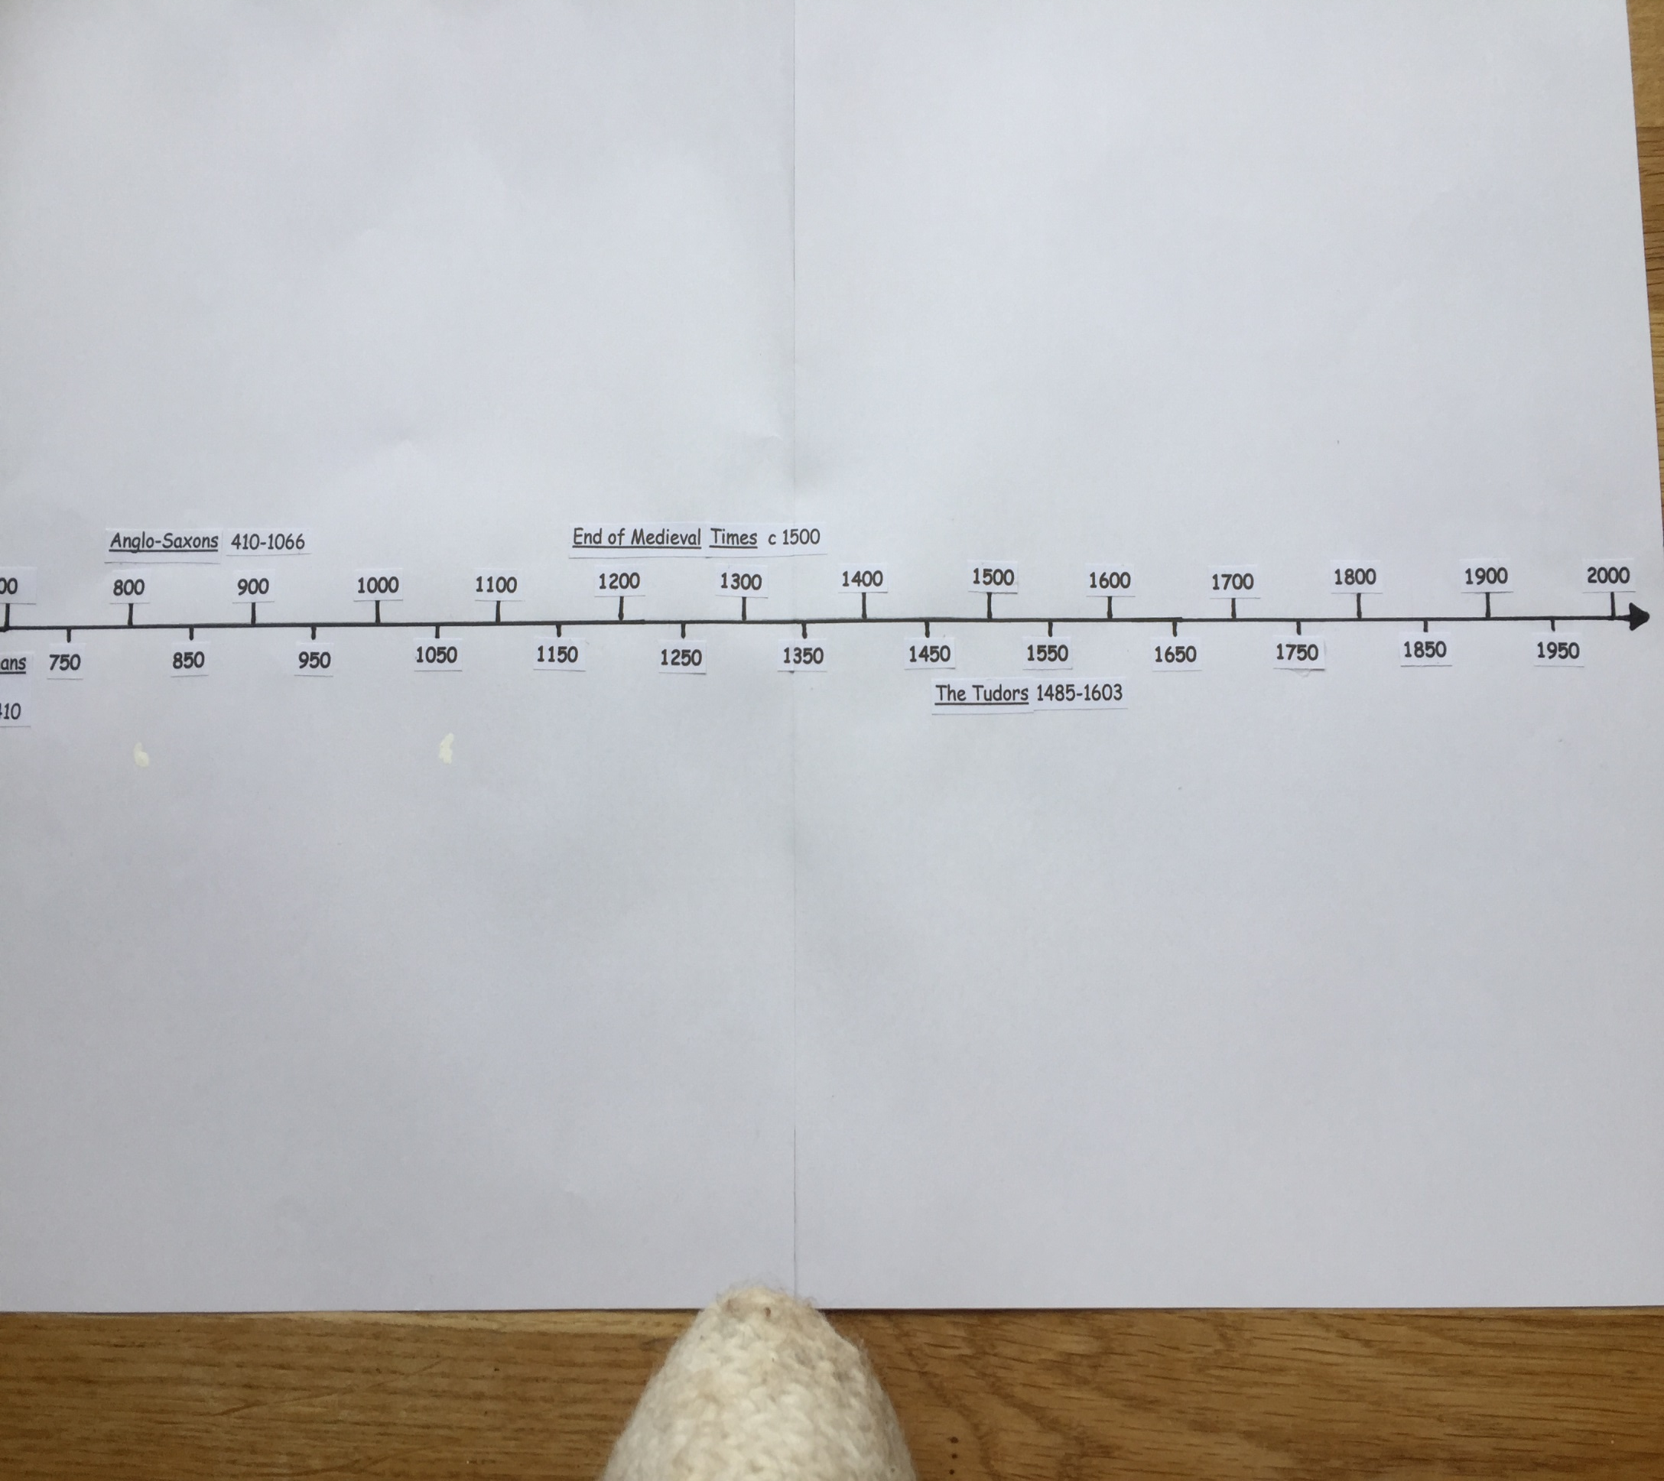

Slide 5
Look carefully at the following six maps.
Find the date of the map in the bottom right hand corner.
Put the person and date of the map on your time line.
Find Leatherhead on each map. Look for the River Mole to help you. The river used to be called Emelene Stream. In the Domesday Book of 1086 it appears as Amele and then Emele in records found in the 12th and 13th centuries. The name is probably from an old English word aemen meaning misty or causing mists.
Label The Domesday Book of 1086 and the River Mole is called Amele.
The River changed its name to the River Moul sometime around 1577.
Put this date and River Moul on your timeline as well.
Look at Seller’s map of Surrey 1693. In the top left-hand corner, you will see the ‘Moul R’ labelled.
Note the spelling of Leatherhead on each map.
Find the river crossing on the later two maps.
Look at the map from 1350. Find the Emelene Stream. How did people cross the stream?
Follow the road up from the river, up Bridge Street to the main crossroads. Can you remember what shops boarder this crossing today?

Slide 6
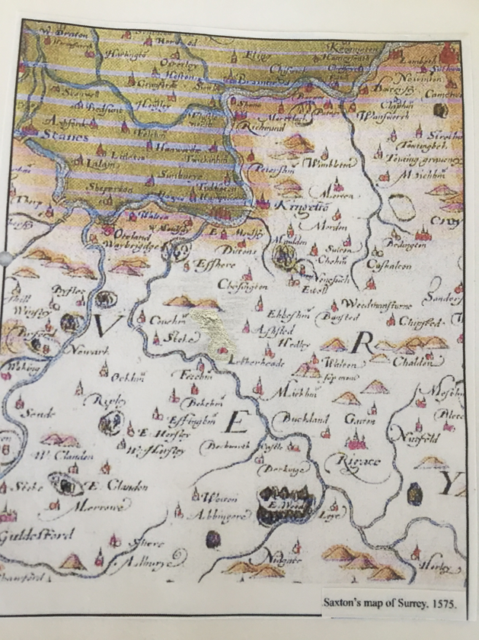

Slide 7
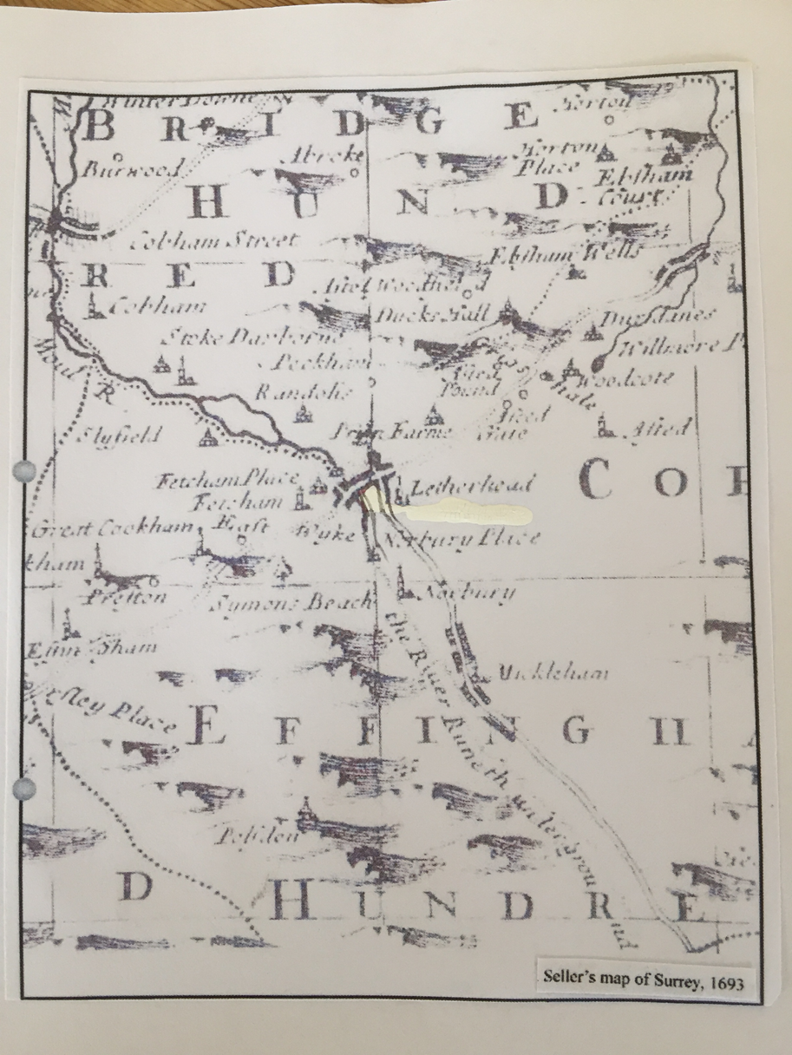

Slide 8
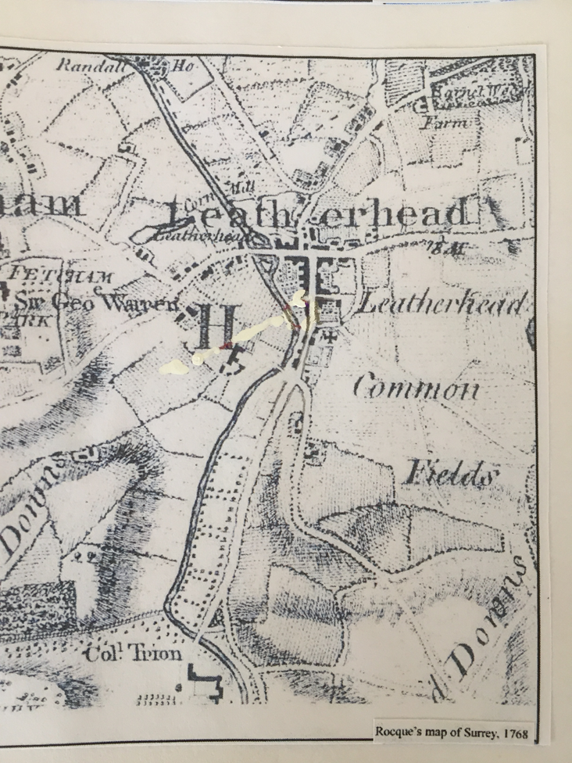

Slide 9
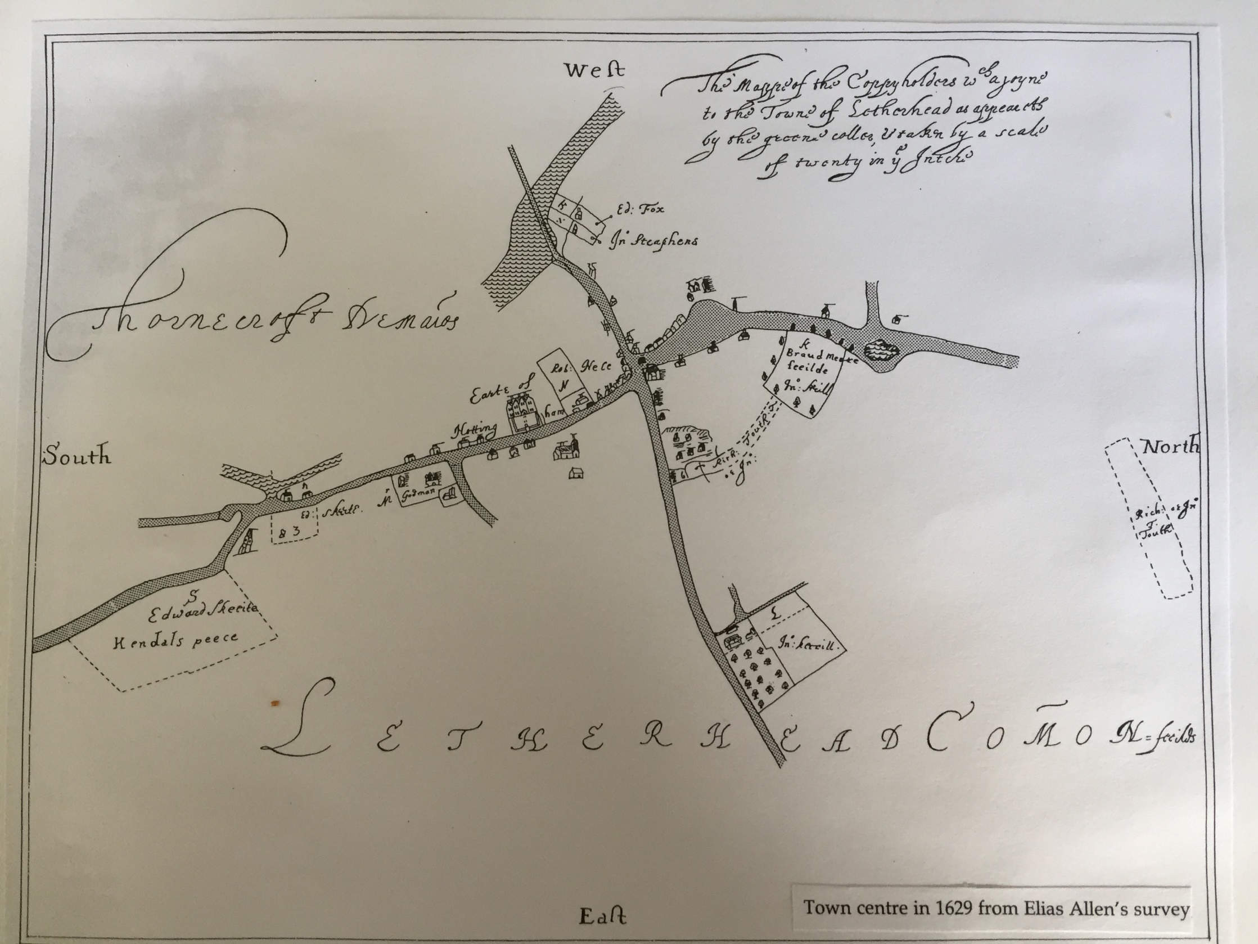

Slide 10
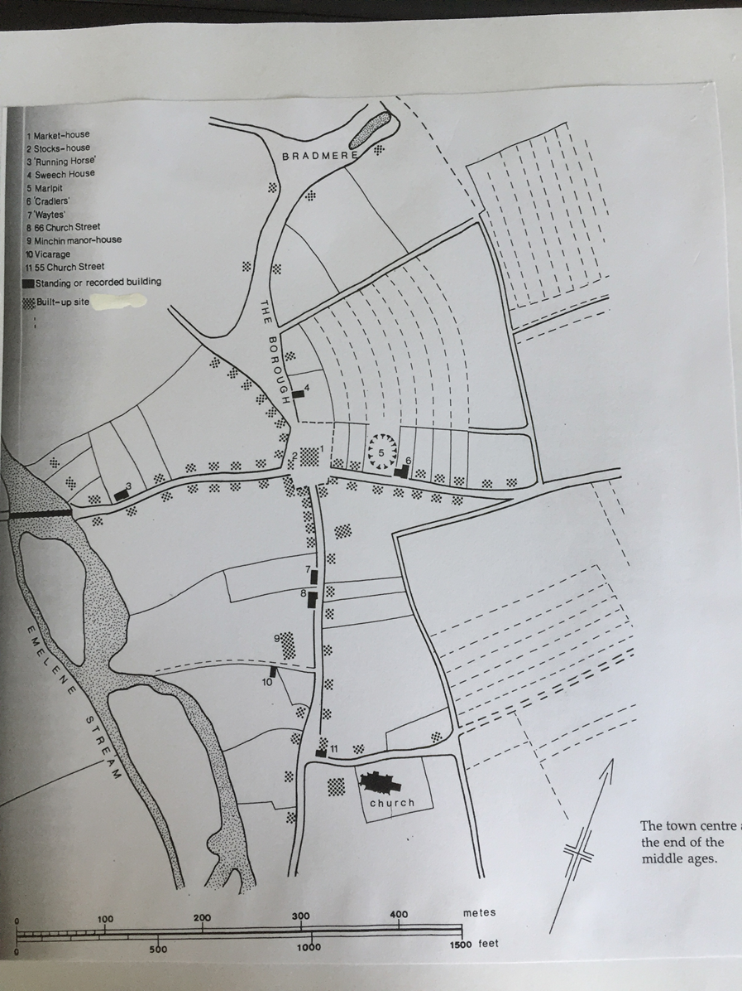

Slide 11
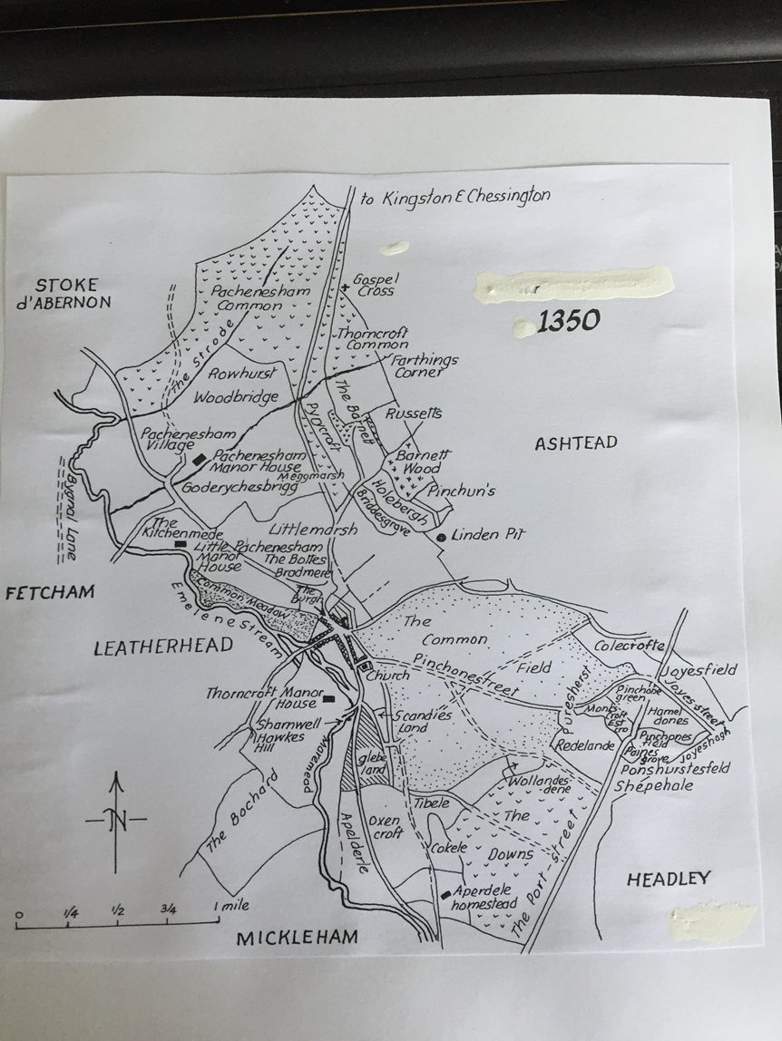

Slide 12
The Settlement
1. The earliest mention of Leatherhead is as Liodridan in 880AD in the will of King Alfred Great who left the land at Liodridan to his son Edward.
Put this date on your timeline with a label.
2. Liodridan was one of only two Celtic names that came from pockets of settlement after the Anglo-Saxon invasion.
It comes from Led and Rid which mean grey ford in Celtic.
Leoda ride means public ford in Anglo-Saxon.
What is a ford? (clue-it is something to do with a river)
3. Gradually the spelling changed including Leodride, Ledrede, Leret then Letherhead.
4. Two Saxon cemeteries have been found in Fetcham and also Leatherhead.
5. The town was a centre of royalty and government during these times and had an important church. It had early importance because it was near to the centre of the county and nearer to London than Guildford.

Slide 13
LO: To find evidence that Leatherhead was once spelt Letherhead.
Look carefully at the next two slides of photographs of primary evidence.
Draw a table with 3 columns like my example.
Complete the table using the evidence on the two slides.
DATE (on evidence) | TYPE (Photograph, painting) | EVIDENCE (what does it show)

Slide 14
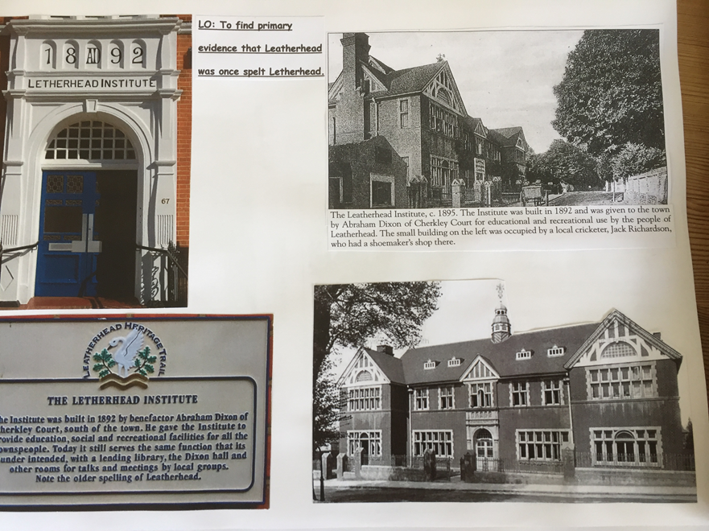

Slide 15
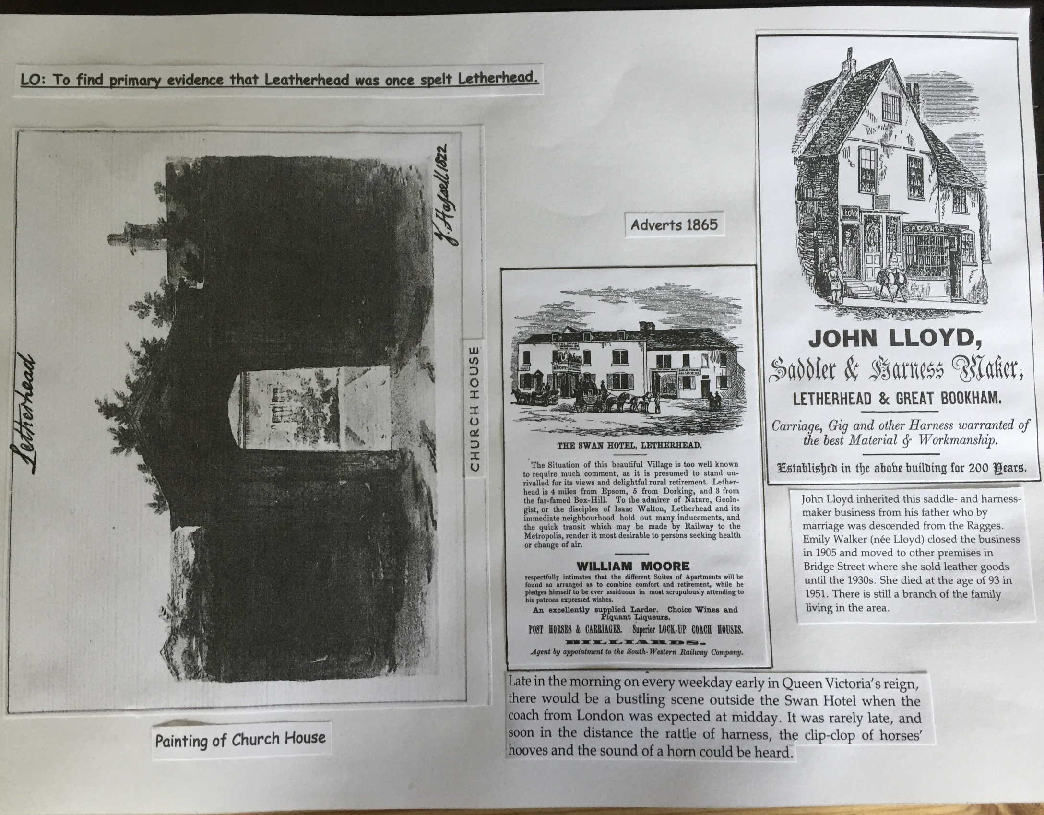

Slide 16
Why did ‘Letherhead’ grow as a settlement where it did? Where did its name come from?
Use the information that you have already learnt.
Use the map on the next slide to help give you clues.
Write a paragraph explaining why ‘Letherhead’ grew as a settlement where it did and where its name came from?

Slide 17


