Slide 1
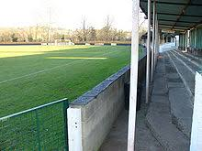
Lesson 2
Local History
Why is Leatherhead football club called The Tanners?

Slide 2
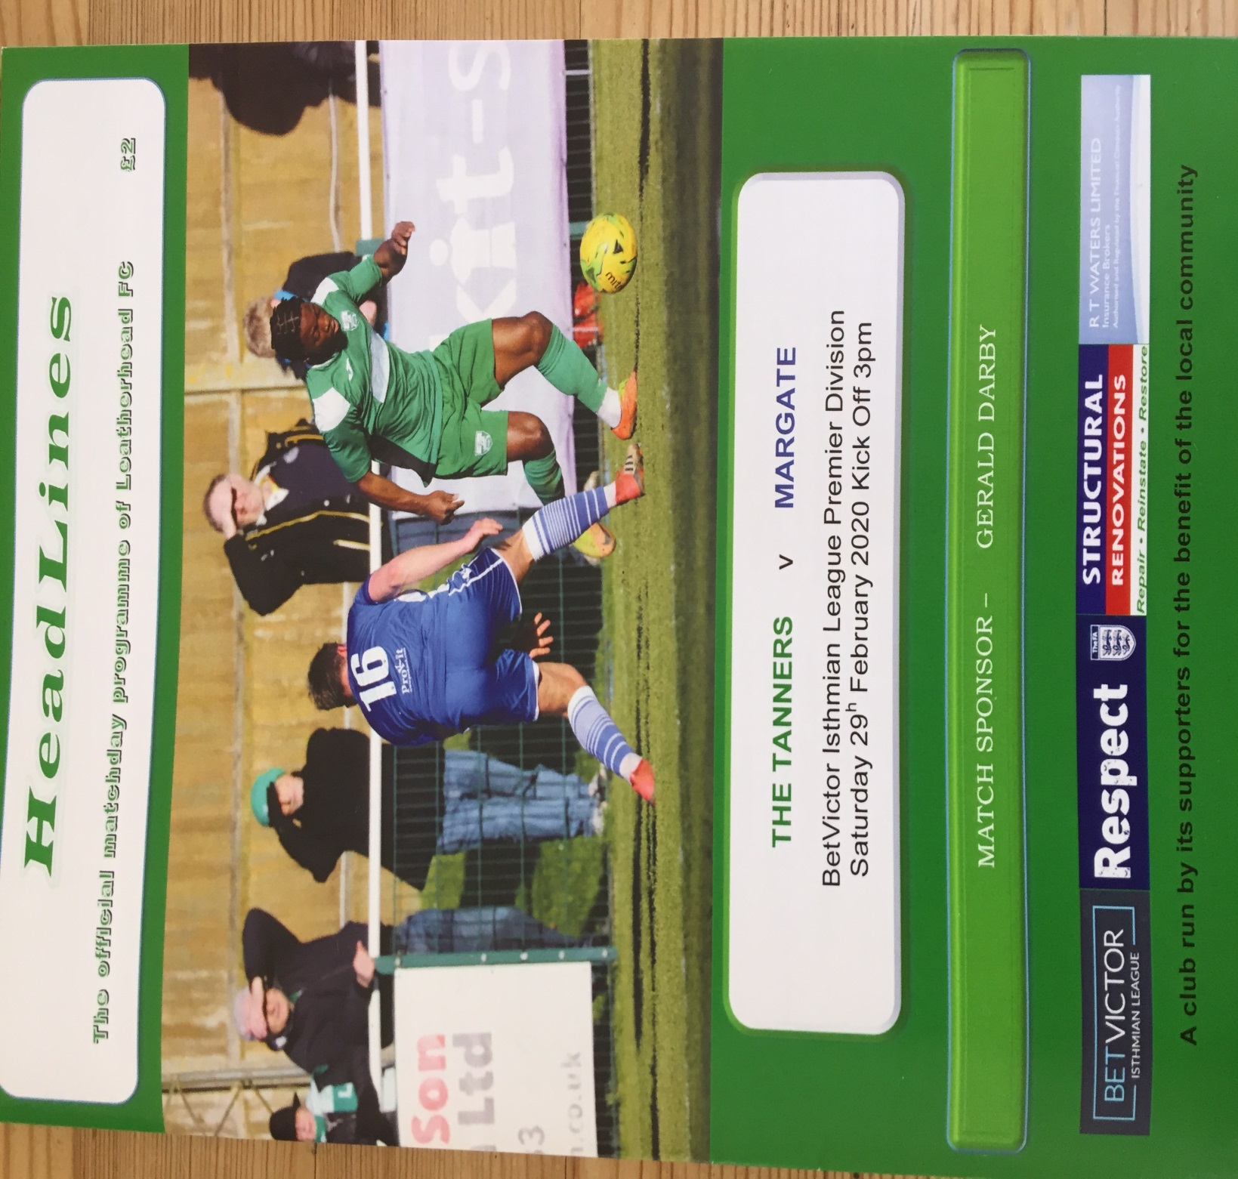

Slide 3
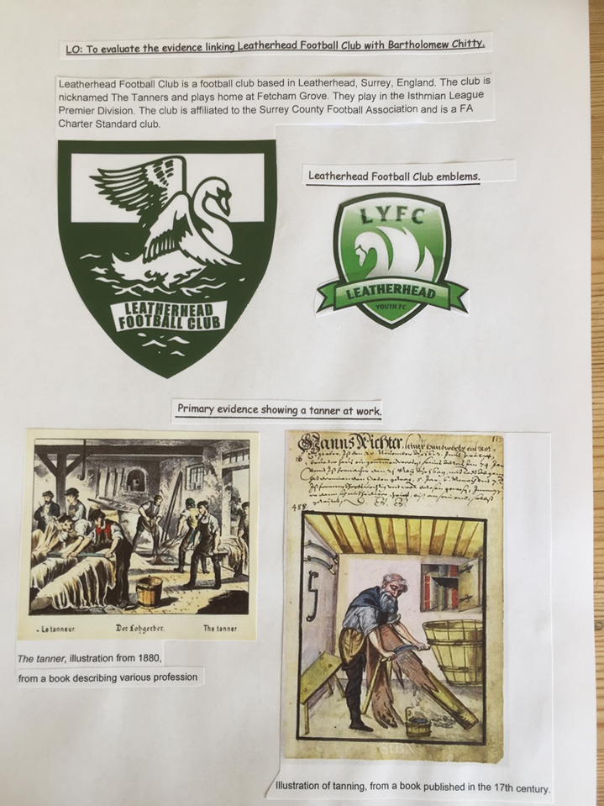

Slide 4
Look at the next slide.
This slide shows you the Census records of a man called Bartholomew Chitty.
What is a census and what data is collected?
The first Census record is of 1853.
2. How old was Bartholomew Chitty when this Census was taken?
3. Who was in his family?
4. The second Census record is of which year? ( clue: look at his age)
5. What was Bartholomew Chitty’s job title?
6.Add to your timeline- ’The Tannery owned by Bartholomew Chitty was prosperous and employed 15 men in 1861. It closed in the 1870’s’.

Slide 5
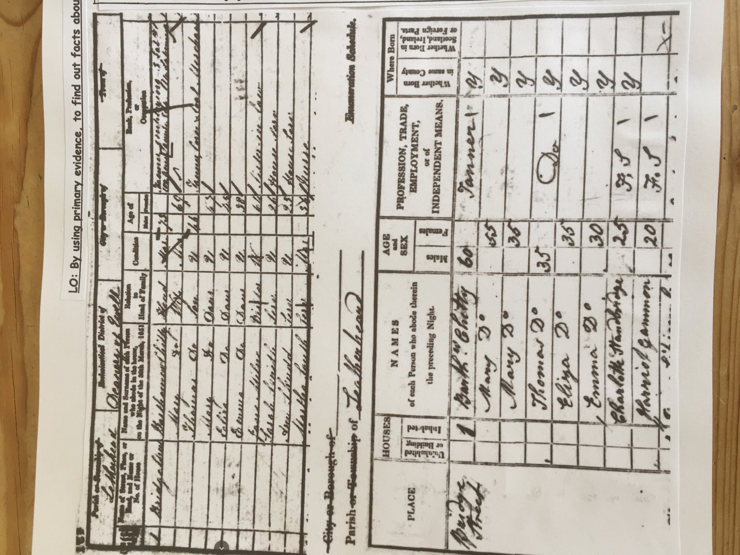

Slide 6
Bartholomew Chitty
Bartholomew Chitty was a rich landowner who invested a great deal of money and time into Leatherhead. He was the owner of a Tannery, Saddlery and Butchers.
What is a Tannery ?
What is a Saddlery?
What did the butcher do?
Write a paragraph.
Use the following two slides to help you.

Slide 7
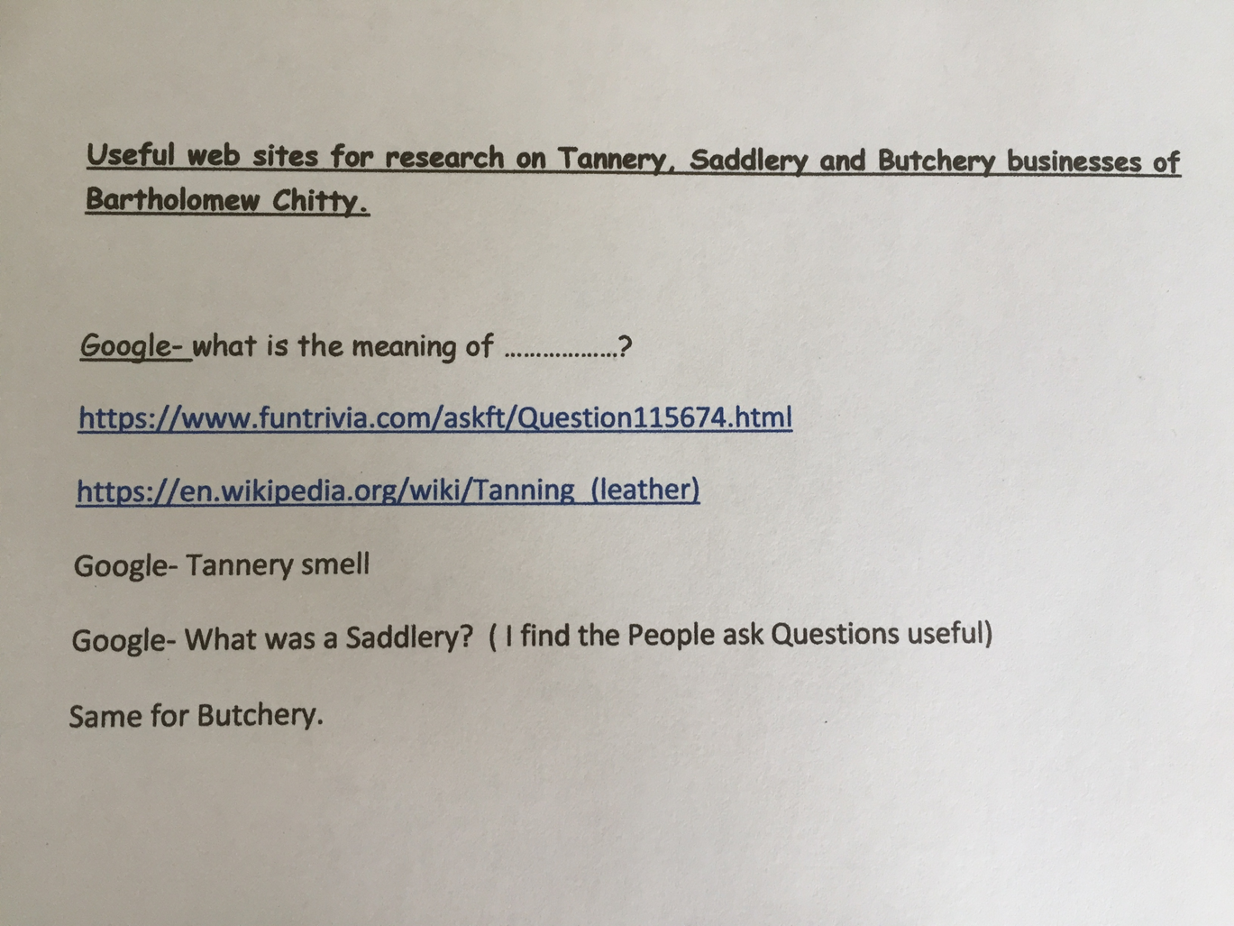

Slide 9
The Tannery was very smelly and so was placed down by the river away from the main part of town.
The Saddlery was where the Kebab shop is today ( opposite the old Harrington’s bakery)
Behind the Saddlery was a very long building where they used to make rope and lay it out. Rope was used to make saddles.
The butchers was opposite the Saddlery.
Next are some photographs of the Tannery down by the river and The Old Leather Shop.

Slide 10
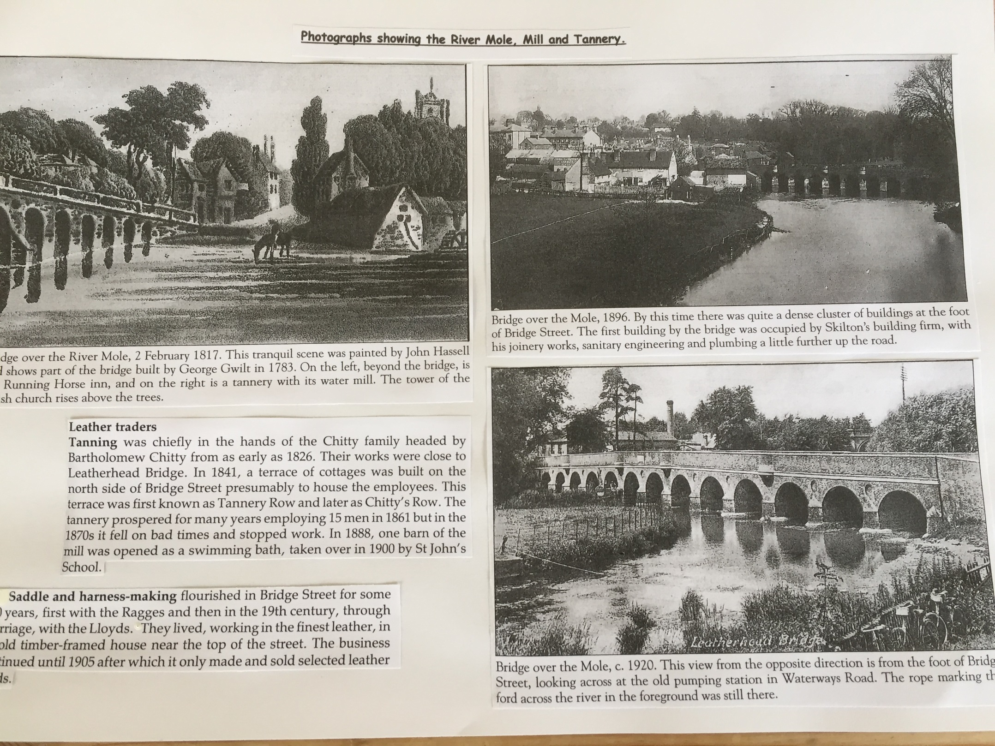

Slide 11
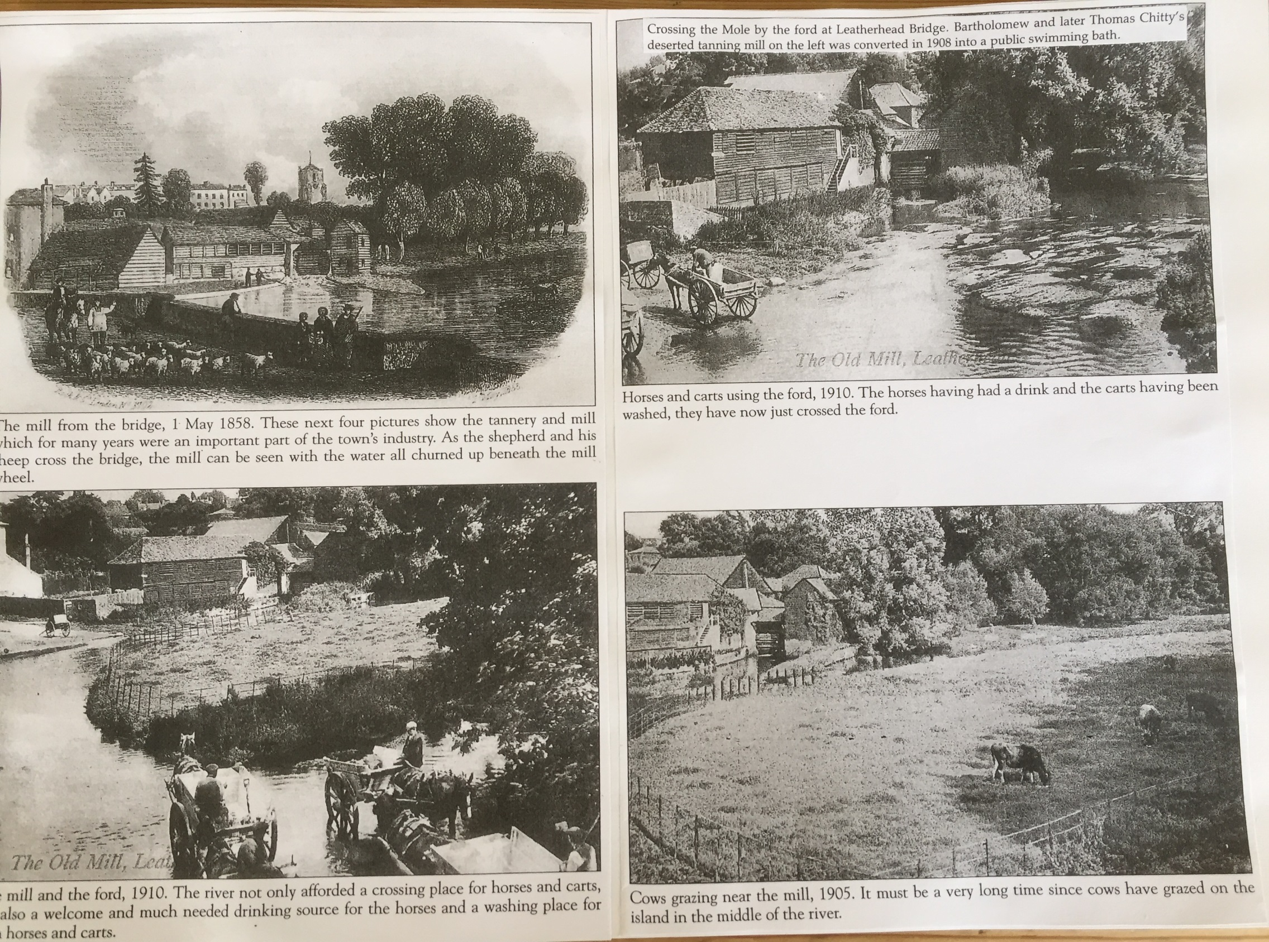

Slide 12
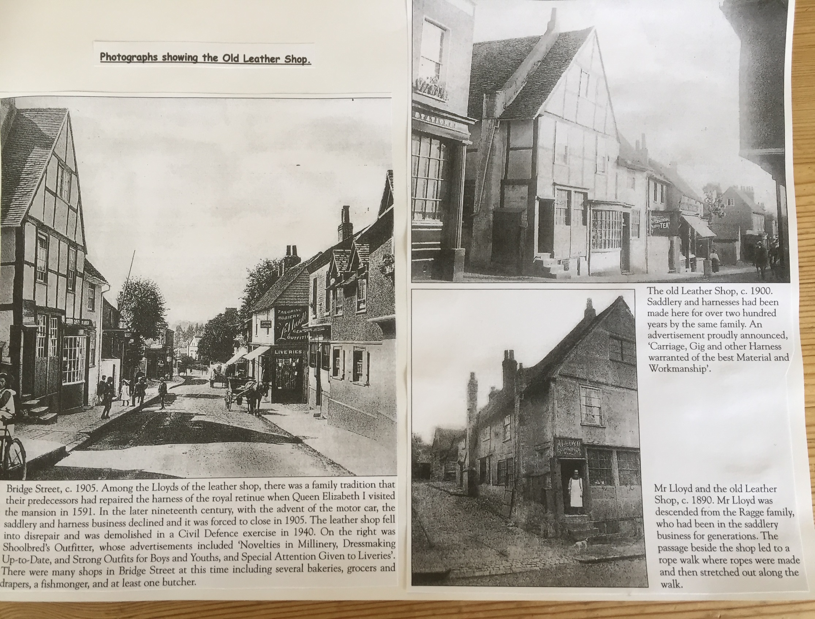

Slide 13
To reach a conclusion as to why the football club is called the Tanners.
Using all the evidence shown and research of your own, explain why Leatherhead football club is called The Tanners.
Write at least half a page and include evidence in your writing (for example dates and type of evidence).

