Slide 1
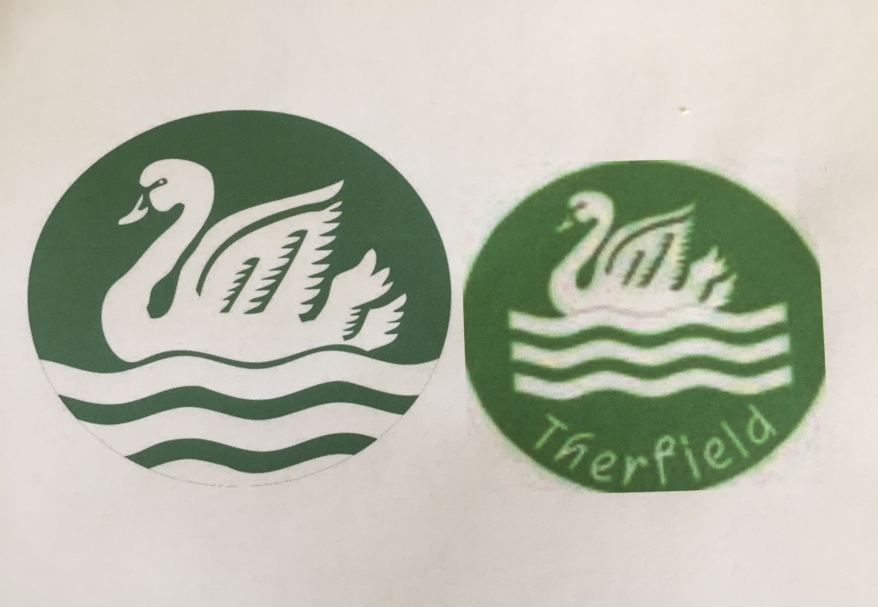
Lesson 3
Local History
What connects The Tanners to Therfield School?

Slide 2
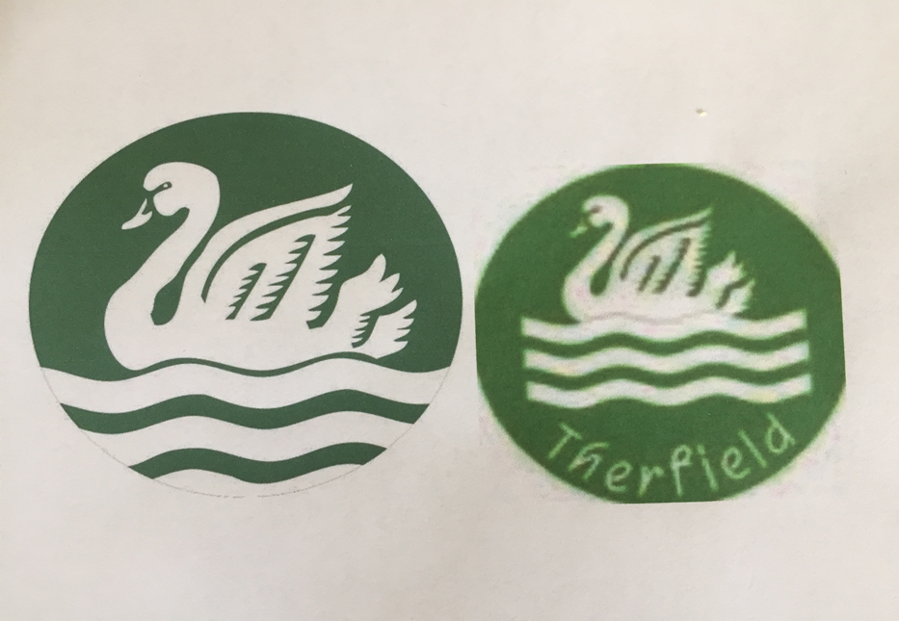

Below are the emblems of Therfield school and The Tanners.
What connects them?

Slide 3
That’s right- A SWAN!
There were two buildings/businesses in Leatherhead linked to a swan. Both were very important and brought a great deal of business, wealth and status to Leatherhead town .
The Swan Hotel- built between 1630-1635 and
pulled down in 1930.
and
The Swan Brewery- began in 1859 and closed in
1921
Add these two important buildings/events to your timeline.

Slide 4
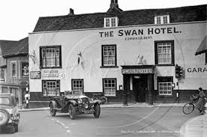
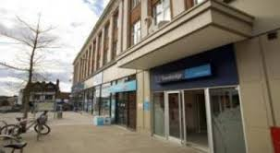
The Swan Hotel used to be where Argos/Martins/Travelodge are now.
What can you spot in both photographs?

Slide 5
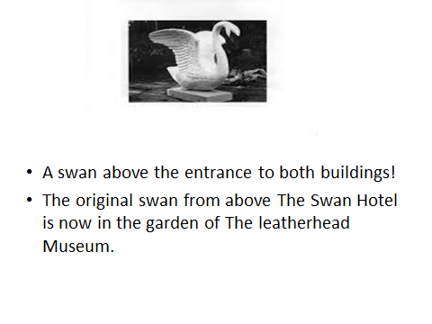

Slide 6

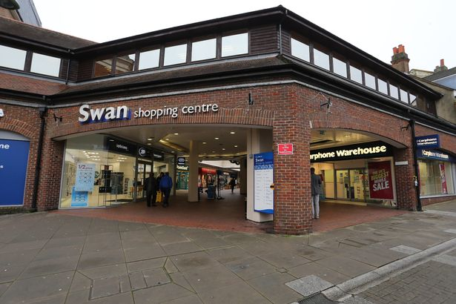
The Swan Brewery used to be where the Swan shopping centre is.

Slide 7
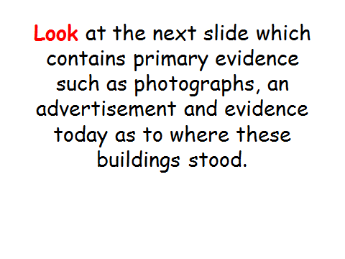

Slide 8
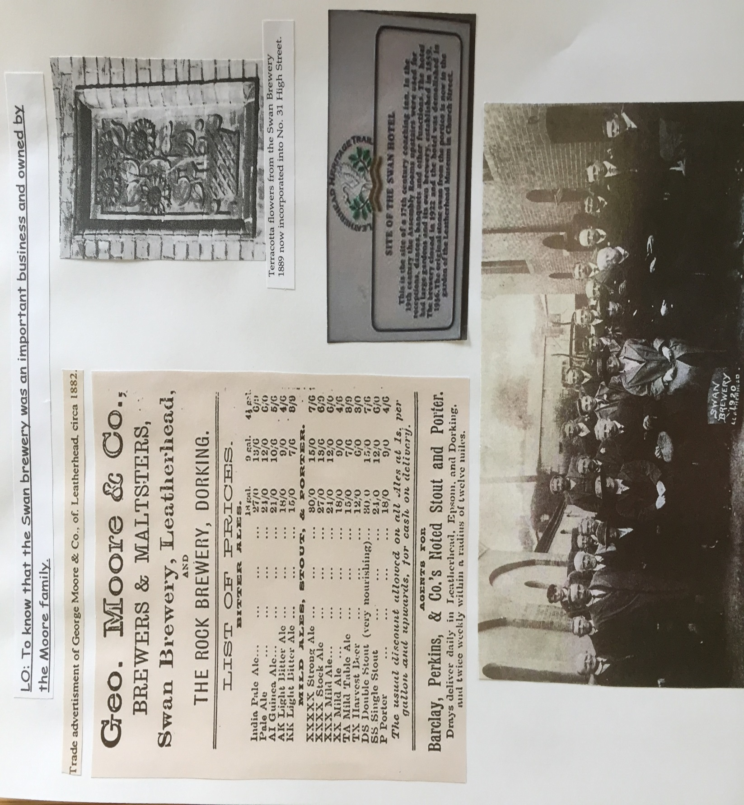

Slide 9
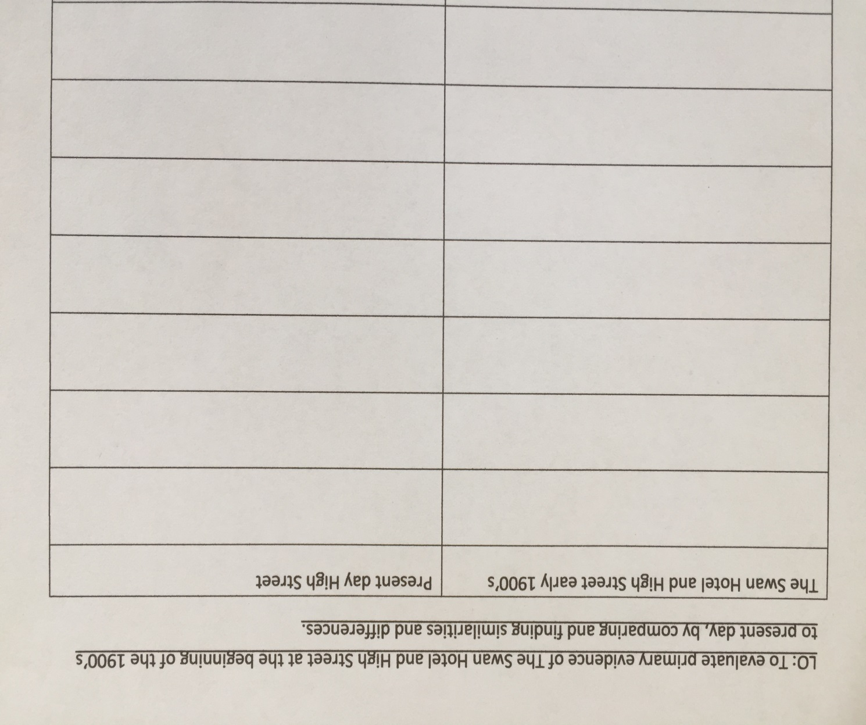
There are many changes to Leatherhead since the beginning of the 1900’s and now.
Draw a table like my example.
Look carefully at the next three slides.
Can you spot differences and similarities between the High Street then to now.
Fill in your table.

Slide 10
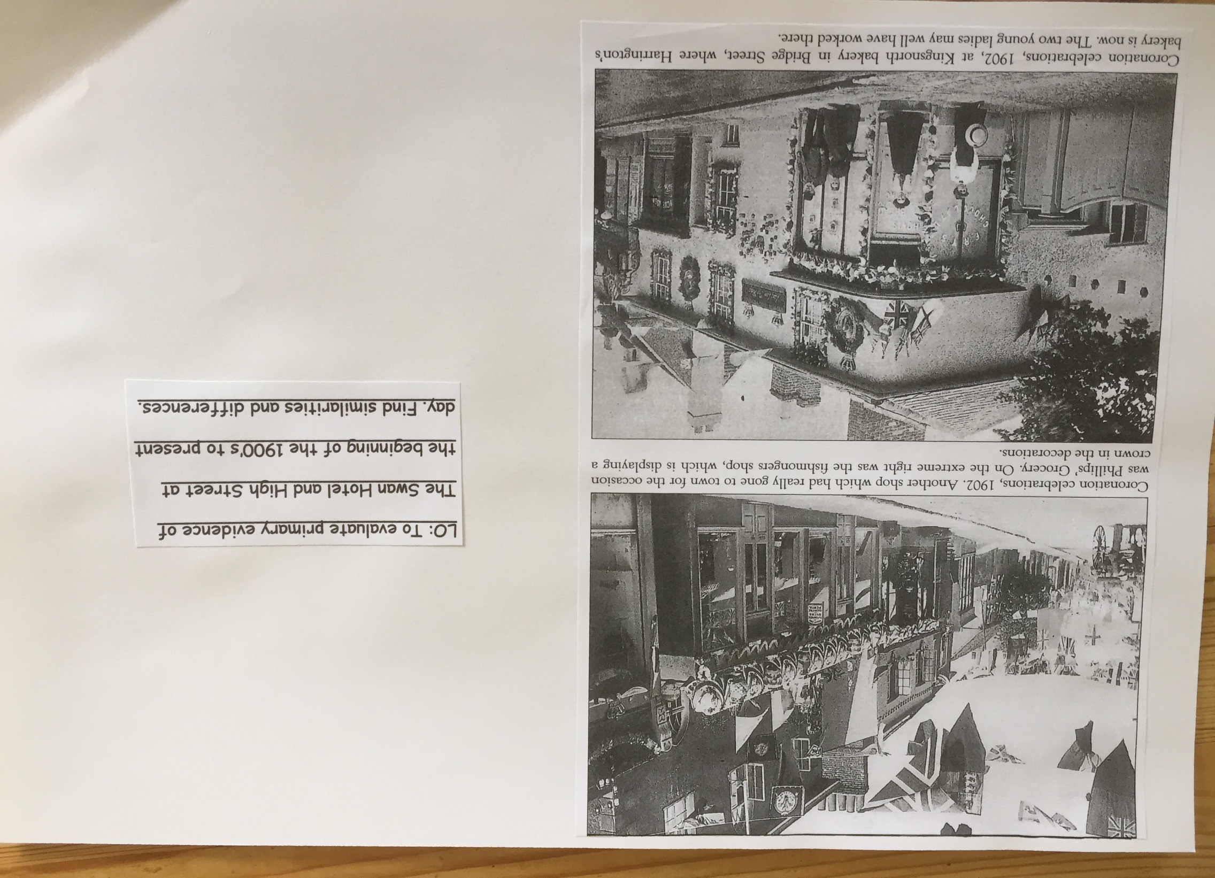

Slide 11
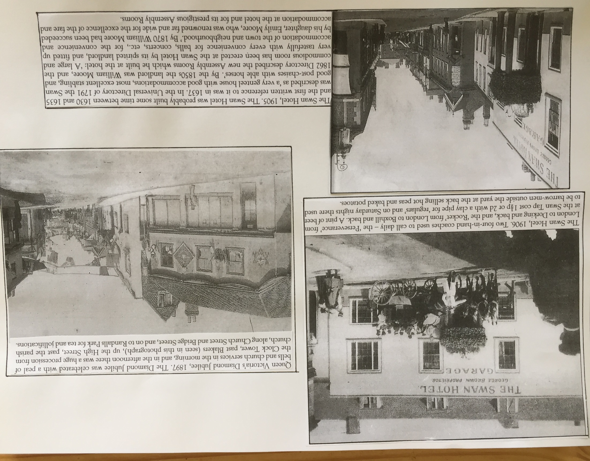

Slide 12
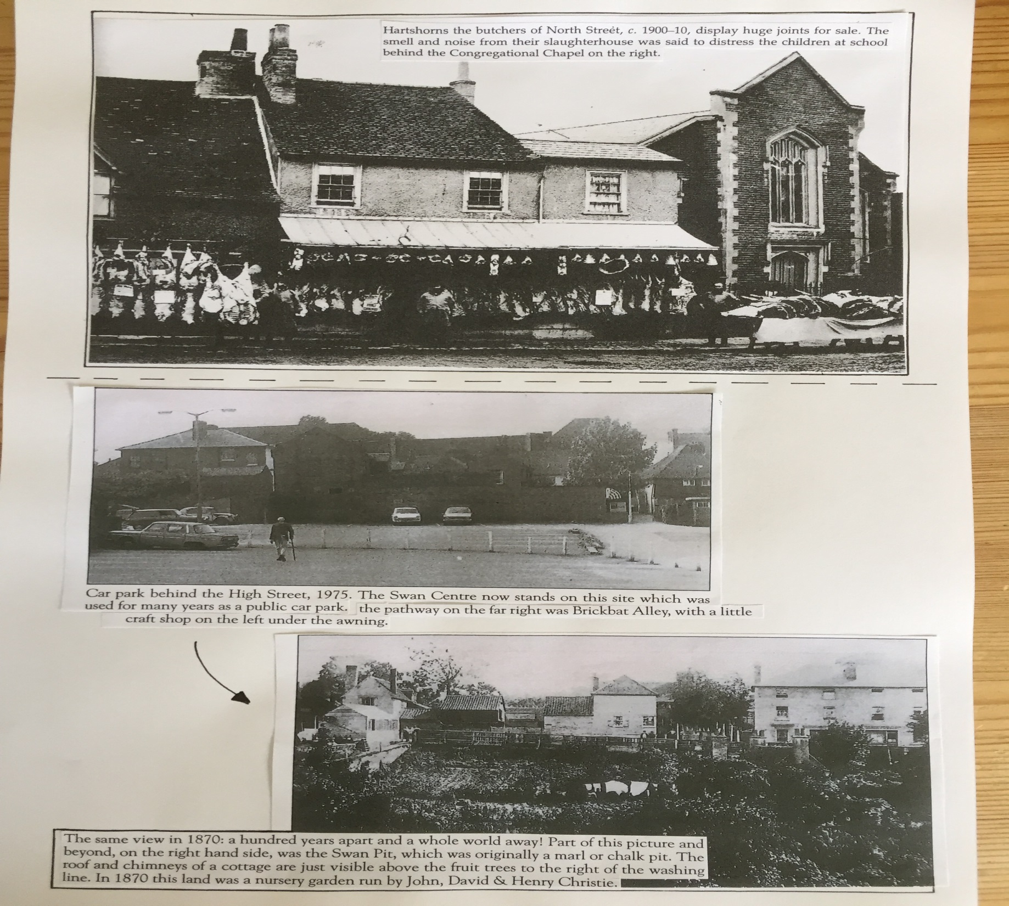

Slide 13
Add in any dates and why, that have interested you, to your timeline.
Choose at least three.

Slide 14

Leatherhead has its own emblem, just like The Tanners and Therfield.
Leatherhead has its own Coat of Arms

Slide 15
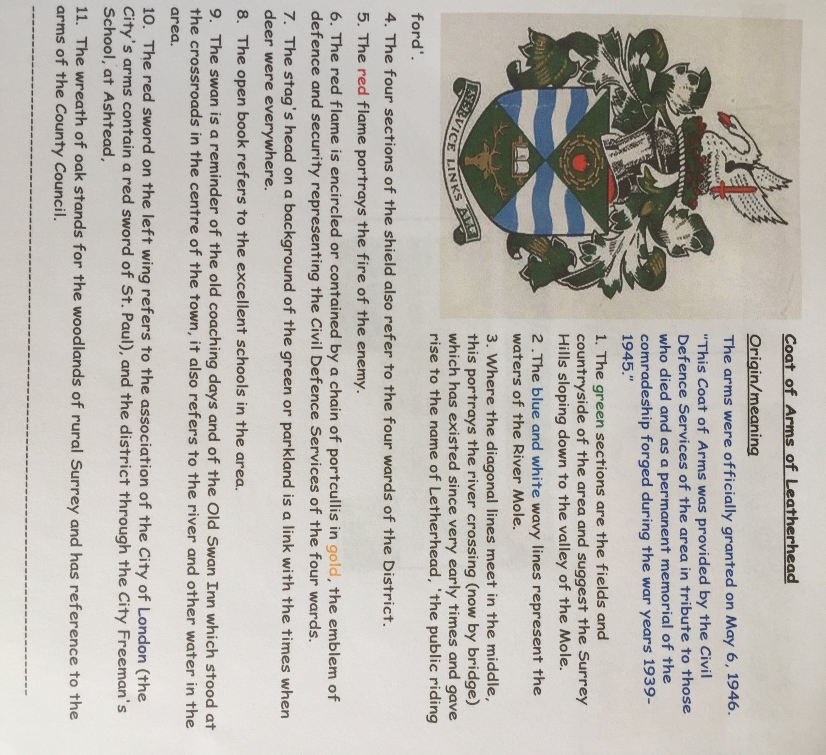

Slide 16
What is a Coat of Arms and why did people and places have them?
1. Look at the power point- Coat of Arms
2. Design your own Coat of Arms for you and your family.
3. Think about where you live, hobbies, clubs, favourite things, family, your personality etc.
I have attached some designs and information to help you on the next slides.
4. Colour in your design.
5. Explain why you have chosen your design and contents.

Slide 17
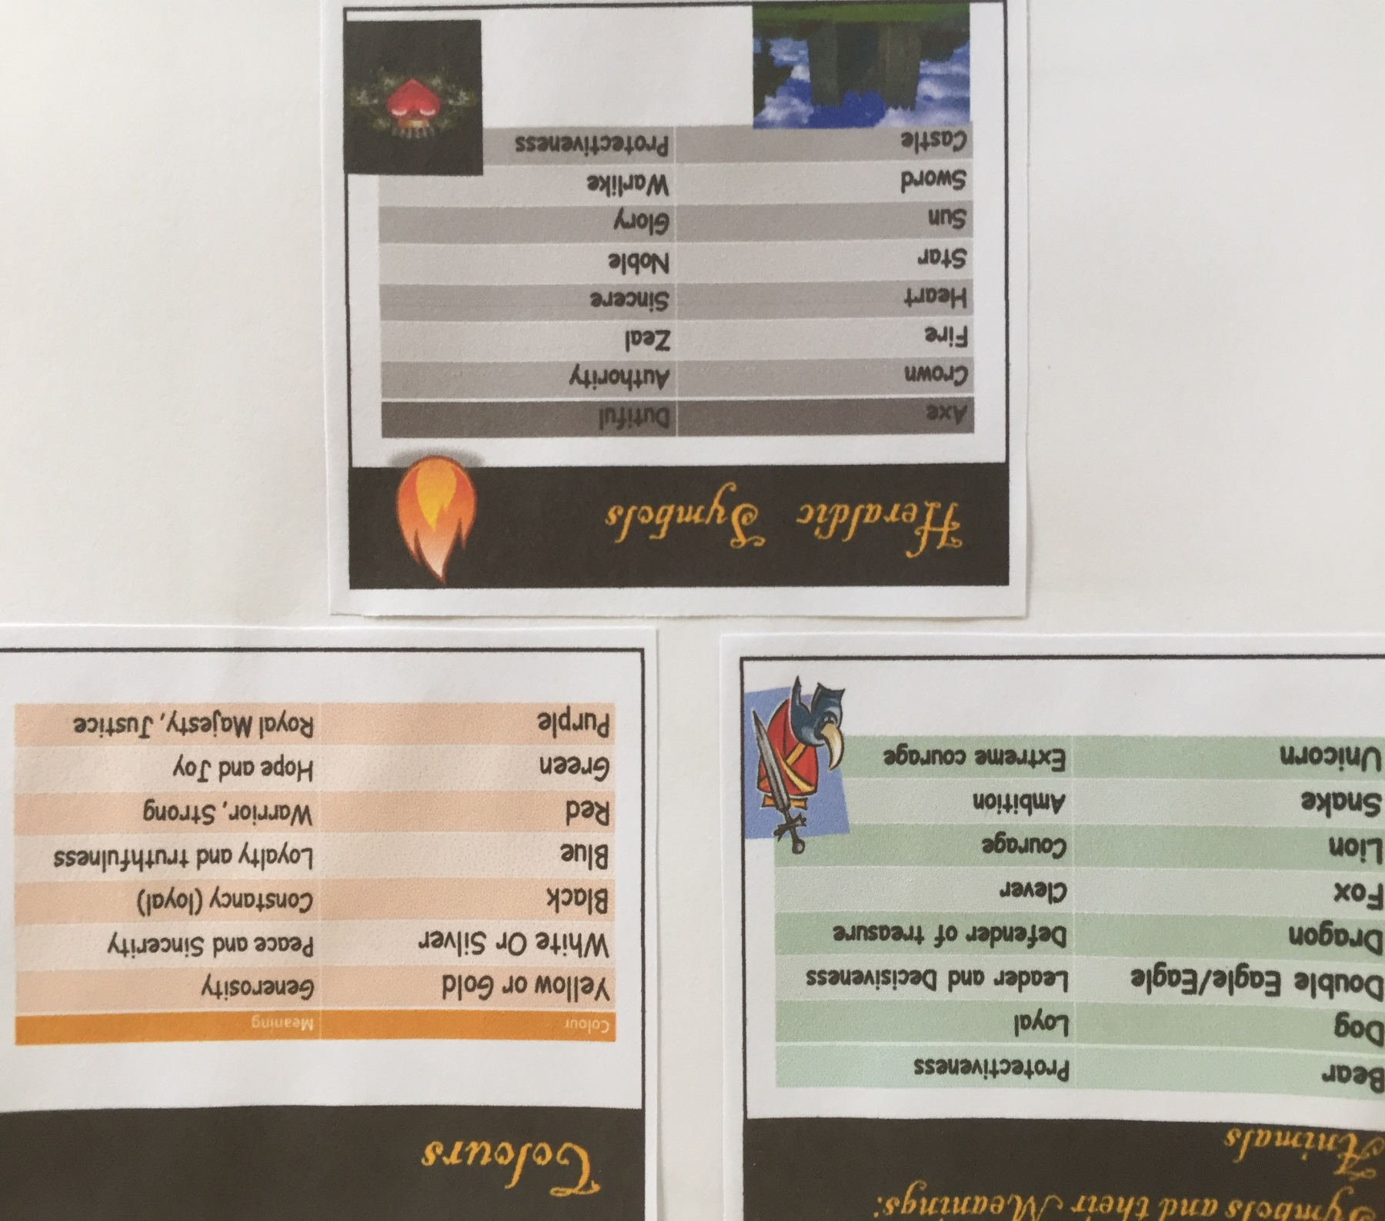

Slide 18
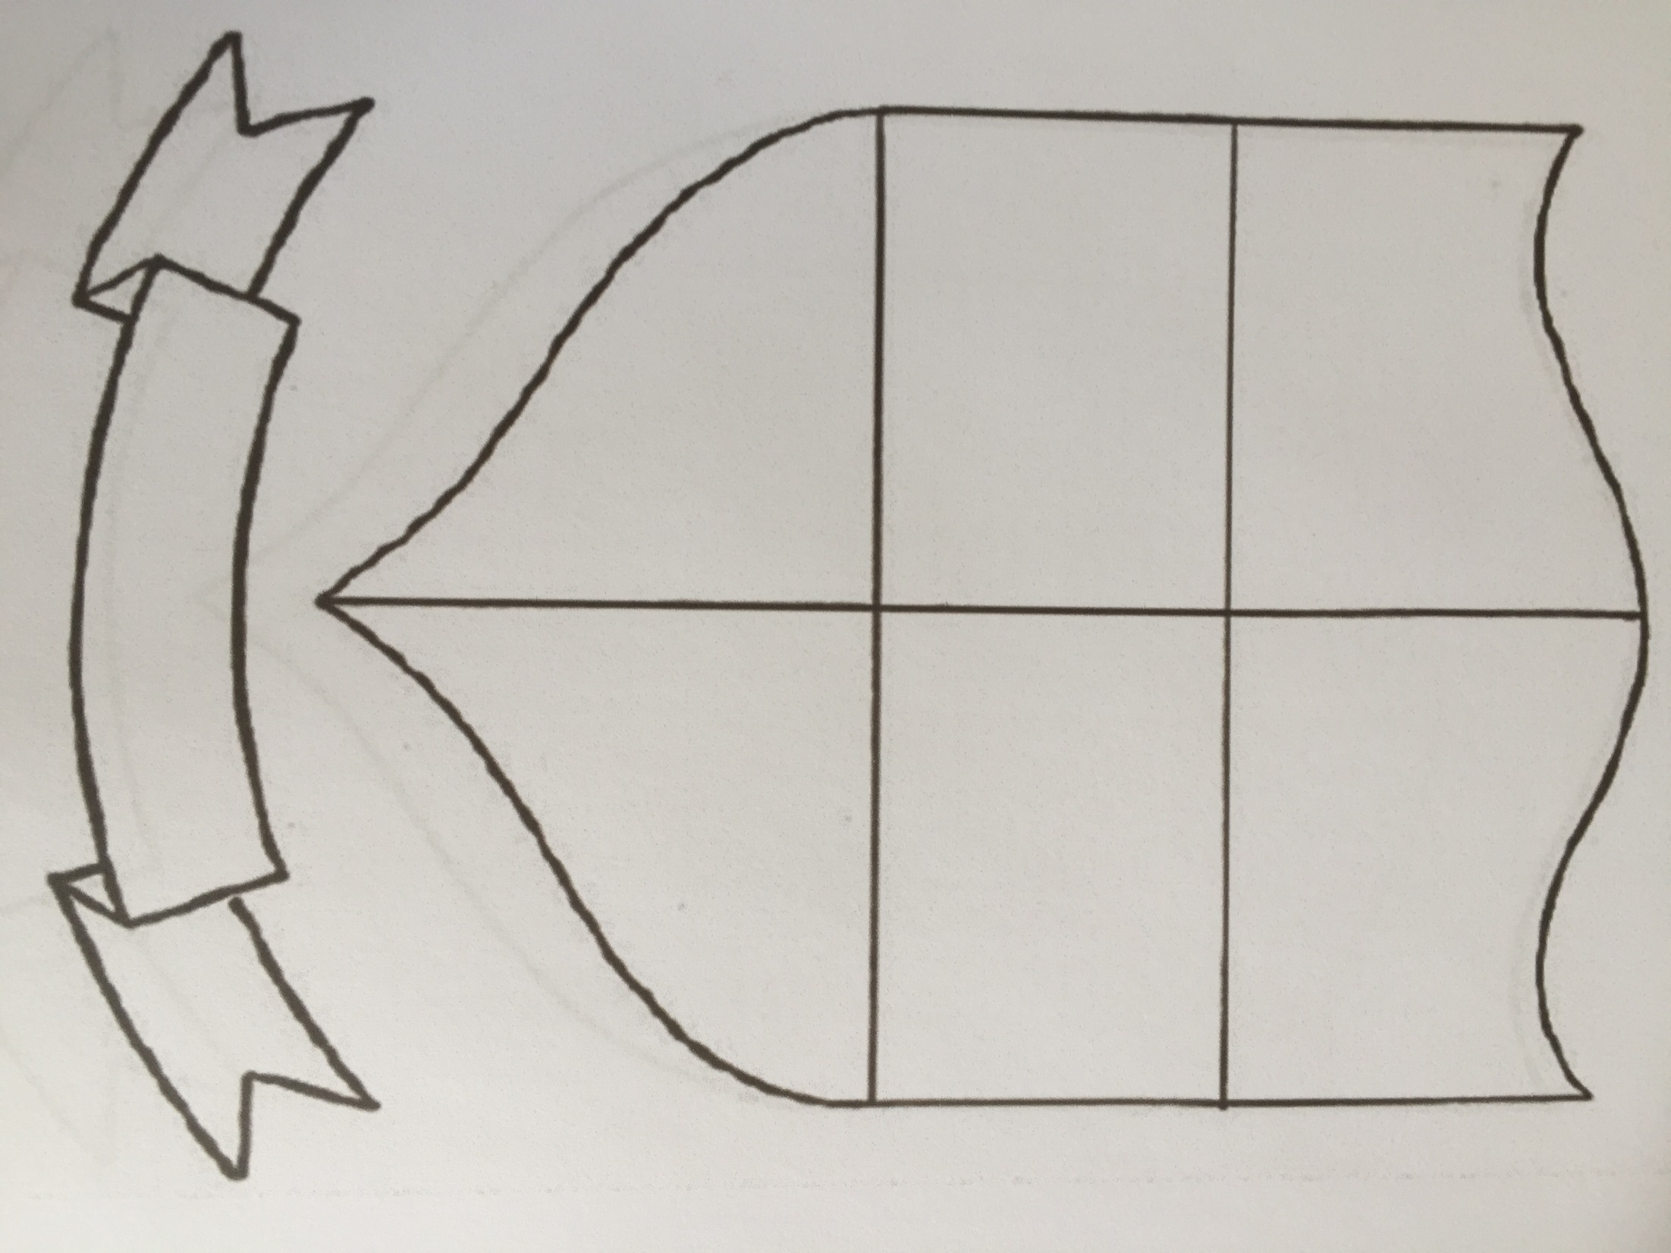

Slide 19
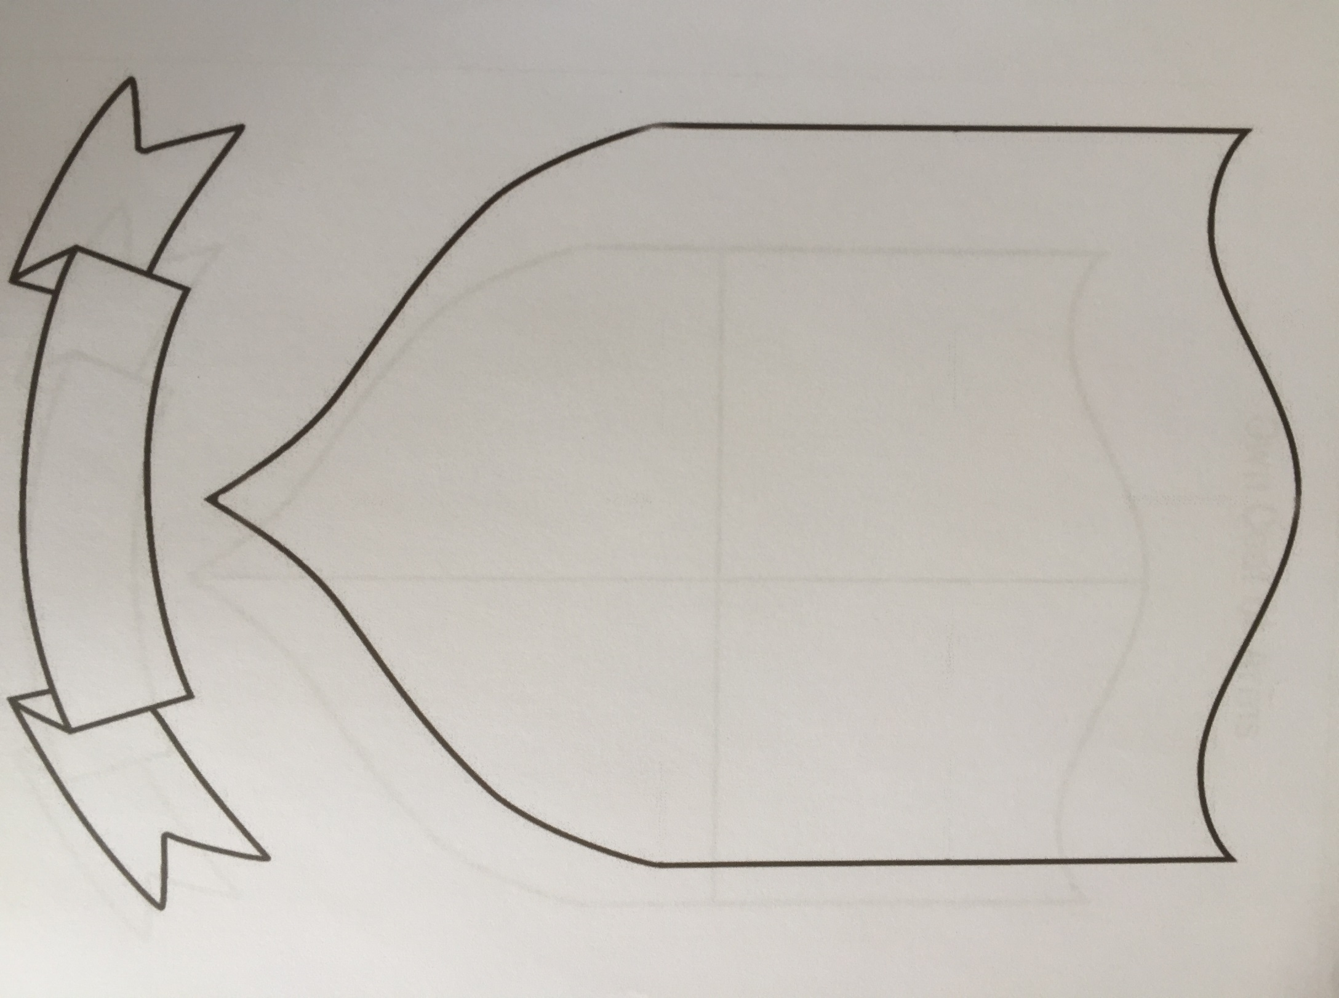

Slide 20
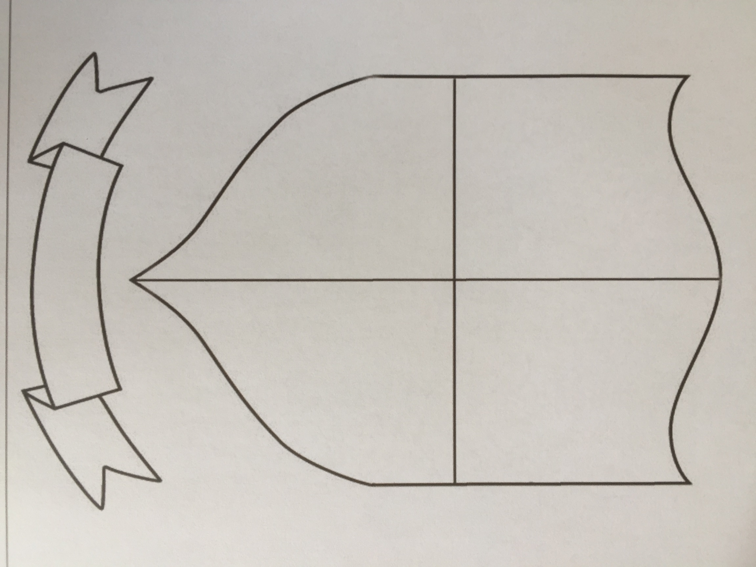

Slide 21


Slide 22
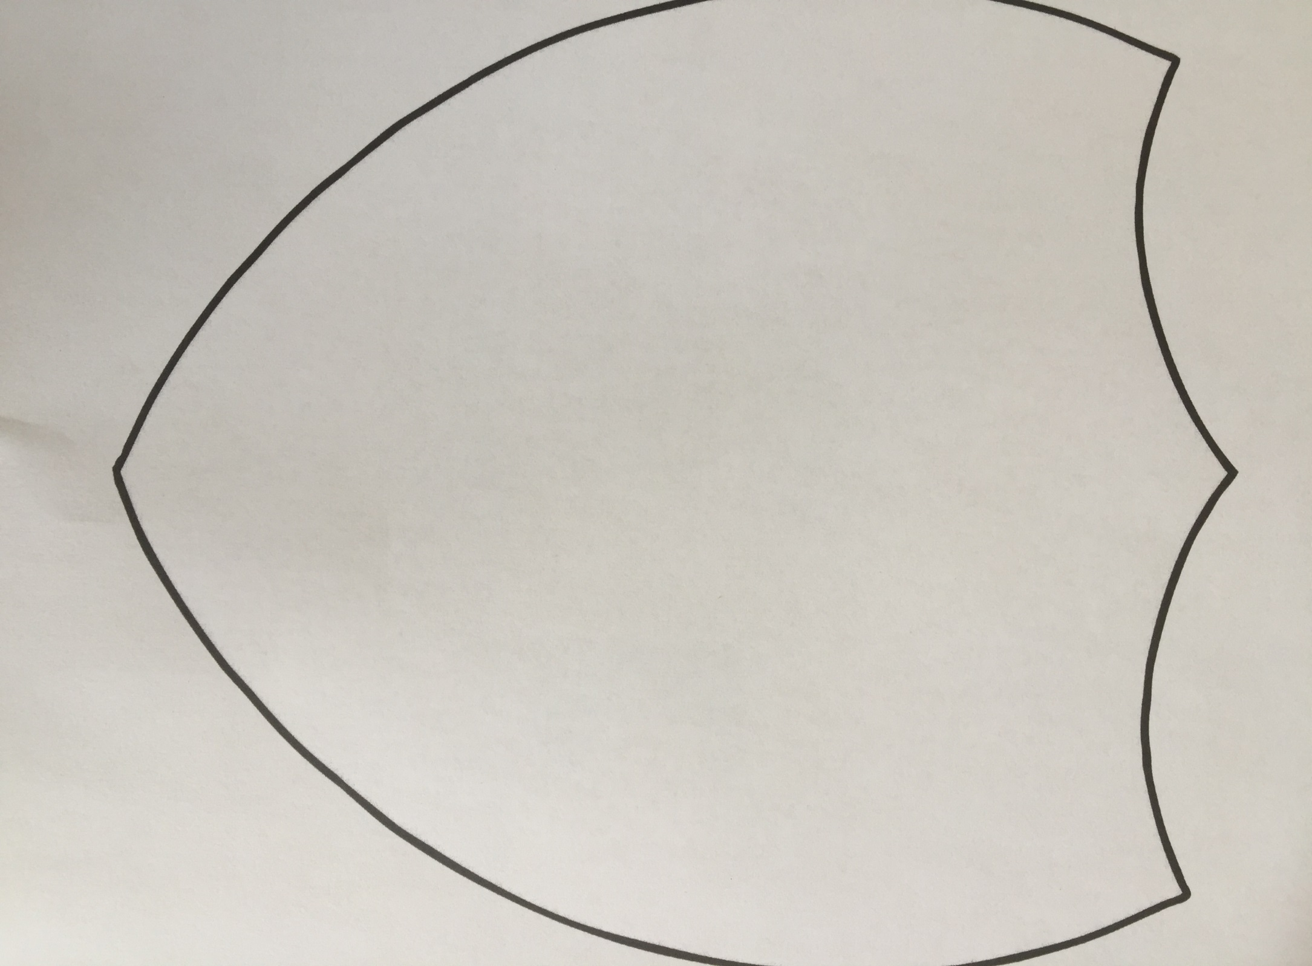

Slide 23


