Slide 1
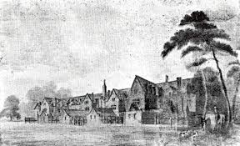
Lesson 4
Local History
How did Septimus Welling help the poor of Leatherhead?
Epsom Workhouse

Slide 2
Look at the next three slides.
These slides show Census evidence from 1850 to 1910. ( the final two are close ups)
Find Septimus Welling’s entry-I have highlighted it in yellow.
What changes can you spot for Septimus over the 60 years? ( clue: age, relation to head of family, job) .

Slide 3
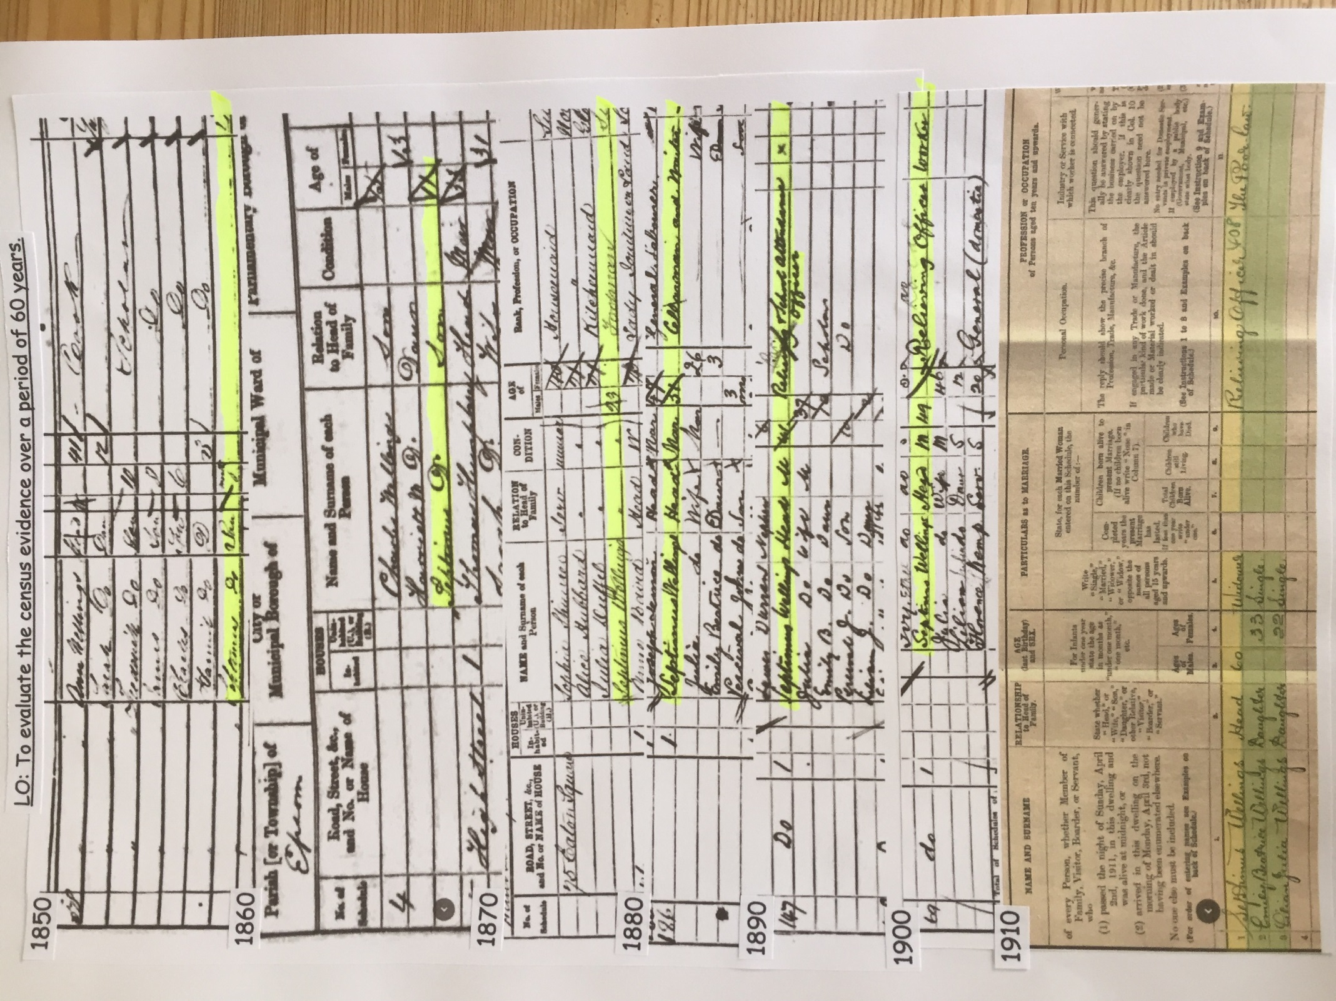

Slide 4
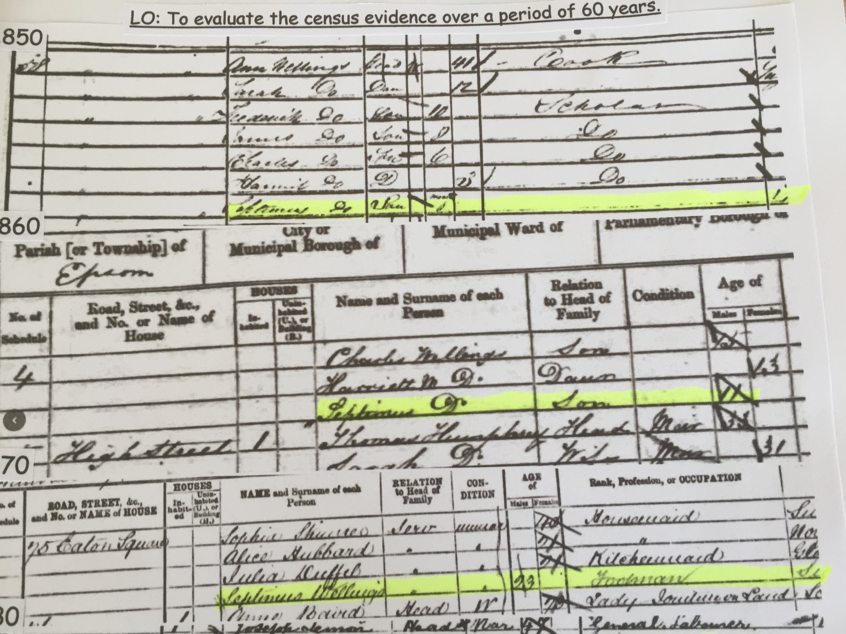

Slide 5
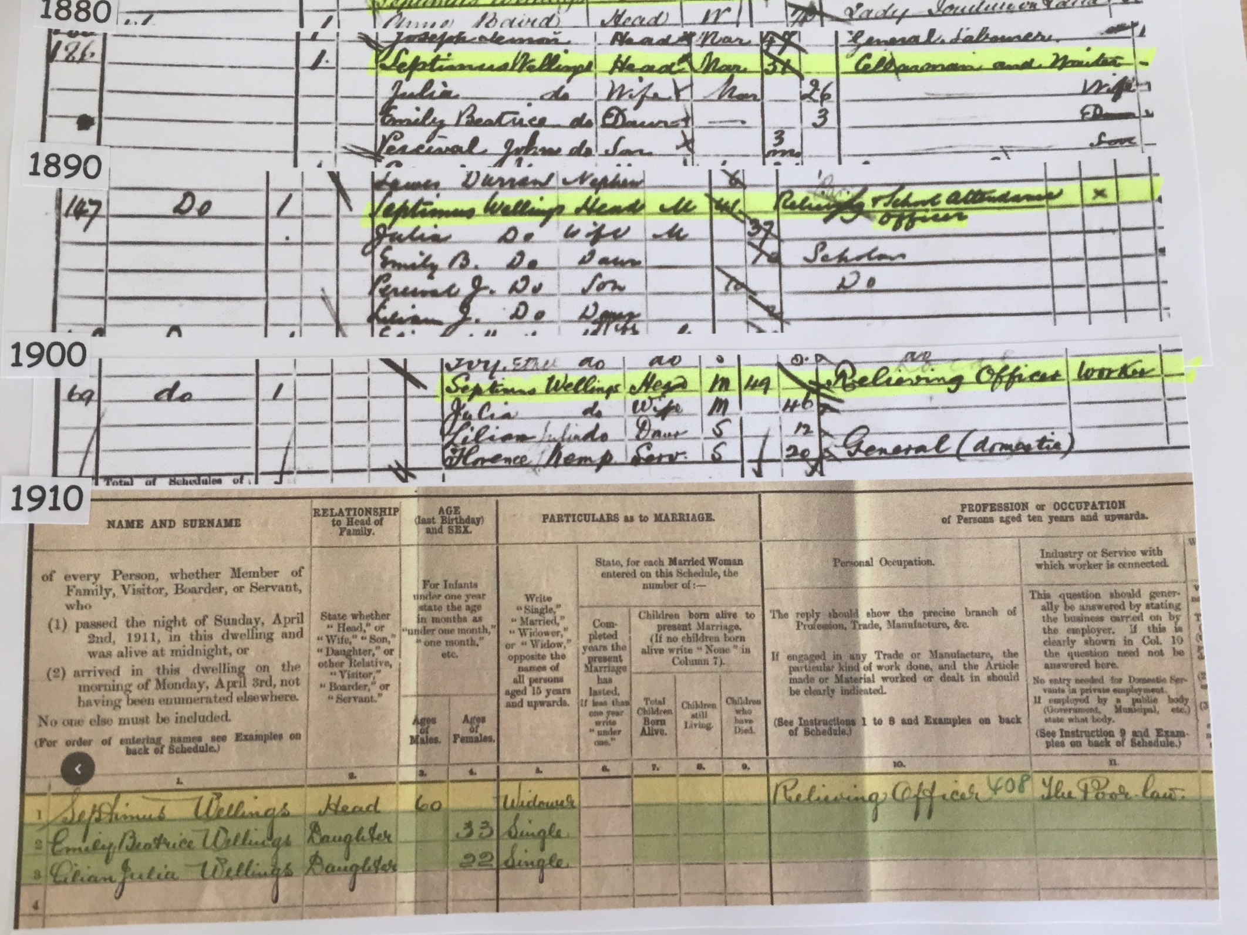

Slide 6
Add the date (and why), when Septimus Welling became a Relieving Officer, to your timeline.

Slide 7
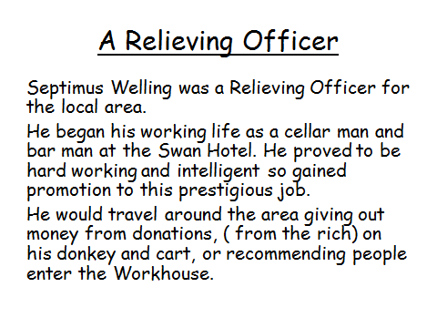

Slide 8
The Workhouse
A workhouse was a place where poor people were given shelter and food but had to work hard for it.

Slide 9
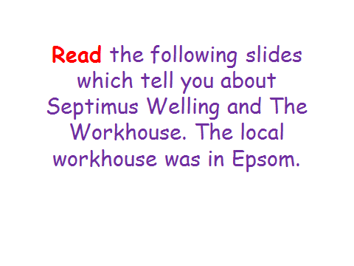

Slide 10
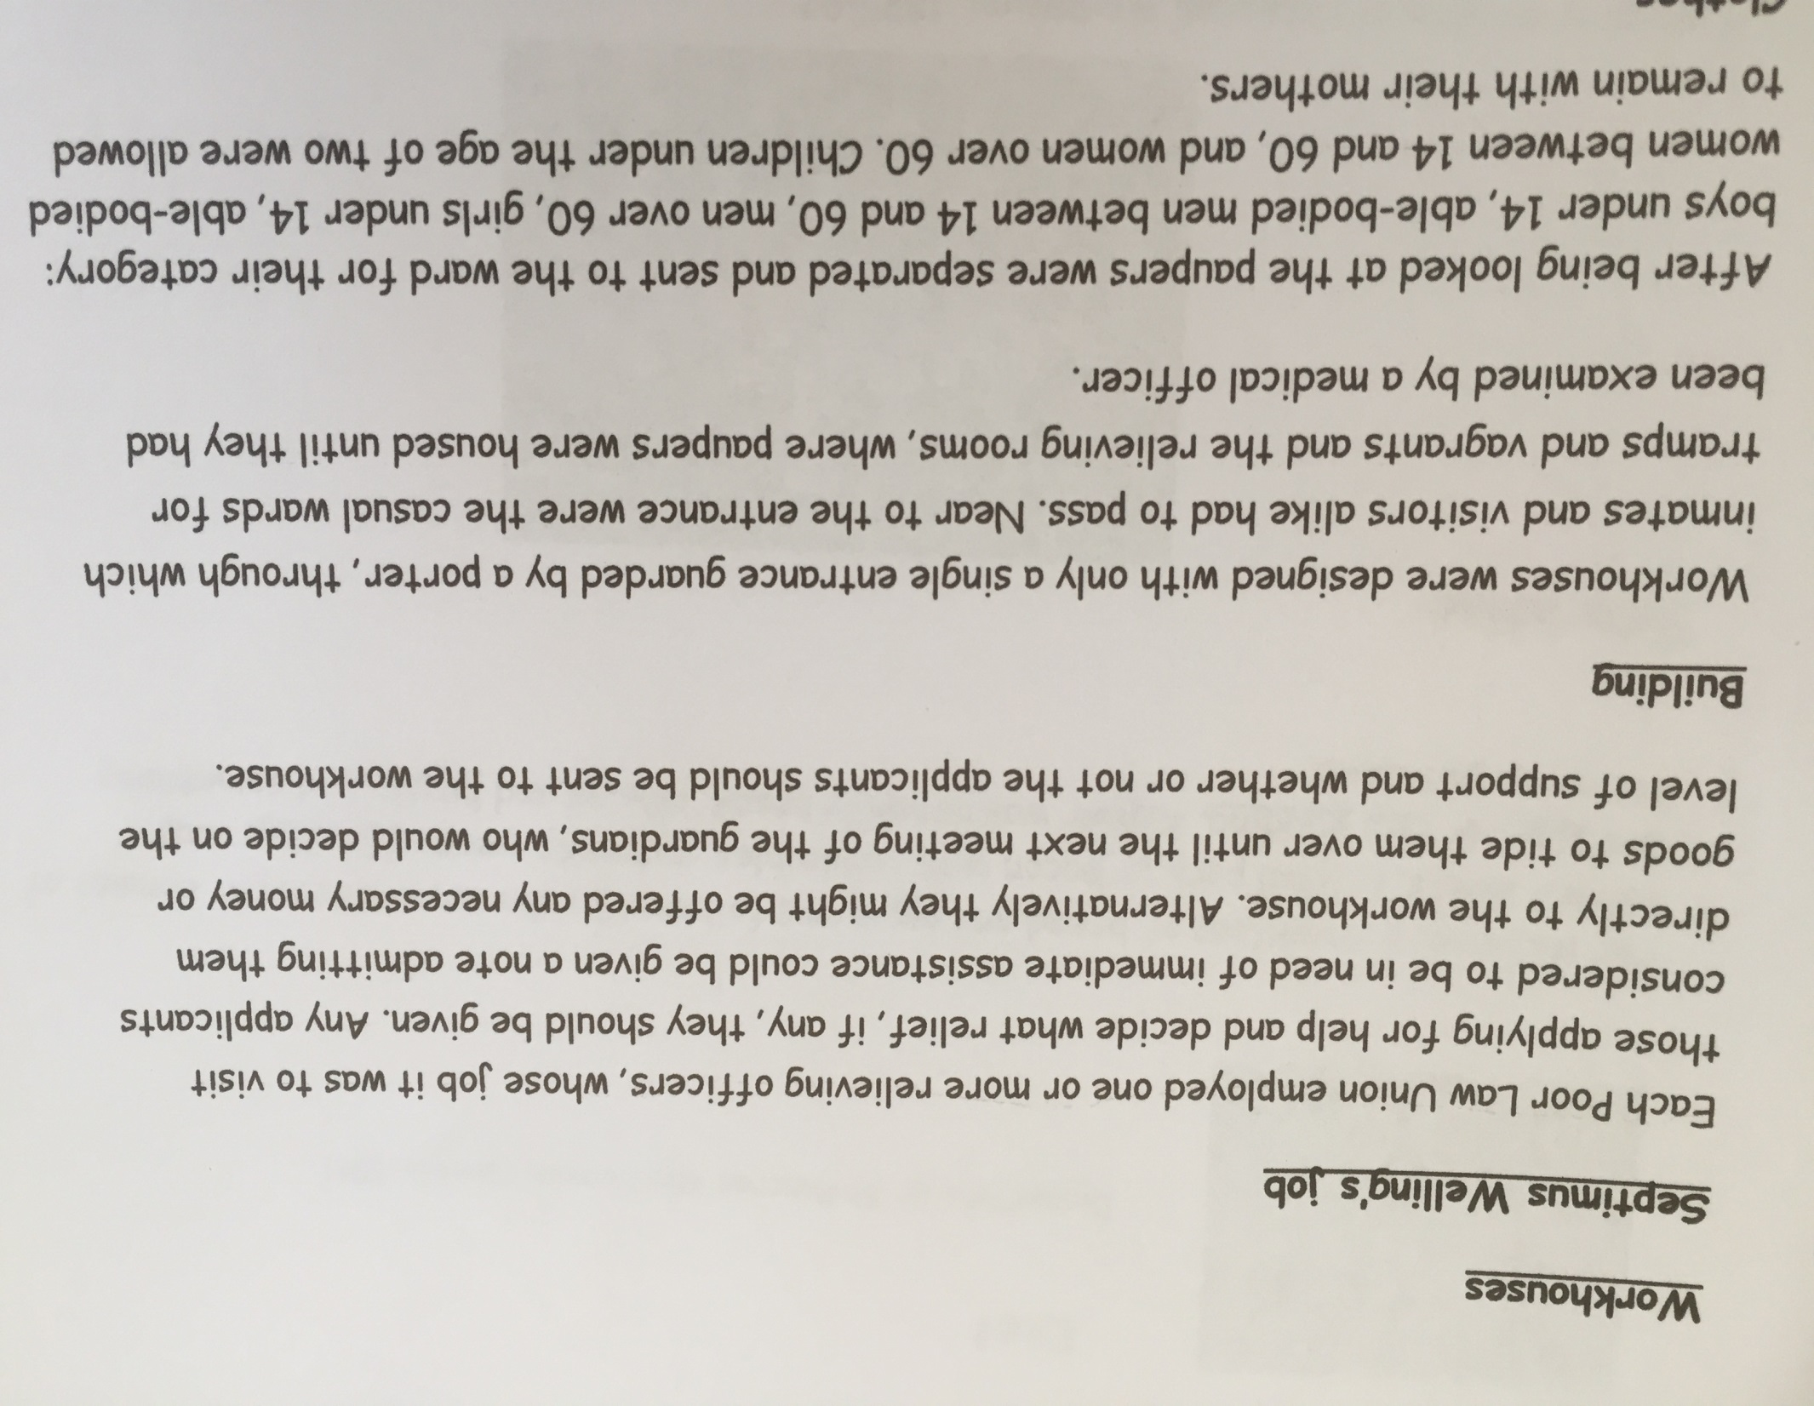

Slide 11
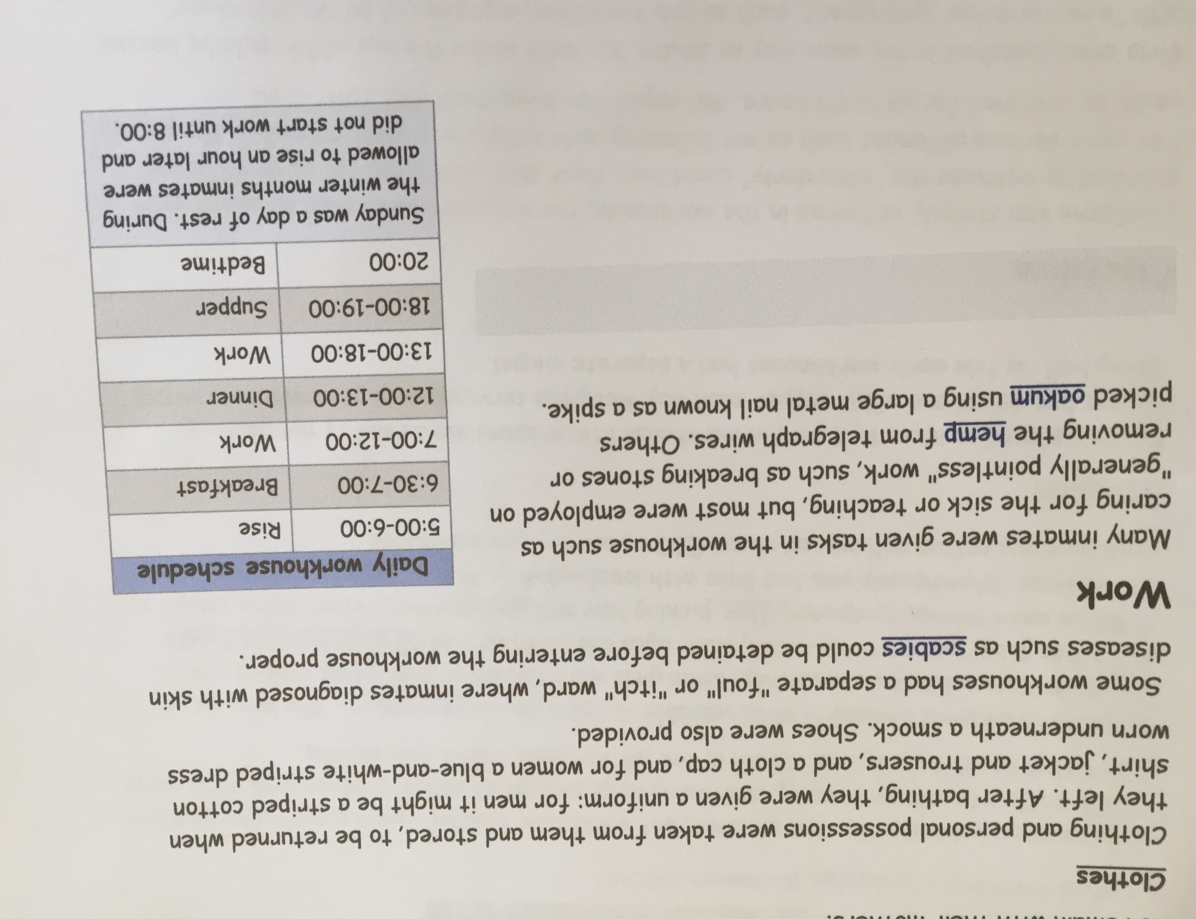

Slide 12
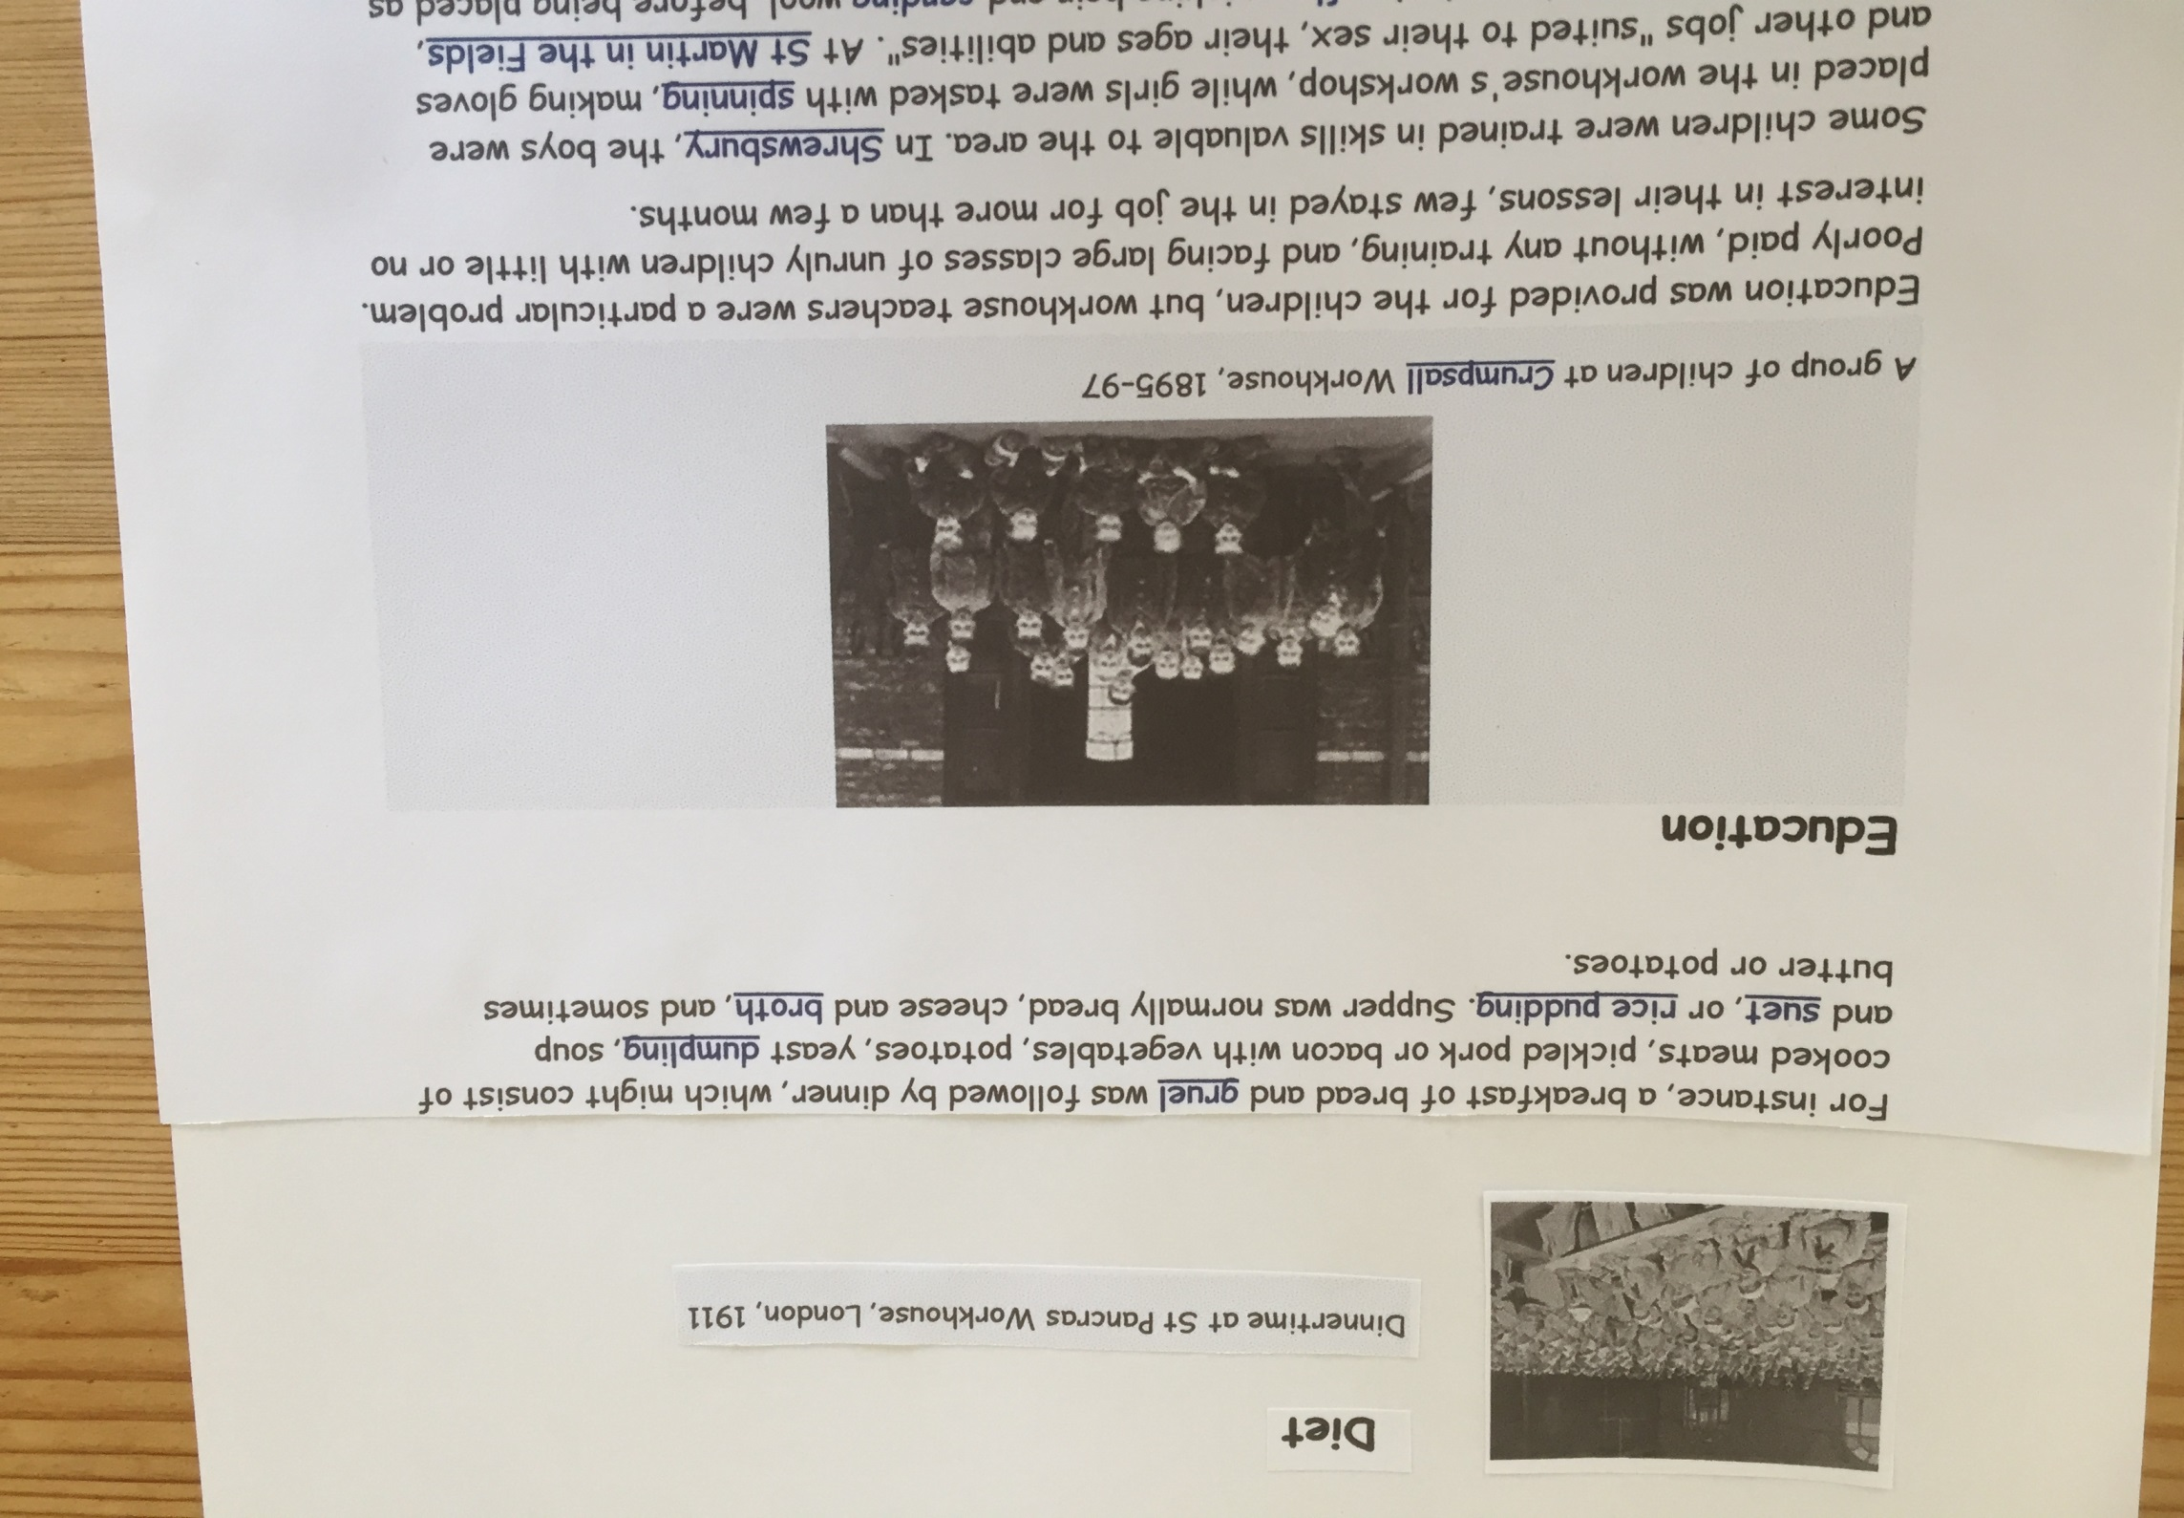

Slide 13
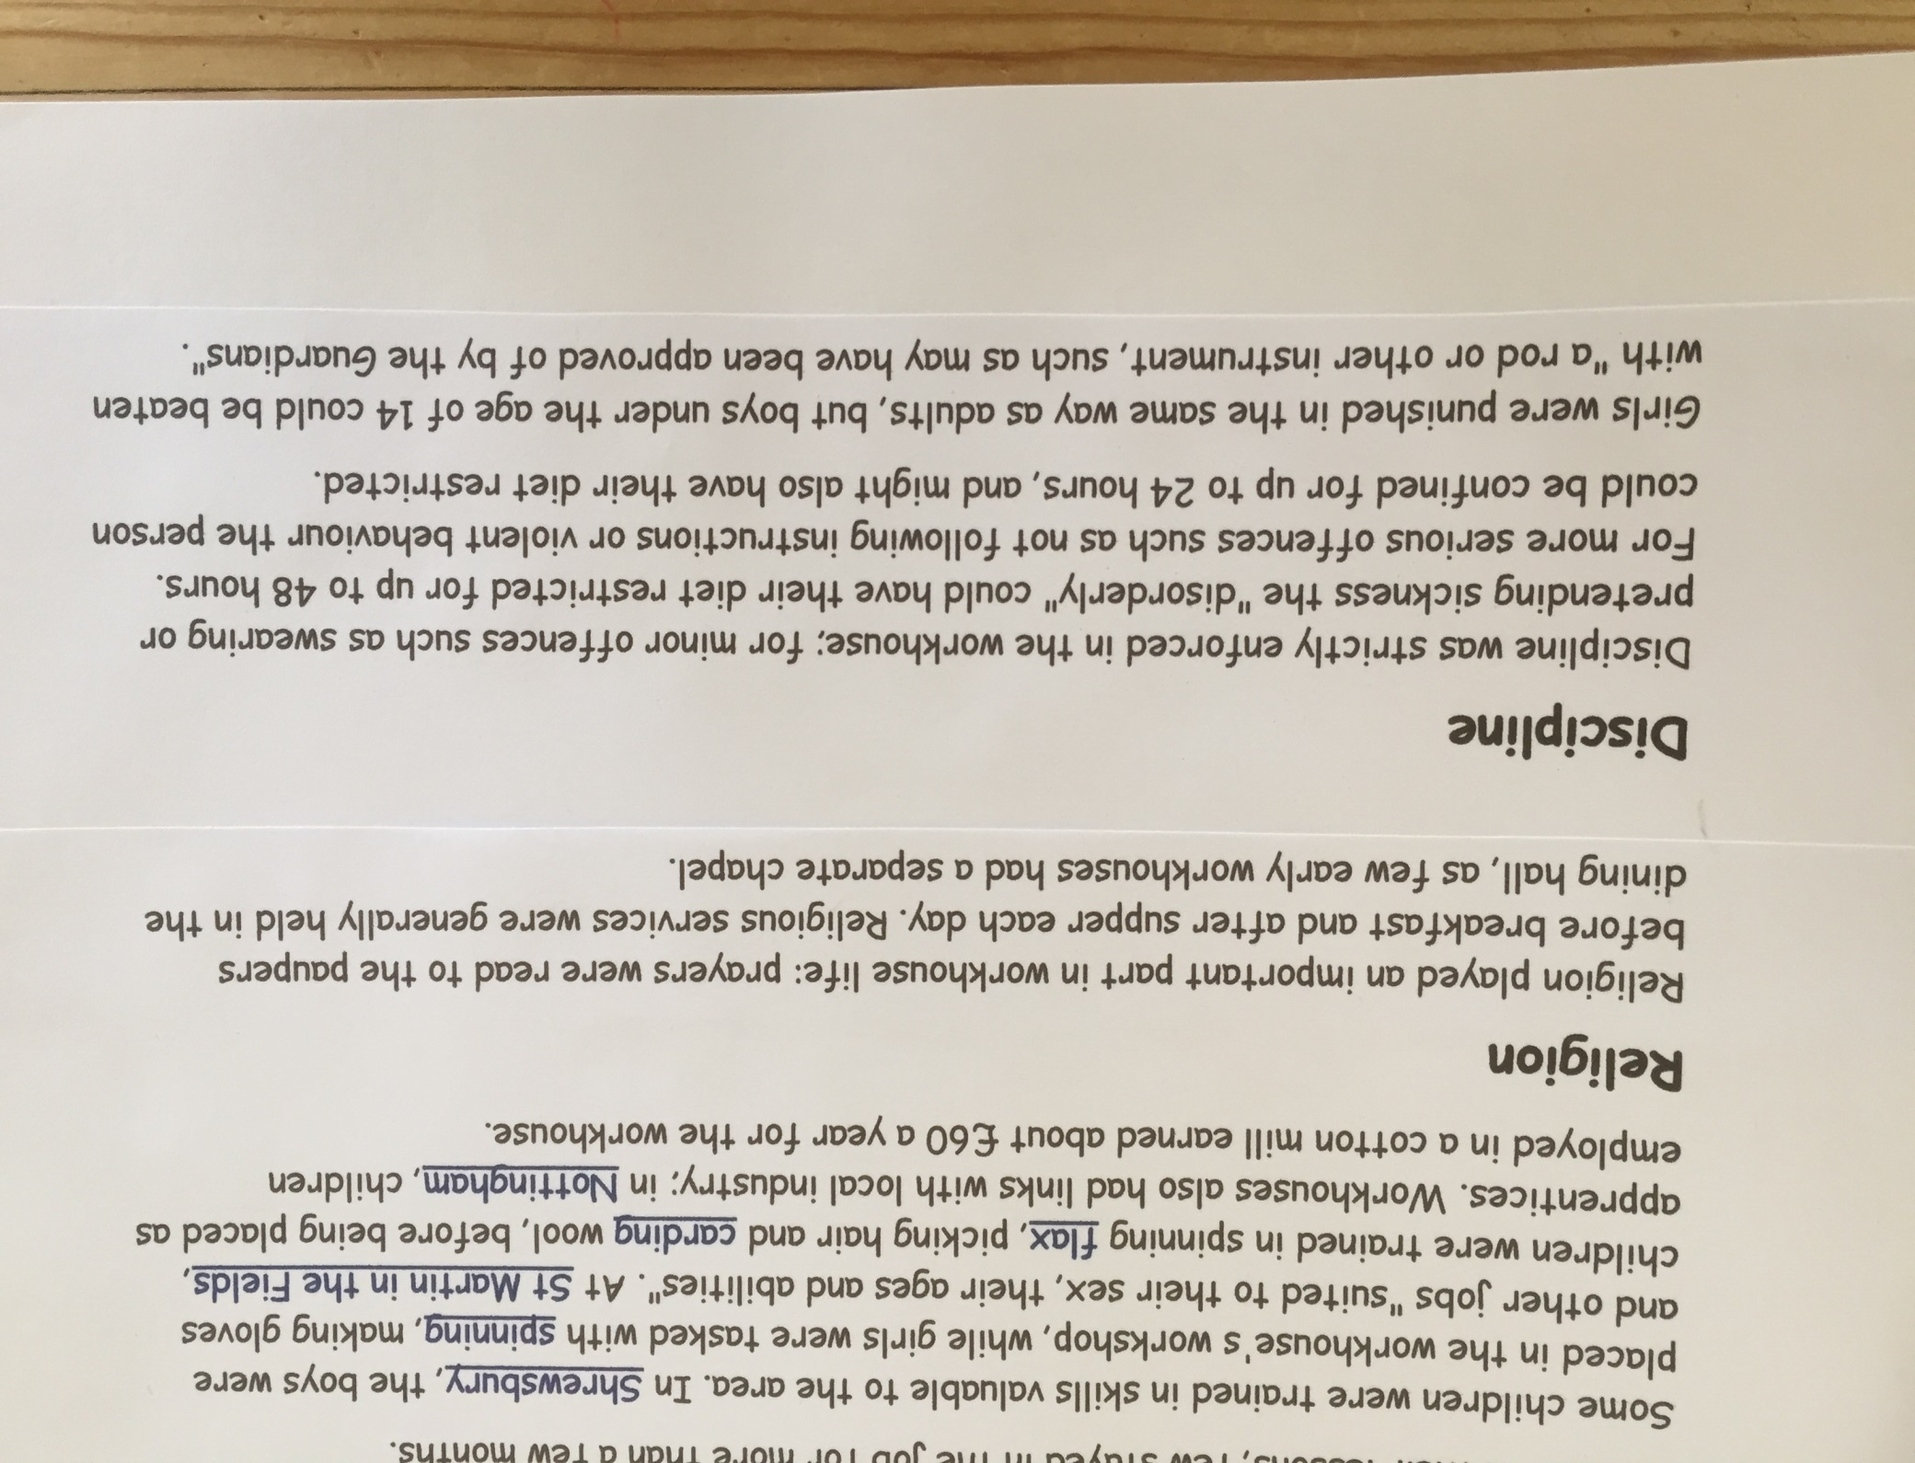

Slide 14
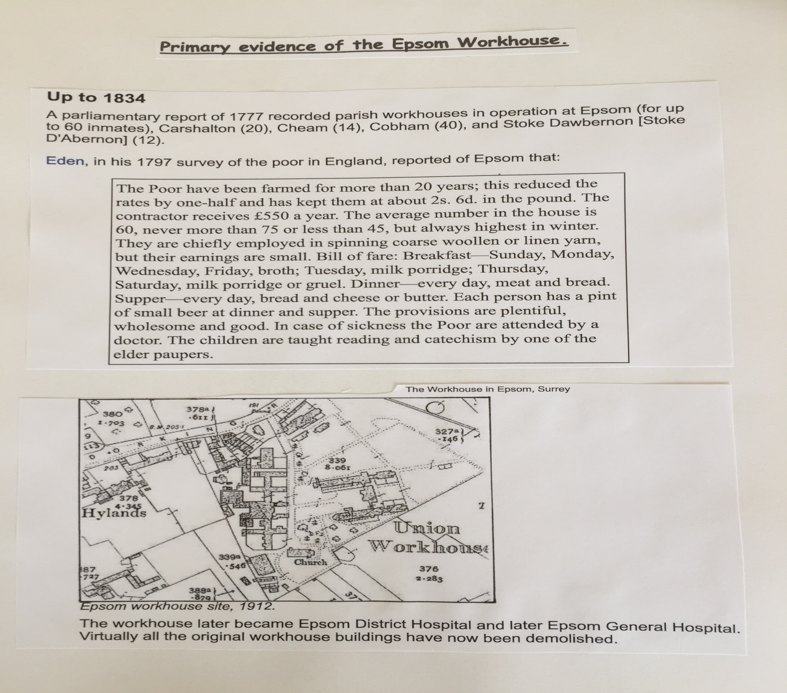

Slide 15
Research on the internet
Google- primaryhomeworkhelp.co.uk-victorians-workhouses
Use your own research and my information sheets on this power point, to do a piece of writing.
Empathise with a child who has been sent to the Workhouse.
1. You may choose how you do your piece of writing- as a diary, a
descriptive piece, looking back in time or something else.
2. Begin where you like- maybe when Septimus Welling comes to
tell you that you and your family are entering the
Workhouse, even as you arrive or wakeup on your first
morning-whatever you like.

