Slide 1

Baking Bread
Hello Year 5.
This is the first lesson in our topic about baking bread.
You will…
learn about different types of bread and the cultures and/or regions they come from.
You will then taste and describe a variety of breads.
You will use these design and technology skills:
Comparing
Evaluating

Slide 2

Useful vocabulary
appetising aromatic bitter bland burnt cheesy crunchy chilled cold creamy crisp delicious dry dull fiery fizzy flavoursome fluffy fresh fruity juicy mild moist oily plain peppery rich rubbery salty spicy smelly lumpy sour sticky sweet tangy tasty seasoned unseasoned velvety warm whipped yummy zesty zingy brown white airholes bubbles crumbly smooth soft hard.

Slide 3
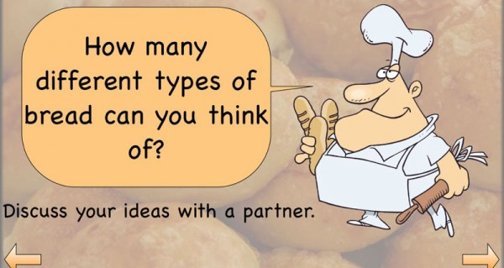

Task 1.

Slide 4
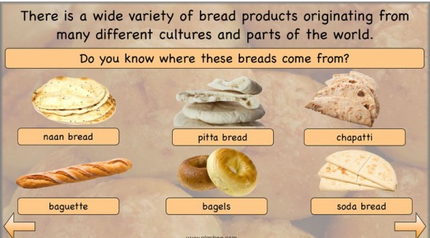
Task 2.
Complete the table below. The web link below will help you with this activity. (Print off/type in and save/ write up on paper)
https://www.bhf.org.uk/informationsupport/heart-matters-magazine/nutrition/cooking-skills/dough/a-to-z-of-breads
Name of bread | Continent of origin | Country/city of origin

Slide 5
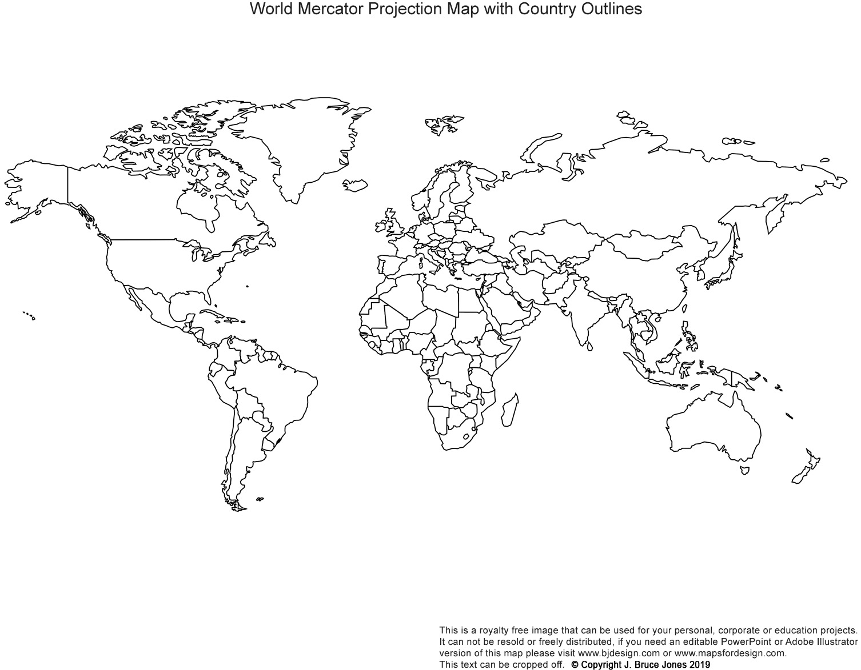
Task 3. On the world map below, add a label line and bread name label, to the country of origin of each of the breads in the previous slide. Do the same for other breads you may have researched. (print off to complete task)

Slide 6
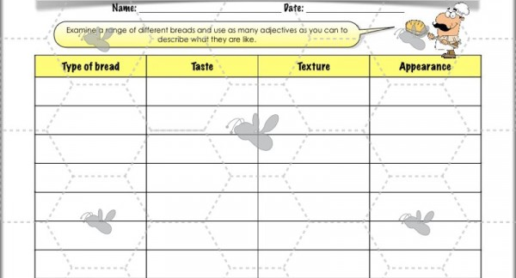
Task 4. You are now going taste some breads you have at home and evaluate each based on their characteristics. The vocabulary slide may be useful for this task. (print off/ draw chart on paper)

Slide 7

Task 5.
In the space below write down which was your favourite bread(s) and why.
…………………………. was my favourite bread because…

