Slide 1

Baking Bread
Hello again Year 5.
This is the second lesson in our topic about baking bread.
You will…
learn about the ingredients you need to make a simple bread
You will use these design and technology skills:
Designing
Testing/ experimenting

Slide 2
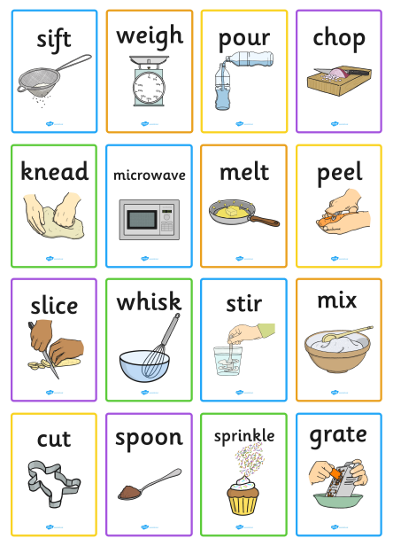
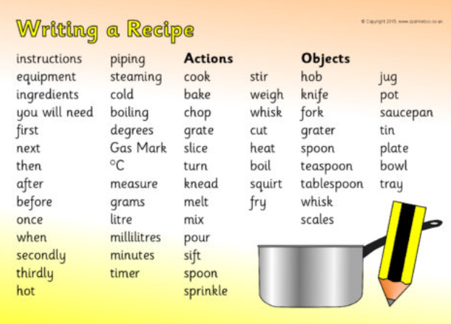
Useful vocabulary

Slide 3
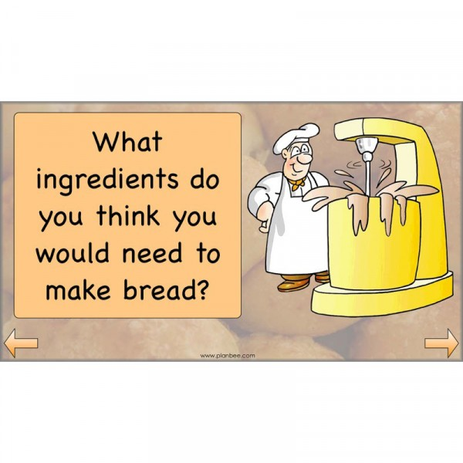
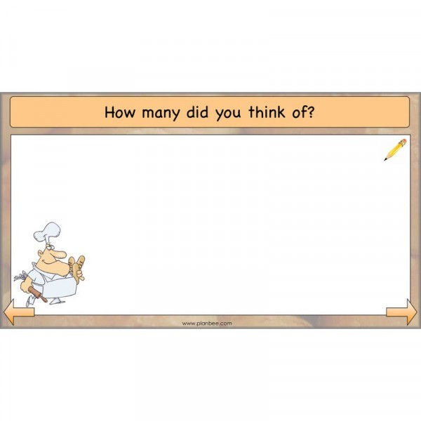
Task 1.
Write down the ingredients you think of here.

Slide 4
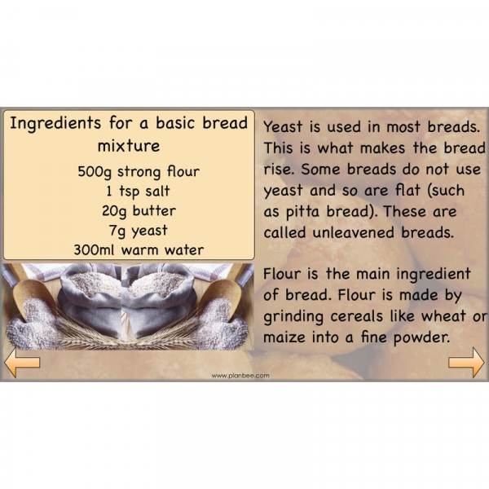
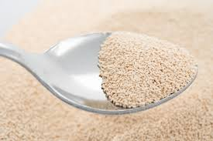
Task 2.
Find out about yeast. What is it? How does it work? What does it do to a bread mixture? What happens to bread made without yeast? What else can you use yeast for? https://kids.britannica.com/kids/article/yeast/442746
Baker’s yeast.
Print out this page and write your research in this box/ type into this box and save/ write up your research on paper.

Slide 5
Find out about flour. What plant is it made from? How is it made into flour? What different types of flour are there? How does it end up on our supermarket shelves? Add diagrams if it helps. http://encyclopedia.kids.net.au/page/fl/Flour
Task 3.
Print out this page and write your findings in this box / type it up here and save it / write up your research on paper).

Slide 6
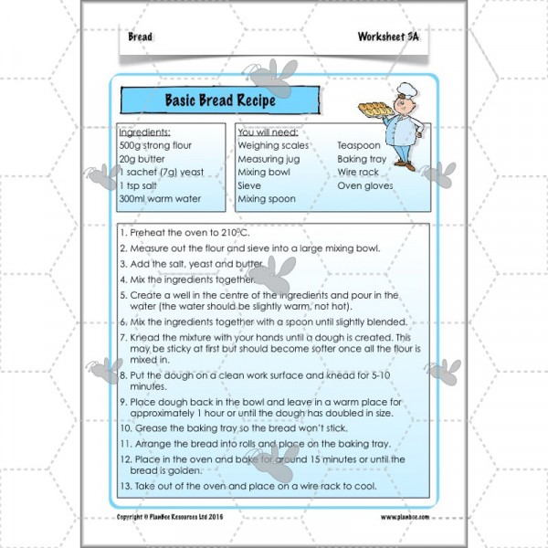
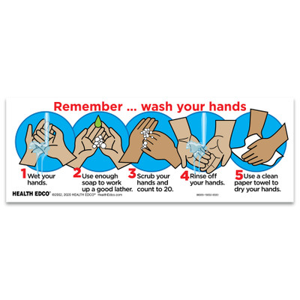
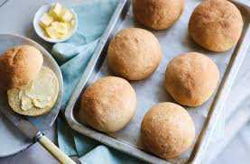
Here is a basic bread recipe. If you would like to bake some of this bread before we move on, please do. It’s really easy and it will help you with the next phase which is designing bread for someone special or for a special celebration. Have fun!

Slide 7
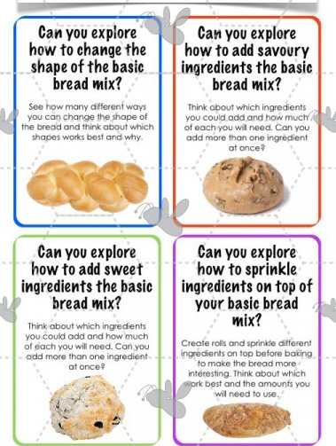
The next stage of your DT learning is to design a bread product for someone special to you or for a special celebration or day. You will choose two extra ingredients to add to the basic bread mix. You could even add food colouring and a topping.

Slide 8
Task 4. Complete the chart below to help you plan your special bread. (Print off/ write out/ type up & save).
Who/ what is your special bread going to be for?
Why have you chosen this person or occasion?
Are you going to make a sweet bread or a savoury bread?
Why have you decided on this?
Which two extra ingredients are you going to add to the basic bread recipe?
Why have you chosen these ingredients?
Will you change the shape of your bread? If so how?
Will you add a topping to your bread? If so what?
Will you add a colour?

Slide 9
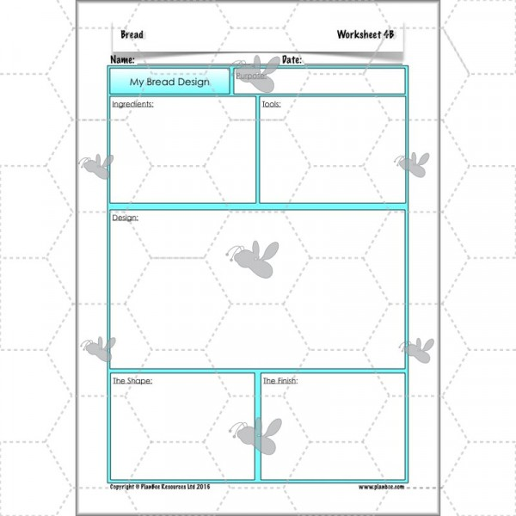
Task 5. Complete this planning sheet. You can draw and label as well as write. (Print off or write & draw on lined paper).

Slide 10
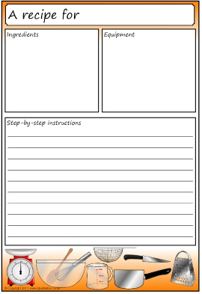
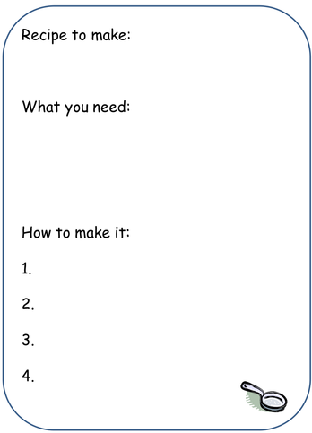
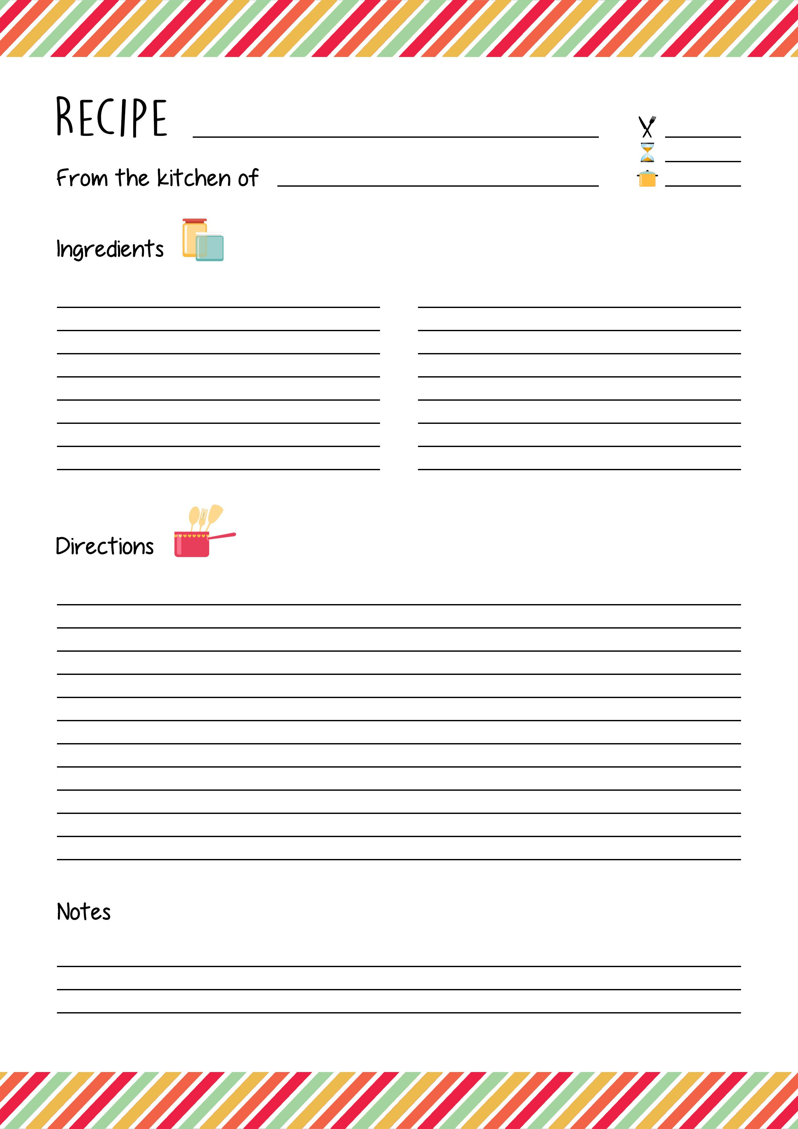
Task 6. You are going to write up your recipe including ingredients, equipment and method. Here are 3 examples of recipe layouts. Choose one you like and enlarge it and print it out or design your own. Be creative. Make it match your special person or occasion. Slide 2 will be useful here.

Slide 11

Next lesson… THE BIG BAKE. Will you be the…?

