Slide 1
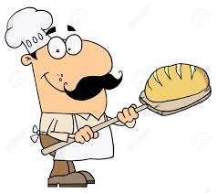
Baking Bread
Hello again Year 5.
This is the third lesson in our topic about baking bread.
You will…
Make bread based on a plan and design
Take photos of the making process and finished products
You will use these design and technology skills:
making
Measuring
Weighing
experimenting

Slide 2
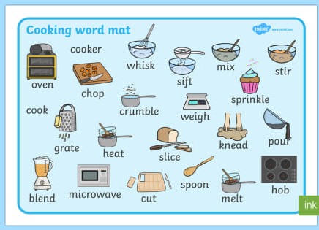
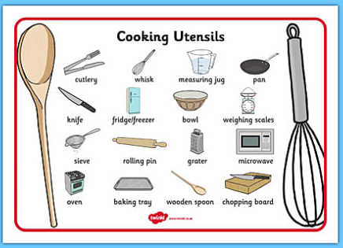
Useful vocabulary
Mix flour yeast salt butter oil prove knock back well dough stiff floured split the dough baking tray oven temperature adult help hot wire rack cool tap hollow sound

Slide 3
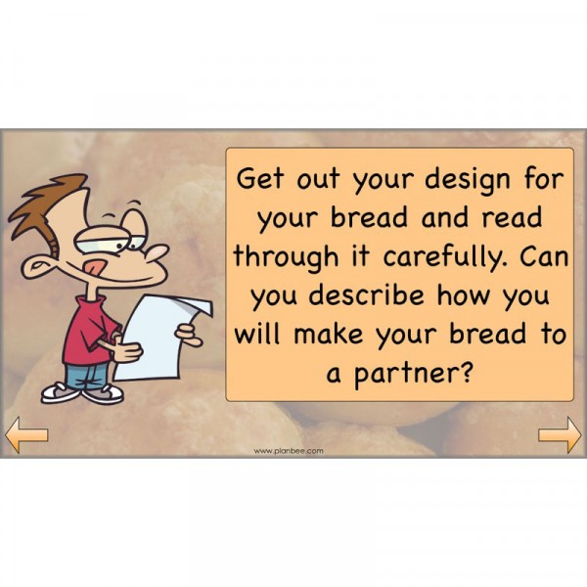
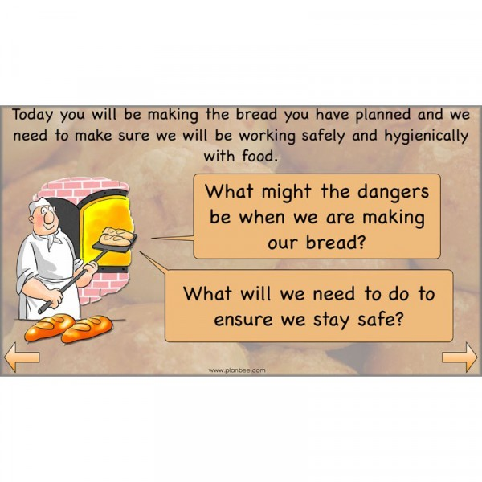

Slide 4
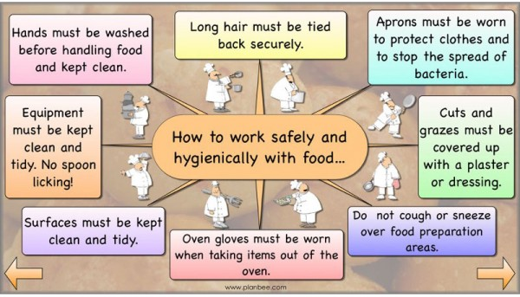

Slide 5
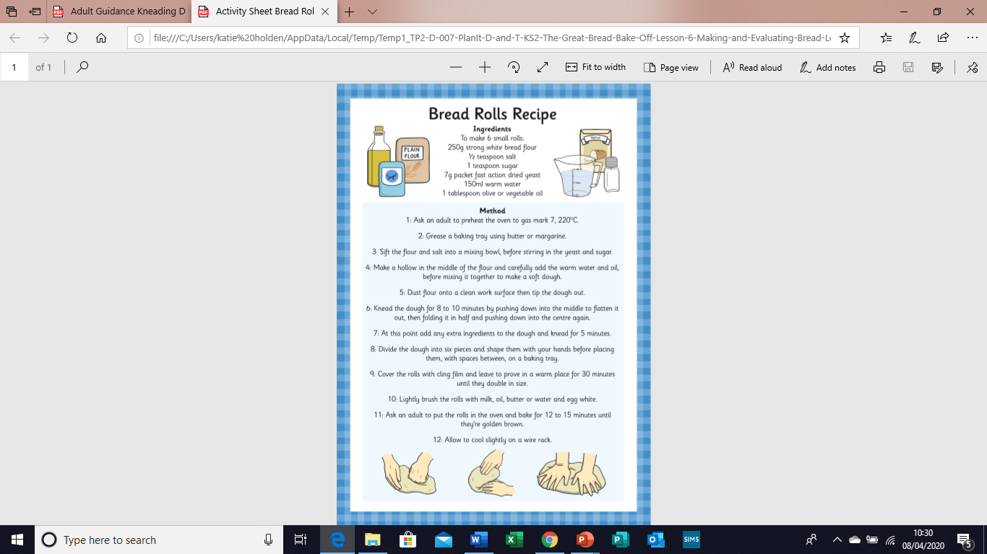
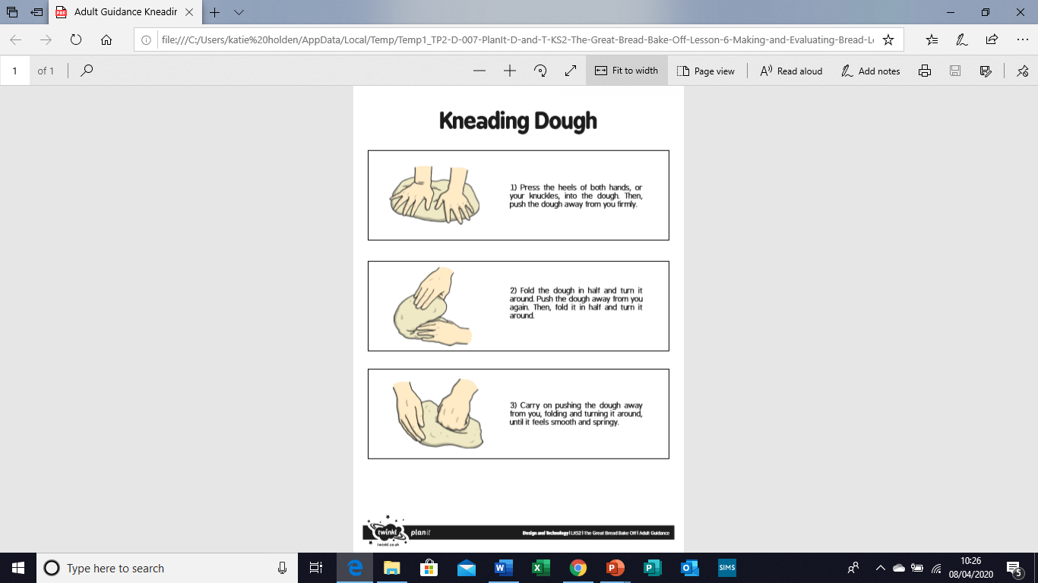
Read through the previous slide to ensure you are working safely. Gather all your ingredients. Gather all the equipment you need.
Watch this link
https://www.bbcgoodfood.com/videos/techniques/how-make-bread it shows how to make a loaf of bread, rather than bread rolls, but is clear and easy to follow.
Task 1.

Slide 6
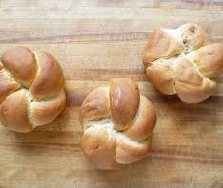
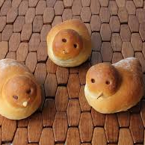
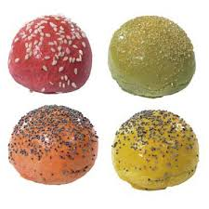
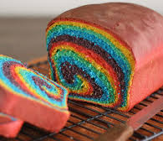
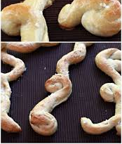
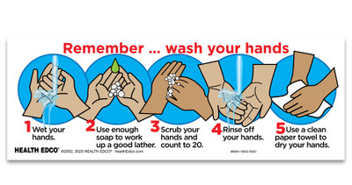
Task 2. Using your recipe and following the instructions step-by-step, make your bread rolls.
Remember, just like when we are doing our long pieces of writing, you can make changes to your plan. Just remember to note them down so that you can do the same (or not) next time you make your special bread.
Task 3. Take photos of your baking so that we can share them and celebrate when we get back to school. You can glue them into the Bread photo albumn if you like.

Slide 7

The next stage of your DT learning is to evaluate the bread that you made. Do this honestly so that you can improve your bread the next time you make it so it will be even more delicious.

