Slide 1
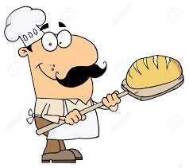
Baking Bread
Hello again Year 5.
This is the fourth and final lesson in our topic about baking bread.
You will…
Evaluate your finished product
Suggest ways your recipe may be improved
You will use these design and technology skills:
Compare
judge
evaluate

Slide 2
Useful vocabulary
Crumbly Chewy Thick Crispy Flaky Soft Smooth Crunchy Smoky Fragrant Musty Juicy Savoury Tangy Mild gooey | Bitter Sweet Sour Fresh Fruity Zesty Citrus Bland Nutty Rich Exotic Hot Soothing Peppery Golden Tasteless | Creamy Cold Spicy Brittle Fatty Dry Salty Moist Lumpy Sandy Delicate Aromatic Strong
positives improvements negatives good taste smell look skills strengths worked well improvement develop practise practical change next time negative positive developing happy skills

Slide 3
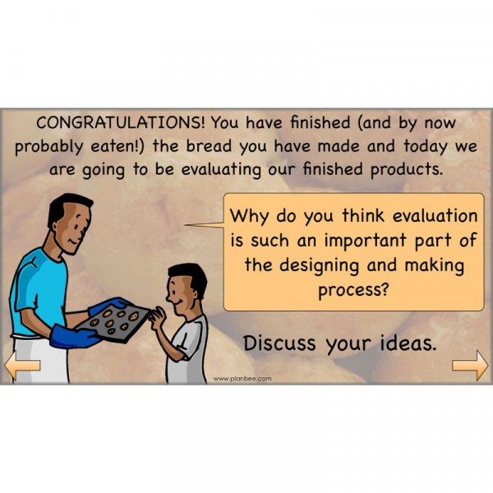
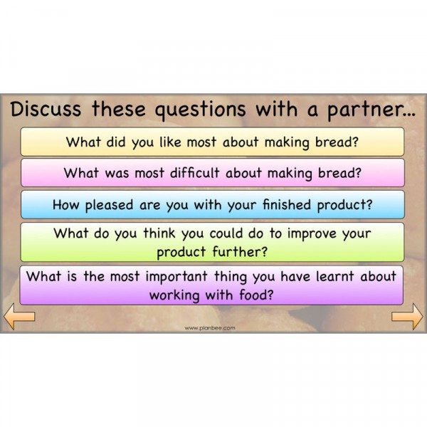
Task 1.

Slide 4
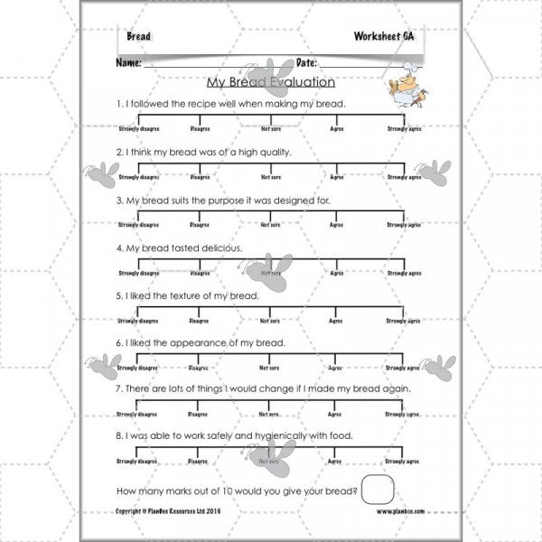
Task 2.
Now it’s time to evaluate your bread creation. Be honest. Use the sheet on the right to help you.
(Print off or write up)

Slide 5
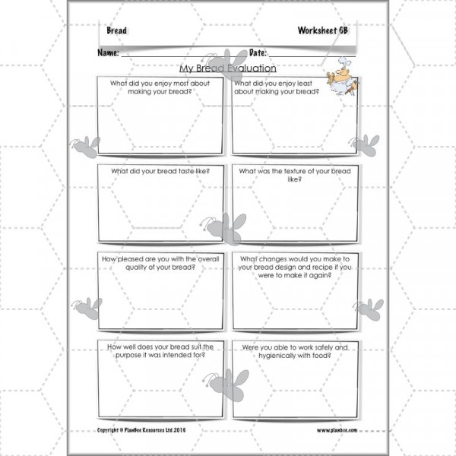
Task 2 continued…
(Print off or write up.)

Slide 6


