Slide 1
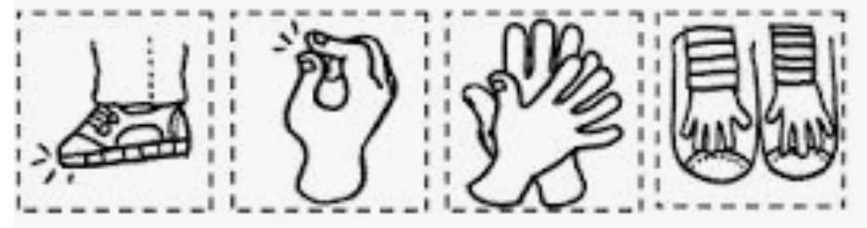
Once you have joined in with some Beat Goes On Body Beats, or if you can’t access that, here is something you could try. This is a way to explore some body percussion whilst revising rhythms.
Print and cut out the images or you could draw your own.
Draw rhythms to go with each image. For example, you might choose a pair of quavers to go with a foot stamp, or a crotchet for a finger click.
Perform your body percussion for a human or a pet!
Have fun! Miss Venables

