Slide 2
Lesson 2 is about friendships
You will think about:
What makes a good friend?
What can change a friendship?
How you can manage a fallout with a friend?

Slide 3
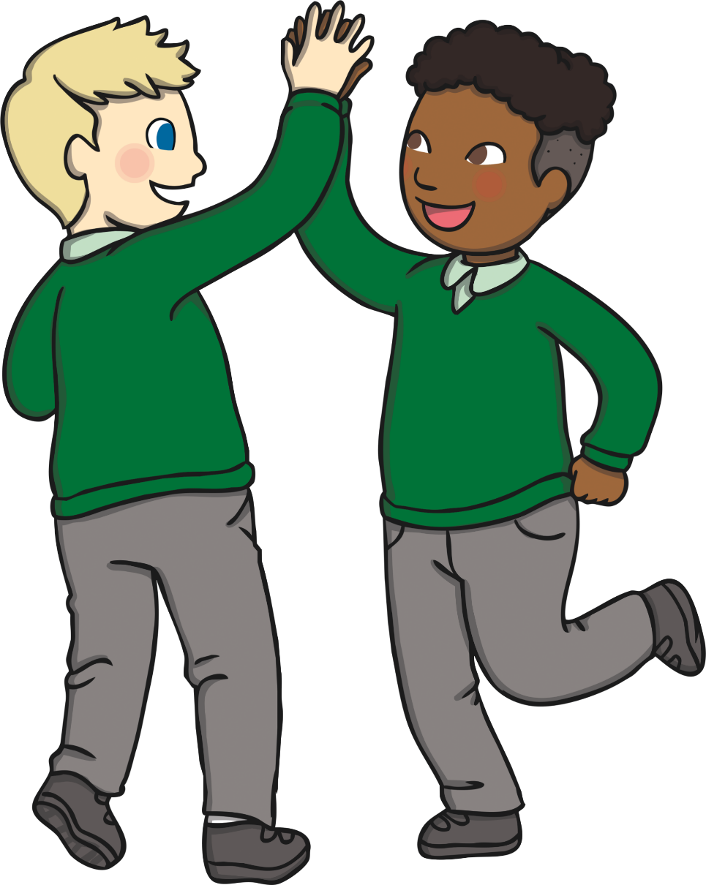
Friends
How are you and your friends similar?
What makes a good friend?
What qualities do your friends have?

Slide 4
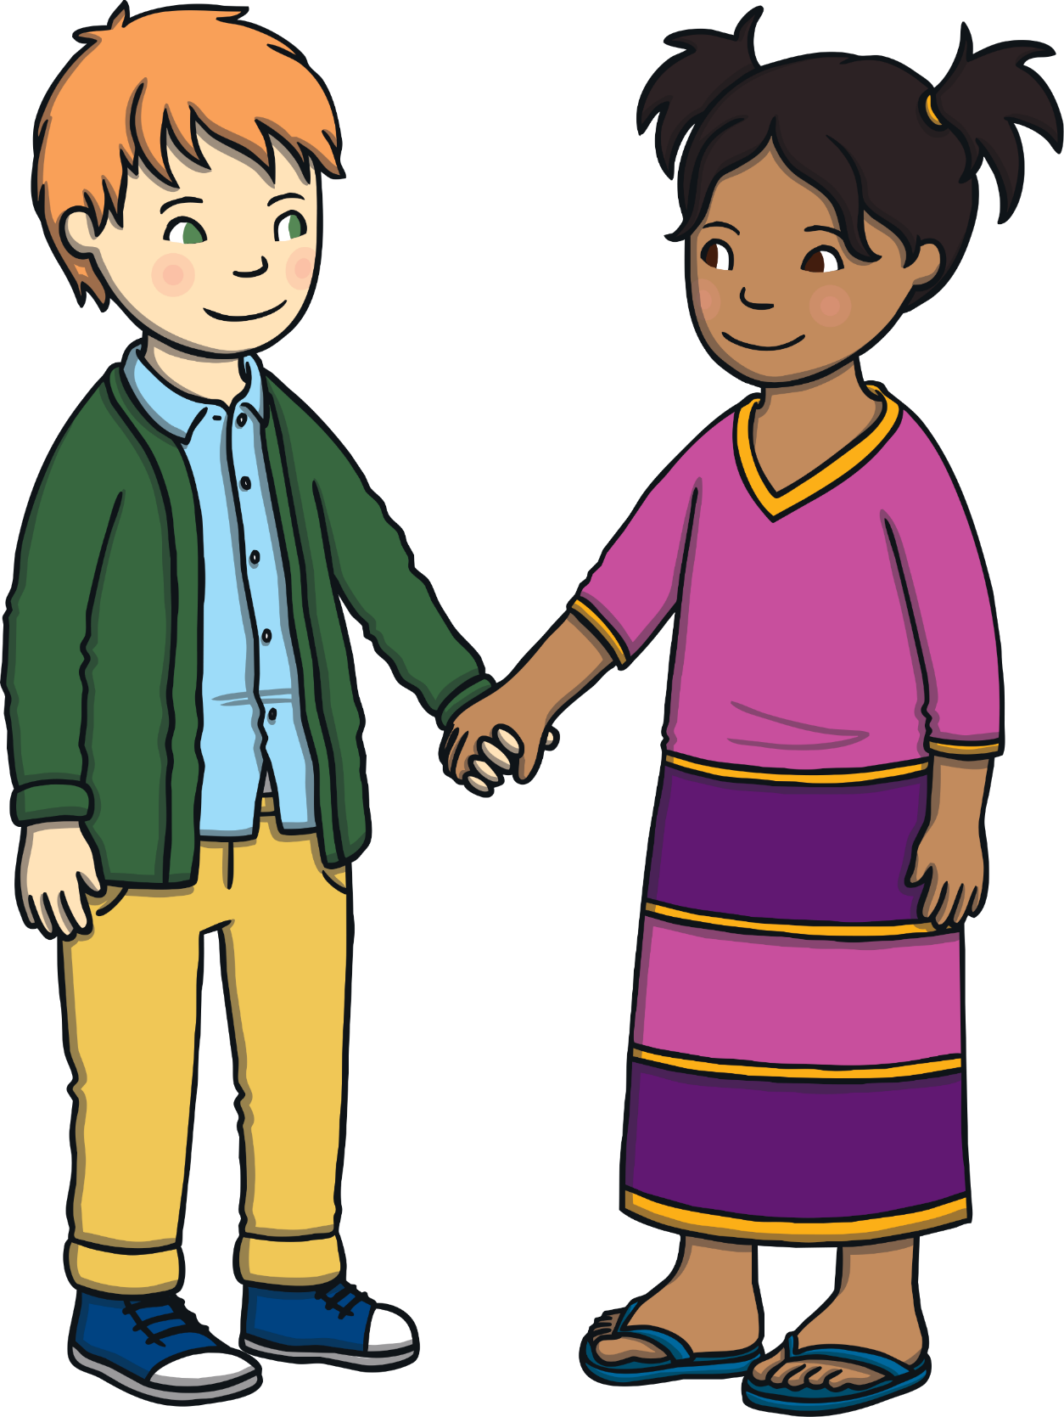
Friends…
Play with us.
Share with us.
Choose to be our partners.
Compliment us.
Make us laugh.
Listen to us.

Slide 5
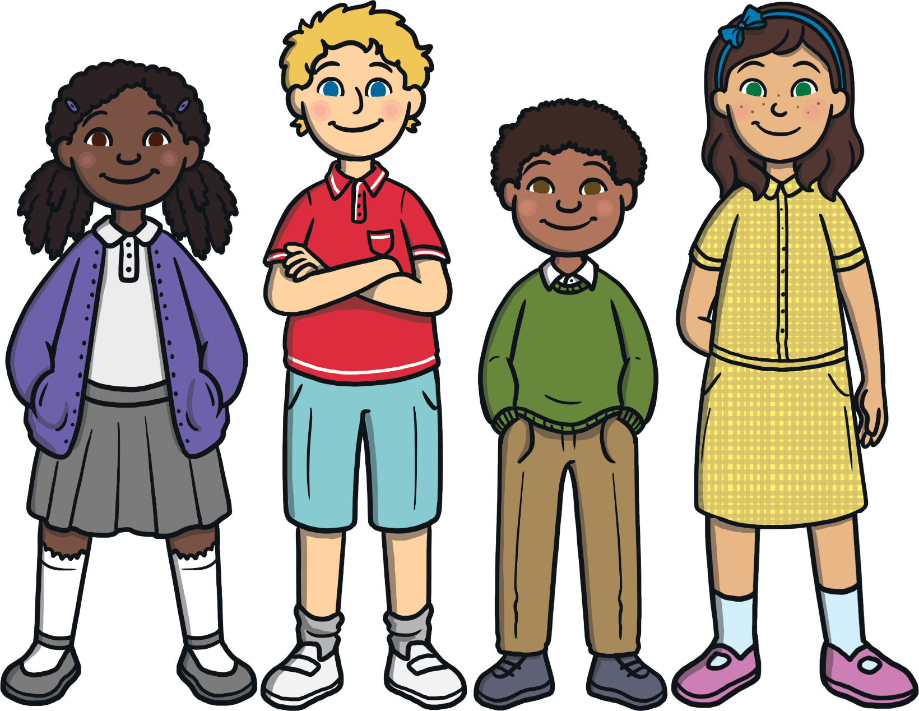
Friends
How do you feel when your friend compliments you?
How do you feel when you give someone a compliment?

Slide 6
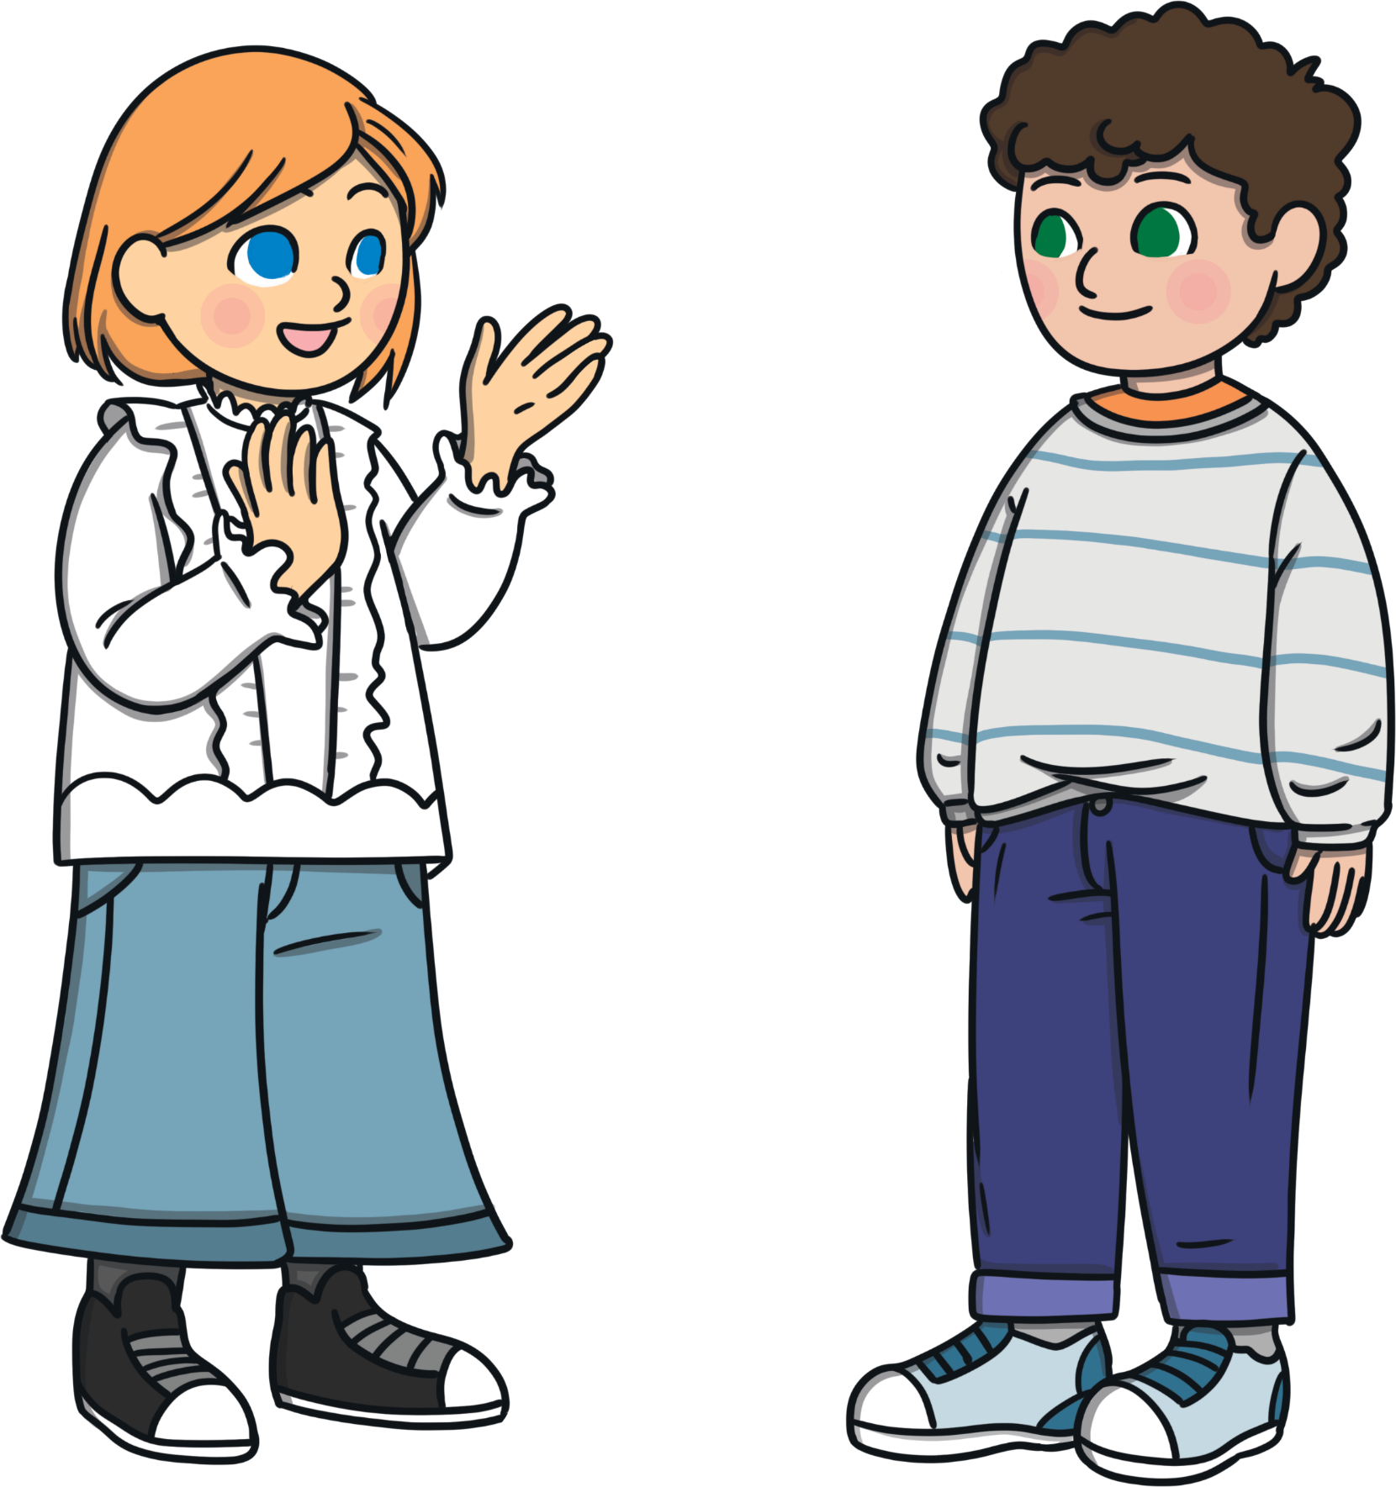
Compliments
Pay your friend a compliment if they
are feeling down. It could even
cheer them up!
Always say ‘thank you’ when someone
pays you a compliment.
Make sure what you say is
nice and genuine.

Slide 7
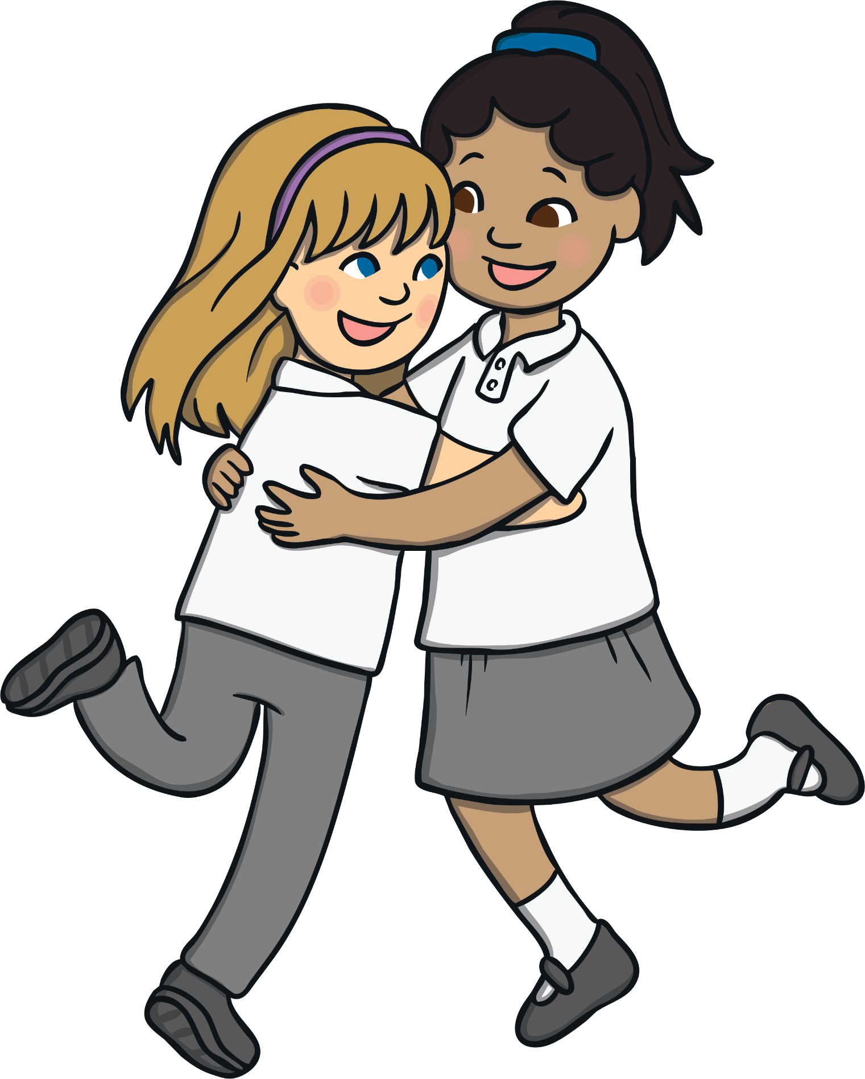
Friends
Do you think that all friends last forever?
Can everyone be a friend?
Can we be friends with someone all the time?
Could you be friends with someone after you have fallen out?

Slide 8
How can friendships change?
One person moves away
friends’ interests change
friends argue and fallout
friends drift apart
new friendships take over
Looking at the list, consider:
• When should you make an effort to save a friendship?
• Can you say to someone ‘I want to end our friendship’ without
hurting their feelings?
• Can you break friends but remain friendly?

Slide 9
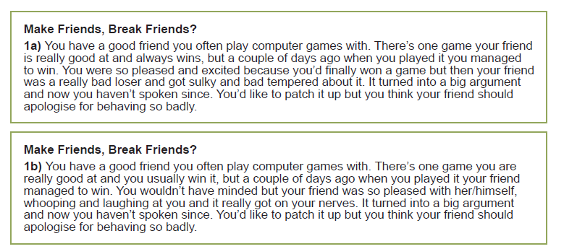
Make friends or break friends
Read the two different sides to the same situation.
How do you feel about it?
Have you been in a similar situation? What could these two children do if they are going to try and stay friends?
Person A
Person B

Slide 10
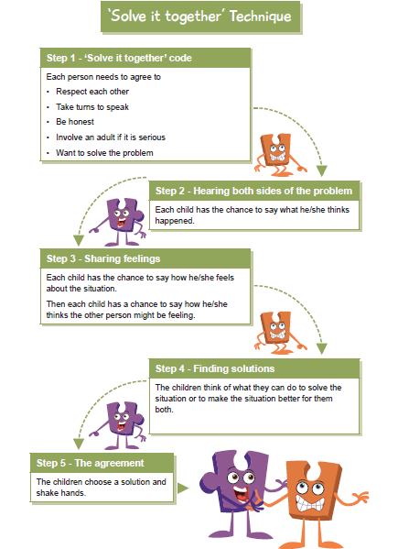
Use this ‘solve it together’ technique to decide whether the children in the scenario should continue with their friendship or do you think it will have to end?
If the friendship ends, does it have to be on bad terms or can it be an agreement that both children are happy with?

Slide 11
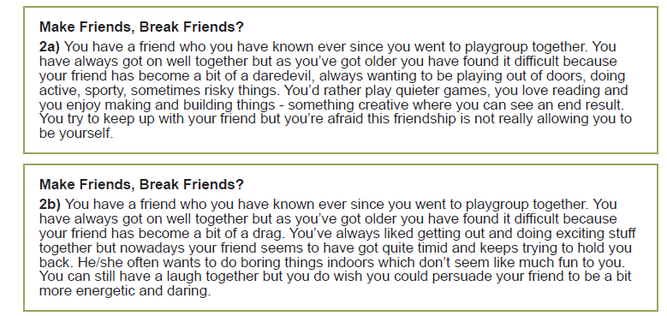


Repeat the same activity for this different situation.

Slide 12
Use this ‘solve it together’ technique to decide whether the children in the scenario should continue with their friendship or do you think it will have to end?
If the friendship ends, does it have to be on bad terms or can it be an agreement that both children are happy with?

Slide 13
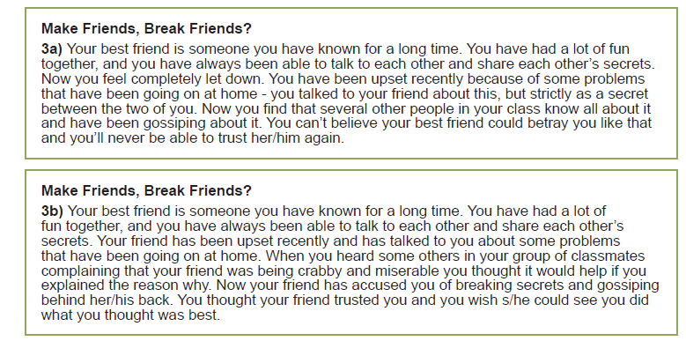
One more situation to look at if you have time.

Slide 14
Use this ‘solve it together’ technique to decide whether the children in the scenario should continue with their friendship or do you think it will have to end?
If the friendship ends, does it have to be on bad terms or can it be an agreement that both children are happy with?

Slide 15
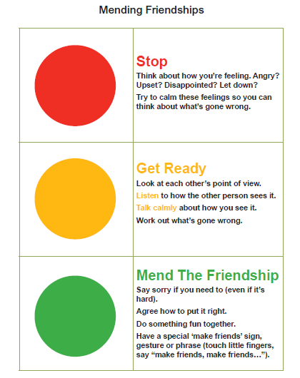
Use this traffic light system to help you to resolve friendship issues in the future.

Slide 16
Reflection time
Which of these words do you think are the most important in managing friendships successfully?
Trust
Loyalty
Anger
Betrayal
Empathy
Negotiate
Compromise.
You may need to look up some of these words in a dictionary.

