Slide 1
Hello Year 5!
Today we are going to begin our new RE topic. During the spring term, we learnt that Hindus believe that there is a part of Brahman ( who is the highest God in Hinduism) in everyone. This is called Atman.

Slide 2
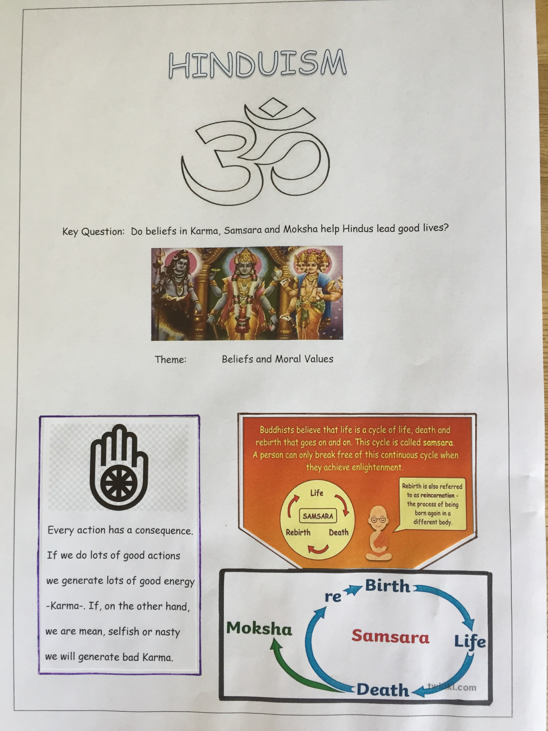

Slide 3
What does consequence mean?
Look it up in a dictionary or google the word/definition.
Remember that any instruction in red means that you are being asked to do it. Words in other colours are for you to read and understand. If you don’t understand, ask us, a parent or someone else with you.

Slide 4
Well done!
Consequence means ‘as a result or outcome’.
ALL ACTIONS HAVE CONSEQUENCES.
Everything we say and do has consequences for ourselves and others.
Like ripples on a pond our actions spread out and affect others because everything is interconnected.

Slide 5
Here’s an example to help you understand.
POSITIVE consequences to an action.
ACTION: Keeping your room tidy.
CONSEQUENCES:
When looking for a certain toy or activity, you are able to find it straight away.
Your clothes are clean and in your cupboard ready for when you choose to wear them.
You have more space to play in.
Your belongings are in safe places.
Your parents or carers feel happier.

Slide 6
NEGATIVE consequences to an action.
ACTION: Your room is untidy.
CONSEQUENCES:
1. You cannot find any of your toys or an activity- you waste time looking for them and miss out on your free time when you could have been chilling.
2. You want to wear your favourite top but you can’t as it’s dirty- you left it on the floor instead of putting it in the wash basket.
3. When trying to find a space to play in, you tread on a favourite toy and break it.
4.Your parents or carers are not happy with you - they need to hoover/clean or do all the washing but they can’t.

Slide 7
What would you rather do?
Have the positive or negative consequences to those actions?
Look at the next slide.
Find 4 consequences, (positive or negative or a mixture of the two) to ’I am finding my homework difficult’.
Choose your own action and write it in under ‘My actions’ ( don’t do the room tidy one which I showed you). Come up with 4 consequences.
Add a key to your work so you can see clearly which are positive and which are negative consequences.( maybe colour in the boxes?)

Slide 8
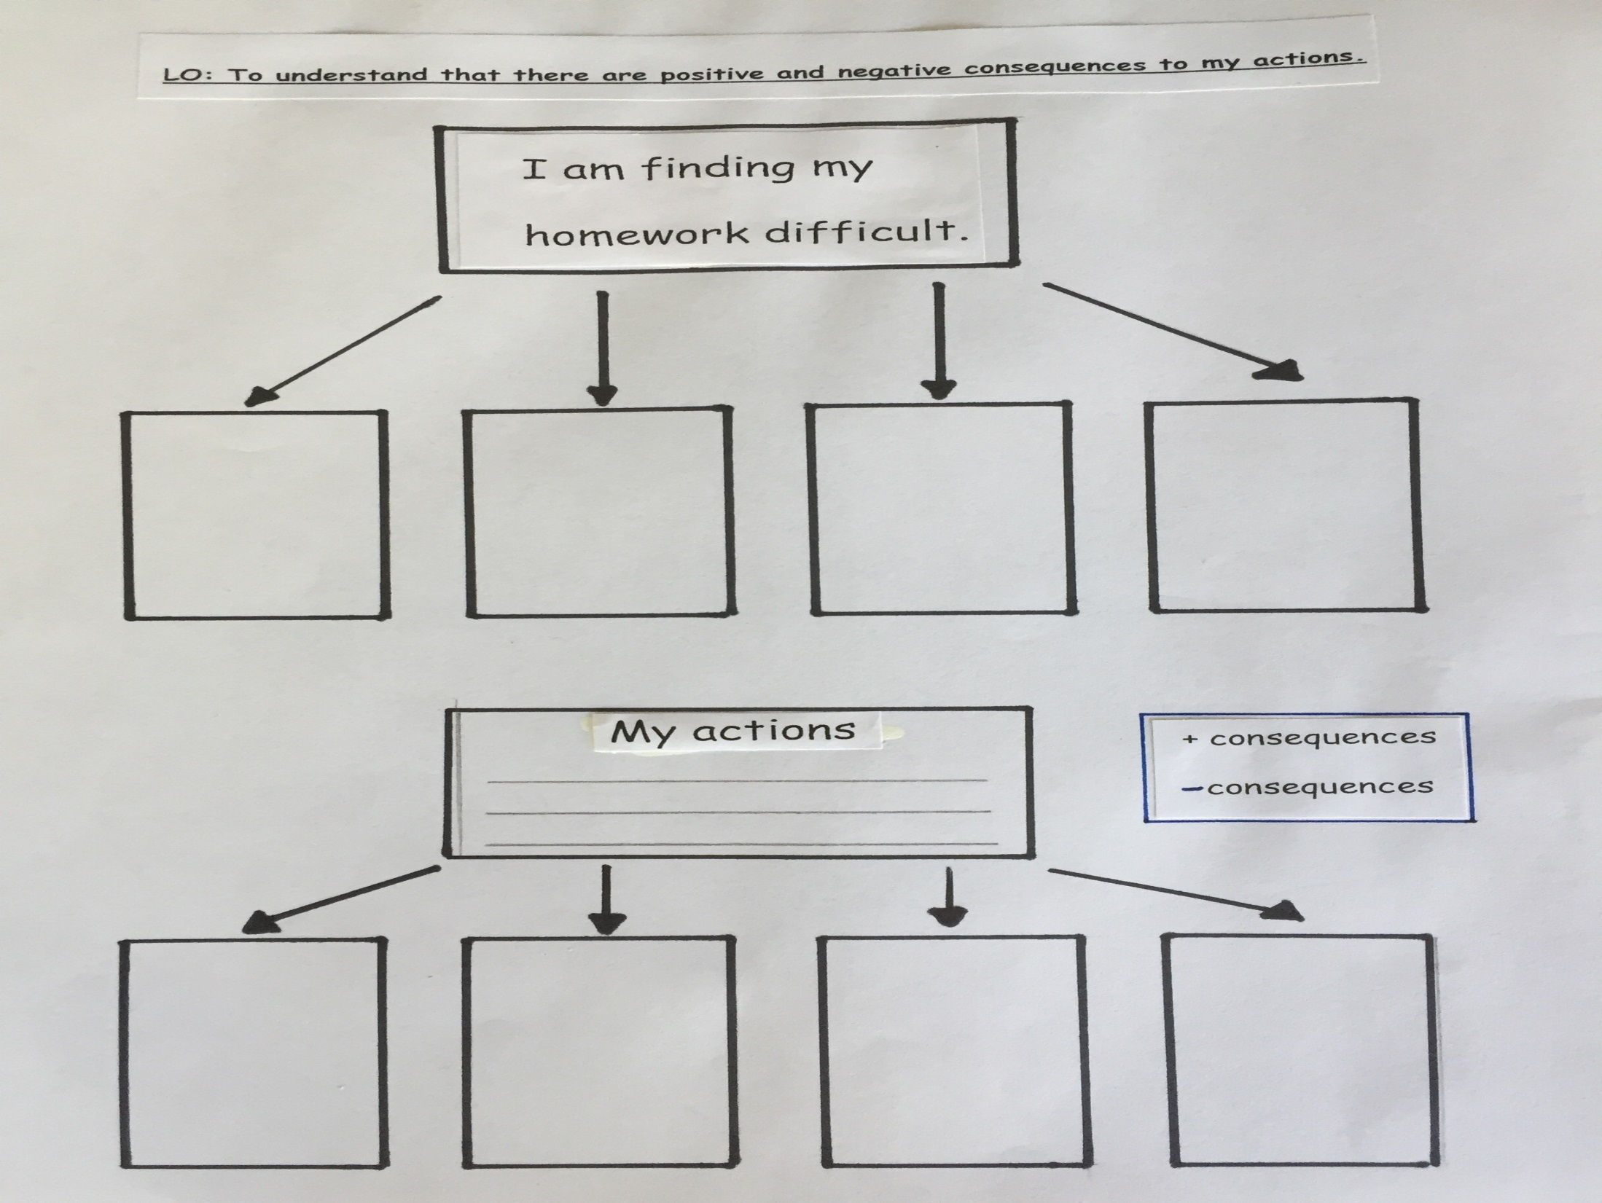

Slide 9
Snakes and Ladders
The board game Snakes and Ladders was originally a Hindu game and represents making good and bad decisions in life.
What happens, in the game, when you make a good decision?
What happens when you make a bad decision?

Slide 10
That’s right!
A good decision-you go up the ladder.
A bad decision- you go down the snake.
Play Snakes and Ladders.
If you are fortunate enough to have your own game you can play that.
If not, I have attached two templates or even create your own.
Enjoy, have fun and remember the meaning behind this Hindu game.

Slide 11
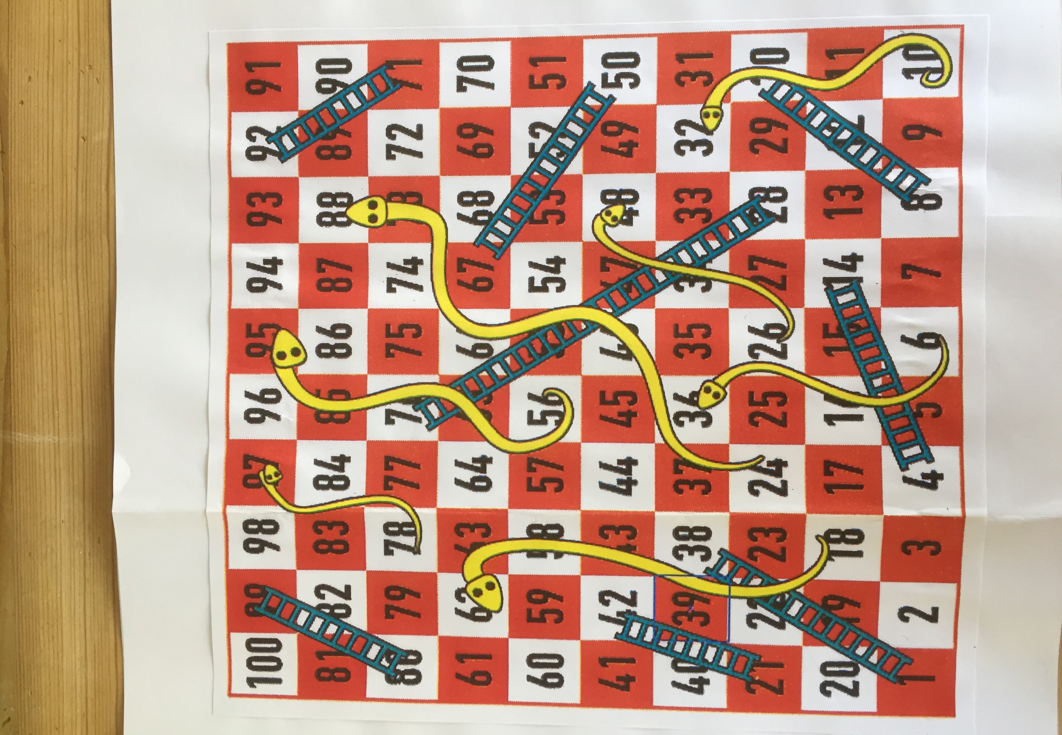

Slide 12


