Slide 1
Welcome back to learning about the beliefs of Hindus and how these impact on their lives.
Last lesson we learnt about how our actions have consequences.
Let’s move onto Lesson 2.

Slide 2
Hindus believe that doing good deeds will bring rewards but it might not be in their life time.
In a life time, Hindus believe that people build up Karma: positive Karma from good actions and deeds negative Karma from bad actions and deeds,
(based on their actions within that lifetime).

Slide 3
Karma
Collecting positive Karma (from good action and deeds) is like going up lots of Ladders (like in the game Snakes and Ladders).
Collecting Karma affects how Hindus lead their lives.
The story of Rama and Sita is an example of doing one’s duty and doing good deeds.

Slide 4
The Story of Rama and Sita
Watch this cartoon retelling the story of Rama and Sita.
https://www.bbc.co.uk/programmes/p06ptdgh
( BBC.co.uk/school radio/assemblies KS2)
Retell the story in the form of a comic strip. Draw/colour pictures and add in words that the characters would have spoken.
Templates
1. The following slides contain templates to help you. Your choice.
2. The first 4 slides contain the story. You just need to add speech and
pictures.
3. The next 3 slides are blank if you wish to retell the story yourself.
4. You may draw the comic strip yourself and don’t need to use mine.

Slide 5
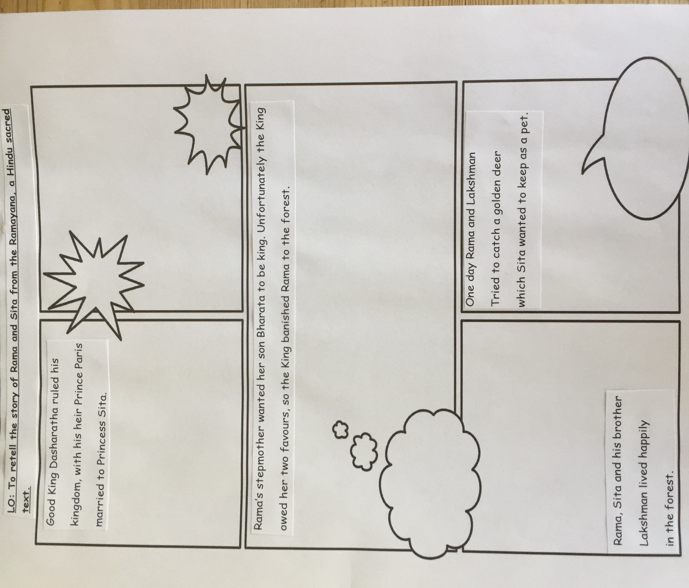

Slide 6
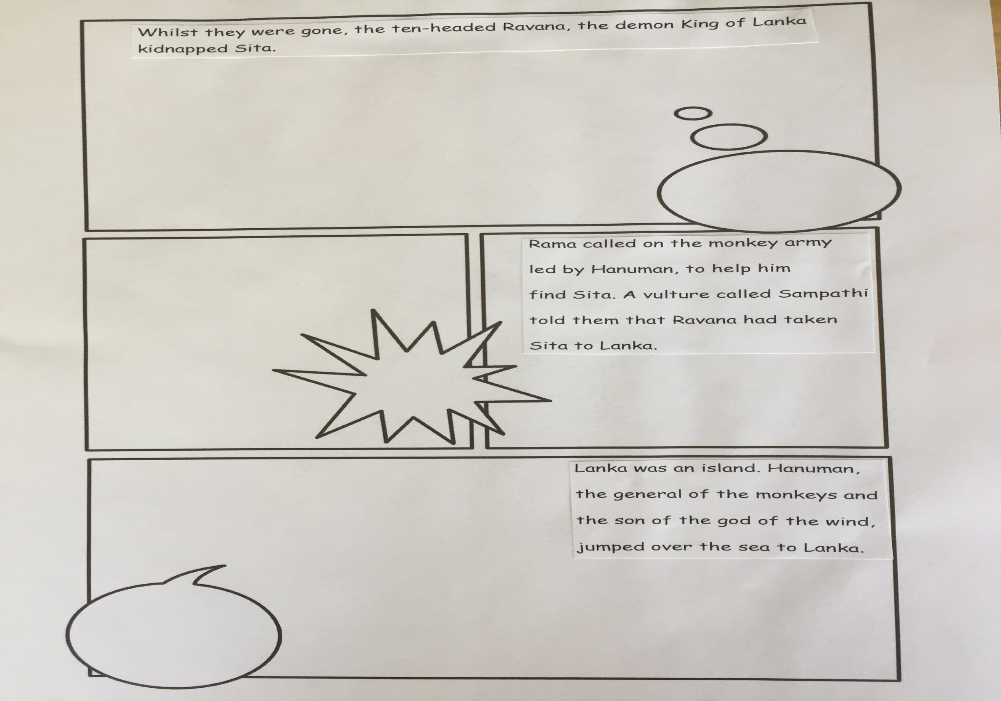

Slide 7
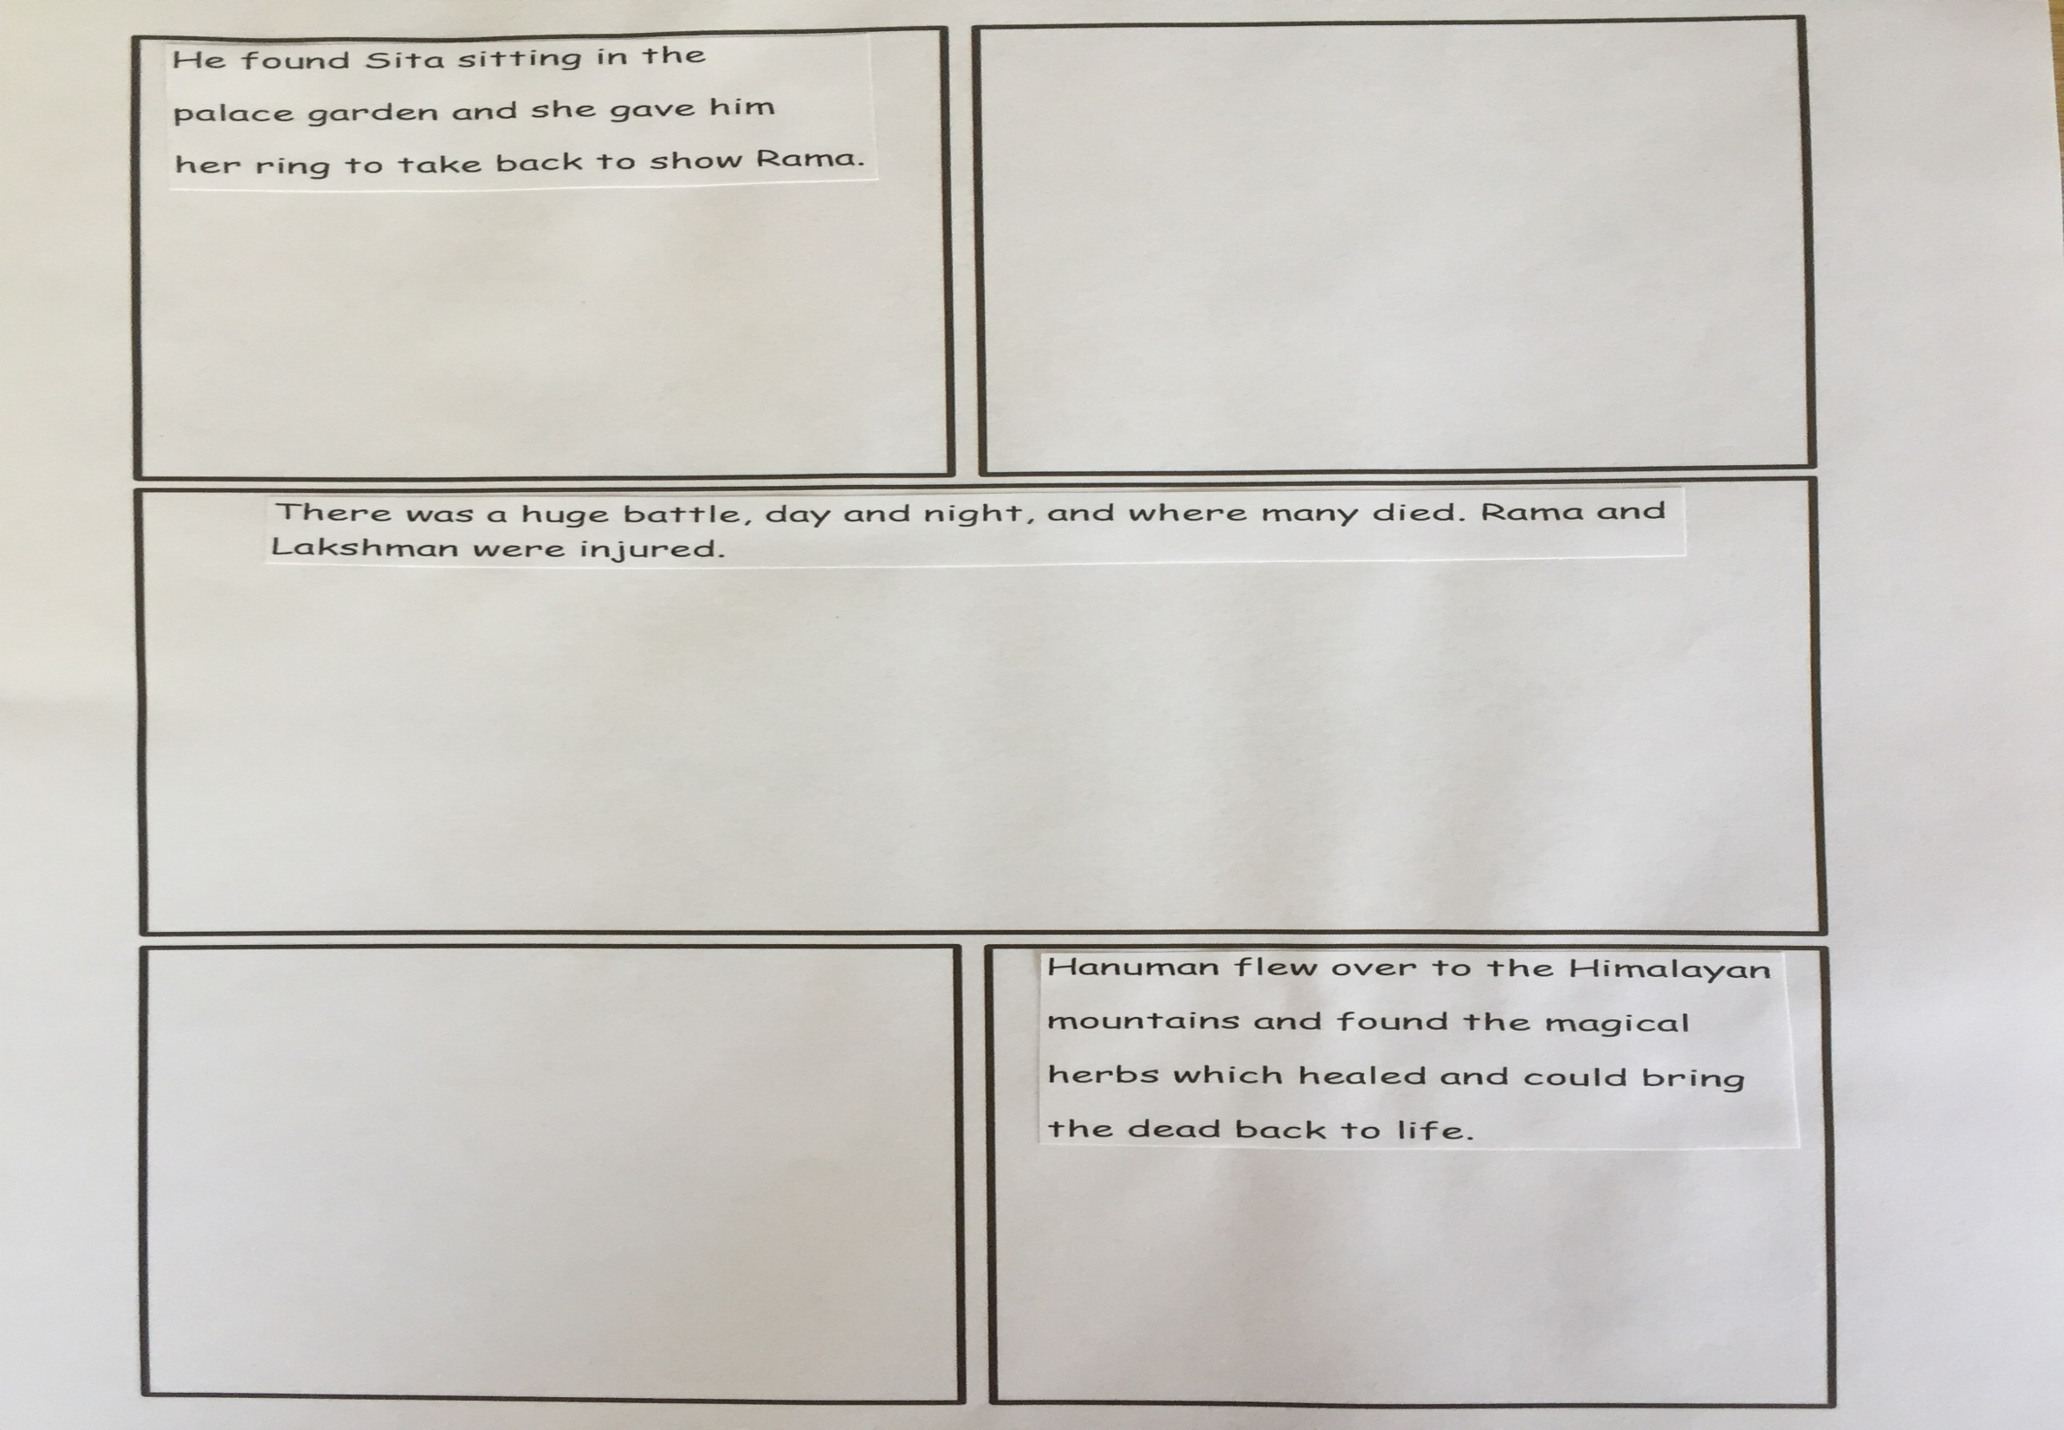

Slide 8
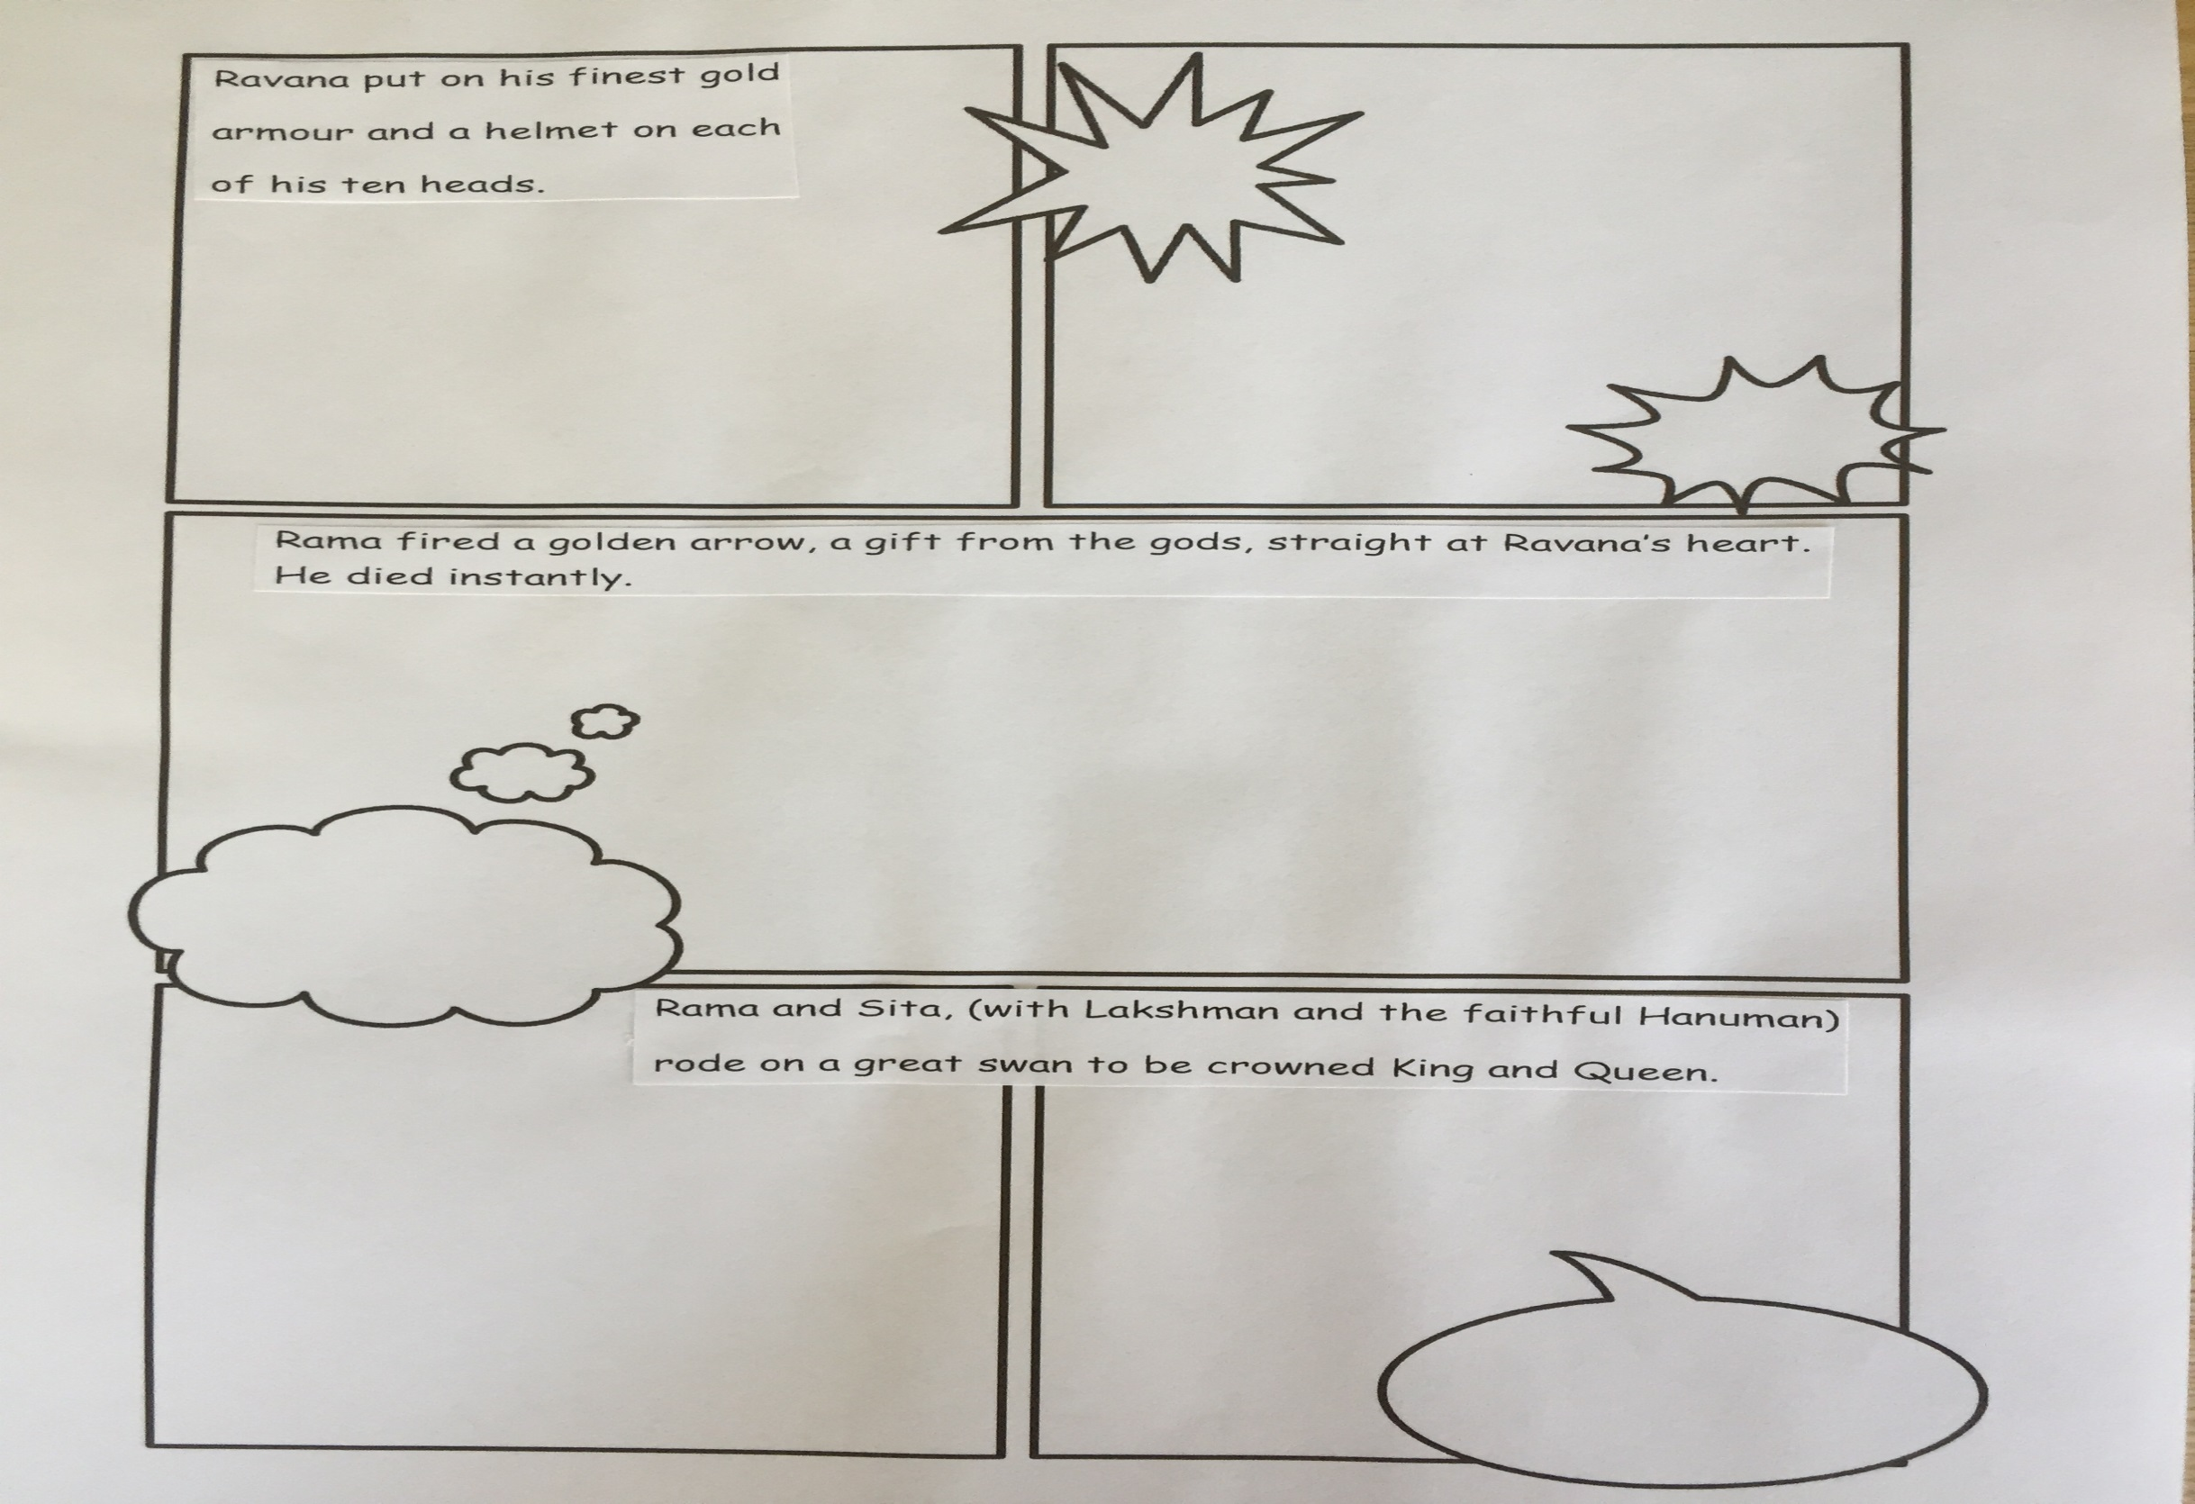

Slide 9
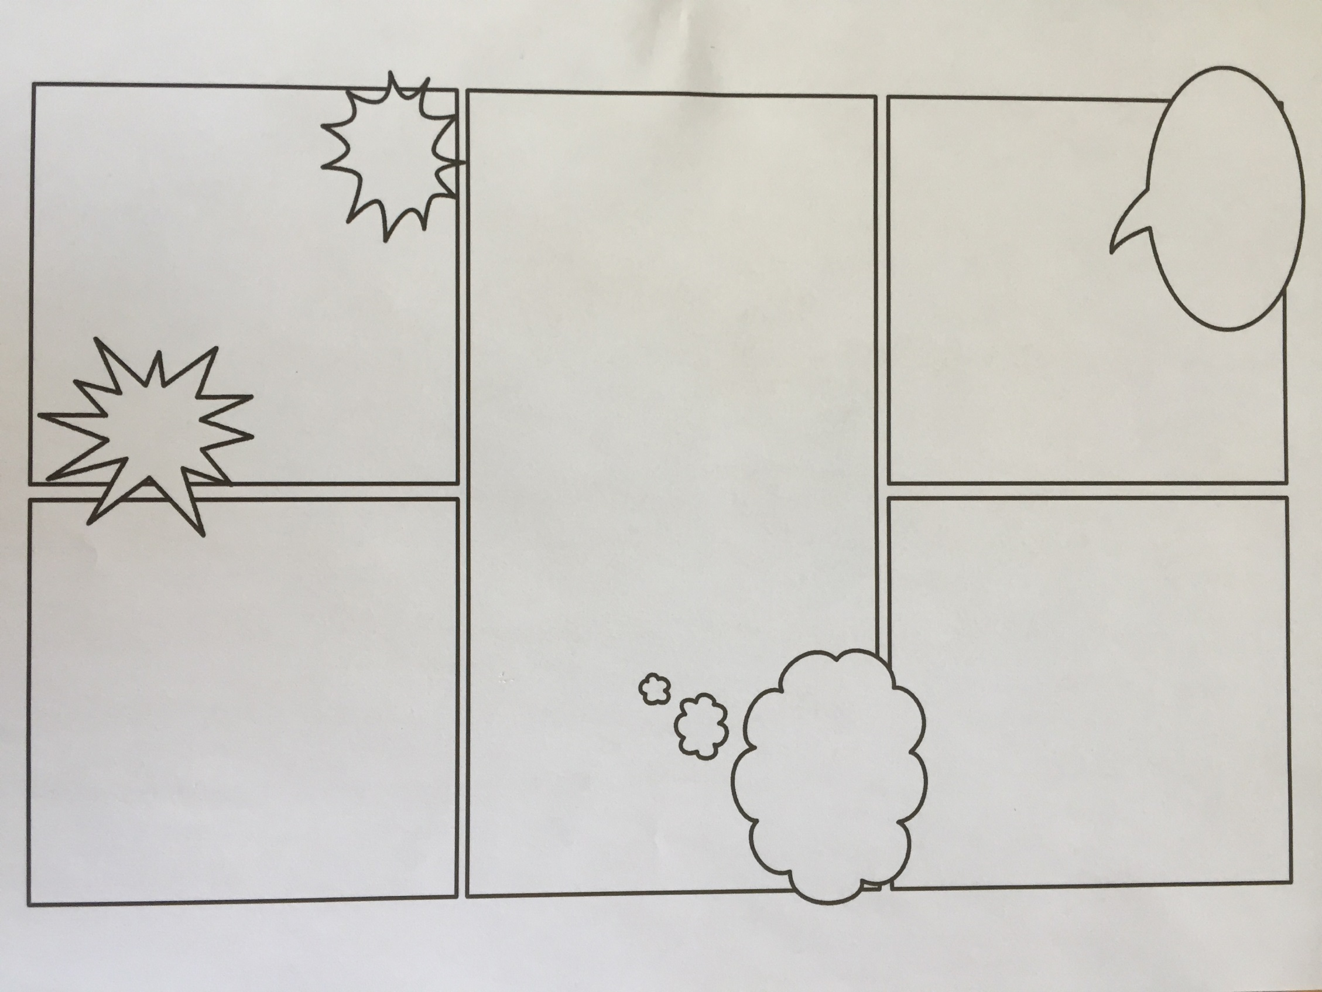

Slide 10
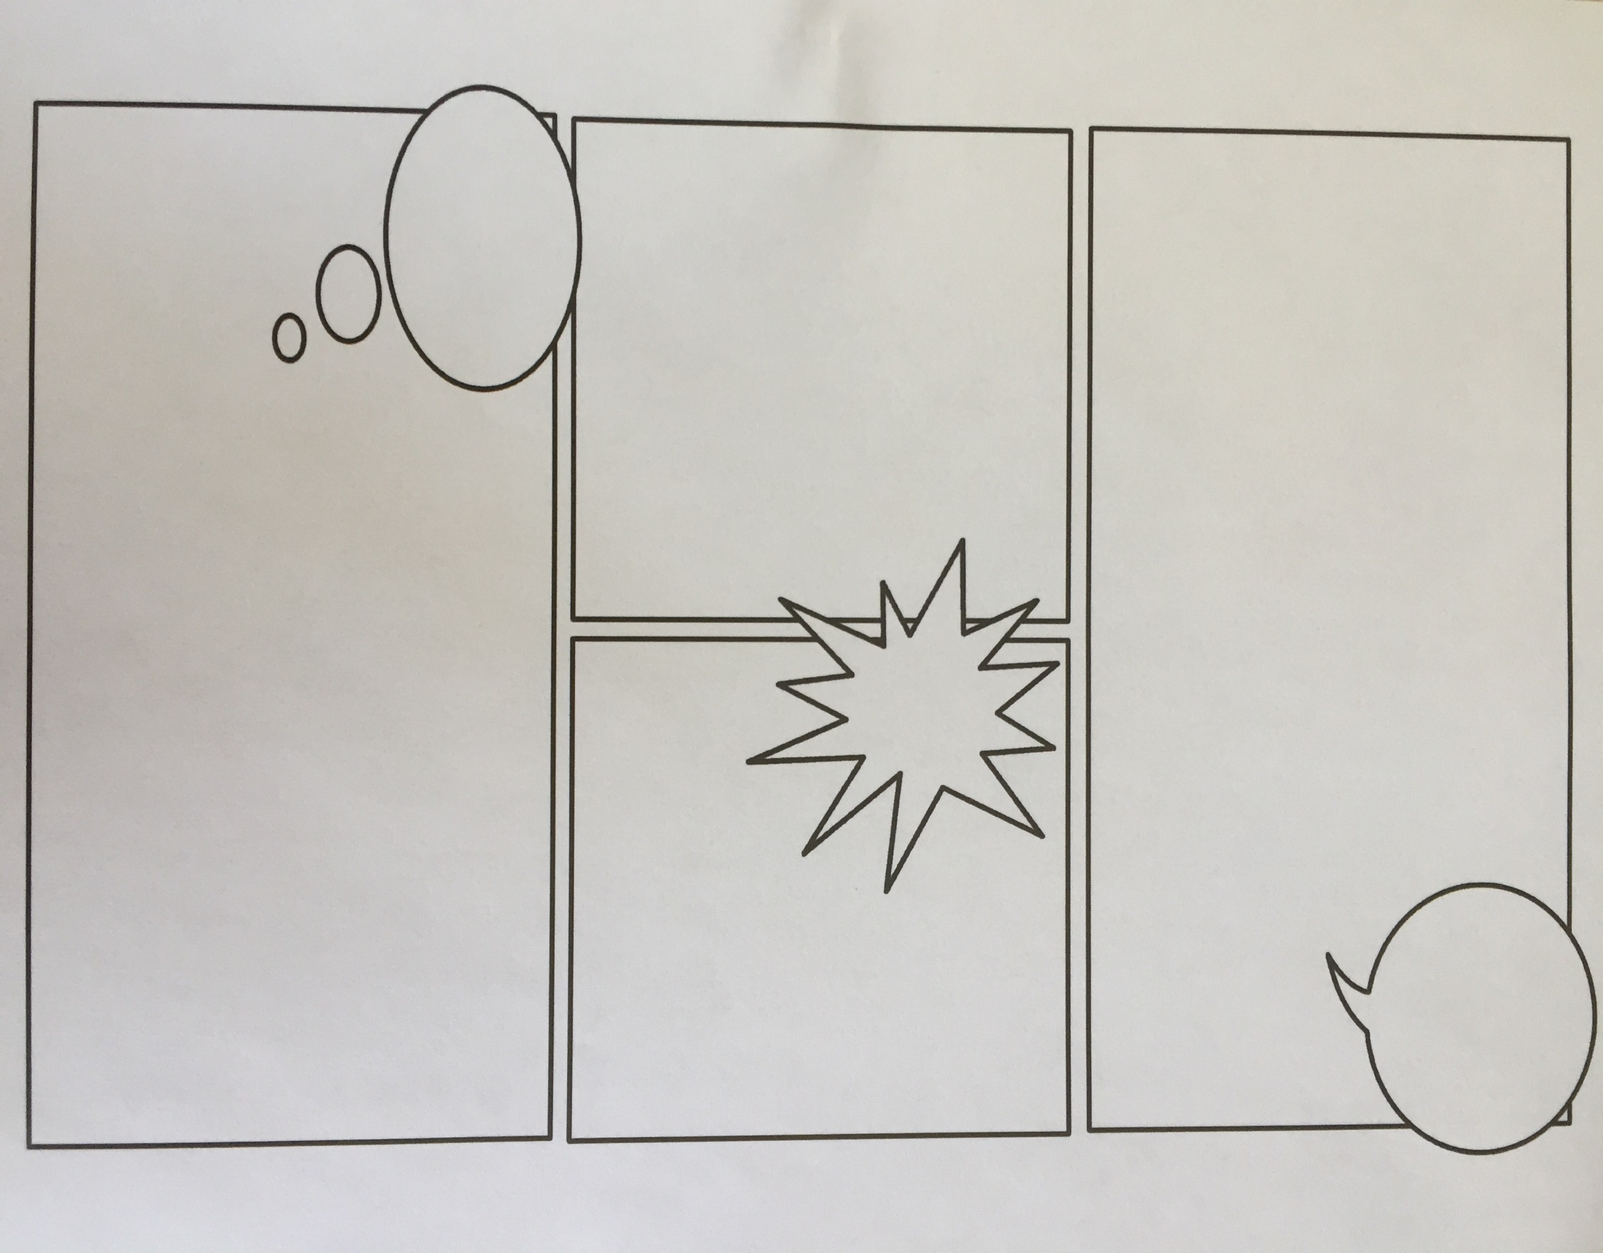

Slide 11


