Slide 1
Hello again!
Time for Lesson 3!
We’ve already learnt about how our own actions have consequences.
We’ve also learnt:
Snakes and Ladders is a Hindu game. Hindus believed that by collecting good deeds you went up the ladder and went down the snakes when you collected the opposite.
In a life time, Hindus build up Karma, both positive (good) and negative (bad).
Collecting Karma affects how they live their lives.
How the story of Rama and Sita is full of good and bad deeds and what happens to those characters.

Slide 2
How does a belief in Karma help Hindus lead good lives?
Hindus believe that their soul passes through a cycle of successive ( one after another) lives.
Hindus aim to live each life in a better way than their life before.
( collecting lots of good Karma)

Slide 3
Hindus believe that the soul goes on forever and lives through many lifetimes, in one body after another.
The soul ( Atman) can be born in a human form, or that of a plant or animal, as all living things have a soul ( Brahman in everything).

Slide 4
Read those last 2 slides again as that is a lot to understand about the beliefs of Hindus.

Slide 5
The goal- what Hindus are working to achieve.
The goal of a Hindu is to become one with Brahman.
When they achieve this, this freedom is called Moksha. Their soul ( Atman) will be released to be with Brahman.
Hindus believe that Moksha can be reached by collecting enough good Karma. It can also be reached by giving up all worldly things such as family, money and objects. A holy person who does this is called a Sadhu.
Read the next slide all about a Sadhu.

Slide 6
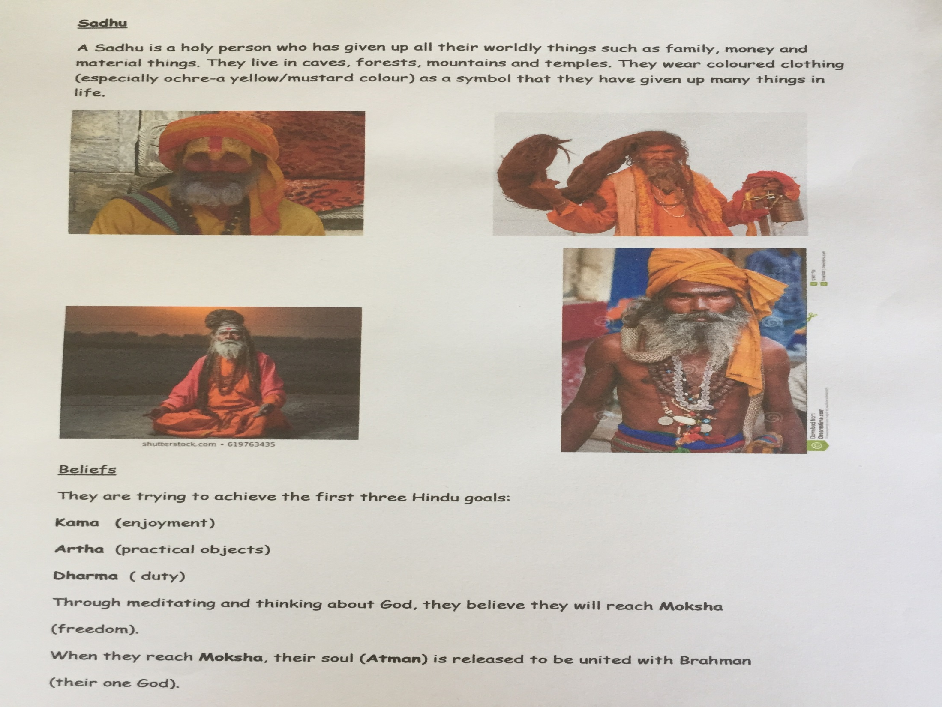

Slide 7
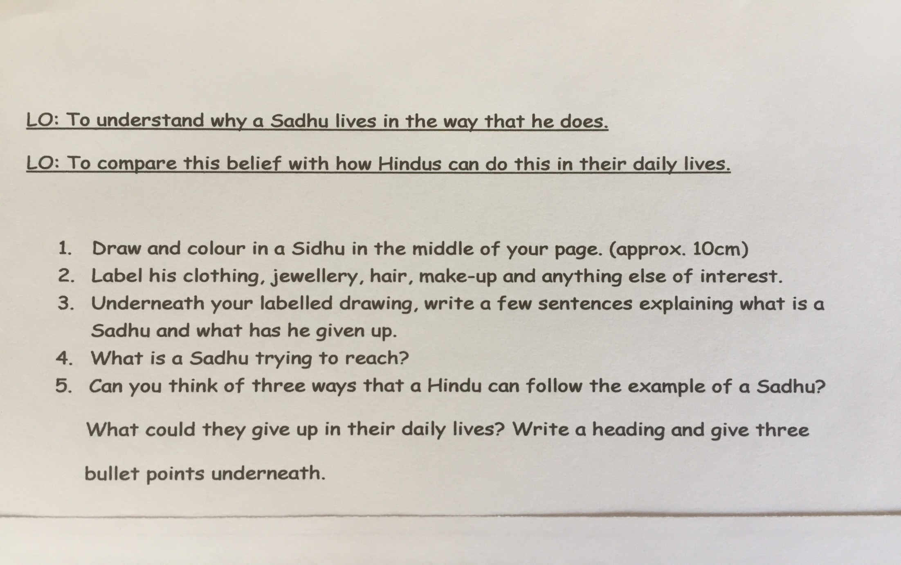
Use the previous slide to answer the following questions.
Use google images to find more photographs of a Sadhu.

Slide 8
Extension work if time.
Design your own board game to show your understanding of actions, consequences and collecting Karma.
You may design your game any way you wish.
The next 4 slides give examples of board designs to help you but again you may draw your own if you wish.

Slide 9
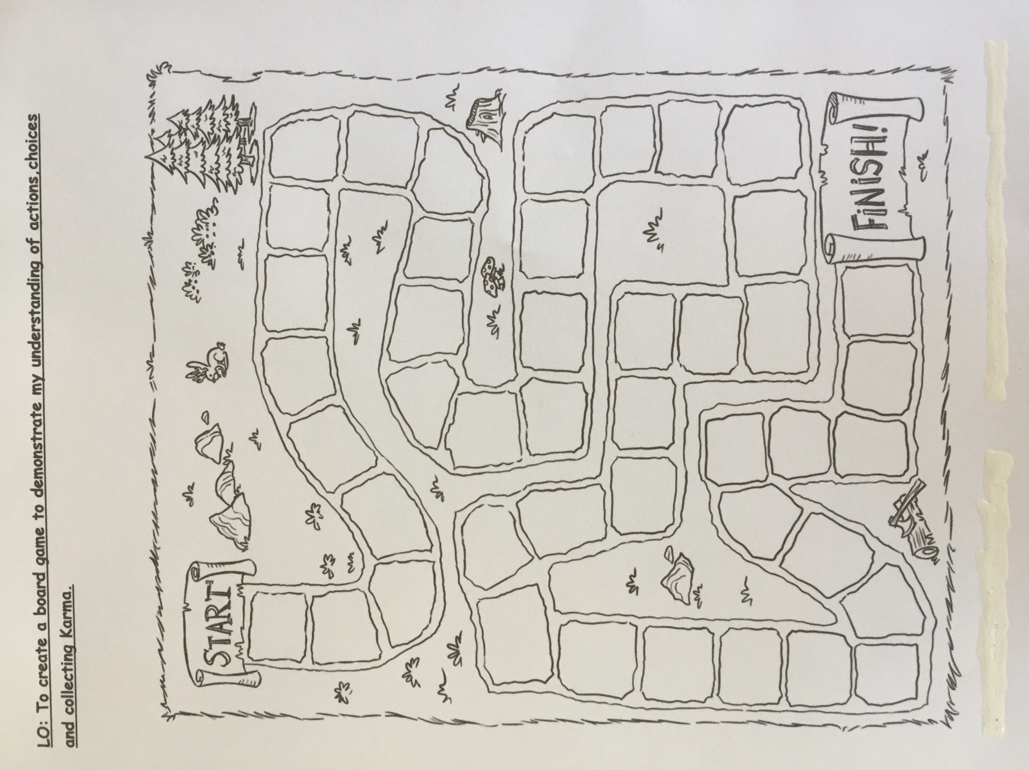

Slide 10
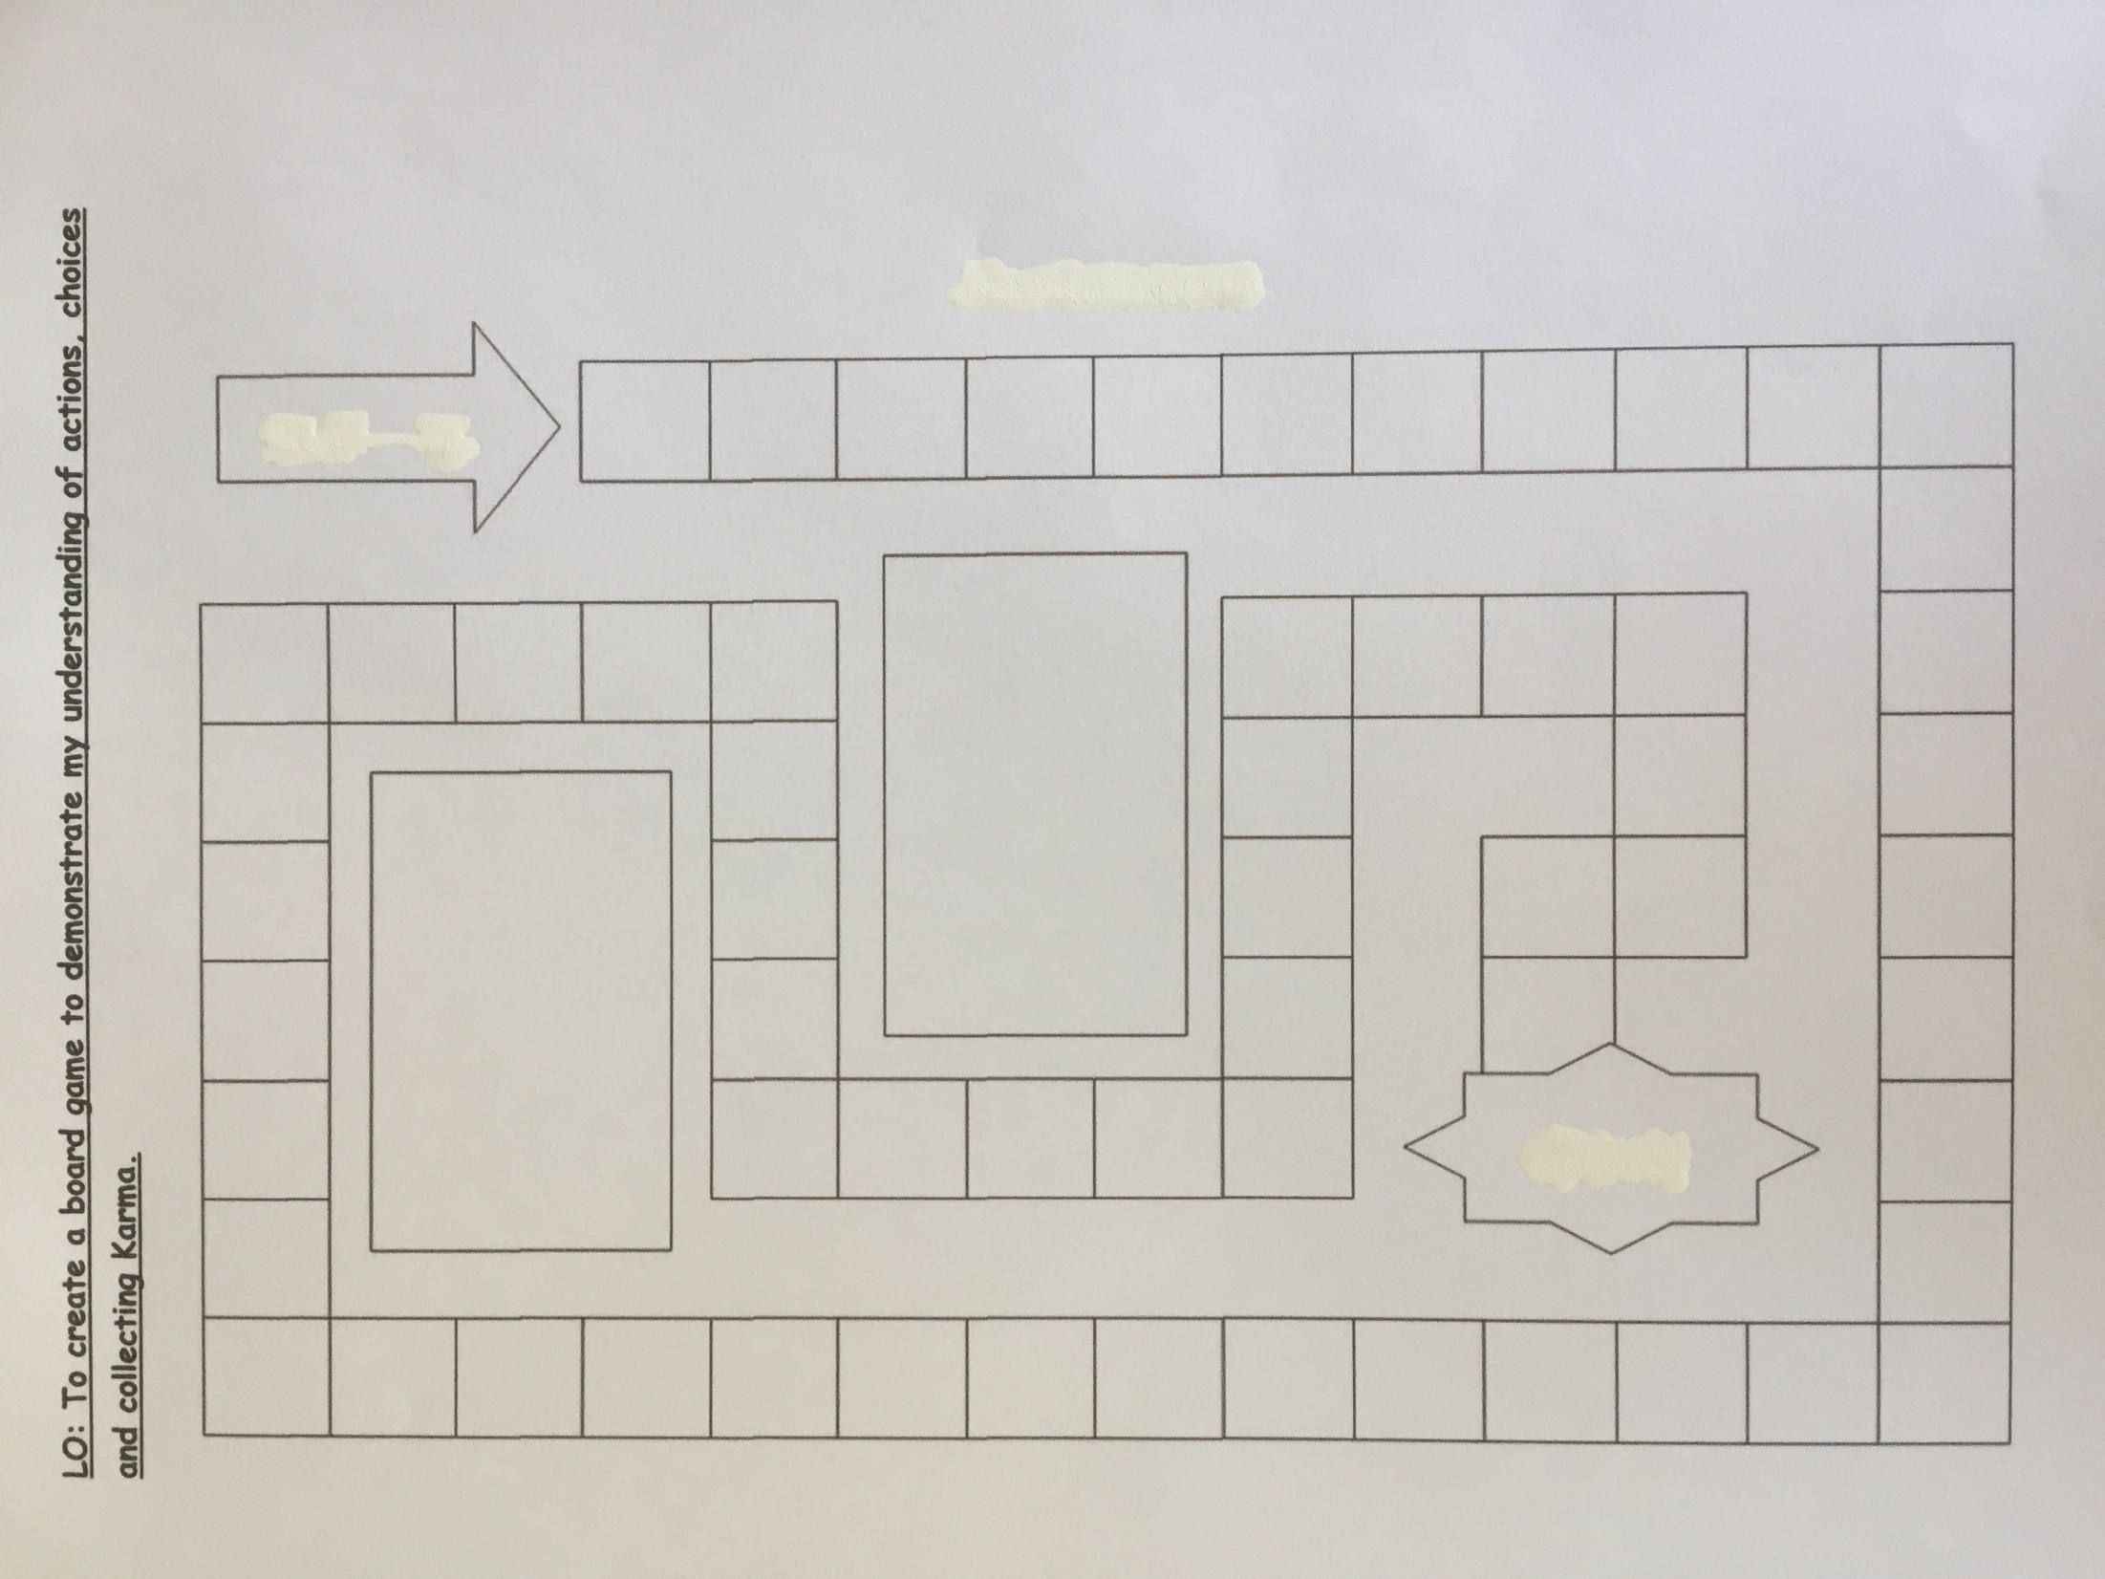

Slide 11
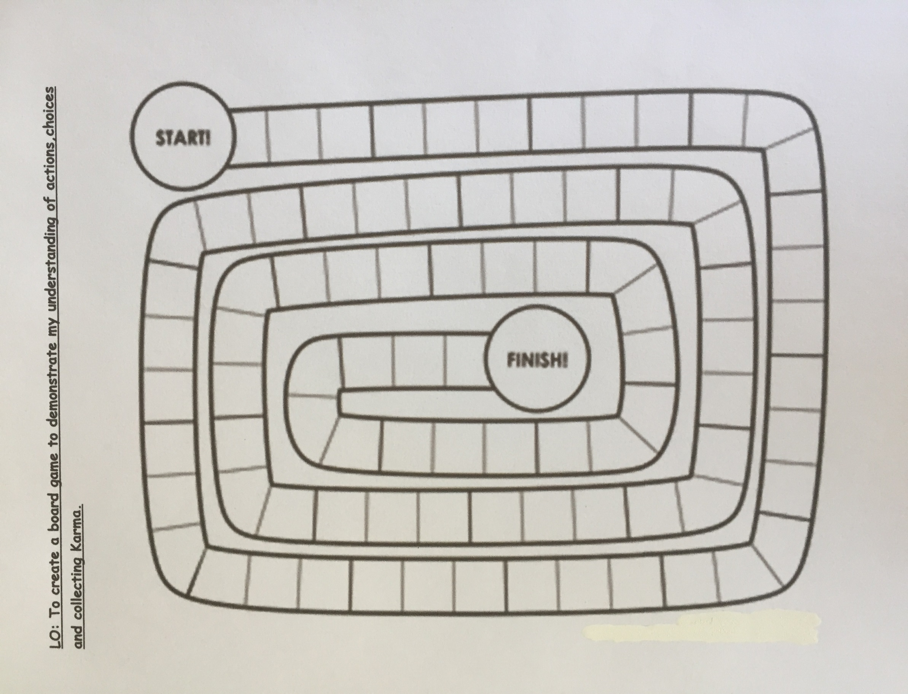

Slide 12


