Slide 1

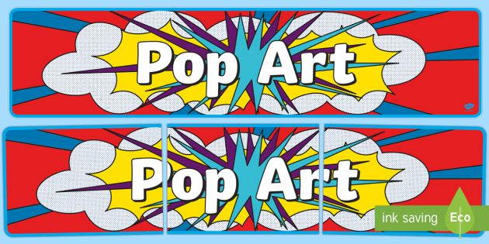
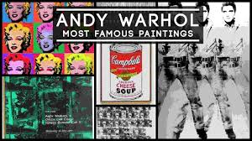
For Art this half term you will research the famous artist Andy Warhol. He was a member of the Pop Art movement and created many very famous pieces. You will create your own Pop Art style piece of your favourite famous person or character.

Slide 2

Task 1: Firstly, you will research the artist Andy Warhol and create a top ten facts page.
Here are some useful links:
https://www.tate.org.uk/kids/explore/who-is/who-andy-warhol
https://www.ducksters.com/biography/artists/andy_warhol.php
https://www.tate.org.uk/kids/explore/who-is/who-roy-lichtenstein
https://www.tate.org.uk/kids/games-quizzes
https://www.tate.org.uk/kids/make

Slide 3
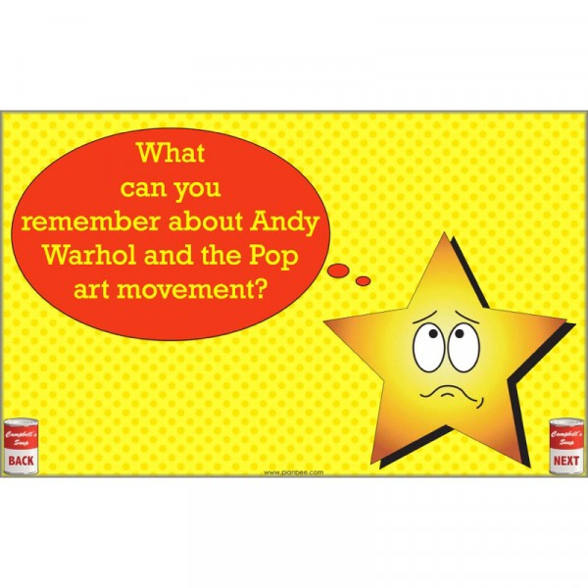
Task 2:
Write what you can remember in the space on this page or on lined paper. Use bullet points to organise your work.

Slide 4
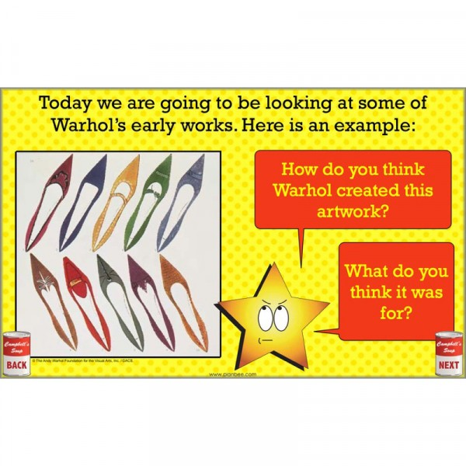
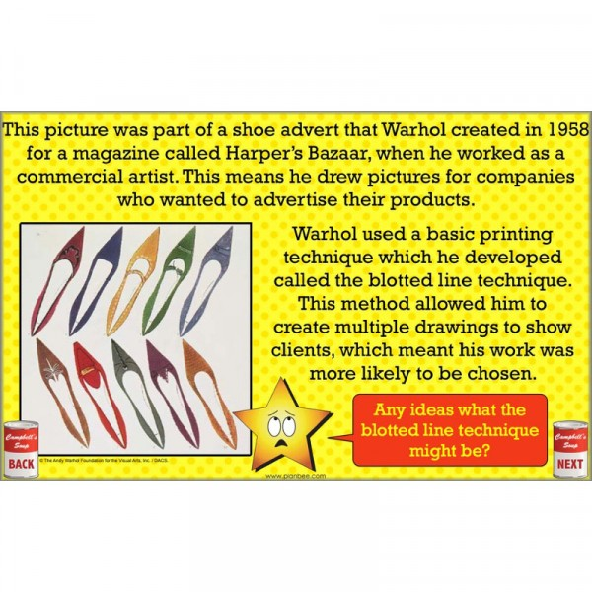
Andy Warhol’s work.

Slide 5
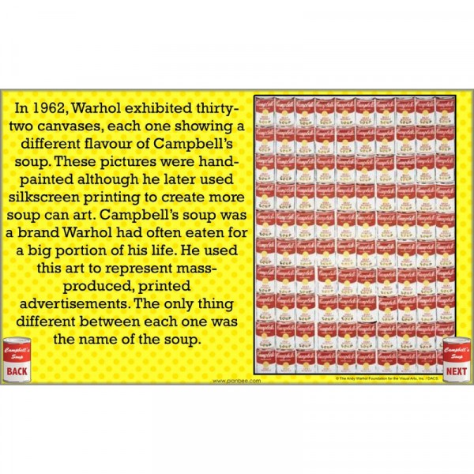
Andy Warhol’s Campbell Soup cans.

Slide 6
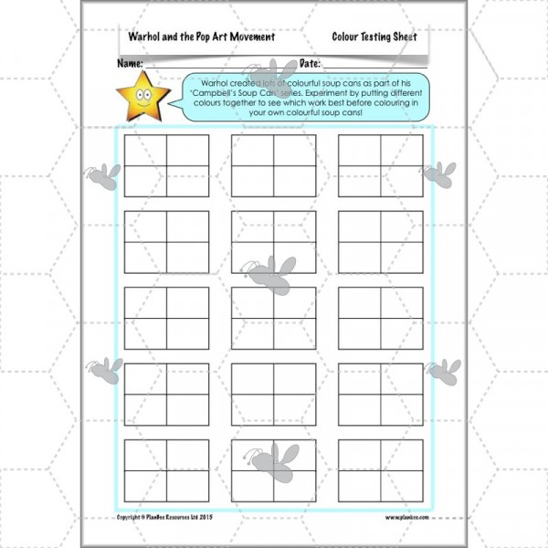
Task 3:
Time to experiment with colours.
(Use 4 different colours for each block of 4 rectangles)

Slide 7
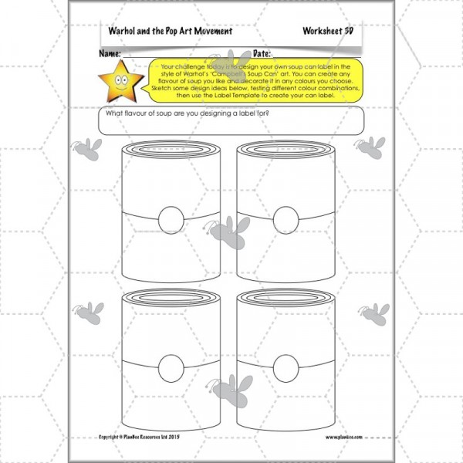
Task 3:
Time to experiment with colours.
Using 4 colours only, colour each part of the soup cans a different colour. E.g. one of the circles red, another blue, the third green and the final one yellow.
Keep doing this for each section of the can. Try not to get the same colour next to the same colour. E.g. no yellow part next to another yellow
part.

Slide 8
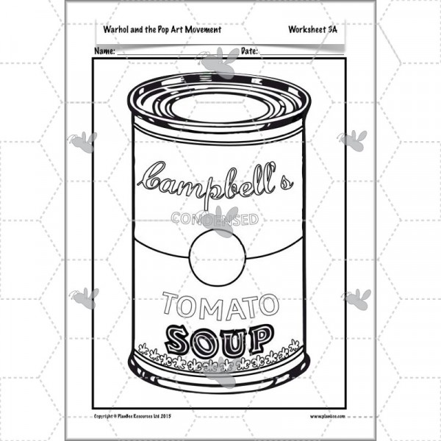
Task 3: Time to experiment with colours.
The label template.
Print out 4 times and colour using the technique you have just practiced.

Slide 9
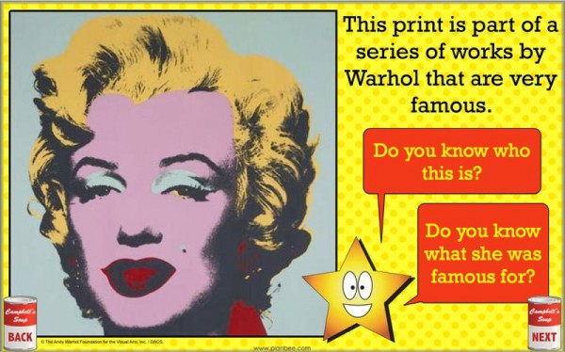
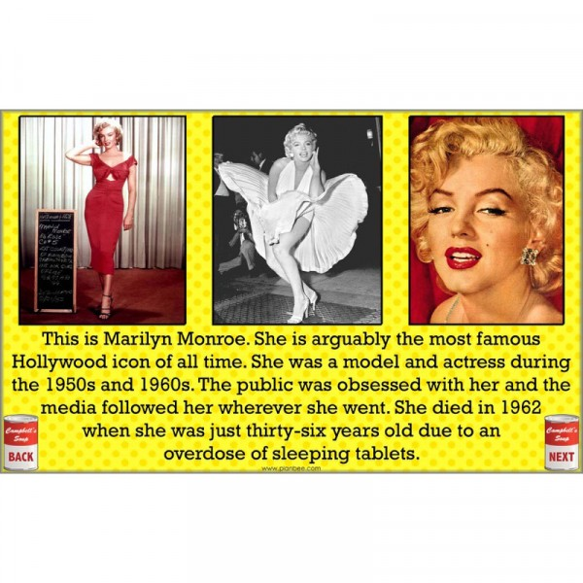

Who is your favourite? (Celebrity or character).

Slide 10
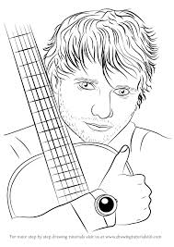
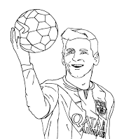
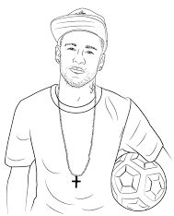
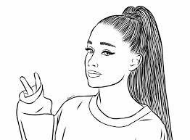
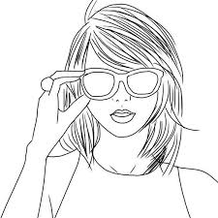
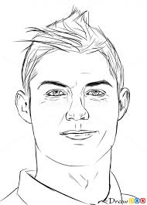
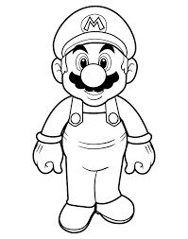
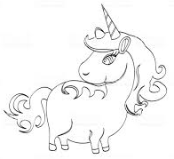
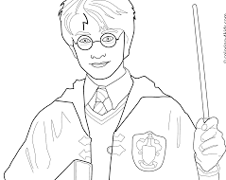
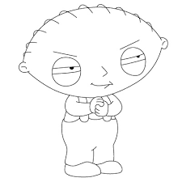
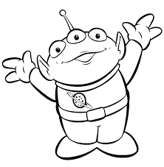
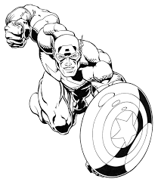
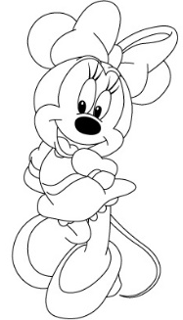
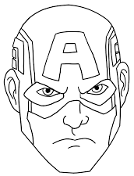
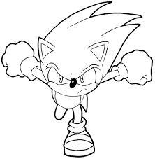
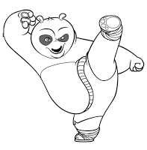
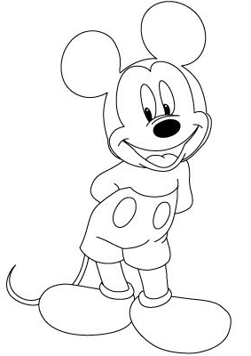
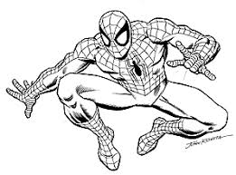
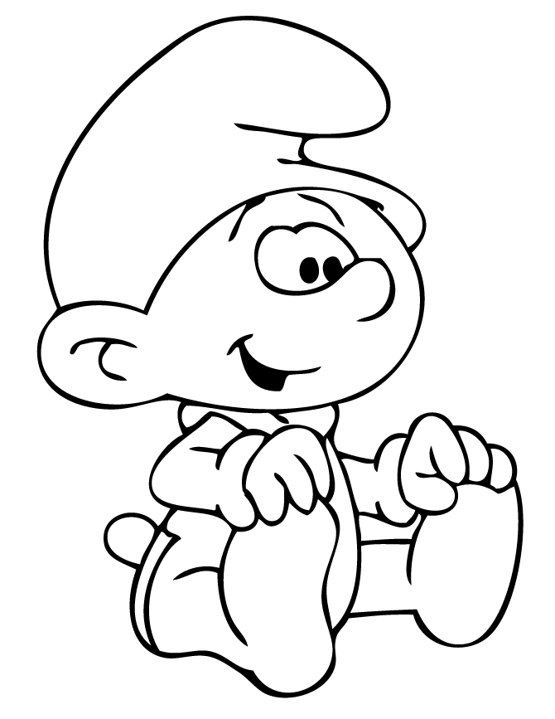
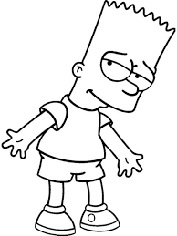
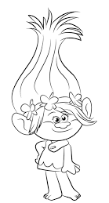
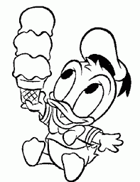

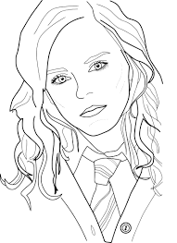
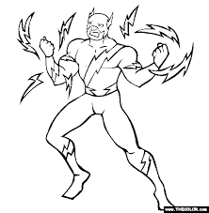
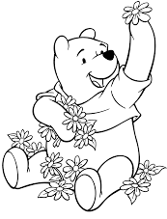
Here are some outline drawings of celebrities and characters that you can use, if you like. Choose one of them, or one of your own. You will need four identical copies. (To use one of these images, copy it, and paste it on to a blank page then enlarge it to A4 and print off 4 copies).

Slide 11
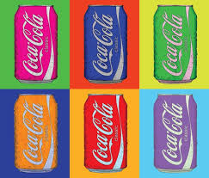
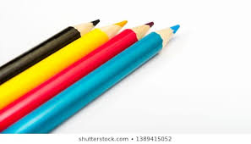
Task 4:
Time to colour!
Choose four different colours, all pencils or all pens – do not use a mix of pencils and pens.

Slide 12
Task 5:
Choose one part of your celebrity or character e.g. the ‘skin’ on the face. Colour the skin on the face on each picture a different one of your chosen colours.
Task 6:
Continue choosing a different part of the picture and colouring the section on each picture a different colour.
TRY NOT TO HAVE THE SAME COLOUR NEXT TO EACH OTHER ON DIFFERENT PARTS OF THE PICTURE.

Slide 13
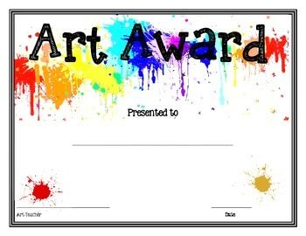
Your work is done!
I hope you are proud of what you have produced. It’s an original art work by you. There isn’t another one in the whole world!

