Slide 1
Human Development

Slide 2
Learning objective for this lesson
To describe the stages of human development.
At the end you will be able to:
I can order the stages of human development.
I can name the 6 stages of human development.
I can explain the changes that occur during the stages of human development.

Slide 3
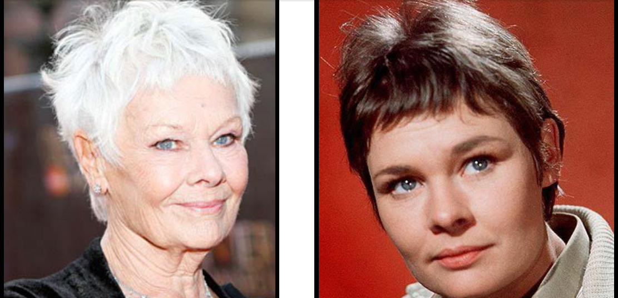
Who are these people?

Slide 4
Why does Dame Judy Dench look different in these 2 photos?

Slide 5

Zog the alien has landed on our planet every 5 years for the last 80 years.
How many times has he visited earth?
Each time he visits he photographs the people from the same family. What changes will he have seen to the people living in that family over the last 80 years.
What are the different stages of development the people will have
gone through?

Slide 6
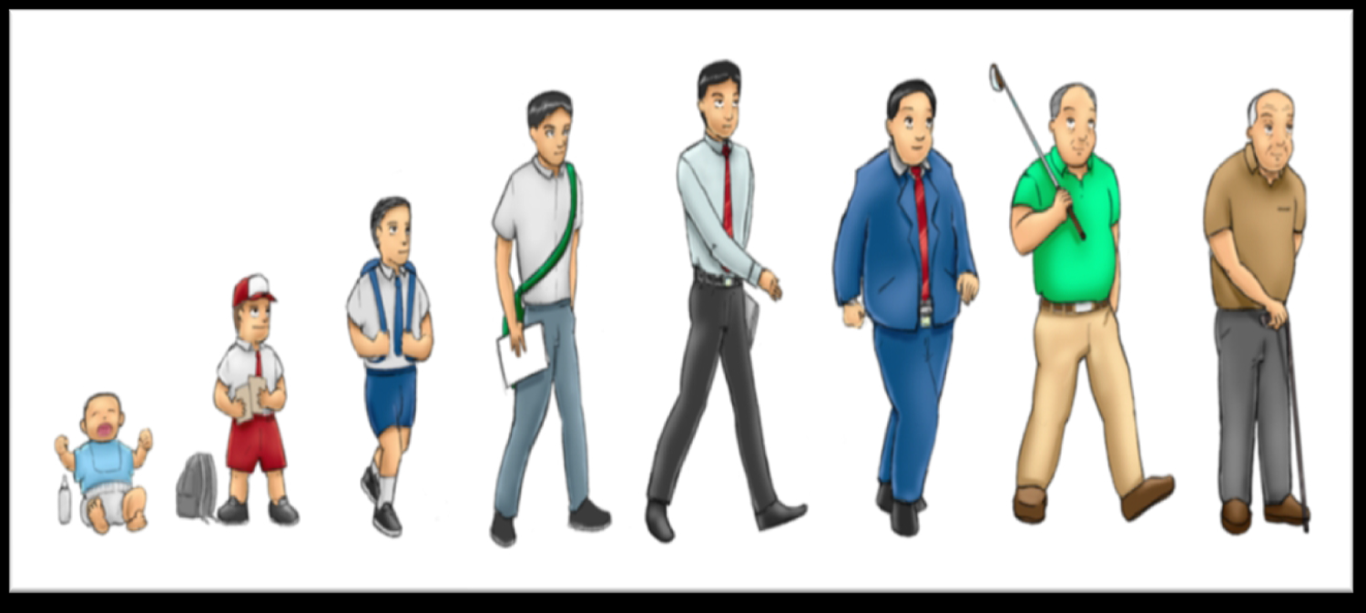
Humans go through many changes during their development
Watch this video clip which explains the changes that humans go through.
https://www.bbc.co.uk/bitesize/topics/zgssgk7/articles/z2msv4j

Slide 7
Let’s recap the different stages we heard about in the video

Slide 8
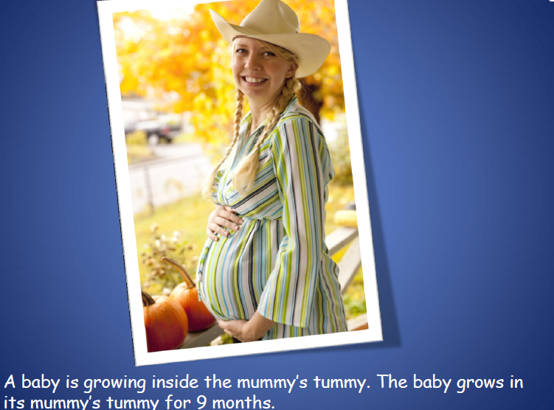

Slide 9
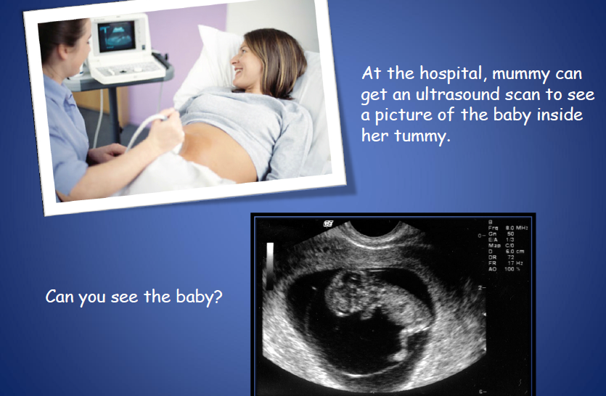

Slide 10


Slide 11
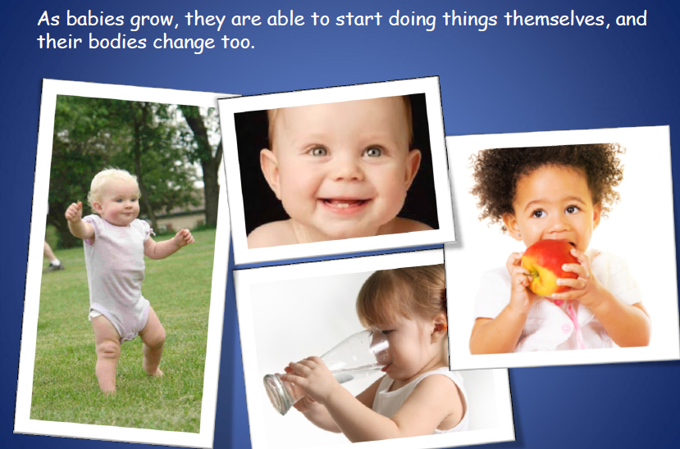

Slide 12
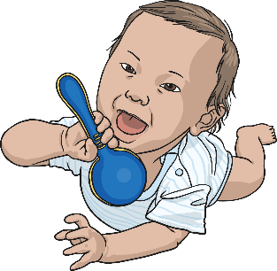
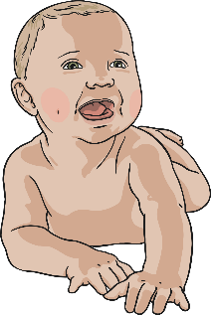
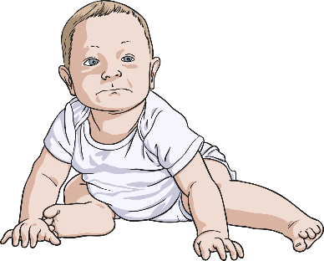
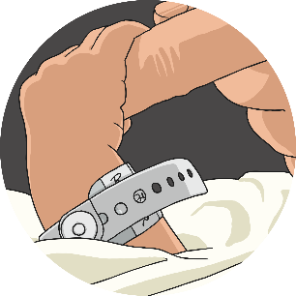
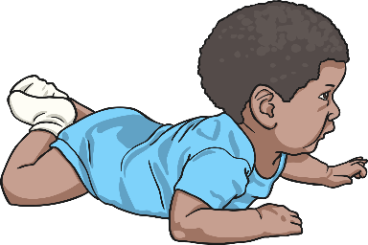
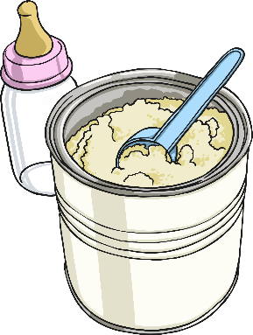
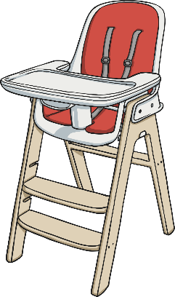
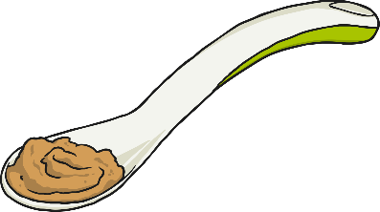

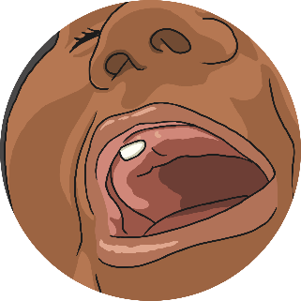
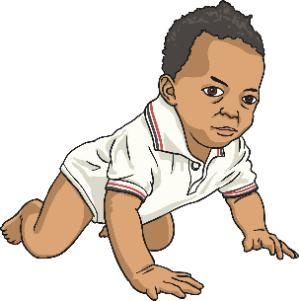
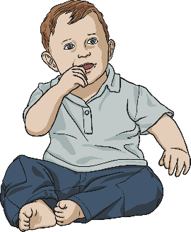
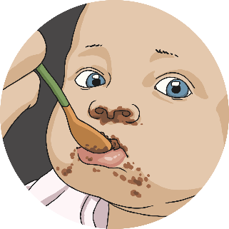
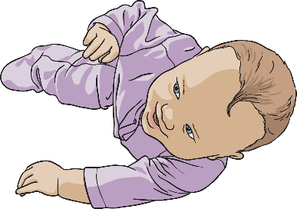
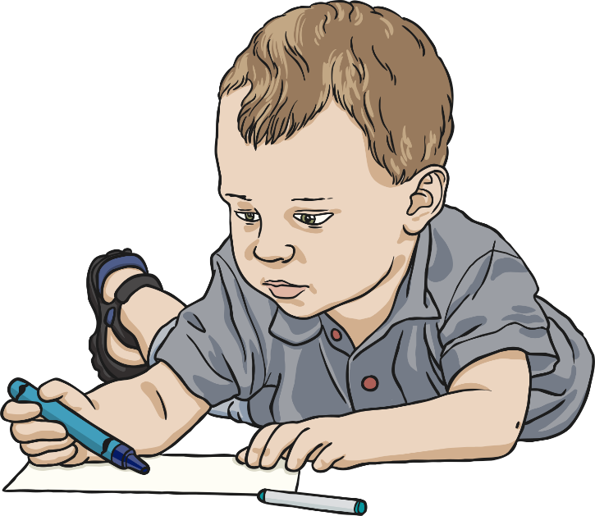
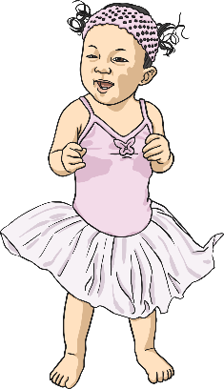

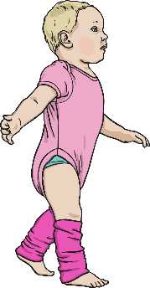
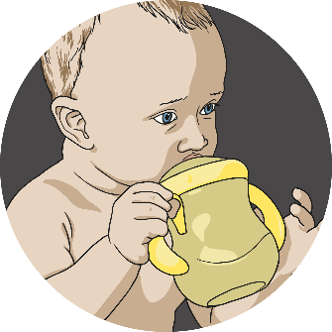

Infancy
1 month
2 months
3 months
4 months
5 months
This stage of development is from birth to 2 years old.
This includes babies and toddlers.
The rate of physical development is fast at this stage.
Infants are totally dependant on others for food and care.
6 months
7 months
8 months
9 months
10 months
Click here for a rough timeline of the period from infancy to a toddler!
11 months
1 year
toddler

Slide 13
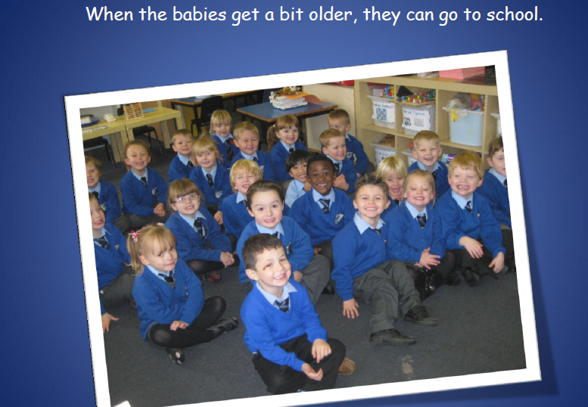

Slide 14
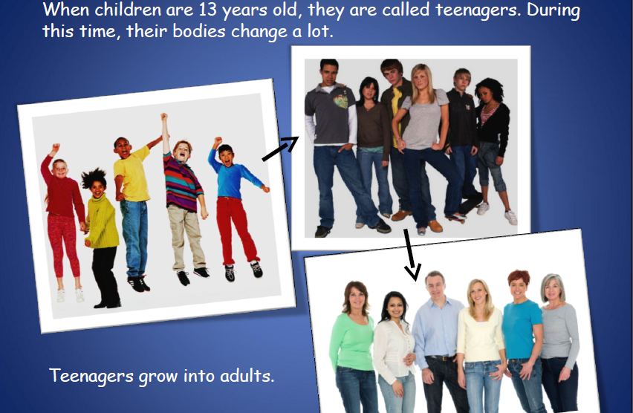

Slide 15
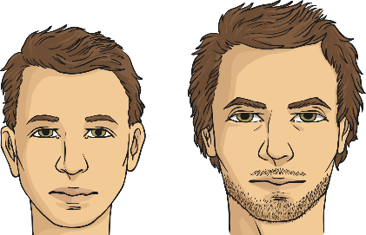
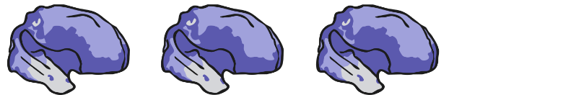

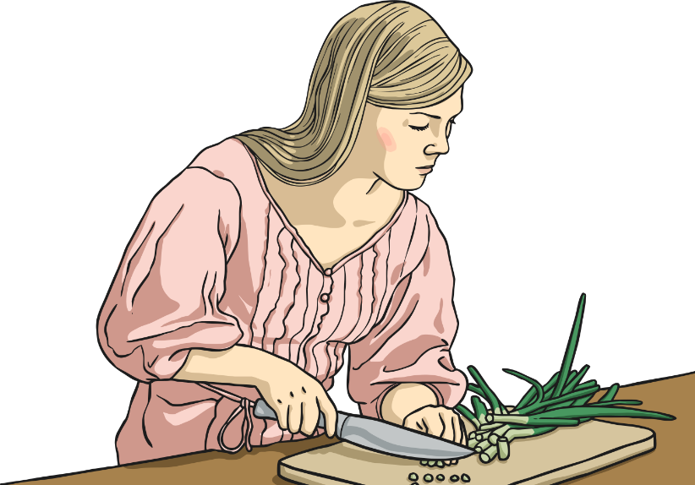
Adolescence
There is even more brain development.
This stage of development lasts from the age of 11 to 19.
During this stage, puberty results in changes in the body.
These changes occur to enable reproduction during adulthood.
Adolescents are increasingly independent.
Notes:
NB: This is an American video – they spell fertilisation with a ‘z’ instead of an ‘s’

Slide 16
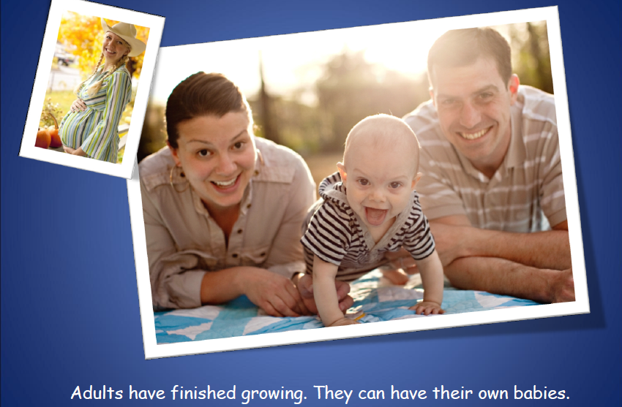

Slide 17
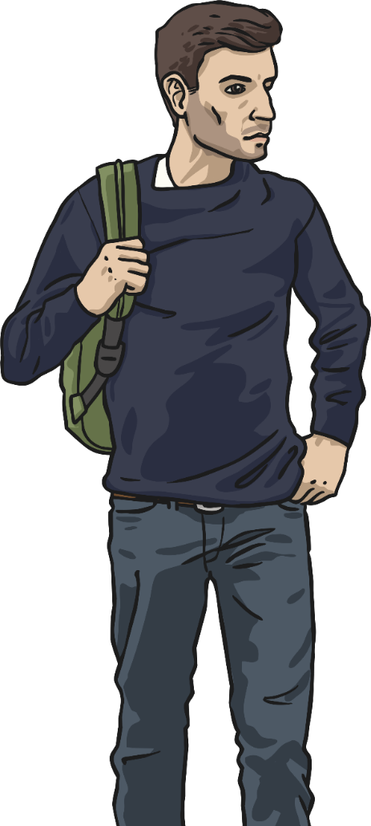
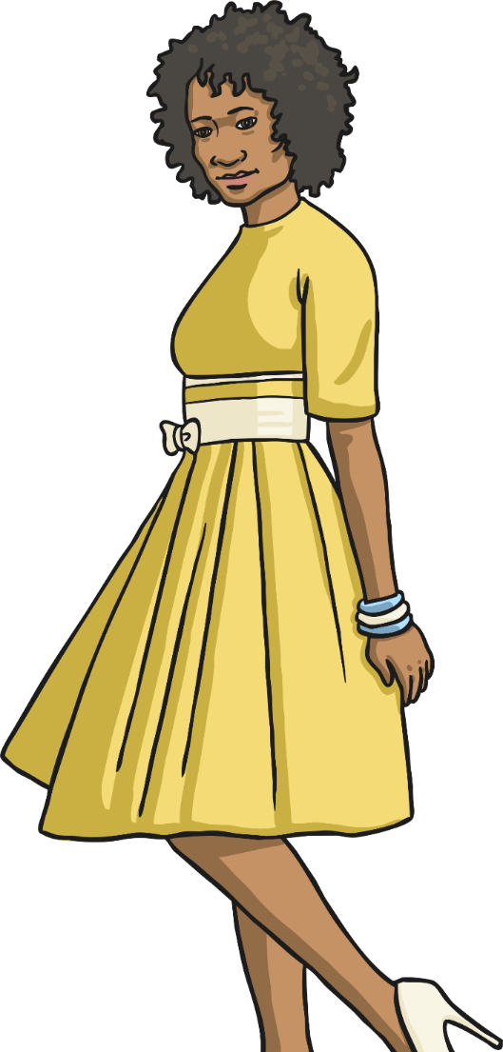
Early Adulthood
This stage of development takes place from the ages of 18/19 to 39.
The human body is at its peak of fitness and strength.
There is still some growth but not of height.
This is the age that most humans reproduce.
Humans are able to take care of their physical needs completely independently.

Slide 18
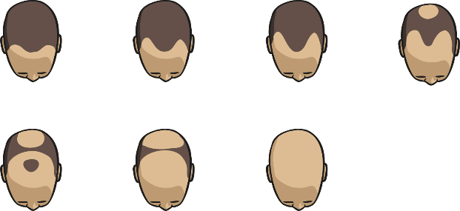
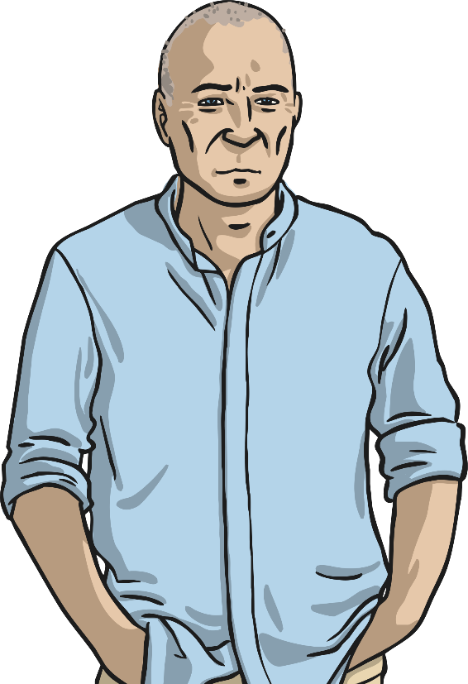
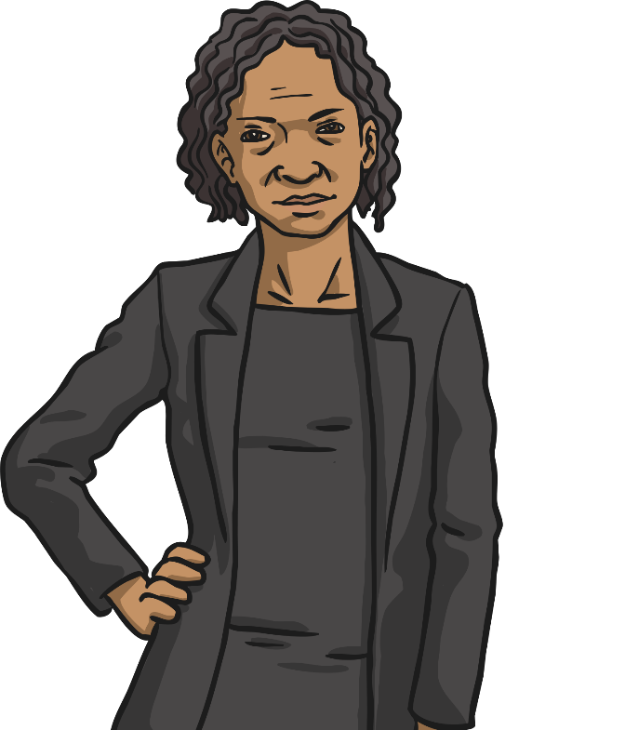
Middle Adulthood
Physical changes can include loss of hair among men and greying hair for both men and women.
This stage of development takes place between 40 to 59 years of age.
Both male and female ability to reproduce declines with age.
Women experience menopause in their 40s or 50s when they no longer produce eggs.

Slide 19
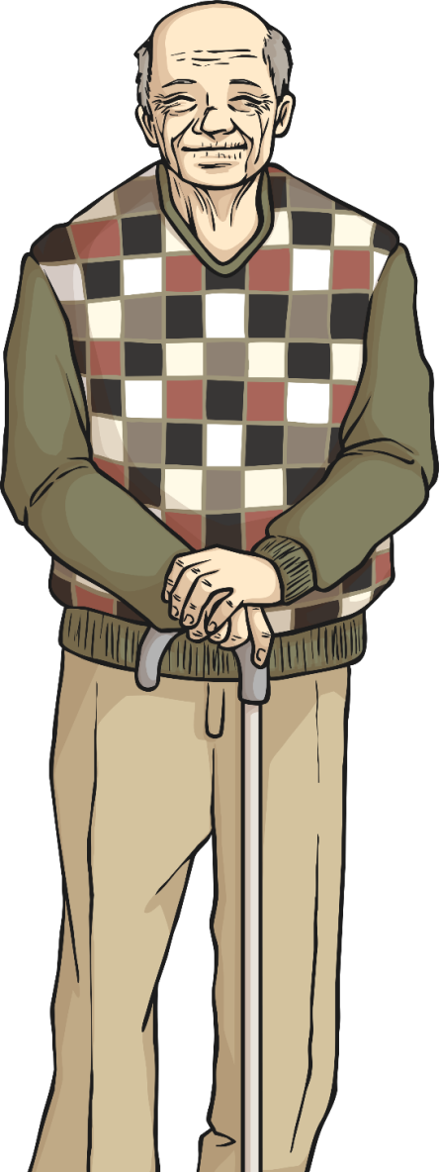
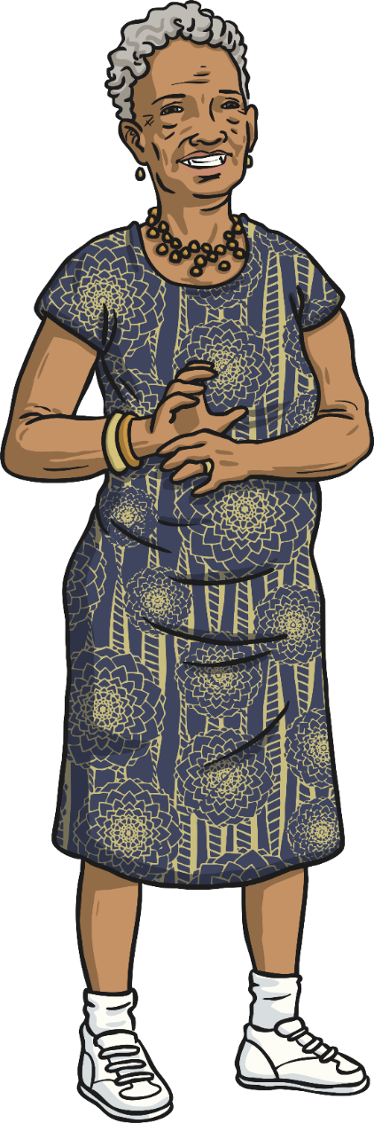
Late Adulthood / Old Age
This is the last stage of human development and takes place after the age of 60.
There is no physical growth although mental development is possible.
The body declines in fitness and health.
Some older people can become more fragile physically.
This can sometimes result in increasing dependency on others to care for them.
The end of the human life cycle is when a human dies. (The age at which this happens varies and is not simply dependent on physical factors.)

Slide 20
Which words can you now use to describe the different stages in the development of humans?

Slide 21
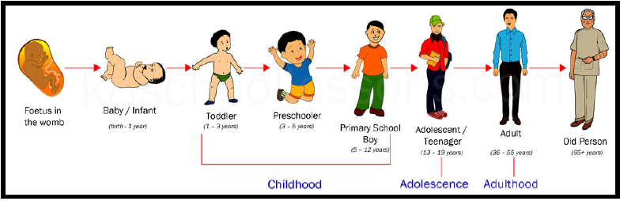
Did you think of any of these words?

Slide 22
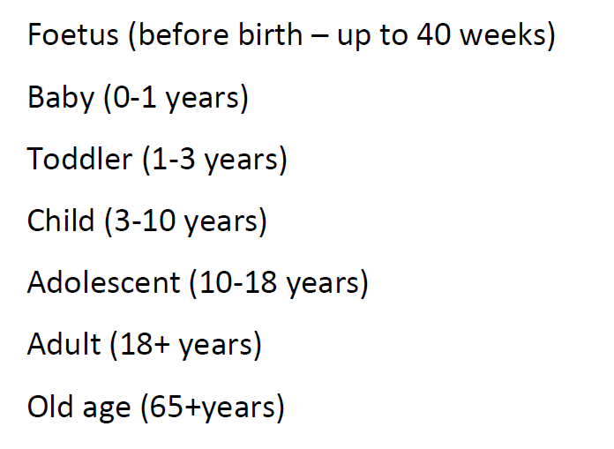
Main stages of development

Slide 23
What have you learnt?
The next 2 slides show 2 activities that you can choose from – you do not have to do both.

Slide 24
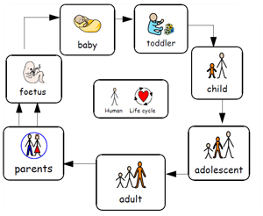
Choice 1 - To describe the stages of human development
Draw your own pictures in the correct order to show the changes humans go through as they develop
Label each picture with the name and age range for that stage in the development
Describe some of the changes/differences between each of the stages.
Display the information on the page in an interesting and informative way.

Slide 25
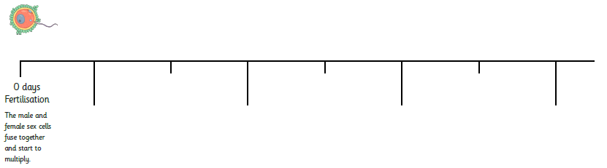
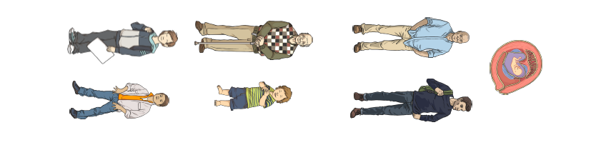
Choice 2 - To describe the stages of human development
Use the pictures provided on the school website to create a timeline to show the different stages in human development. Label each stage with the appropriate name.

Slide 26
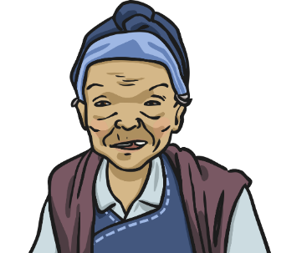

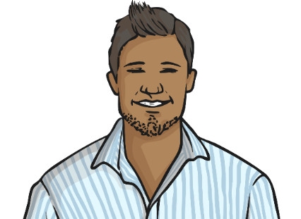
Human Life Cycle Revisited
What new vocabulary have you learnt in this lesson?
Did you identify all the stages of human growth and development?
Which new ones have you learnt about in this lesson?

