Slide 1
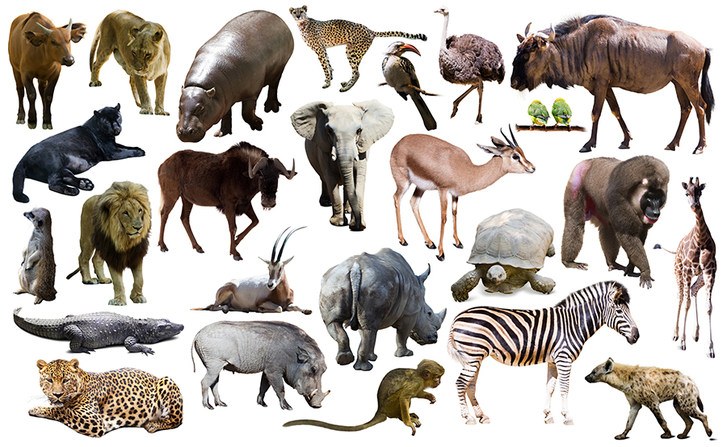
To compare gestation times of animals

Slide 2
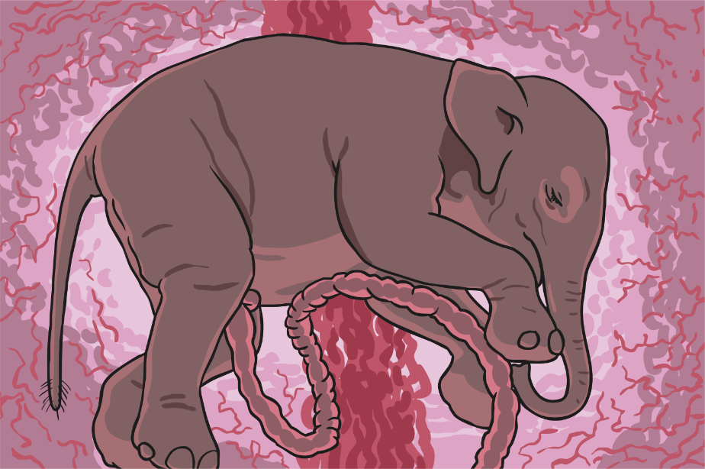
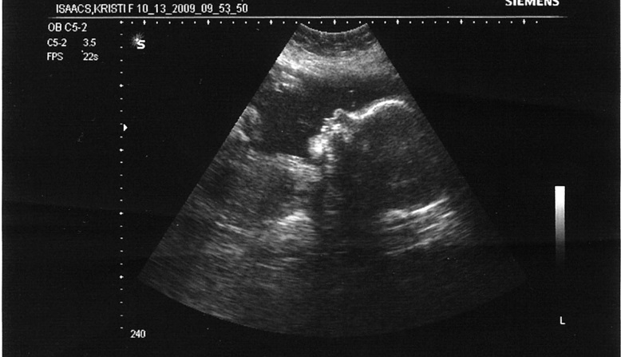
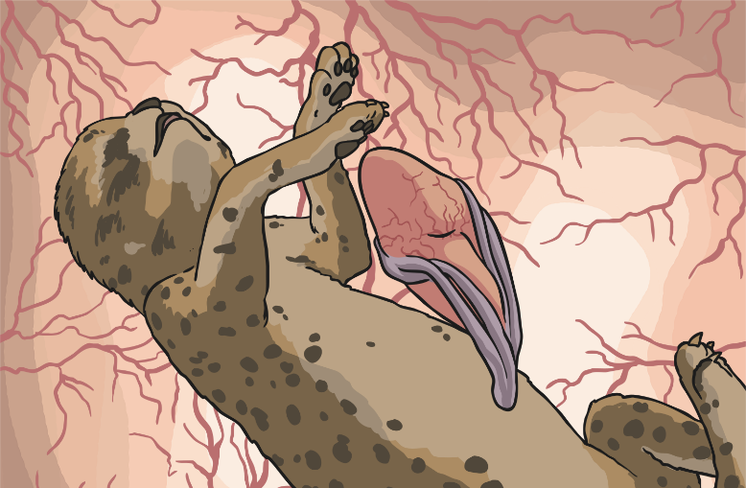
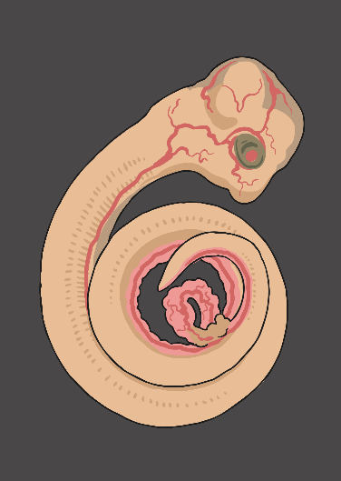
Gestation
What do you think gestation is?
Photo courtesy of Travis Isaacs (@flickr.com) -granted under creative commons licence – attribution

Slide 3
Gestation is the time it takes for the baby to develop inside its mother
The gestation time for a human baby is usually 9 months.
Do all animals have the same gestation time as humans?

Slide 4
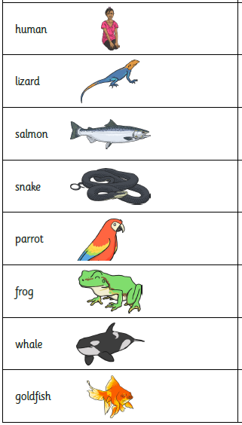
Comparing Gestation Times
First, make a prediction about the gestation time of the different animals. Place each animal on a time line
frog
Shortest gestation period
Longest gestation period
The answers are on the next slide so make your predictions BEFORE you move onto the next slide.

Slide 5
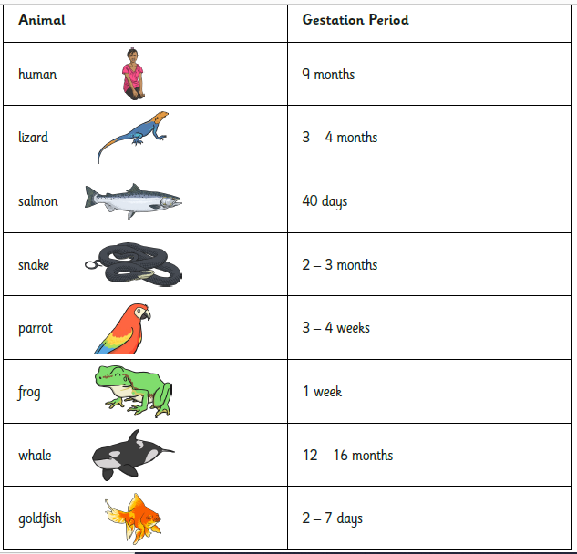
Were your predictions correct?

Slide 6
Does the type of animal Affect the gestation time?
You now know that different animals have different gestation times.
You found out in year 4 that animals belong to different groups according to features that they have in common

Slide 7
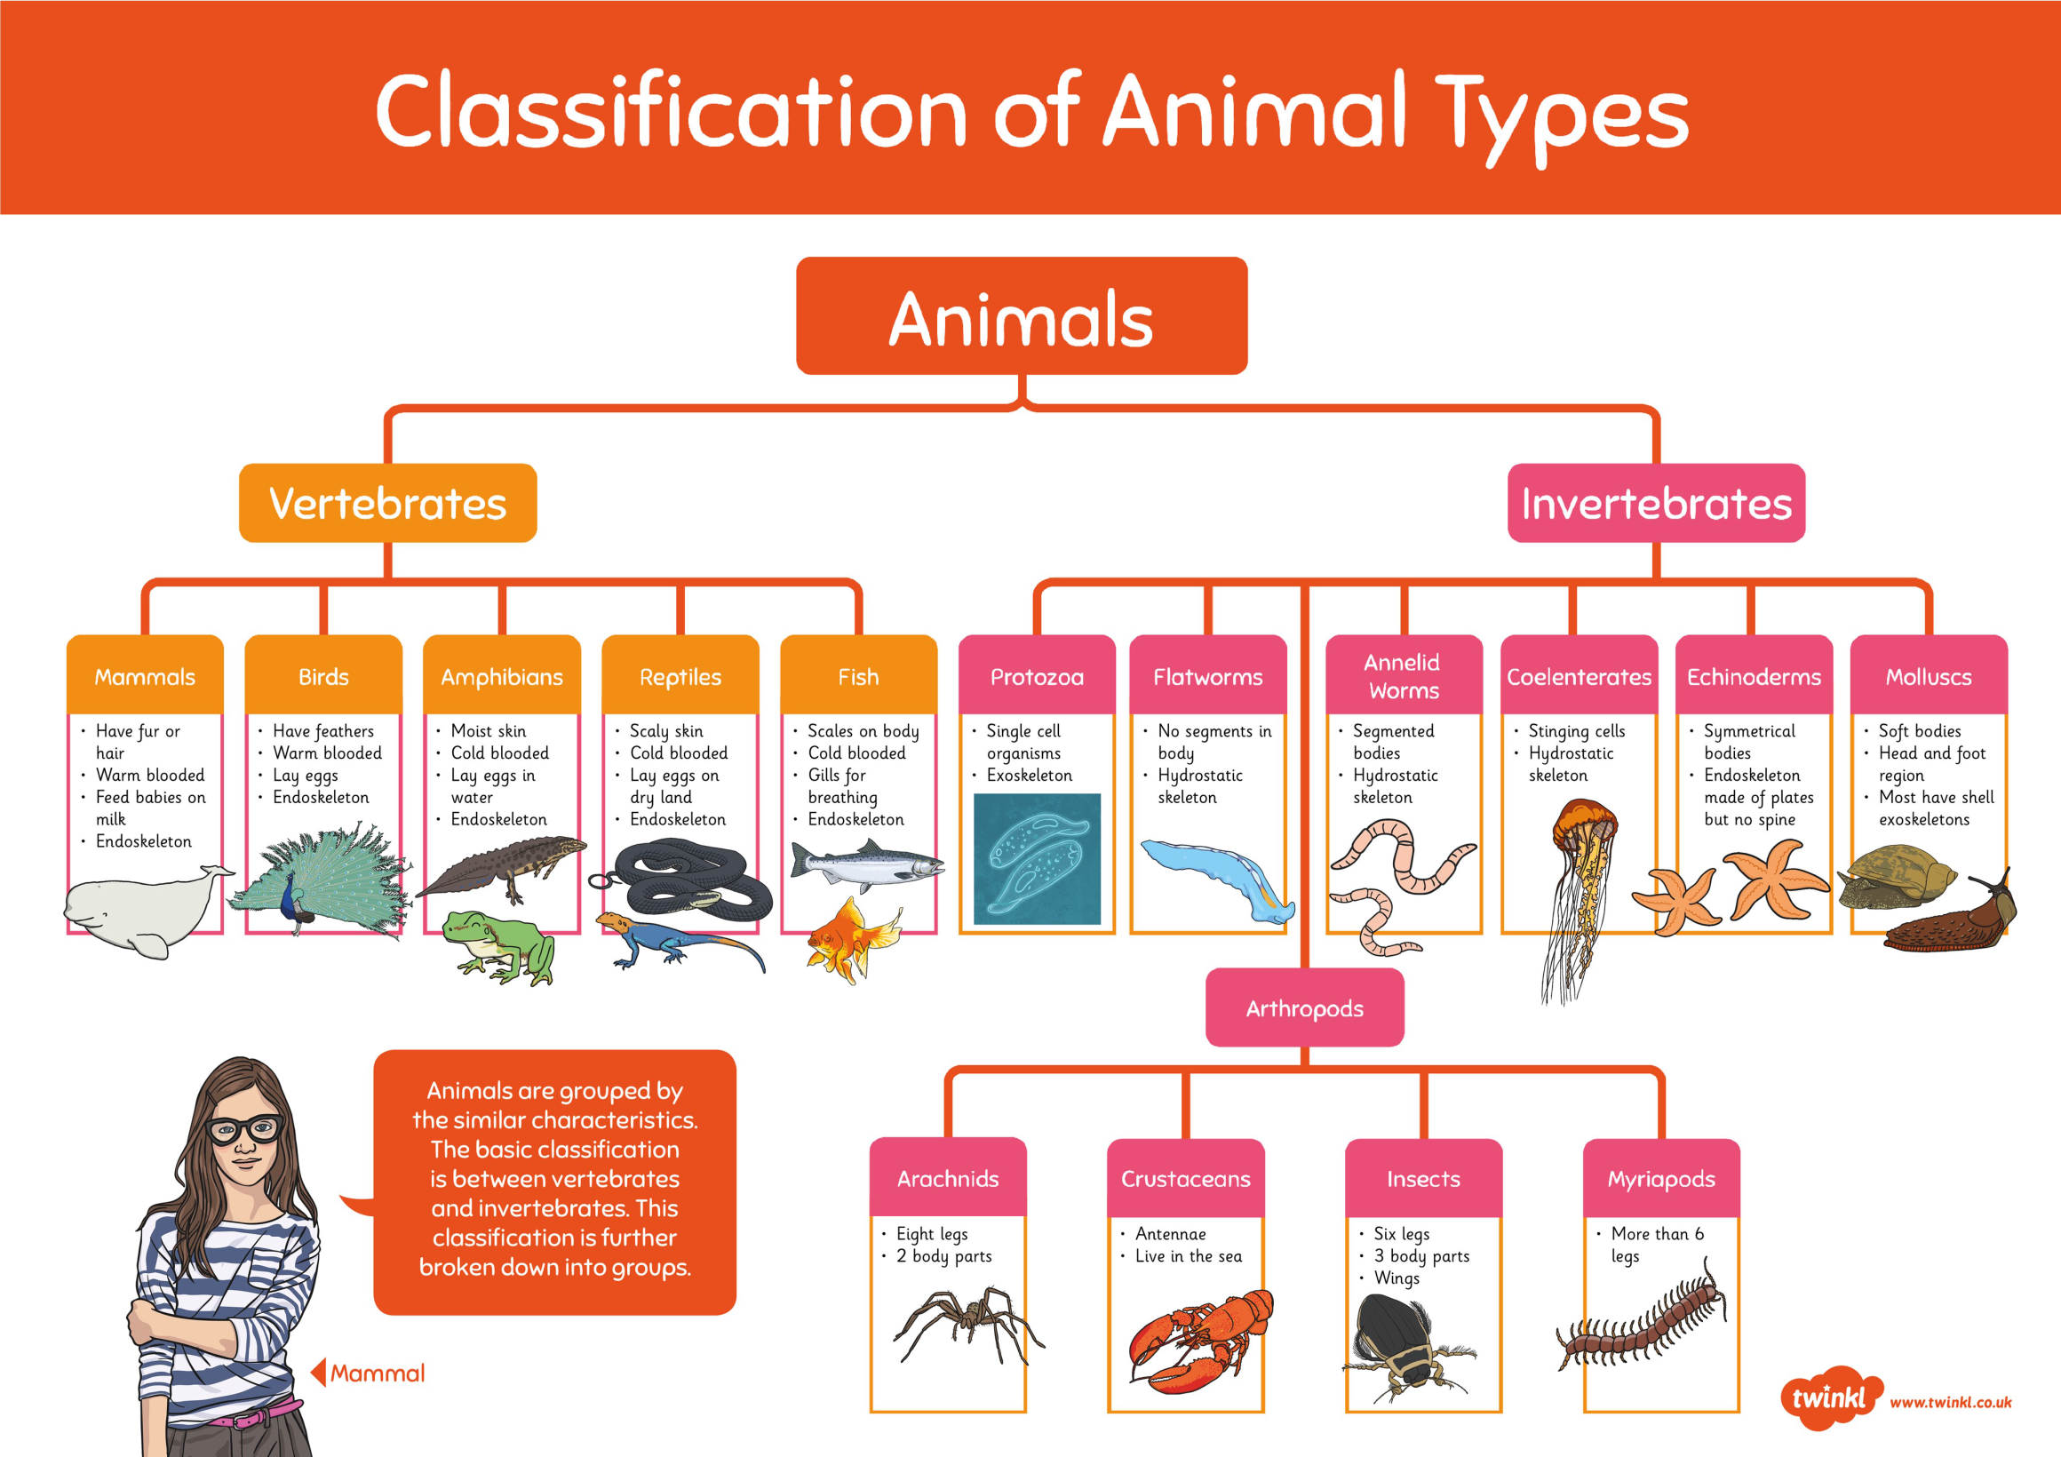

Slide 8
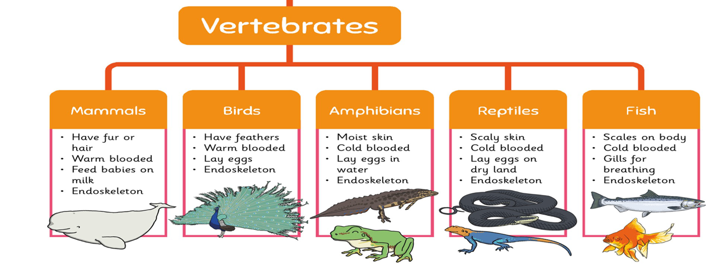
We will explore the gestation times of vertebrates in more detail

Slide 9

do all vertebrates have the same gestation times?
Does a mammal have the same gestation time as a bird? Or a reptile?
Do all mammals have the same gestation time?
What might effect the length of gestation?
Which types of animals will have the longest gestation periods? The shortest?

Slide 10
You are going to think of a question about gestation times to research
Here are some more suggestions to get you thinking.
Do animals with legs have a longer gestation period than animals who don’t?
Do animals who live in the water have shorter gestation periods than animals who live on land?
Do reptiles have a shorter gestation time than mammals?
Think about how animals are different to help you to come up with a question or use one of mine that interests you.

Slide 11
Reporting your findings
Write your question at the top of your page.
Research the gestation times for any relevant animals or use the information on the sheets on the school website.
Record your findings.
Your Conclusions
What have you found out about the gestation times of your animals?
Conclude your findings – does the type of animal have an effect on the length of gestation? Make sure you have answered the question at the top of your page.

Slide 12
What have you learnt about gestation in this lesson?

