Slide 1
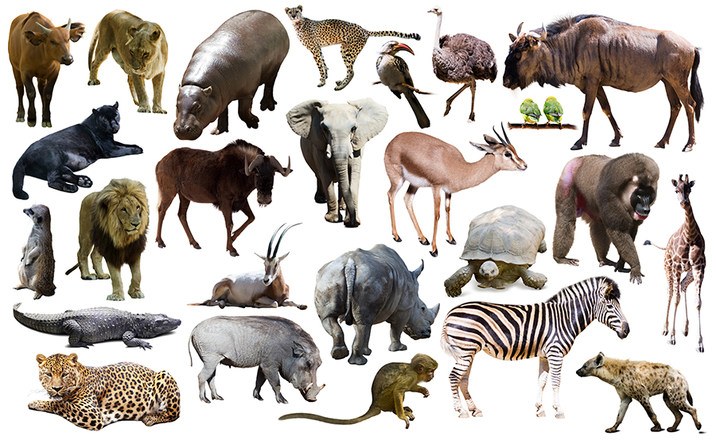
To compare gestation times of animals – part 2
In this lesson you will work scientifically by showing data on a graph

Slide 2
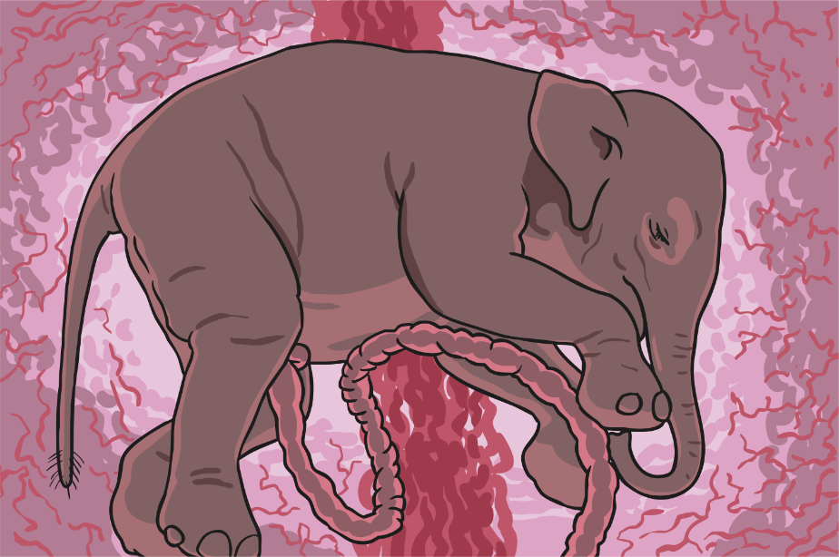
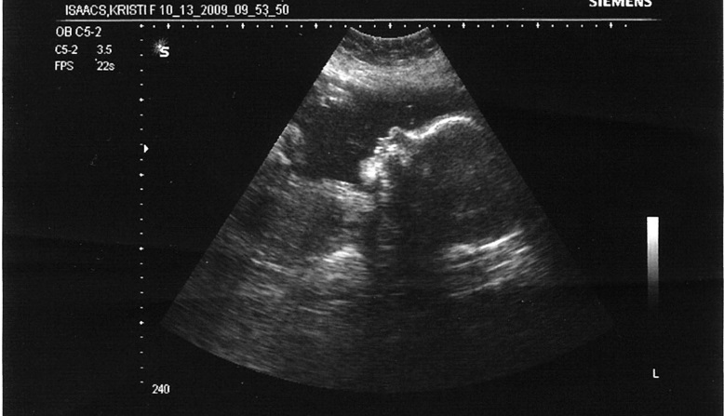
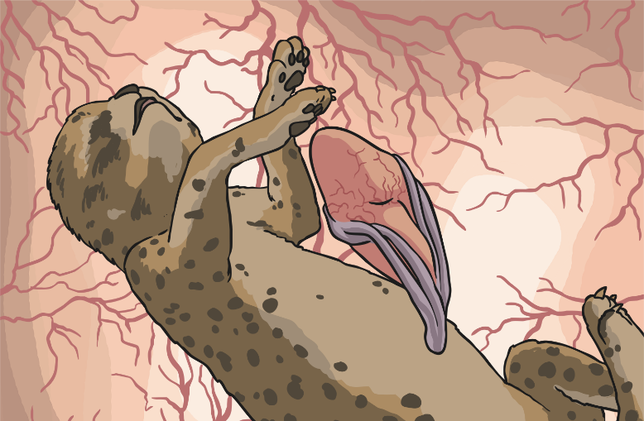
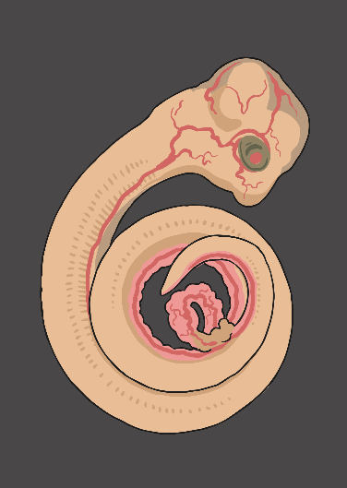
Gestation
Can you remember what this word means?
Photo courtesy of Travis Isaacs (@flickr.com) -granted under creative commons licence – attribution

Slide 3
Gestation is the time it takes for the baby to develop inside its mother
The gestation time for a human baby is usually 9 months.
What did you find out last lesson about the gestation time of other animals? Are they all the same?

Slide 4
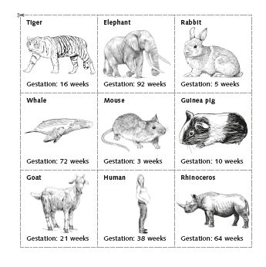
You will now compare the size of some mammals to their gestation time.
Look at this information (it can be printed from the school website)
Do smaller mammals have shorter gestation times?
Make a prediction using this information.

Slide 5
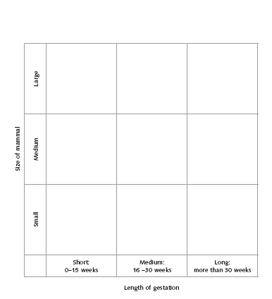
Do smaller mammals have a shorter gestation time?
Copy this grid onto paper – use a ruler! (or print it from the school website)
Use the animals on the previous slide and put each animal in the correct place on this sorting grid. It is like the Carroll diagrams we have used in maths.
I have done two for you.
Elephant
Mouse

Slide 6
What does your completed grid show you?
I have added a few more animals. Did you put these animals in the same place?
Do all large animals have a long gestation time?
Do all small animals have a short gestation time?
Elephant
rhino
goat
human
Mouse
Guinea pig

Slide 7
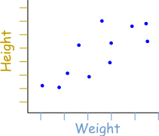
Comparing Gestation Times
You will now look at showing information in a scatter graph
This type of graph allows you to compare two criteria. For example this scatter graph compares weight against height

Slide 8
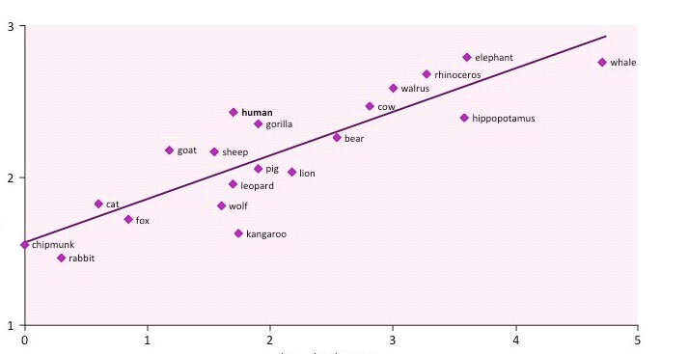
This scatter graph compares animals gestation time to their weight.
You will have a go at doing your own scatter graph similar to this one.
Gestation time
Body mass

Slide 9
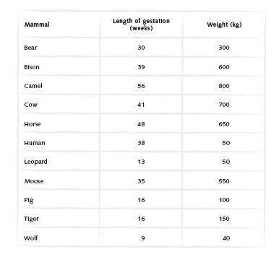
Do heavier animals have a longer gestation time?
You will use this data to compare the animals weight to their gestation time to see if heavier animals have longer gestation time.
You can print this from the school website.

Slide 10
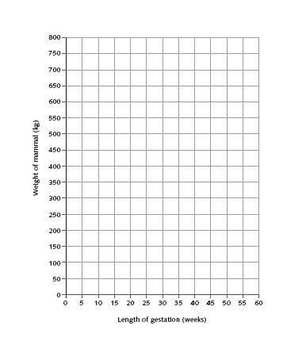
Do heavier animals have a longer gestation time?
Print this sheet from the school website or use squared paper to draw your own axes.
Plot the data on the previous slide. I have done 2 for you to get you started.
bear
wolf

Slide 11
Do heavier animals have a longer gestation time?
Your conclusions – write these on the back of your graph.
What information does your scatter graph tell you?
Does it help you to answer the question at the top of this slide?
Are there any animals that have a gestation time that is longer than you would expect? Look at the animals that have a long gestation but are not the heavier ones.
Are there any animals that have a shorter gestation time than you would expect. Are there any heavy animals that have a shorter gestation?
Is there anything else that you find interesting?

Slide 12
What have you learnt about gestation time and the size (weight) of an animal?

