Slide 1
Life cycles
Hello year 5.
This is the first lesson in our topic about the life cycle of different animals.
This lesson you will learn about the life cycle of :
A Mammal
An Amphibian
You will work scientifically by comparing the life cycle of these animals to see how they are similar and different.

Slide 2
Important vocabulary you will use this lesson
Life cycle
Birth
Growth
Reproduction
Aging
Death
Juvenile
Mammal
Cubs/pups
Amphibian
Frog
Metamorphosis
Tadpole
Froglet
Gills
Maturity
Mate

Slide 3
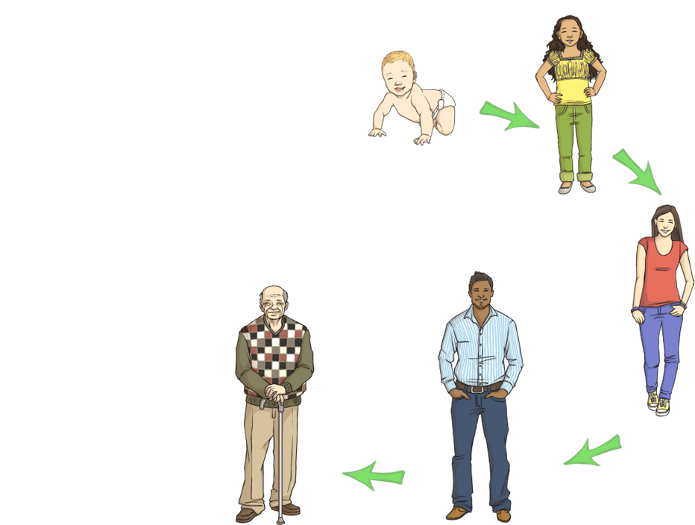
What is a life cycle?
A life cycle shows the stages in the life of the animal.
What names do we give to the stages in a human life cycle?

Slide 4
What is a life cycle?
What is the final stage in a human life cycle?
Baby
Child
Adolescent
Elderly or Old
Adult

Slide 5
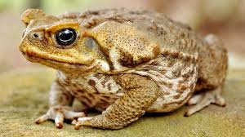
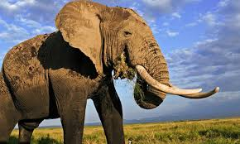
Do you know which animal is a mammal and which is an amphibian?
Does a human belong to one of these groups?
Amphibian
Mammal

Slide 6
Do all animals have the same life cycle?
These animals all share a common sequence in their life cycle which is:
birth, growth, reproduction, aging and death.

Slide 7
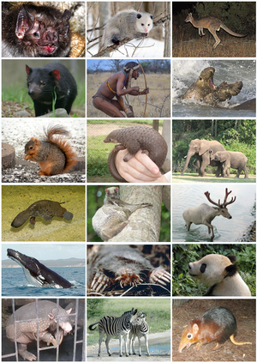
You will now look in more detail at the life cycle of a mammal

Slide 8

The life cycle of a mammal
Log on to https://www.discoveryeducation.co.uk/
Select the Espresso dropdown box in the top right hand corner.
Username: student28853
Password: oaktree
Search for life cycles KS2
Click on the Module for life cycles
Click on videos and watch the video for the life cycle of a mammal

Slide 9
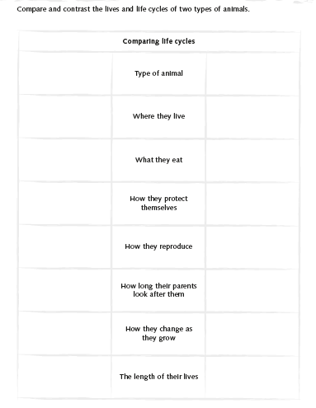
Compare two mammals
Choose 2 mammals from the list below.
Research their life cycle using the prompt questions.
Record your findings
Mammals:
hedgehog, bat, polar bear and mountain gorilla.

Slide 10
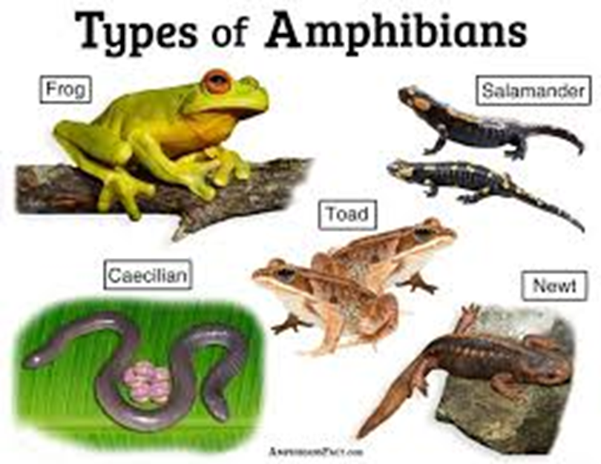
You will now look in more detail at the life cycle of an amphibian

Slide 11
The life cycle of an amphibian
Log on to https://www.discoveryeducation.co.uk/
Select the Espresso dropdown box in the top right hand corner.
Username: student28853
Password: oaktree
Search for life cycles KS2
Click on the Module for life cycles
Click on videos and watch the video for the life cycle of an amphibian

Slide 12
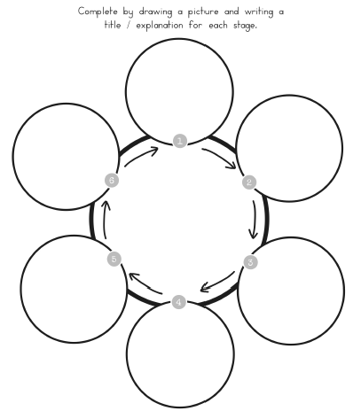
Life cycle diagram of an amphibian
Using the information from the video complete a life cycle diagram to show the life cycle of a frog.
You must include:
The correct number of stages
Pictures/drawings of each stage.
Writing explaining the features of each stage
Remember good presentation and accurate spelling of scientific vocabulary.

Slide 13
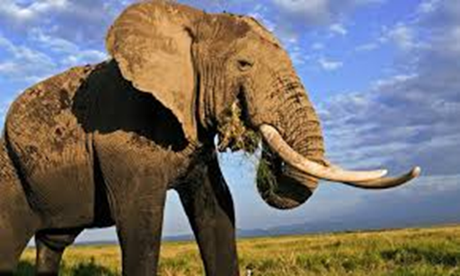
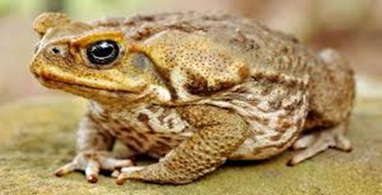
What have you learnt about the life cycle of a mammal and an amphibian?
How are their life cycles similar and how they are different?
In your next lesson you will look at the life cycle of a bird and an insect.

