Slide 1
Life cycles
Hello year 5.
This is the second lesson in our topic about the life cycle of different animals.
This lesson the knowledge you will learn will be about the life cycle of :
A Bird
An Insect
You will work scientifically by comparing the life cycle of these animals to see how they are similar and different.

Slide 2
Important vocabulary you will use this lesson
Life cycle
Birth
Growth
Reproduction
Aging
Death
Eggs
Nymph
Larvae
Aquatic
Moult
Incomplete metamorphosis
Complete metamorphosis
Hatchling
Fledgling

Slide 3
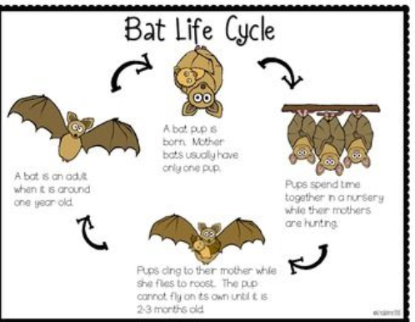
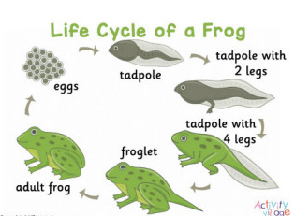
What did you learn in the last lesson?
Life cycle of a mammal
Life cycle of an amphibian
Did you notice any similarities and differences between the life cycles?

Slide 4
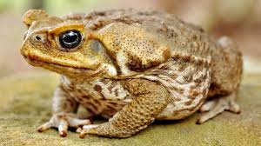
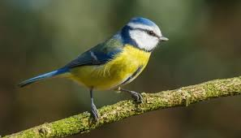
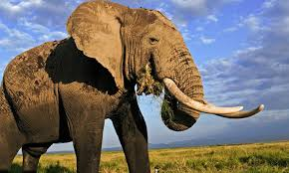
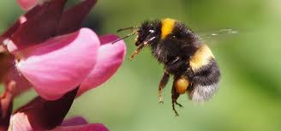
Do you know which animal is a mammal, bird, amphibian and insect?
Amphibian
Bird
Mammal
Insect

Slide 5
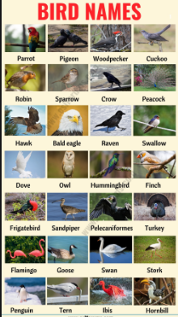
You will now look in more detail at the life cycle of a bird

Slide 6

The life cycle of a bird
Log on to https://www.discoveryeducation.co.uk/
Select the Espresso dropdown box in the top right hand corner.
Username: student28853
Password: oaktree
Search for life cycles KS2
Click on the Module for life cycles
Click on videos and watch the video for the life cycle of a bird

Slide 7
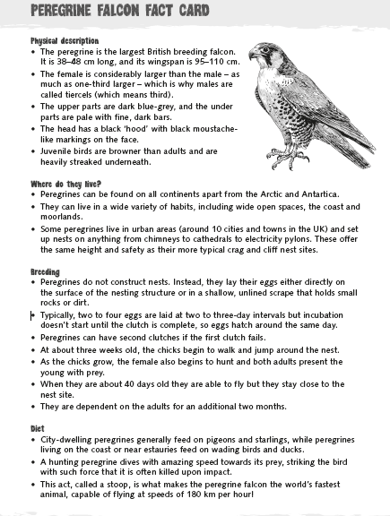
Research a bird of your choice and create a fact file about it.
Your fact file MUST include information about its life cycle (breeding). You can add other additional information of your choice.
Use this one on the Peregrine Falcon to help you.

Slide 8
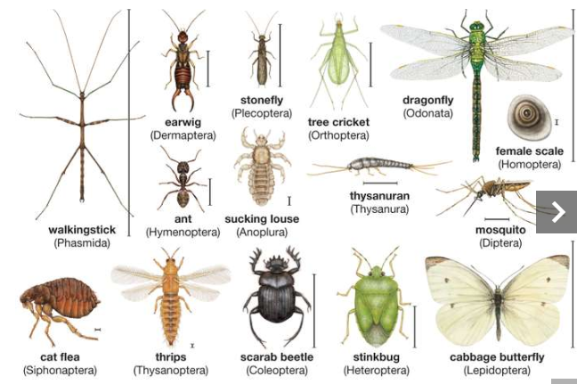
You will now look in more detail at the life cycle of an insect

Slide 9
The life cycle of an insect
Log on to https://www.discoveryeducation.co.uk/
Select the Espresso dropdown box in the top right hand corner.
Username: student28853
Password: oaktree
Search for life cycles KS2
Click on the Module for life cycles
Click on videos and watch the video for the life cycle of an insect

Slide 10
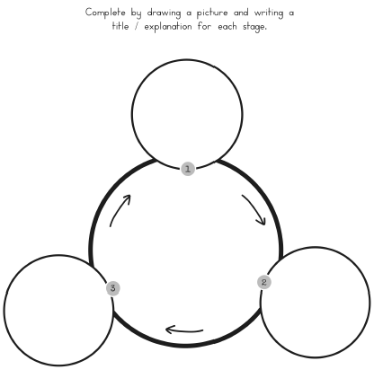
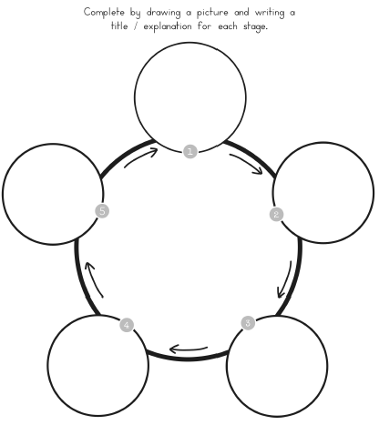
Life cycle diagram of an insect
Using the information from the video complete a life cycle diagram to compare the life cycle of a dragon fly and a butterfly.
You must include:
The correct number of stages
Pictures/drawings of each stage.
Writing explaining the features of each stage
Remember good presentation and accurate spelling of scientific vocabulary.

Slide 11
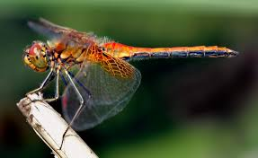

What have you learnt about the life cycle of a bird and an insect?
How are their life cycles similar and how they are different?
In your next lesson you will compare the life cycle of all the animals we have studied.

