Slide 1
Life cycles
Hello year 5.
This is the final lesson in our topic about the life cycle of different animals.
This lesson you will think about what you know about the life cycle of :
A Mammal
An Insect
A Bird
An Amphibian
You will work scientifically by comparing the life cycle of these animals to see how they are similar and different.

Slide 2
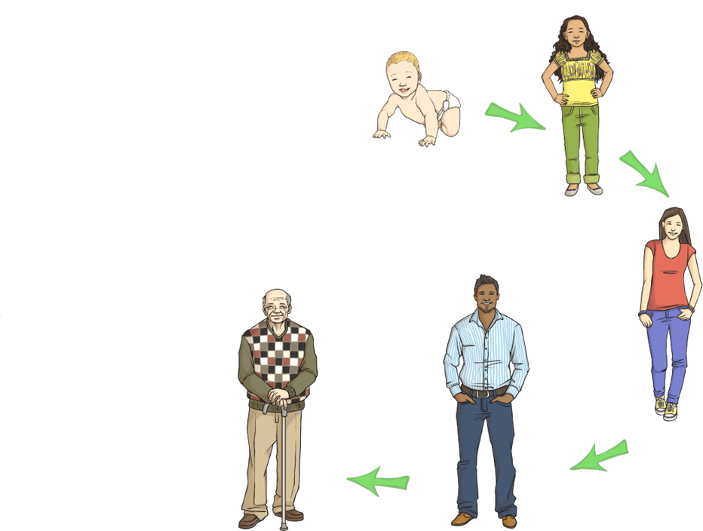
Recap - What is a life cycle?
A life cycle shows the stages in the life of the animal.
What names do we give to the stages in a human life cycle?

Slide 3
What is a life cycle?
What is the final stage in a human life cycle?
Baby
Child
Adolescent
Elderly or Old
Adult

Slide 4
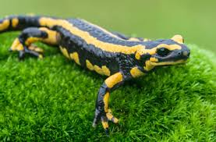
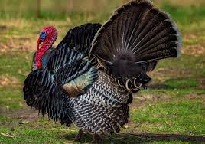
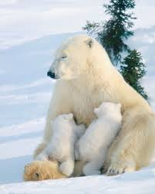
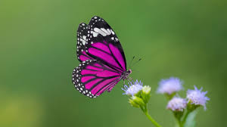
Do you know which animal is a mammal, bird, amphibian and insect?
Amphibian
Bird
Mammal
Insect

Slide 5
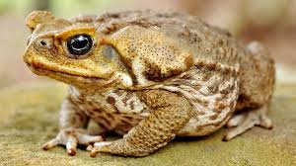
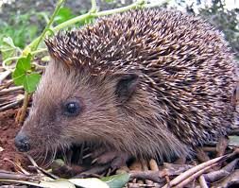
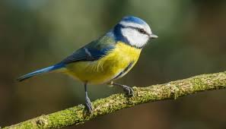

Do all animals have the same life cycle?
The animals we have studied all share a common sequence in their life cycle which is:
birth, growth, reproduction, aging and death.
There are also many differences between the life cycles.

Slide 6
How are the life cycles of these animals different?
What do they have in common?
You will compare the life cycle of each of the animals studied to see if there are any:
Differences
Similarities in the stages that the animals go through from when they are born to when they die.

Slide 7
How are the life cycles of mammals, amphibians, birds and insects different?
What do they have in common?
Use all of the information that you have gathered over the last few lessons to write a paragraph that explains what you have found out about the differences between the life cycle of a mammal, bird, amphibian and insect.
Also include any information about how some of the life cycles are similar.

Slide 8

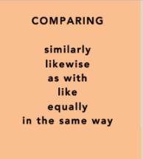
Useful conjunctions

Slide 9
An idea to get you started
I have found out that the life cycle of a bird, insect and amphibian are similar as they all involve laying eggs on water or the ground whereas with a mammal the baby develops inside the mother.

Slide 10
What have you learnt about the life cycle of a mammal, bird, insect and amphibian?
What key scientific vocabulary have you learnt?
What new facts do you now know?
Have you got better at drawing diagrams?
Have you been able to find some similarities and differences between the life cycles?

Slide 11
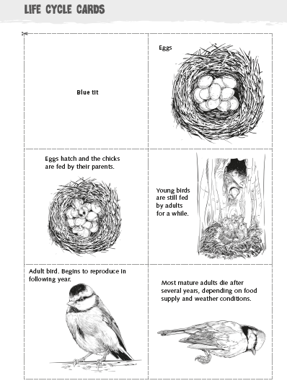
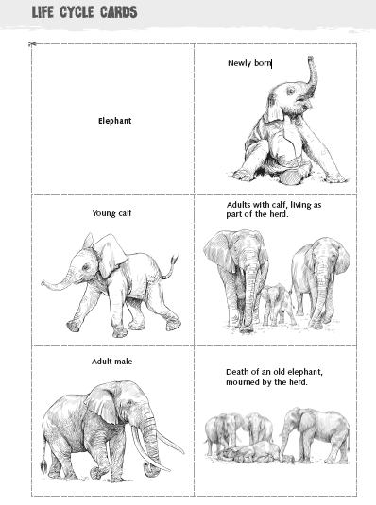
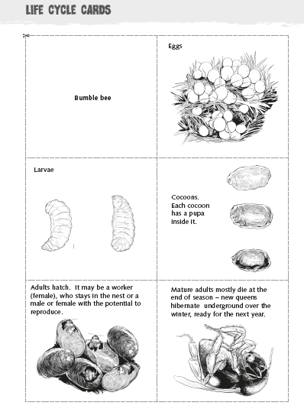
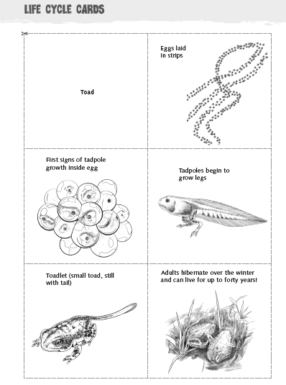
Additional resources:
A copy of these life cycle cards are on the school website for you to use if you wish.

